Slide 1
Non-Opioid Options for the Treatment of Pain
Sarah Endrizzi, MD
Medical Director, MCW Pain Management Centers

Slide 2
Disclosures
None

Slide 3
Overview
Current state of opioid prescribing
  How did we get here?
  Scope of the crises
Implications of chronic pain
Non-opioid treatment options for pain
  Medications
  Interventions
  Behavioral Health
  Therapy
  CAM

Slide 4
History of the Opioid Epidemic
1985-1995
  Medical Practice - acknowledgement of the under treatment of pain
  Availability of Medications - lack of fully effective pain medications aside from opioids
  Understanding of pain – relatively little $ dedicated to pain research
  Medical (mis-)Education – “<1% of patients receiving opioids for pain become addicted”
Mid 1990’s: Pain as the “fifth vital sign”
Notes:
Pain Management Standards began recognizing pain as the “fifth vital sign”, lead by campaign by Dr. Russell Portenoy, then the president of the American Pain Society
Healthcare providers were required to ask about pain as a standard to maintain accreditation
CMS also uses patient surveys, which include questions regarding patients’ satisfaction with their pain treatment to determine hospital reimbursement rates

Slide 5
History of Opioid Epidemic
1996-2007
1996: Purdue Pharma introduced OxyContin
1997: FDA relaxes Direct to Consumer Advertising regulations
Aggressive marketing techniques
  Sales $48M in 1996 --> $1.1B in 2000
  1996-2001: providers paid to speak for Perdue
  Purdue specifically targeted and marketed high opioid prescribing physicians
  Patient coupons for Oxycontin
  Specifically marketed to PCPs for non-cancer pain patients
    Prescriptions for non-cancer pain increased 10x (670k to 6.2M) from 1997-2002
    Cancer pain prescriptions increased 4x in same time period
Notes:
-Important to note that control studies at the time of introduction of Oxycontin did not find any therapeutic benefit between that medication and other available opioids
Aggressive marketing techniques:
1996-2001 >5000 physicians, nurses and pharmacists attended paid conferences to be part of Purdue’s national speaking bureau
Purdue specifically targeted and marketed high opioid prescribing physicians
Patients provided with coupon for free trial (up to 30 days) of OxyContin. By 2001 34,000 coupons redeemed

Slide 6
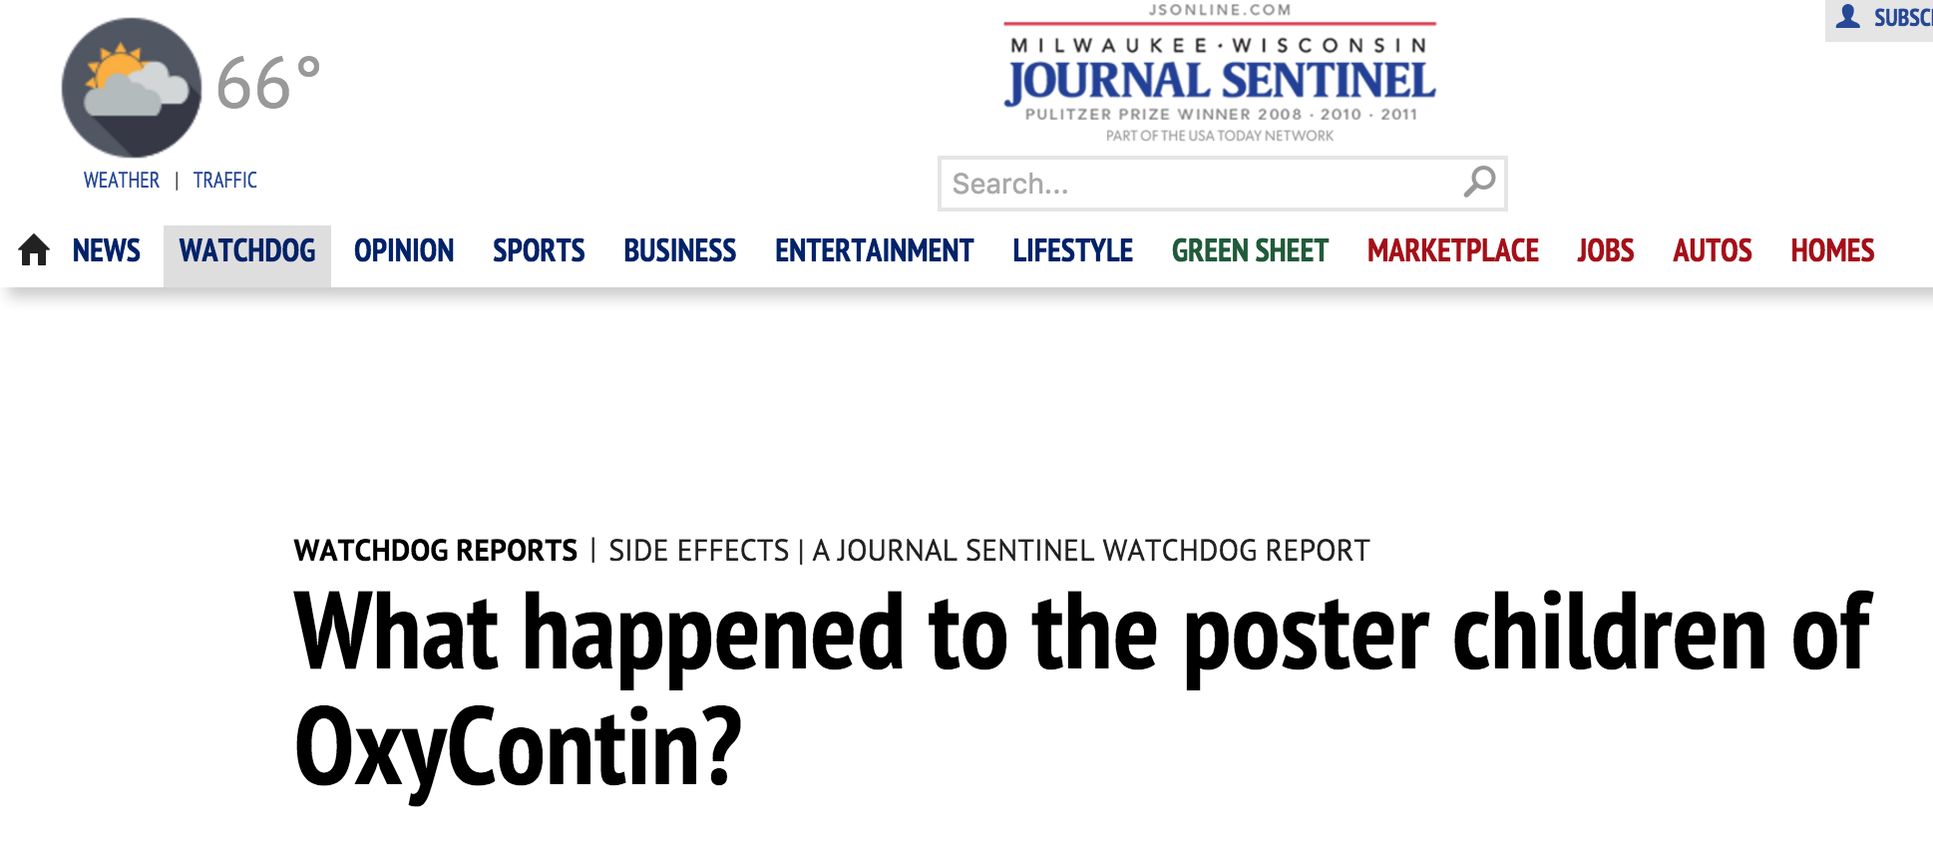
History of Opioid Epidemic
Purdue marketed lack of risks/side effects of OxyContin
Marketing material quoted studies that showed that <1% of patients using opioids for acute pain were found to develop addiction
Purdue OxyContin Commercial
September 8, 2012
https://youtu.be/hwtSvHb_PRk

Slide 7
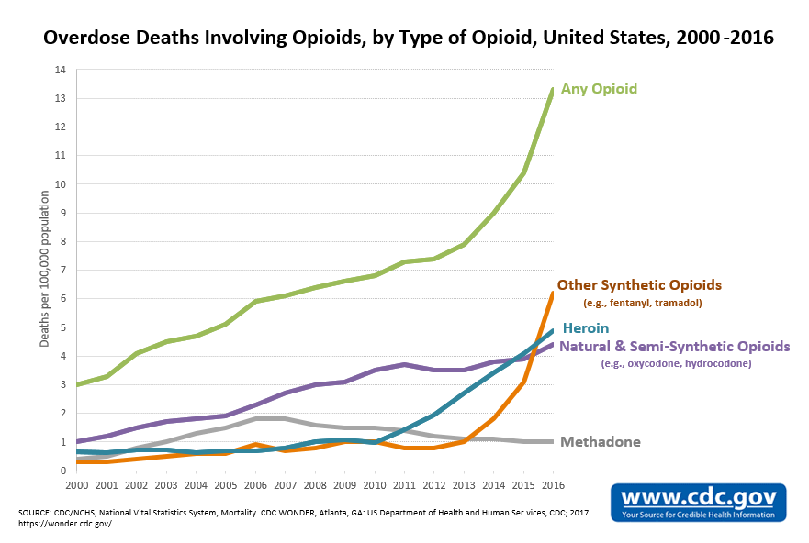
Current state

Slide 8
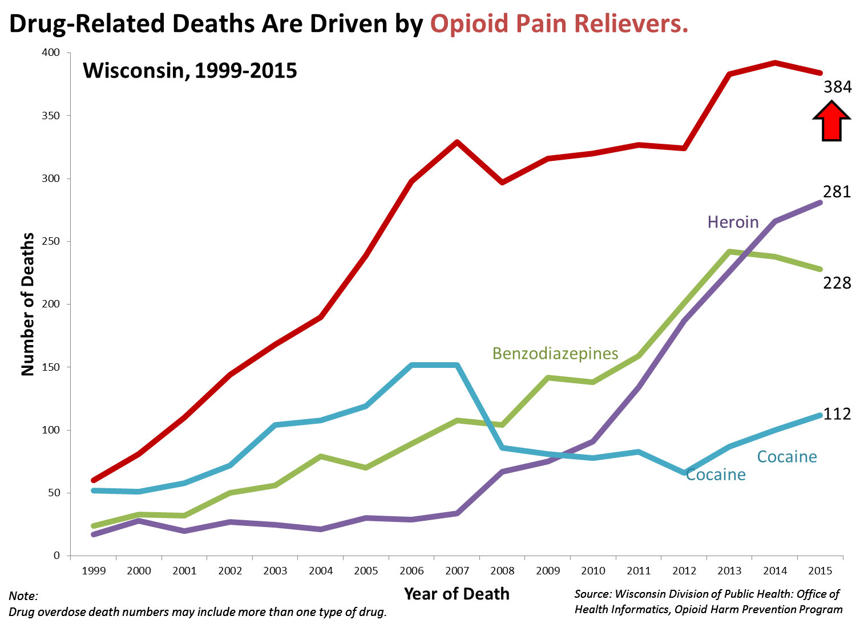
Current state

Slide 9
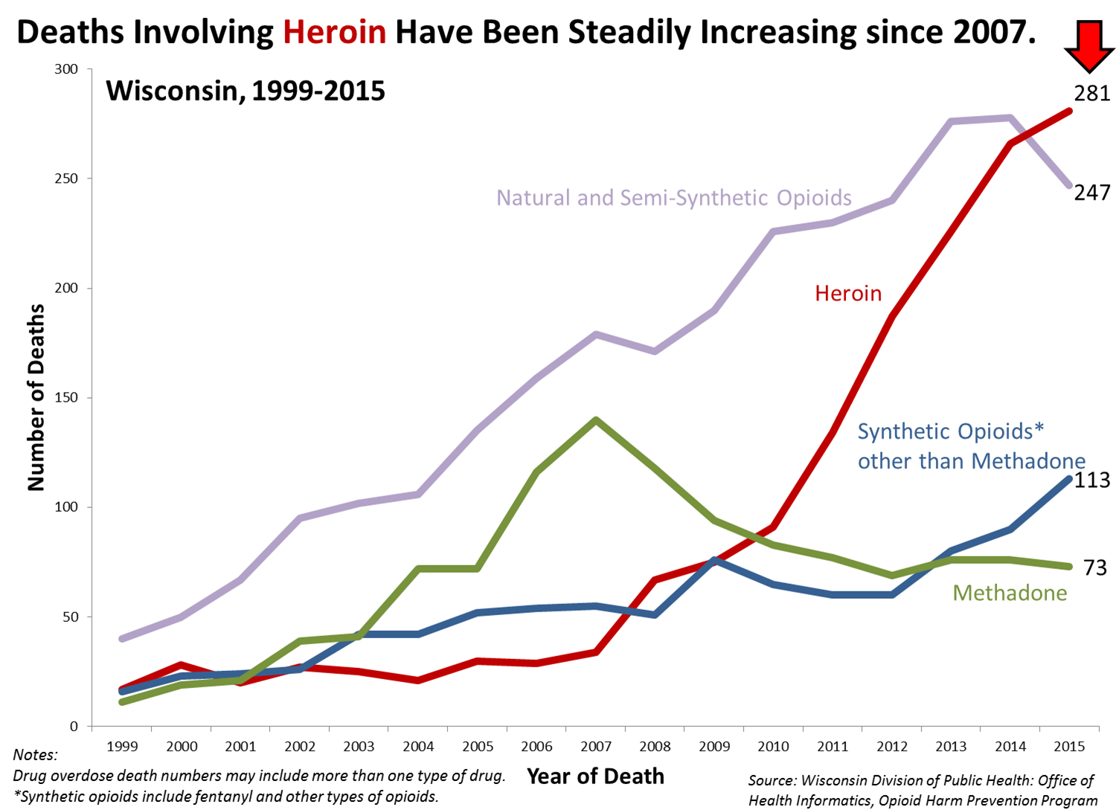
Current state

Slide 10
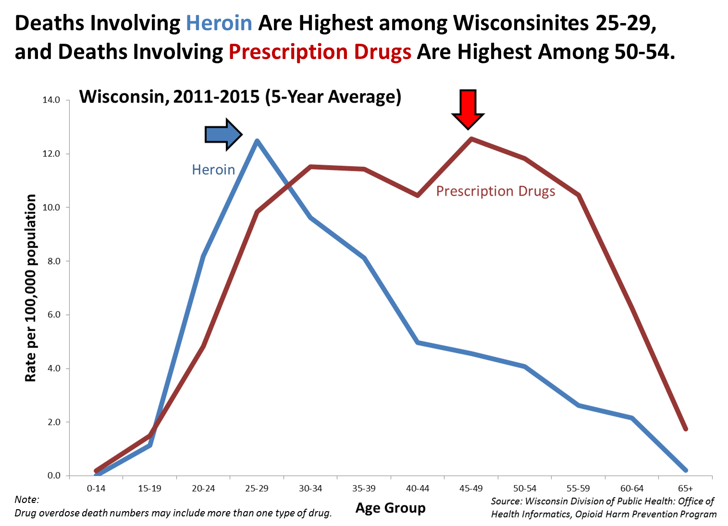
Current state

Slide 11
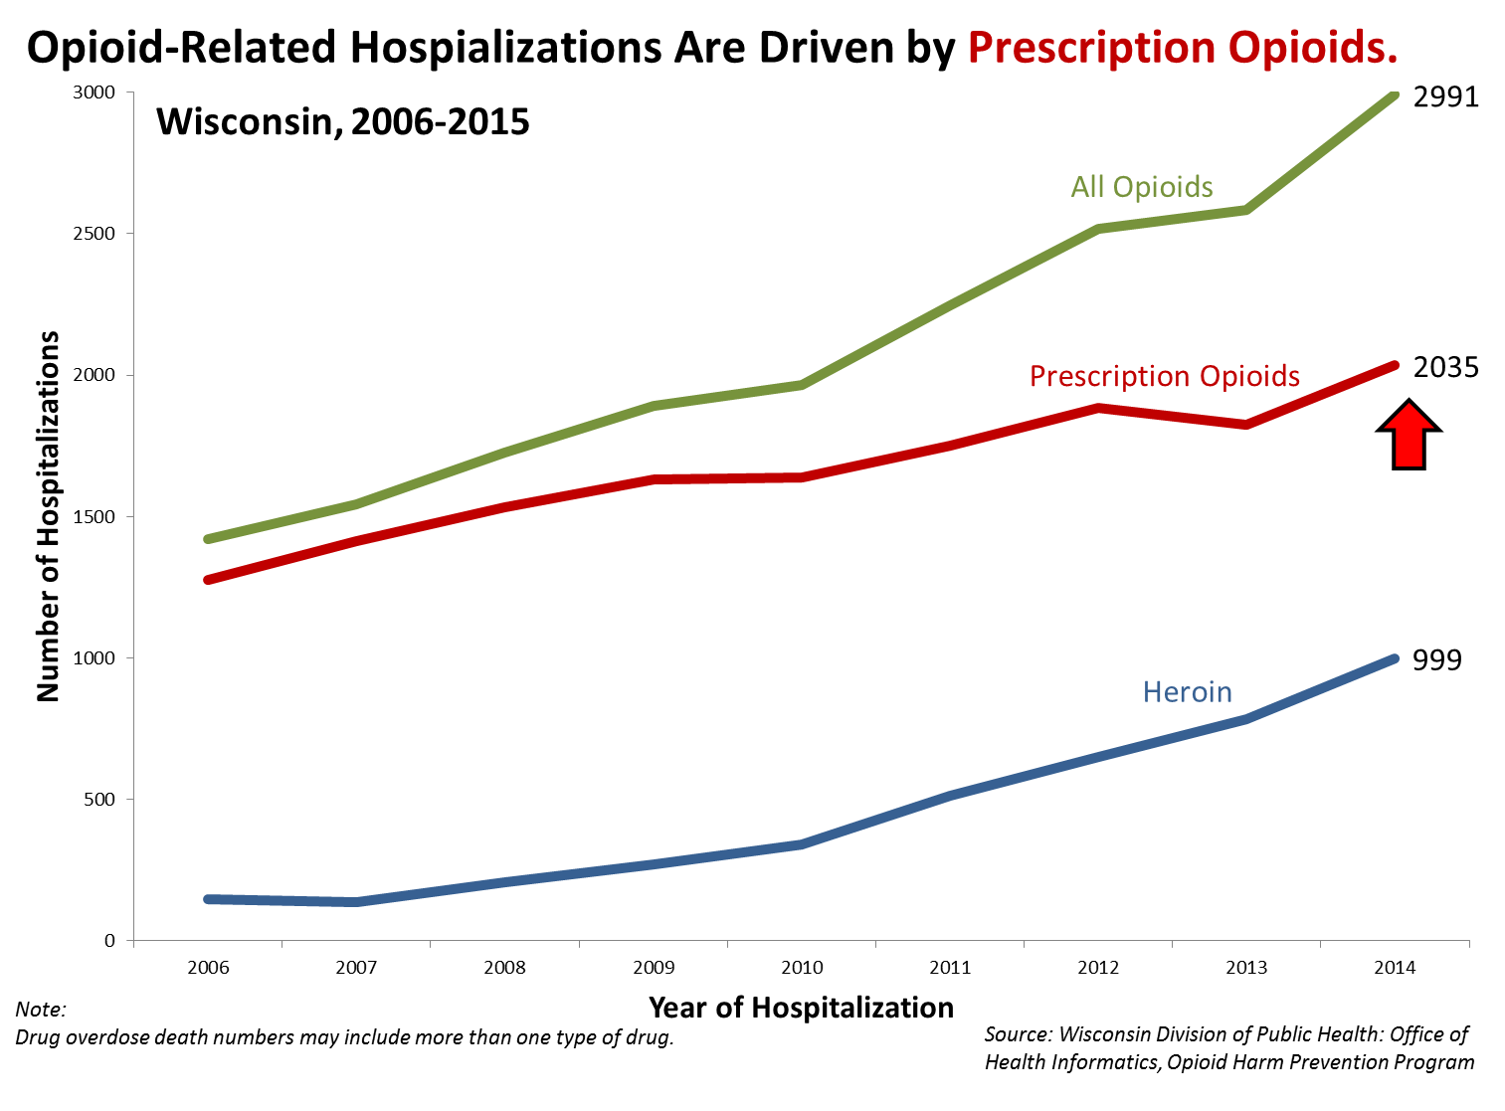
Current state

Slide 12
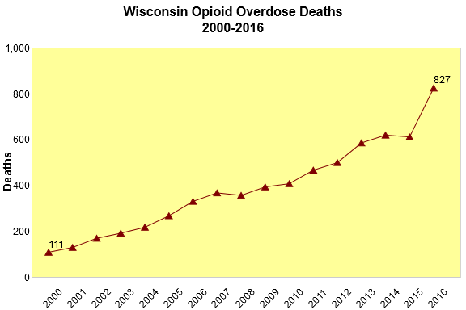
Current state

Slide 13
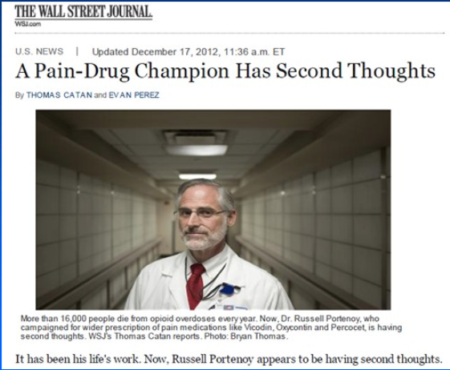
Opioid Safety and Effectiveness
“Dr. Portenoy and other pain doctors who promoted the drugs (opioids) say they erred by overstating the drugs’ benefits and glossing over risks.”
“Clearly, if I had an inkling of what I know now then, I wouldn’t have spoken in the way that I spoke. It was clearly the wrong thing to do.” – Dr. Portenoy
“Data about the effectiveness of opioids does not exist.” – Dr. Portenoy
Wall Street Journal, December 2012

Slide 14
Opioid Effectiveness
SPACE RCT, JAMA, March 2018
  One of very few studies to look at long term opioid effectiveness
  240 patients with chronic back, hip or knee pain randomized to opioid or non-opioid treatment
  Primary outcome was Brief Pain Inventory interference scale (BPI)
  At 12 months, groups did not significantly differ on pain interference (3.4 for opioid group, 3.3 for non-opioid group)
  Pain intensity was significantly better in the non-opioid group (3.5 vs 4.0 in opioid group)
  Adverse medication symptoms significantly more common in opioid group
Krebs EE, Gravely A, Nugent S. Effect of Opioid vs Nonopioid Medications on Pain-Related Function in Patients with Chronic Back Pain or Hip or Knee Osteoarthritis Pain. JAMA. 2018; 319(9):872-882.

Slide 15
Post-op Opioid Requirements
Prescription Opioid Analgesics Commonly Unused After Surgery. A Systematic Review. Bicket, MC, et al. JAMA Surgery, 2017
  Review of 6 studies with a total of 810 patients undergoing ortho, trauma, OB and general surgery procedures
  67-92% of patients reported unused opioids
  Of all opioid tablets, 42-71% went unused
  Ortho specific: 25% of patients had >/= 200 OME leftover 1 month post-op; 20% stopped taking opioids by POD 2
  71-83% reported not taking or finishing opioid prescription because of adequate pain control
  >90% of patient did not dispose of medications in FDA recommended manner

Slide 16
Post-Op Opioid Requirements
A systematic review of opioid use after extremity trauma in orthopedic surgery.
  Patients who consume more opioid medications report greater pain intensity and less satisfaction with pain control
  Post-op pain control should be tailored to each patient and include multimodal drugs and regional anesthesia, if appropriate
Koehler RM, et al. Injury. Accepted for publication April 3, 2018.

Slide 17
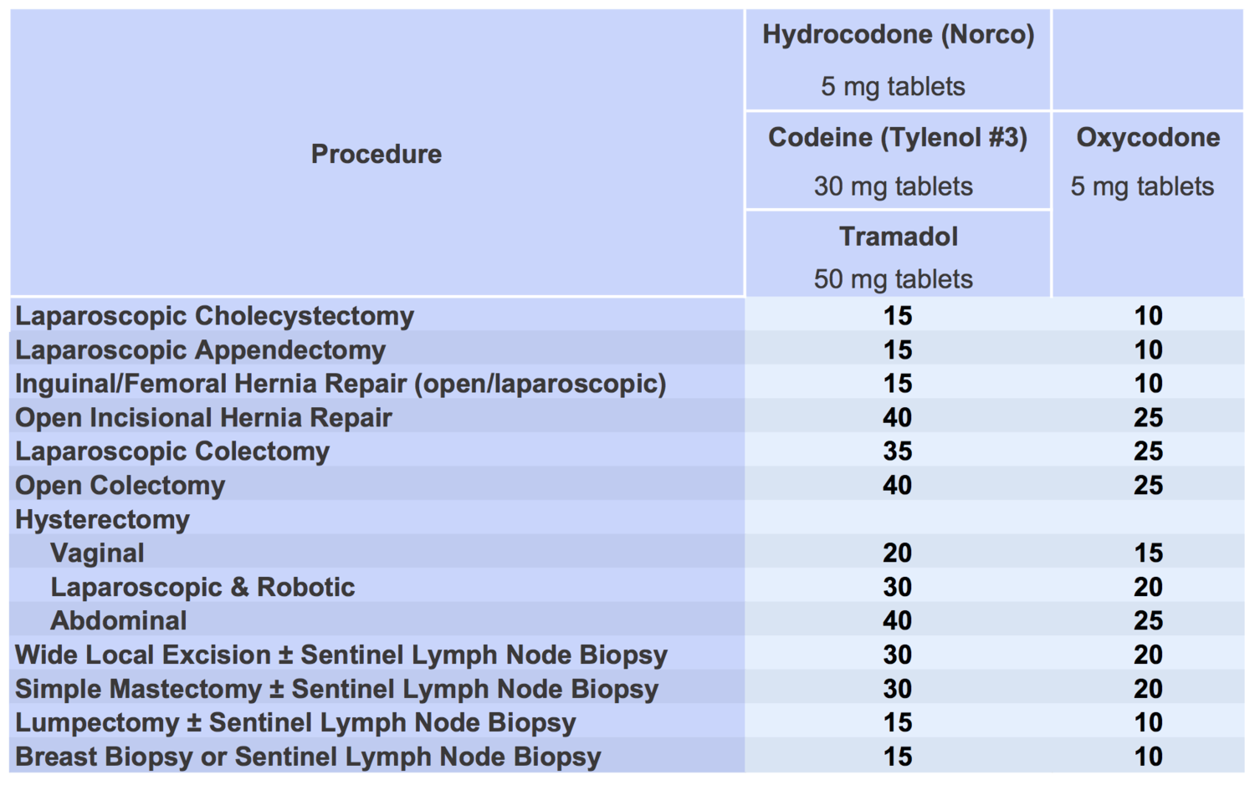
Post-op Opioid Requirements
http://michigan-open.org/

Slide 18
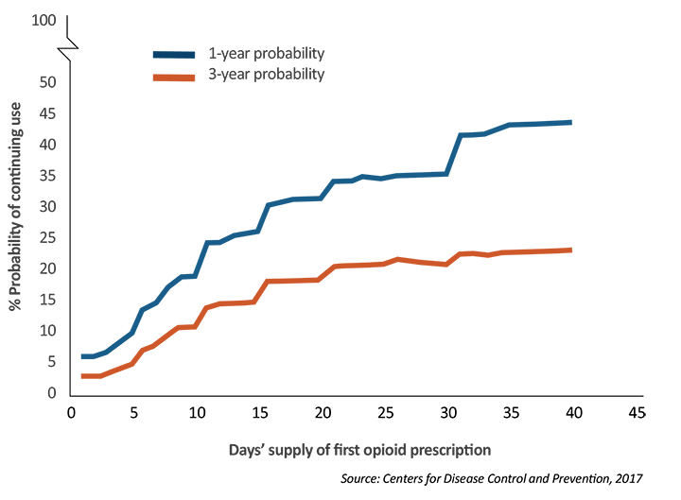
Transition to Chronic Opioid Use

Slide 19
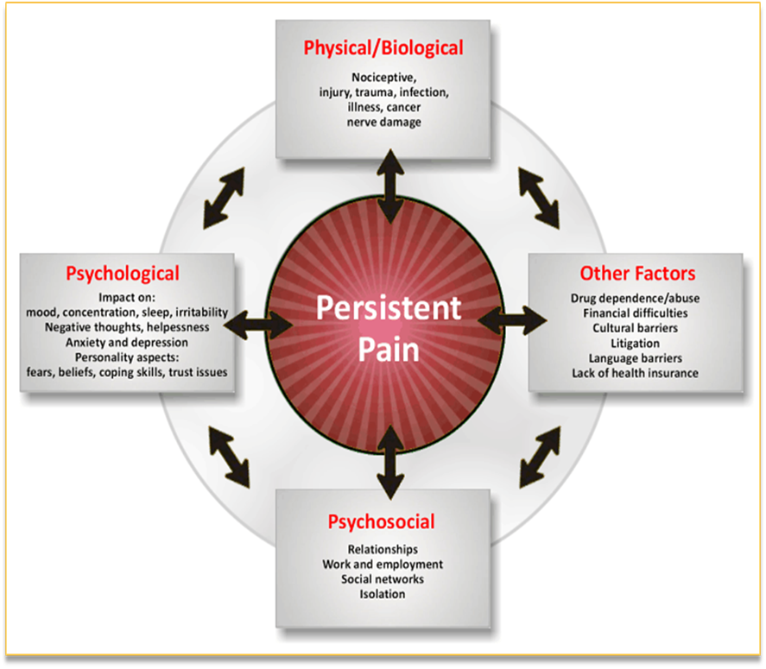
Treatment of Pain

Slide 20
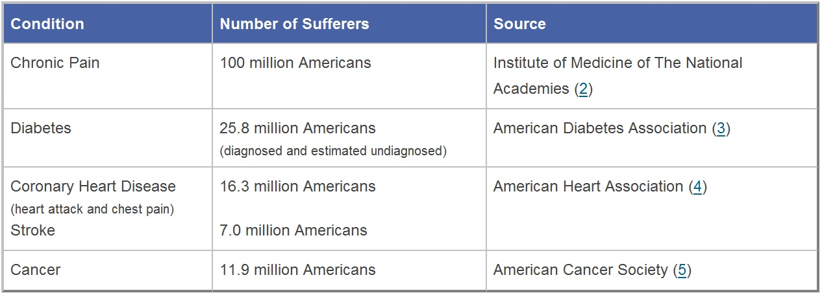
Epidemiology of Chronic Pain
American Academy of Pain Medicine

Slide 21
Chronic Low Back Pain
  Most prevalent cause of pain and disability in advanced industrialized nations
  Most prevalent reason for lost work time, worker’s compensation claims and early social security disability
  Approximately 150 million work days lost per year
  In the US, healthcare costs due to chronic back and neck pain are over $87 Billion per year (2013)
    3rd highest cause of health care spending after diabetes and heart disease
Dieleman JL, Baral R, Birger M, et al. US Spending on Personal Health Care and Public Health, 1996-2013. JAMA. 2016;316(24):2627–2646. doi:10.1001/jama.2016.16885

Slide 22
Non-Pharmacologic Treatment Options for Chronic Pain
Behavioral Health
  Biofeedback
  CBT
  Guided imagery
  Mindfulness
  Pain School
Therapy
  PT, OT
  Aquatic therapy
  Therapeutic Massage
  Chiropractic
CAM
  Acupuncture
  Tai Chi, yoga
  Hypnosis
  Music therapy
Interventions

Slide 23
Interventional Procedures
ESIs:
  Mainly beneficial for radicular pain
    Failed back/neck surgical syndrome
    Spinal Stenosis
    Disc Herniation
    Disc Tear
  Neuropathic pain
    Post-herpetic Neuralgia
    Intercostal neuralgia
    Post-thoracotomy pain

Slide 24
Epidural Steroid Injection
Notes:
Inflammatory mediators increase dorsal root ganglion sensitivity and firing
Nucleus Pulposus when placed on to the DRG causes excitation and mechanical hypersensitivity
Only the inflamed nerve root is painful when pressed or stretched

Slide 25
Transforaminal Approach

Slide 26
Facet (zygapophyseal) Joints
True synovial joints formed from superior and inferior articular processes
Source of axial spine pain, headaches, referred pain patterns
Volume capacity is 0.5-1.0 ml in cervical and 1.0-1.5 ml in lumbar¹
1. Benzon, H, et al. Practical Management of Pain. Elsevier 2014. Pg 816.

Slide 27
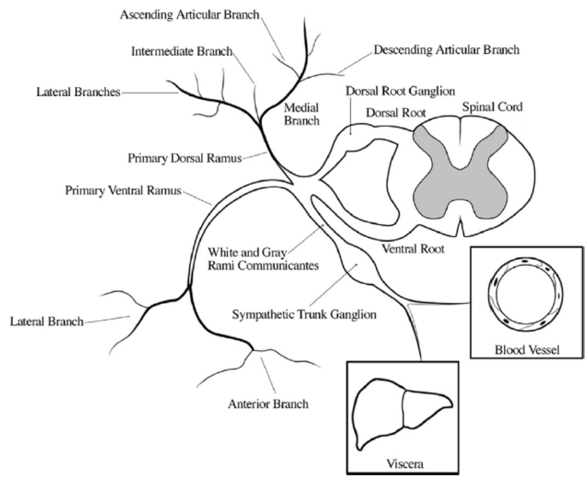
Facet Innervation
Lateral branch of the dorsal rami innervates paraspinous muscles (except multifidus), skin, and SI joint.
Intermediate branch innervates longissimus muscles.
Medial branches innervate the facet joints and the multifidus muscle

Slide 28
Facet Innervation
Each facet is innervated by two medial branches:
  Cervical level: nerve at the level of the joint and the nerve below (ie: C2-3 facet is innervated by C2 and C3 medial branch nerves)
  Thoracic and lumbar levels: nerve above and at the level of the joint (ie: L4-5 facet joint is innervated by L3 and L4 medial branches)

Slide 29
Facet Mapping

Slide 30
Medial Branch Block
Two diagnostic MBBs
  Two different local anesthetics, each procedure about a week apart
  Patient keeps a pain diary for 6 hours
If >50-80% pain relief with both blocks, proceed to RFA

Slide 31
Lumbar Medial Branch RFA
18 or 20 gauge RFA needle with a 5 or 10 mm active tip placed at each nerve
Needle probe heated to 80* C for 90 seconds

Slide 32
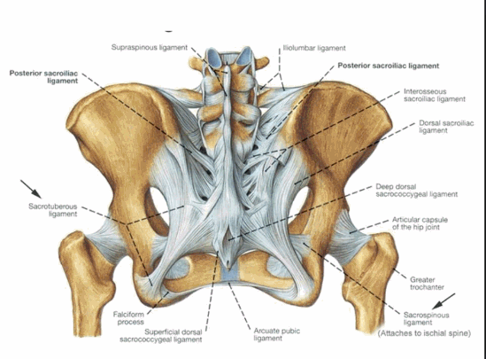
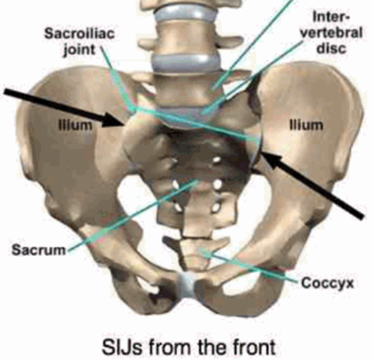
SI Joint Pain
Primary Innervation is L5 dorsal ramus and S1-S3 lateral branches.
Prevalence 10-38%
Significant pain generator after lumbar fusion.

Slide 33
SI Joint Pain
RFA of lateral branches of sacral dorsal rami
  Lateral branches sit at the inferior, superior and lateral portion of the sacral foramen
  SI joint also has sensory contribution from L4 (?) and L5 medial branches

Slide 34
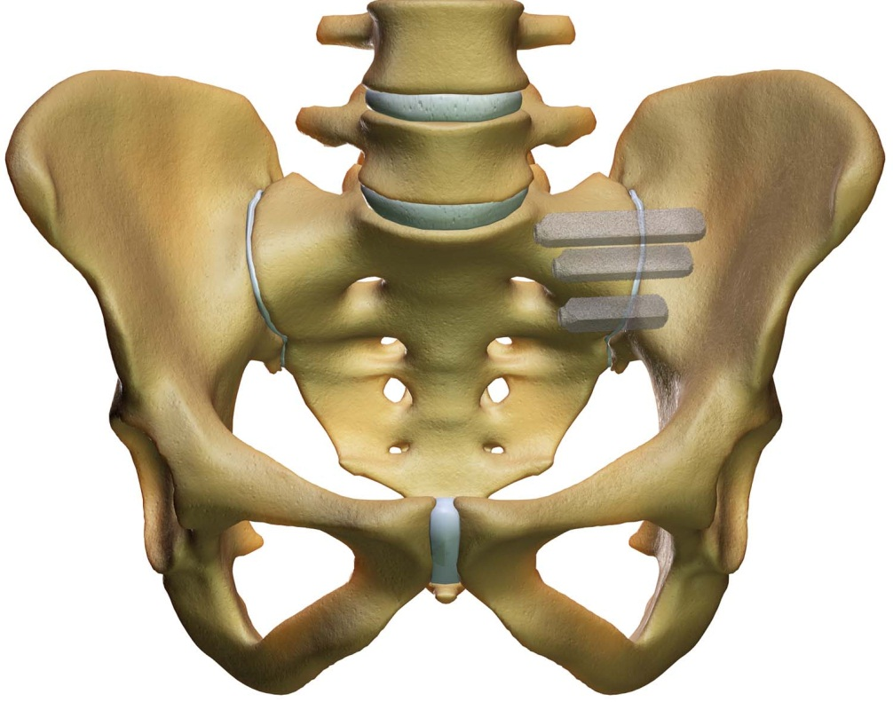
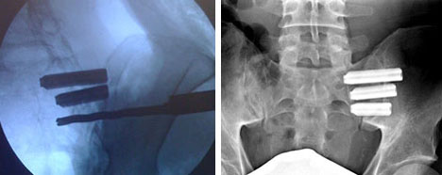
SI Fusion

Slide 35
Neuromodulation
Spinal Cord Stimulator:
  Implanted devices that provides electrical stimulation to the dorsal column of the spinal cord
  Lead placed in the cervical or thoracic epidural space
  Common indications:
    Failed back or neck surgical syndrome
    Spinal radicular pain
    Neuropathy
    Complex Regional Pain Syndrome
Dorsal Root Ganglion (DRG) Stimulation
  Specifically targets DRG for localized pain

Slide 36
Neuromodulation Program
Only comprehensive multidisciplinary neuromodulation program in the state
Pain physicians, functional neurosurgeon, psychologists
Monthly case conference to discuss candidates, difficult cases, current patients
Trial is done at the ASC in the MCW Pain Centers Tosa Clinic
Most implants are done at Froedtert with Dr. Pahapill (neurosurgery)
Same day procedure

Slide 37
Interventions for Peripheral Joint Pain
Intra-articular steroid injections
Viscosupplementation
Nerve ablation for hip (obturator and femoral articular branches) and knee (genicular nerves)
Can be candidate for neuromodulation if pain is neuropathic

Slide 38
Non-Opioid Medications
Nonsteroidal Anti-inflammatory
  Ibuprofen
  Naproxen
  Diclofenac
  Celecoxib
Antidepressants
  SNRIs
    Duloxetine
    Venlafaxine
  TCA
    Amitriptyline
    Doxepin
Low Dose Naltrexone
Anticonvulsants
  Gabapentin
  Pregabalin
  Topiramate
Muscle relaxants
  Baclofen
  Tizanidine
NMDA inhibitors
  Ketamine
  Dexmedetomidine
Topical Medications
  Lidocaine
  Diclofenac
  Capsaicin

Slide 39
Pain Psychology
18-85% of patients with chronic pain have a comorbid psychiatric condition (Doan, Neural Plasticity, 2015)
35% with Chronic back/neck pain have depression or anxiety disorder (Katz, Spine. 1997,1999)
Correlation between severity of pain and degree of depression (Fishbain, CJ of Pain, 1997)
Cognitive approaches include CBT, biofeedback, hypnosis

Slide 40
PT/OT
Physical Therapist/Occupation Therapist
  Educate on physiological basis of pain
  Teaches body mechanics, pacing
  Role in physical rehabilitation
  Address vocational issues
  Techniques for managing pain on the job
Gatchel, Am Psychologist. 2014

Slide 41
Physical Therapy
Active Treatment (better evidence)
  Gait Training
  Core Strengthening and stability
  Postural re-education
Passive Treatment (less evidence)
  TENS
  Heat/ Cold
  Ultrasound

Slide 42
CAM Therapies
Acupuncture
Massage
Manipulation
  Better than placebo at improving pain, function (Furlan 2010)
Yoga and tai chi

Slide 43
Case Study: LBP
Medications
  First-line: acetaminophen, non-steroidal anti inflammatory drugs (NSAIDs)
  Second-line: Serotonin and norepinephrine reuptake inhibitors(SNRIs)- duloxetine, venlafaxine; tricyclic antidepressants (TCAs)- amitriptyline, nortriptyline
Focused PT
Interventions
  ESI, MBB/RFA, SCS
Behavioral Health
Finnerup, et al. Pharmacotherapy for neuropathic pain in adults: a systematic review and meta-analysis. Lancet Neurol. 2015 Feb;14(2):162-73. doi: 10.1016/S1474-4422(14)70251-0. Epub 2015 Jan 7.

Slide 44
Case Study: Neuropathic Pain
Medications
  First-line: Anti-seizure meds (gabapentin, pregabalin, topiramate), SNRIs/TCAs
  Second-line: lidocaine patches, capsaicin, tramadol
  Third-line: stronger opioids, Botox
Interventions
  Sympathetic blocks
  Peripheral nerve blocks
  Neuromodulation
Therapy
  Desensitization therapy
  Mirror therapy
Finnerup, et al. Pharmacotherapy for neuropathic pain in adults: a systematic review and meta-analysis. Lancet Neurol. 2015 Feb;14(2):162-73. doi: 10.1016/S1474-4422(14)70251-0. Epub 2015 Jan 7.

Slide 45
Case Study: Chronic Migraines
Preventive treatments
Acute treatments
Beta-blockers
TCAs
Antiseizure medications
Calcium channel blockers
Non-pharmacological treatments: CBT, relaxation, biofeedback, exercise therapy
Interventions:
  Occipital blocks, cervical RFA, Botox, sphenopalatine block
Avoid migraine triggers
Aspirin, acetaminophen, NSAIDs (may be combined with caffeine)
Antinausea medication
Triptans-migraine-specific
www.cdc.gov/drugoverdose/prescribing/guideline.html

Slide 46
Case Study: Chronic Osteoarthritis Pain
Nonpharmacological treatments:
  Exercise, water therapy, weight loss, patient education
Interventions:
  Joint injections (steroid or viscosupplements), nerve blocks/RFA
Medications
  First-line: Acetamionphen, oral NSAIDs, topical NSAIDs
  Second-line: Intra-articular hyaluronic acid, capsaicin (limited number of intra-articular glucocorticoid injections if acetaminophen and NSAIDs insufficient)
                www.cdc.gov/drugoverdose/prescribing/guideline.html
Notes:
Amy

Slide 47
Case Study: Fibromylagia
Nonpharmacological treatments:
  Low-impact aerobic exercise (e.g., brisk walking, swimming, water aerobics, or bicycling)
  Cognitive Behavioral Therapy
  Biofeedback
  Interdisciplinary rehabilitation
  Smoking Cessation
Medications
  FDA-approved: Pregabalin, duloxetine, milnacipran
  Other options: TCAs, gabapentin
www.cdc.gov/drugoverdose/prescribing/guideline.html
Notes:
Amy

Slide 48
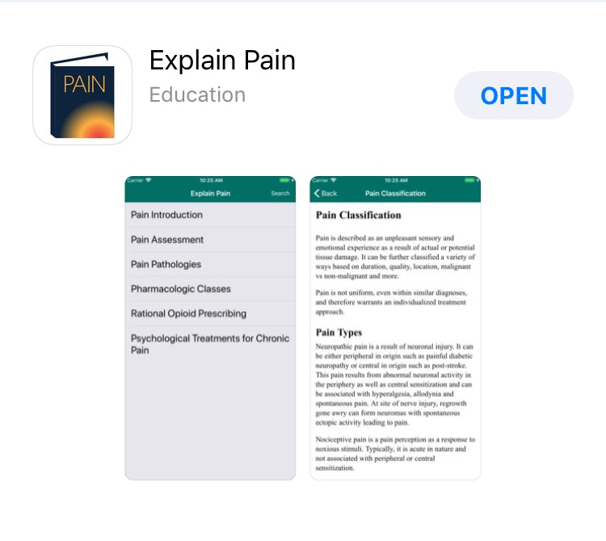
Helpful resources: Explain Pain App
Developed by MCW pain management physicians
Includes
  Pain assessment
  Pain pathologies
  Pharmacologic classes
  Rational opioid prescribing
  Psychological treatment for chronic pain

Slide 49
Helpful Resources: Improving Opioid Care
www.improvingopioidcare.org
Great website with many different handouts and resources
Under “Helpful Resources” and then “Resources for Clinics”
  Tips for difficult conversations, including video vignettes
  “5 Negotiation Strategies for Compassion-Based Interactions”
  “Opioid Patient Discussion Guidelines”: language suggestions and scripts.
MED Calculator
Tapering flow chart
Handout on medical risks of long-term opioid use for patients

Slide 50
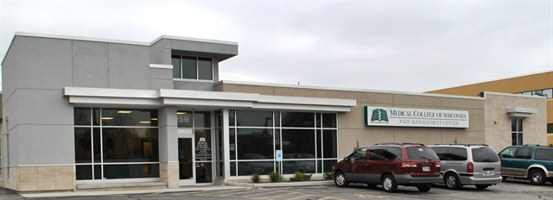
Thank you!
MCW Pain Management Centers- Tosa
Medical College of Wisconsin Pain Management
959 N Mayfair Road
Wauwatosa, WI 53226

