Slide 1


Center for Bioethics and Medical Humanities & Department of Psychiatry and Behavioral Medicine
Medical College of Wisconsin
Buoyancy, Belay, Broken:
Peering Over the Precipice of Burnout
Friday, September 13, 2019
8:00 am – 4:30 pm
Alumni Center Medical College of Wisconsin
8701 Watertown Plank Road
Milwaukee, Wisconsin

Slide 2
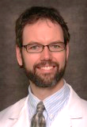
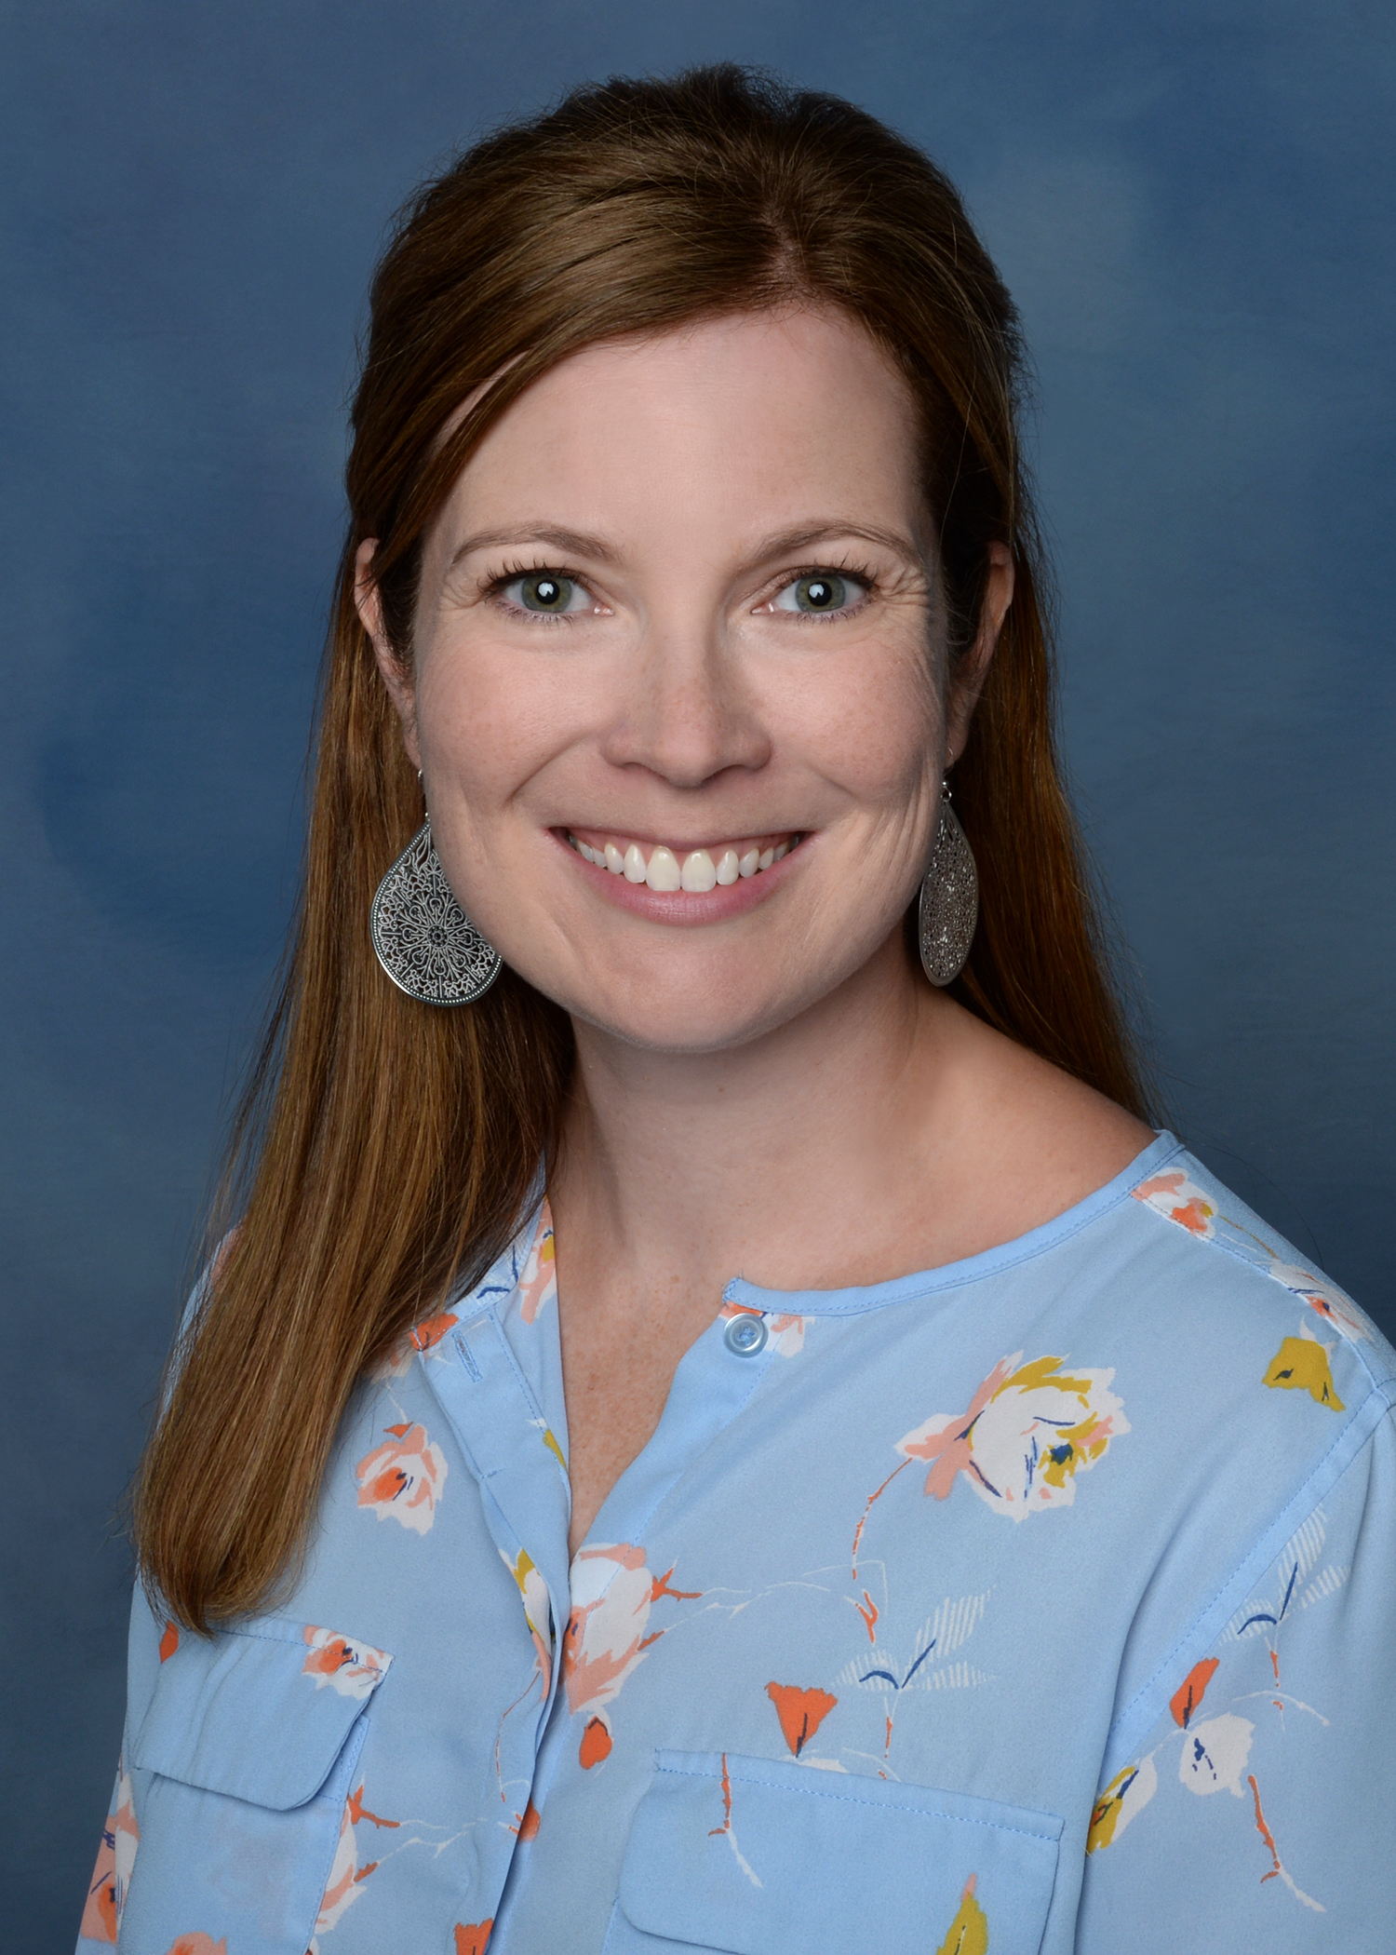
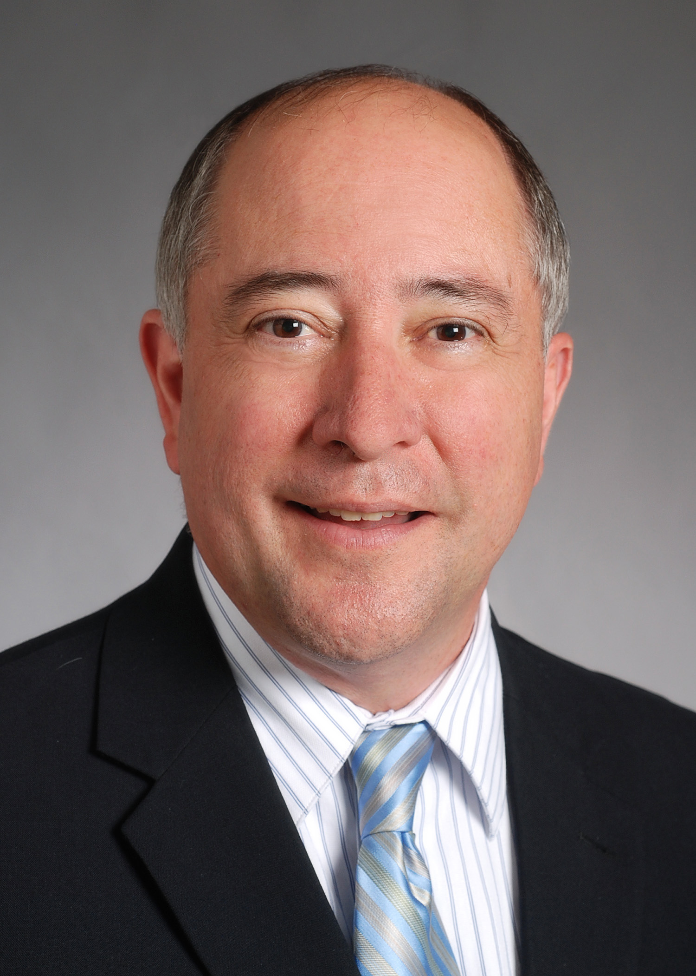
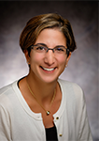
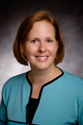
Guest Speakers
Buoyancy, Belay, Broken: Peering over the Precipice of Burnout
Jonathan Gully, MD
Associate Professor, Palliative Care,
Division of Hematology and Oncology
Medical College of Wisconsin
Conference Program
8:00 am Check-In with Continental Breakfast
8:25 am Welcome and Opening Comments
8:30 am Searching for a Hand Hold
Jonathan Gully, MD
9:00 am Compassion Fatigue: How to Avoid the Pitfalls
Lawrence Miller, PsyD
9:45 am Break
10:00 am Panel Discussion: Is this Working?
Moderator: Brittany Bice-Urbach, PhD
11:00 am Staying Between the Lines: Assessing the Impaired Provider
Alison Minkin, PhD
12:00 am Lunch
1:00pm Hanging in Tension: The State of the Science
David Cipriano, PhD
2:00pm Break
2:15pm Across the Ages: Duty to Whom?
Moderator: Sadie Larsen, PhD
3:15pm Individual Burnout and the Organization
Michelle Shasha, PhD and Natalie Fleury, JD
4:00pm What Do We Do Now?
Moderator, Table Discussions: Kenneth Grizzle, PhD
4:30pm Thank you for Coming!
Lawrence Miller, PsyD
Assistant Professor, Department of
Psychiatry and Behavioral Medicine
Medical College of Wisconsin
Alison Minkin, PhD
Psychologist Program Manager
Clement J. Zablocki VA Medical Center, Milwaukee
David Cipriano, PhD
Associate Professor, Psychiatry
Director of Student and Resident Behavioral Health
Medical College of Wisconsin
Michelle Shasha, PhD
Ombuds
Medical College of Wisconsin
Natalie Fleury, JD
Ombuds
Medical college of Wisconsin

Slide 3
Target audience: Psychologists, Physicians, Health care providers
At the conclusion of this activity participants will be able to:
Given that “burnout” is a diagnosis assigned to health care providers, outline present symptom profile and strategies for treatment.
Identify behaviors that indicate possible impairment in health care providers and discuss competence/fitness for duty evaluations.
Analyze challenges facing health care providers focusing on age and gender differences and share perspectives related to “duty to whom.”
Outline personal barriers to sustaining careers in the health care field and discuss how to communicate needs concerning system-based challenges.
Buoyancy, Belay, Broken: Peering Over the Precipice of Burnout
REGISTRATION:
To register, log in to your EthosCE account and visit http://ocpe.mcw.edu/ethics/ and select Buoyancy, Belay, Broken. Choose the appropriate registration option and educational credit fee (if desired) and “Add to Cart.” Click “Checkout” and follow the screen prompts to complete the registration process. Successful registrations will receive a receipt via email. If you do not already have an EthosCE account, go to http://ocpe.mcw.edu/ethics/ and select “Create Account” and enter all required information. You will need to access this account again to complete a course evaluation and print a CE certificate. Please note your username and password for future use.
No on-site registration available
Registration Fees:.
$100 General registration
$75 MECN members and MCW affiliated hospital staff/employees
Plus an additional $25 fee for CE credit certificate, if requested.
Please note there is a non-refundable $4.00 processing fee added to all registrations.
Please note: The billing address entered upon checkout MUST match the billing address on the credit card you will be using to pay for the course. MCW accepts MasterCard, VISA and Discover cards.
Refunds: Registration and CE credit fee refunds will be provided if requested prior to 12:00 Noon on September 11, 2019. Submit refund requests to Diane Kramer at dkramer@mcw.edu.
NEED MORE INFORMATION OR SPECIAL ACCOMODATIONS?
Please call or email Diane Kramer at 414-955-8498 or dkramer@mcw.edu
Planning committee: Jo Weis, PhD, Program Director, Jonathan Gully, MD, Kenneth Grizzle, PhD, Sadie Larsen, PhD, Brittany Bice-Urbach, PhD, Heather Smith, PhD, Lawrence Miller, PsyD, Kris Tym, MA, and Diane Kramer.
ACCME Accreditation Statement:
The Medical College of Wisconsin is accredited by the Accreditation Council for Continuing Medical Education to provide continuing medical education for physicians.
AMA Credit Designation Statement:
The Medical College of Wisconsin designates this Live Activity for a maximum of 6.5 AMA PRA Category 1 Credit(s)™. Physicians should claim only the credit commensurate with the extent of their participation in the activity. Hours of Participation for Allied Health Care Professionals The Medical College of Wisconsin designates this activity for up to 6.5 hours of participation for continuing education for allied health professionals.
This activity meets the Ethics Requirements for State of Wisconsin Psychology Licensing

