Slide 1
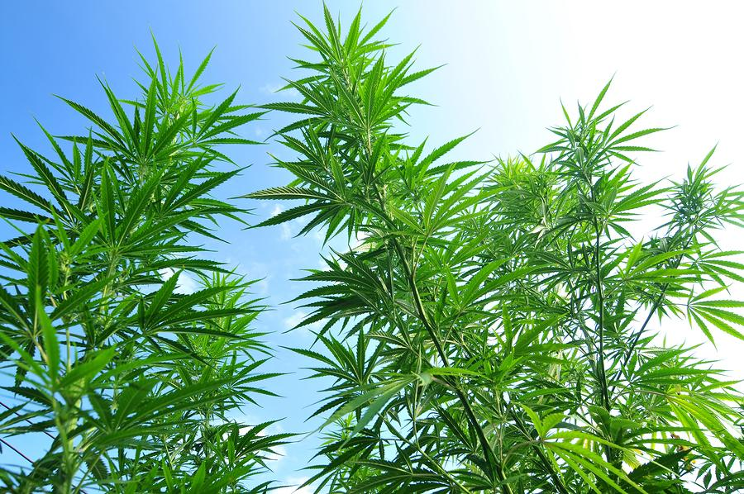
“What is a Weed?”
Tracy Kersten MSN, FNP-BC, APNP
Renee Foutz MD

Slide 2
Objectives
History and current use in the US
What is “medical marijuana”
What it’s used for
How it is used
Adverse effects
Long-term risks
Provider responsibilities

Slide 3
History
1840’s: First introduced in to Western medicine
1850: Was introduced in to the US Pharmacopeia and prescribed for pain, nausea, and rheumatism
1914: Use was defined as a crime by the Harrison Act and some states passed laws prohibiting use for nonmedicinal purposes
1937: US Congress passed Marijuana Tax Act criminalizing use
1941: Was removed from the US Pharmacopeia no longer being recognized as having medicinal use
1970: Became a Schedule I drug
1996: California legalized use by people with AIDS, cancer, and other serious illnesses
2010: CO and WA passed recreational use laws
Notes:
Wilkie 2016
Schedule 1: Hi pot for abuse, lack of medicinal use, lack of accepted safety for use under med supervision

Slide 4
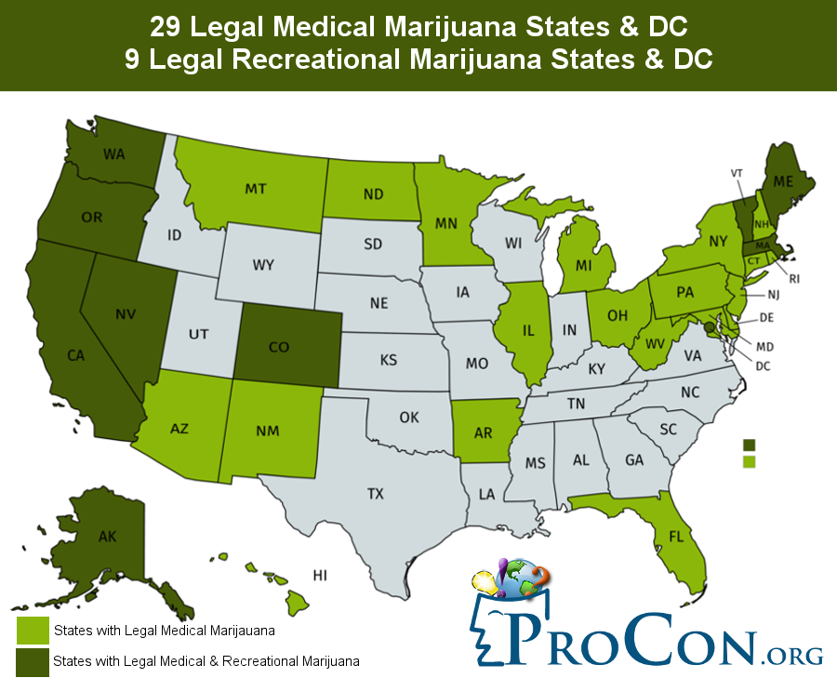
Adapted from https://medicalmarijuana.procon.org. Last updated of 4/24/2018

Slide 5
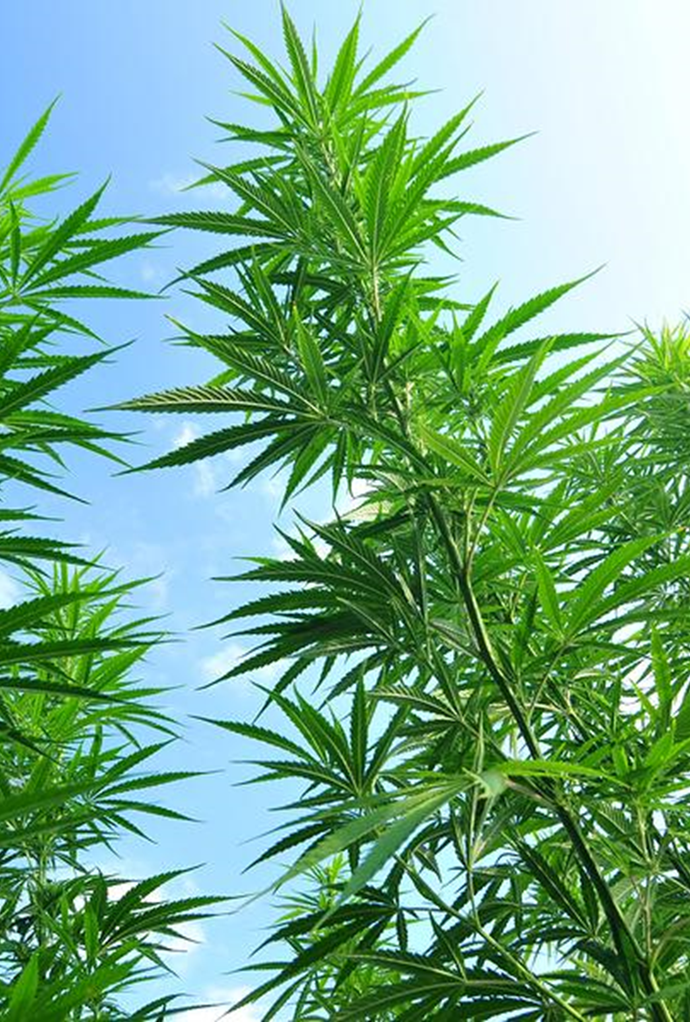
Terminology
Cannabis: generic term used for drugs produced from the dried leaves and flowers of Cannabis sativa ssp
Medical cannabis refers to use of cannabis or cannabinoids as medical therapy to treat disease or alleviate symptoms
Cannabinoids: molecules that act on the cannabinoid receptors
Cannabinoid receptors
  CBD1 receptors found throughout body with high concentration in CNS
  CBD2 receptors found mainly in the immune system
Notes:
Whiting 2015

Slide 6
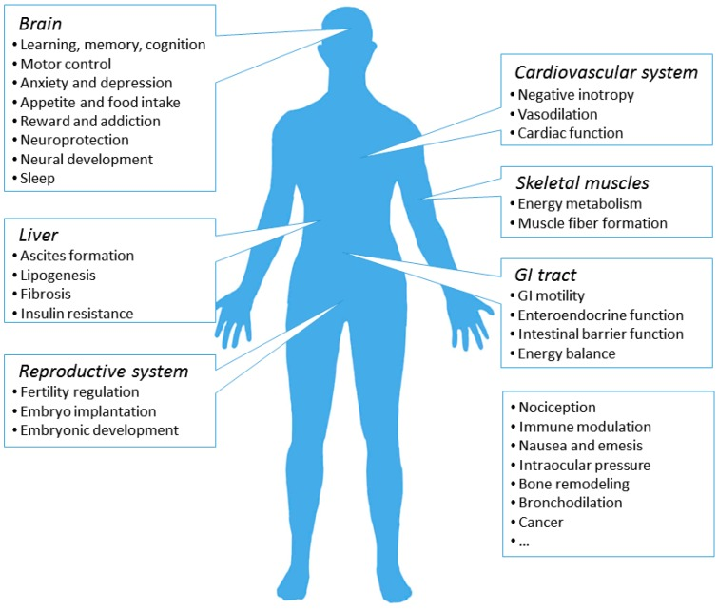

Slide 7
The CBD Receptors
  Endocannabinoids: endogenous neurotransmitters
    Expression of CBD1 receptors correlates with psychoactive effects of cannabis. Regulates appetite, memory, fear extinction, motor responses, and posture.
    Physiologic role of CB2 is less well understood. May have a role in chronic pain, bone density, atherosclerosis, inflammation.
  Phytocannabinoids: hundreds of compounds in C sativa
    Tetrahydrocannabinol (THC)
    Cannabidiol (CBD)
    Many other cannabinoids
  Synthetic cannabinoids
    Dronabinol (Marinol, Syndros)
    Nabilone (Cesamet)
    Nabiximol (Sativex)
Notes:
The health effects of cannabis and cannabinoids: the current state of evidence and recommendations for research
Mackie, 2006
Dronabinol: and Nabilone: approved for anorexia for AIDS and n/v for chemo pt
Nabiximol not approved in US but examine by FDA, used in several countries for pain from MS and cancer, spray

Slide 8
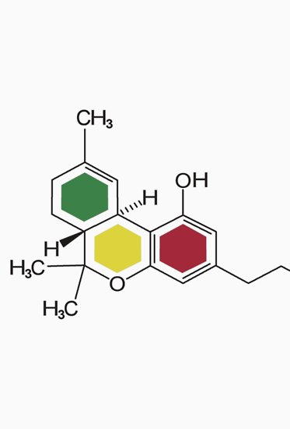
What’s important to us
THC is most active and well studied cannabinoid
  Psychoactive
  Synthetic THC approved for CINV and AIDS related anorexia
  May cause:
    Enhanced sociability
    Sensitivity to stimuli
    Altered time perception
    Appetite for sweet and fatty foods
    Feeling relaxed
    Anxiety
    Paranoia
Notes:
The Health Effects

Slide 9
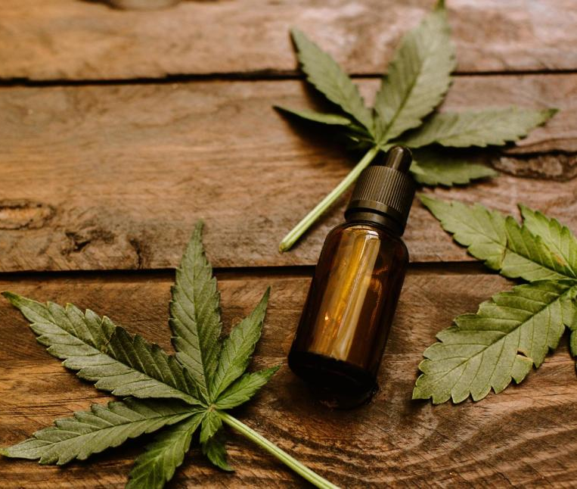
Cannabidiol (CBD)
Cannabidiol
  Not psychoactive
  Thought to effect the receptor binding and metabolism of THC enhancing it’s effect

Slide 10
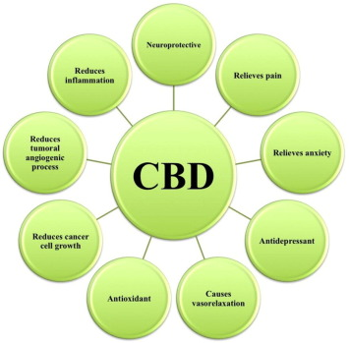
Notes:
Pharmacology and Therapeutics July 2017 Cannabidiol: State of the art and new challenges for therapeutic applications

Slide 11
CBD and seizures
Class 1 evidence that adjuvant use improves control compared to placebo for Dravet syndrome and Lennox-Gastaut syndrome
Unclear if related to combination use with other meds
April 2018: Federal health advisors endorsed use of CBD for severe seizures in children with epilepsy
Notes:
FDA approved study for seizures
Perucca

Slide 12
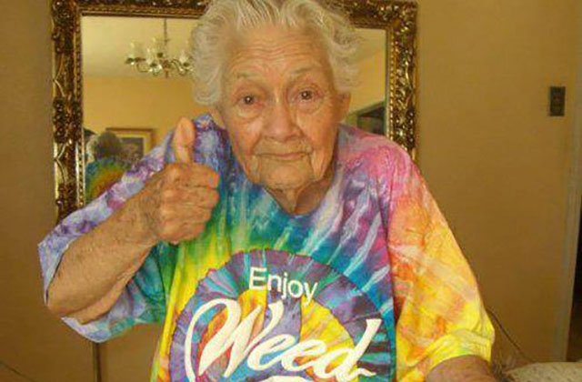
Evidence for Medical Marijuana
  Moderate quality evidence for:
    Chronic neuropathic
    Cancer pain
    Spasticity
  Low quality evidence for:
    Chemotherapy induced nausea and vomiting
    Weight gain in HIV infection
    Sleep disorders
    Tourette syndrome
Notes:
Whiting

Slide 13
Cochrane Review, March 2018
Author’s conclusions:
“The potential benefits of cannabis-based medicine (herbal cannabis, plant-derived or synthetic THC, THC/CBD oromucosal spray) in chronic neuropathic pain might be outweighed by their potential harms.”

Slide 14
Pain, May 2018
“It appears unlikely that cannabinoids are highly effective medicines for chronic non cancer pain.”
Notes:
Cannabis and cannabinoids for the treatment of people with chronic non-cancer pain conditions: a systematic review and meta-analysis of controlled and observational studies. Stockings E, Campbell G, Hall WD, Zagic D, Rahman R, Murnion B. Pain. 2018.
NNTB high, NNTH low

Slide 15
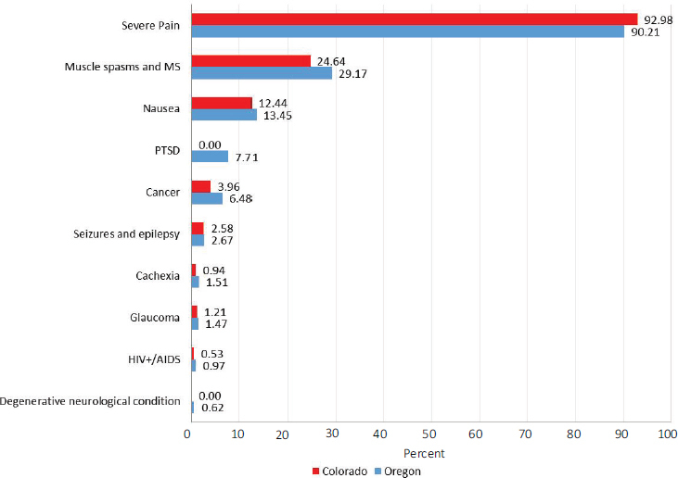
Notes:
The health effects of cannabis and cannabinoids:the current state of evidence and recommendations research:

Slide 16
Common Adverse Events
Asthenia
Balance problems
Confusion
Dizziness
Disorientation
Dry mouth
Fatigue
Hallucinations
Nausea
Vomiting
Somnolence
Notes:
Whiting

Slide 17
CBD Safety and Side Effects
Tiredness
Diarrhea
Changes in appetite/weight
Majority of studies performed were for treatment for epilepsy and psychotic disorders
Better side effect profile than many meds for those conditions
More needs to be known about interactions with other meds
Notes:
Iffland

Slide 18
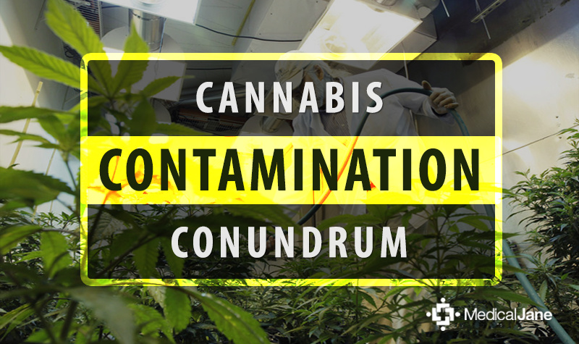

Slide 19

What are the risks of marijuana?
Known Risks:
  Driving impairment
  Addiction
  Hyperemesis syndrome
Possible Risks:
  Myocardial infarction
  Stroke
  Schizophrenia
  Psychotic episodes
  Long-term cognitive dysfunction
Notes:
From ocpe.mcw.edu Stoned A Doctor’s Case for Medical Marijuana

Slide 20
Long-term Risks from Smoking Marijuana
Lung disease
Most studies found significant association between smoking marijuana and chronic bronchitis symptoms
  Not been shown to cause significant abnormalities in lung function
  Not a clear link to COPD
Cancer
  Evidence not found to link marijuana smoking to lung cancer
Notes:
Tashkin 2013 and 2018

Slide 21
How it’s used
Route can affect onset, intensity, duration of effect, effect on organs, addictive potential, and negative consequences
Pills
Oils
Smoking
Vaping
“Dabbing”
Edibles
Notes:
O
Smoking (max blood level after about 30 minutes)
Vaping similar to smoking
“Dabbing”-flash-vaporizing butane hash oil based concentrates stronger effect than smoking
Edibles produces effects 30 minutes to 2 hours with prolonged effect
ral route absorbed by intestine and trasnported to the liver. Edibles have delayed and variable onset.

Slide 22
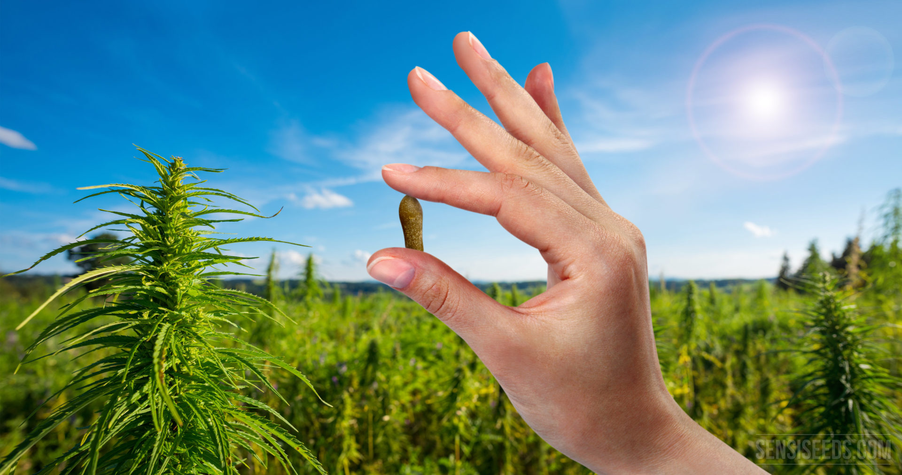
Other Routes of Administration
Oromucosal spray
Creams
Patches
Vaginal sprays
Rectal suppositories

Slide 23
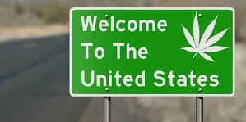
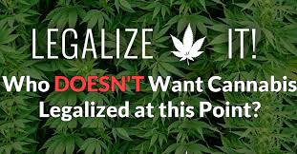
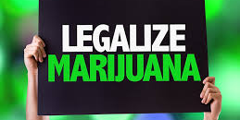
Changing Attitudes About Marijuana
In 1969 4% of Americans had tried marijuana, in 2017 45% had tried marijuana (Swift, 2017)
One in eight Americans smoke marijuana (Swift, 2017)
60% of Americans believe marijuana should be legal; a record high (Swift, 2017)
Institute of Medicine, American College of Physicians, American Medical Association and the American Society of Addiction medicine ALL support further research (Kollas, 2012)
Hospice and Palliative Nurse Association support the need for further research (HPNA, 2014)
American Nurses Association (ANA) supports therapeutic use of marijuana (HPNA, 2014)
Notes:
With more states making medical and recreational marijuana legal, opinions seem to be changing and support for therapeutic use and further research seems to be growing.

Slide 24
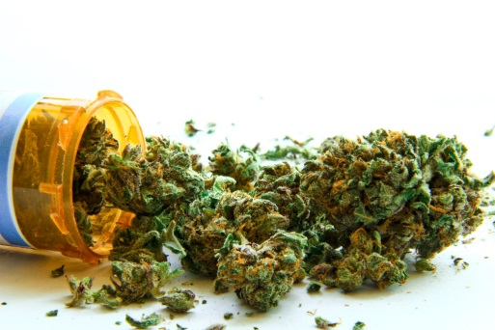
Provider Responsibilities In Other States
Providers do not actually prescribe marijuana, but make a recommendation or certify a patient is eligible under individual state laws
The types of providers allowed to make the recommendation(s) or certify vary by state
Indications for use vary by state (cancer, AIDS, chronic pain, glaucoma etc) (Brown, et al, 2018 and Ourso and Hedberg, 2016)
Documentation must include: patient evaluation, treatment plan, ongoing evaluation (Ourso and Hedberg, 2016)
US Attorney General and various state laws are not clear on the legal situation for those recommending or using therapeutic marijuana (Phillpsen, et al, 2014)
Bottom line: know the laws specific to the state you practice in!
Notes:
Marijuana is illegal on the federal level and considered a schedule I substance, therefore, no provider prescribes it, but make a recommendation
Some states are MD only while others allow APPs
Dispensaries and growers are regulated and monitored per state guidelines. Some states have registries for patients and all have registries for providers who can recommend or certify
Documentation varies by state, but is fairly consistent

Slide 25
Provider Responsibility in Wisconsin
It is NOT legal to recommend or provide guidance on how to use marijuana
It IS legal to recommend use of CBD oil for patients for any medical condition (MDs only) (Americans for Safe Access, n.d.)
Physicians must provide official documentation to patients to authorize use and possession of CBD-only cannabis (Americans for Safe Access, n.d.)
Physicians may dispense some forms of cannabis with investigational drug permit (Americans for Safe Access, n.d.)
It IS legal to have a discussion about medical marijuana to the extent that you are comfortable (Kollas, 2012)
Notes:
Because marijuana is not legal, we cannot make a recommendation for use, but we can counsel and provide education about risks vs potential benefits, things to think about if they are going to use it: THC vs CBD content, where is it coming from, not all are created equally, who is providing guidance on use, etc.
CBD was originally only legal for pt’s using it for seizures when law originated in 2014; was updated in 2017 to okay CBD to ALL patients with a letter from and MD
Production of CBD products is NOT legal in WI
WI law around CBD is quite vague, unclear what needs to be documented, if anything for making recommendation/certification

Slide 26
Conclusion
No provider in the US is allowed to prescribe marijuana (Federal Government still considers marijuana a Schedule I substance).
While marijuana may offer some benefit, it does not come without risks
All marijuana and products containing CBD and/or THC are NOT created equally
It is OKAY to discuss marijuana with patients, however, providers in WI cannot recommend or counsel on how to use it
Each state has different laws/guidelines on medical marijuana
Encourage patients to educate themselves prior to use of CBD oils, marijuana, etc.
Notes:
From our palliative care clinic team: don’t turn them in, does not routinely screen for THC. Let patients know we cannot prescribe, counsel on use, and they need to use caution when using because it’s not known how it could affect prescribed medications, how strong the marijuana is, how they will react, etc.

Slide 27
“What is a weed? A plant whose virtues have never been discovered.”
-Ralph Waldo Emerson

Slide 28
References
Abuhasira R, Shbiro L, Landschaft Y. Medical use of cannabis and cannabinoids containing products – regulations in Europe and North America. Eur J Intern Med. 2018;49:2-6.
Americans for Safe Access. (n.d.). Wisconsin Medical Marijuana Laws and Regulations. Retrieved from: https://www.safeaccessnow.org/wisconsin_legal_information
Brown, E.G., GnanaDev, D., Kirchmeyer, K. (2018). Medical Board of California’s Guidelines for the Recommendation of Cannabis for Medical Purposes. Retrieved from: https://www.mbc.ca.gov/Publications/guidelines_cannabis_recommendation.pdf
Casarett, D. (2018). Stoned: a doctor’s case for medical marijuana. Retrieved from https://ocpe.mcw.edu.
Hospice and Palliative Nurses Association. (2014). HPNA Position Statement: The Use of Medical Marijuana. Retrieved from: http://www.advancedholistichealth.org/PDF_Files/The_Palliative_Use_of_Medical_Marijuana_2014.pdf
Iffland K, Grotenhermen F. An update on safety and side effects of cannabidiol: a review of clinical data and relevant animal studies. Cannabis Cannabinoid Res. 2017;2(1):139-154.
Kollas, C. (2012). Medical Marijuana: What Should Palliative Care Specialists Know? Retrieved from: http://aahpm.org/uploads/education/publications/Summer_12_Quarterly_Feature.pdf
Mackie K. Cannabinoid receptors as therapeutic agents. Annu Rev of Pharmacol Toxicol. 2006;46:101-122.
Mucke M, Phillips T, Radbruch L, Petzke F, Hauser W. Cannabis-based medicines for chronic neuropathic pain in adults . Cochrane Database Syst Rev. 2018.
National Academies of Sciences, Engineering, and Medicine. 2017. The health effects of cannabis and cannabinoids: Current state of evidence and recommendations for research. Washington, DC: The National Academies Press.

Slide 29
References
Ourso, A. and Hedberg, K. (2016). HB 4014 Clinical Guidelines Work Group. Retrieved from: http://www.oregon.gov/omb/Topics-of- Interest/Documents/medical-marijuana-guidelines.pdf
Perucca E. Cannabinoids in the treatment of epilepsy: hard evidence at last? J Epilepsy Res. 2017;7(2):61-76.
Philipsen, N., Butler, R., Simon-Waterman, C., and Artis, J. (2014). Medical Marijuana: A Primer on Ethics, Evidence, and Politics. The Journal for Nurse Practitioners, 10, 633-640.
Philipsen, N., McMullen, P., and Wood, C. (2017). Medical Marijuana: A 2014-2016 Update on Law and Policy for Nurse Practitioners. The Journal for Nurse Practitioners, 13, 145-149.
Pisanti S, Malfitano AM, Ciaglia E, Lamberti A, Ranieri R, Cuomo G, et al. Cannabidiol: state of the art and new challenges for therapeutic applications. Pharmacol Ther. 2017;175:133-150.
Swift, A. (2017). American’s Marijuana Use. Gallup. Retrieved from: http://news.gallup.com/poll/214250/say-tried-marijuana.aspx
Tashkin DP. Effects of marijuana smoking on the lung. Ann Am Thorac Soc. 2013;10(3):239-247
Tashkin DP. Marijuana and lung disease. Chest. 2018.
Whiting PF, Wolff RF, Deshpande S, Di Nisio M, Duffy S, Hernandez AV, et al. Cannabinoids for medical use: a systematic review and meta-analysis. JAMA. 2015;313(24):2456-2473
Wilkie G, Sakr B, Rizack T. Medical marijuana use in oncology: a review. JAMA Oncol. 2016;2(5):670-675.

