Slide 1
Opioid Crisis APP Symposium
June 20th 2018
Mary-Anne Kowol MD
Addiction Psychiatrist
MCW
mkowol@mcw.edu

Slide 2
Disclosure:
DHS start up grant for the addiction psychiatry fellowship

Slide 3
Objectives
Discuss the definition, biology, and assessment of addiction with focus on opioids.
Discuss the latest pharmacologic treatment strategies for opioid (including) and heroin addiction.
Recognize the uniqueness of care in the acute care setting for the addicted individual.

Slide 4
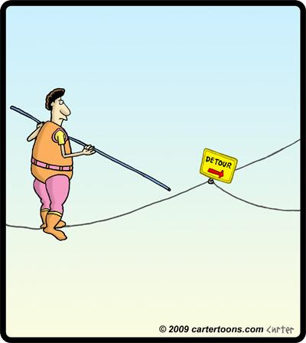
How does addiction start?
Notes:
Opioids: pill misuse: 7.5%, heroin 23-30%, most persistent, often lifelong. Periodic remissions common

Slide 5
How does addiction start?
Heroin: 23-38% within 1-12 months after heroin onset
Notes:
Opioids: pill misuse: 7.5%, heroin 23-30%, most persistent, often lifelong. Periodic remissions common

Slide 6
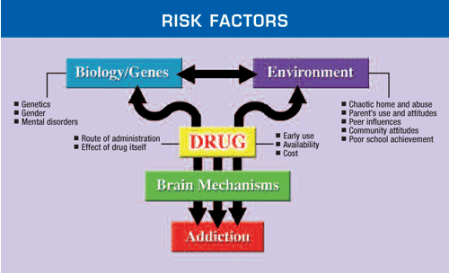

Slide 7
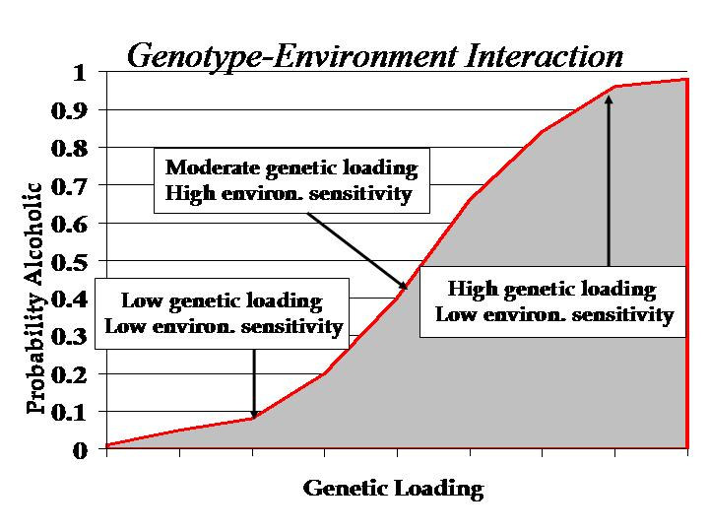
Nature vs Nurture
40-60% genetic!

Slide 8
Addiction knows no boundaries
Risk factors | Protective factors
Adolescence/ young adult | Older
Family history of addiction | Lack thereof
ADD, bipolar, schizophrenia, depression, PTSD | No mental health issues
Community poverty | Neighborhood pride
Aggressive childhood behavior | Good self-control
Poor social skills | Positive relationships
Availability for drugs at school | School anti-drug policies
Lack of parental supervision | Parental monitoring and support
Sexual abuse/ trauma | Safe environment
Drug experimentation | Academic competence

Slide 9
Risk factors
Inability to manage emotions
Inability to delay gratification
Impulsivity
Risk taking proneness
Risk perception
Notes:
RK McHugh, The Journal of Pain, 2016

Slide 10
Stress – Pain Connection
Social disconnect and physical pain share the same brain structures.
Those structures have a high density of mu opioid receptors
Opioids substitute for the rewards of social connection.
Mice not raised by moms liked opioids much more than mice raised by moms
Notes:
D

Slide 11

Risk Factors: agent perspective:
Arrives at the brain quickly
  Route of using
Latches to receptors tightly
Activates receptors fully
Activates the reward center strongly
  Cannabis vs heroin
Leaves the brain quickly
  Cocaine vs clonazepam

Slide 12

What is “Addiction”?

Slide 13
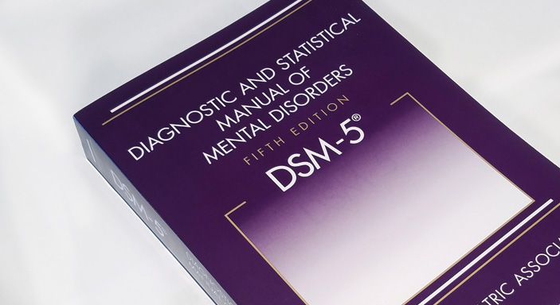
DSM 5 Definition: Substance Use Disorder
A problematic pattern of substance use leading to clinically significant impairment or distress, as manifested by at least two of the following, occurring within a 12-month period:
  Larger amounts, longer than intended
  Persistent, unsuccessful effort to cut down or abstain
  Lot of time spent on using, obtaining, recovering
  Cravings
  Slips at work, school, home duties
  Using despite social or interpersonal problems caused or made
  Stopping or decreasing important social, occupational, or recreational activities
  Using when physically hazardous
  Using despite physical or psychological problems caused or made worse by opioids
  Tolerance: need for increased amounts, decreased effect with use
  Withdrawal and using to relieve withdrawals
Opioid
exception
Notes:
This criterion is not considered to be met for those taking opioids solely under appropriate medical supervision.

Slide 14
DSM 5 Critique
Great for insurances and billing
Missing: disease concept, developmental perspective, prognostic outlook.
Nothing beats good rapport and a thorough history

Slide 15

Addiction
Addiction is a primary, chronic disease of brain reward, motivation, memory and related circuitry.
Dysfunction in these circuits leads to characteristic biological, psychological, social and spiritual manifestations.
This is reflected in an individual pathologically pursuing reward and/or relief by substance use and other behaviors.
Like other chronic diseases, addiction often involves cycles of relapse and remission. Without treatment or engagement in recovery activities, addiction is progressive and can result in disability or premature death.
Notes:
Disease
“a disordered or incorrectly functioning organ, part, structure, or system of the body resulting from the effect of genetic or developmental errors, infection, poisons, nutritional deficiency or imbalance, toxicity, or unfavorable environmental factors; illness; sickness; ailment.
Random House Dictionary

Slide 16
Addiction:
Inability to consistently Abstain;
Impairment in Behavioral control;
Craving; or increased “hunger” for drugs or rewarding experiences;
Diminished recognition of significant problems with one’s behaviors and interpersonal relationships; and
A dysfunctional Emotional response.

Slide 17

Not part of the Definition per ASAM:
Tolerance & Withdrawal
Substance/ Behavior

Slide 18
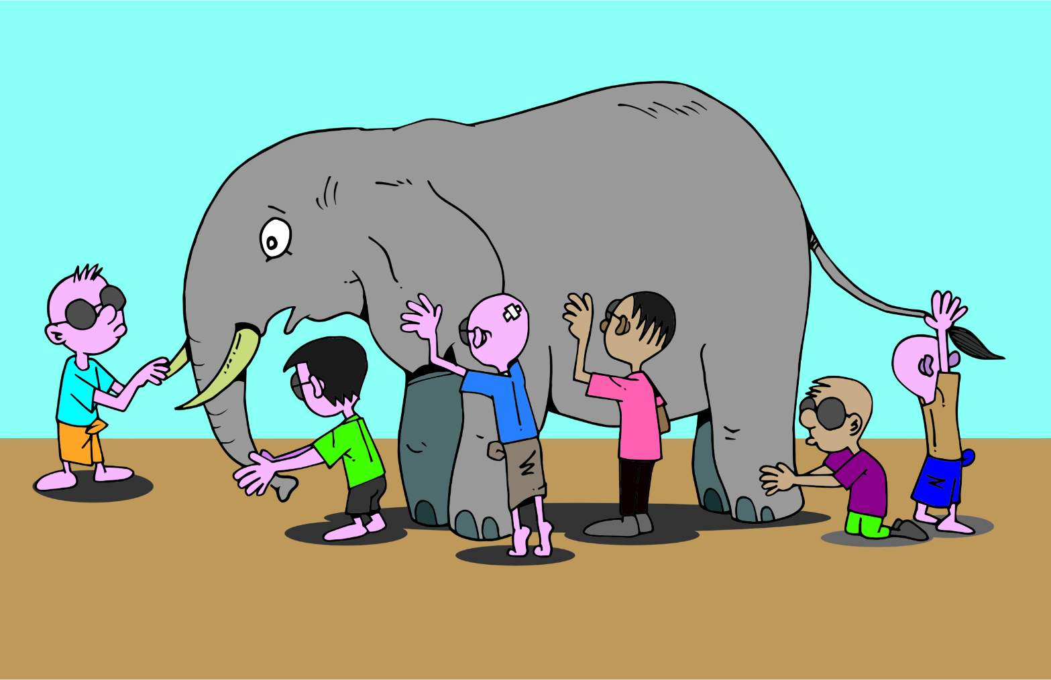
Neurobiology of Addiction
Several theories
No conclusive answer
All models have short comings

Slide 19


Dopamine Action in the Reward Center:
Natural rewards
Drugs with addiction potential
Notes:
Spike leads to the quick learning

Slide 20
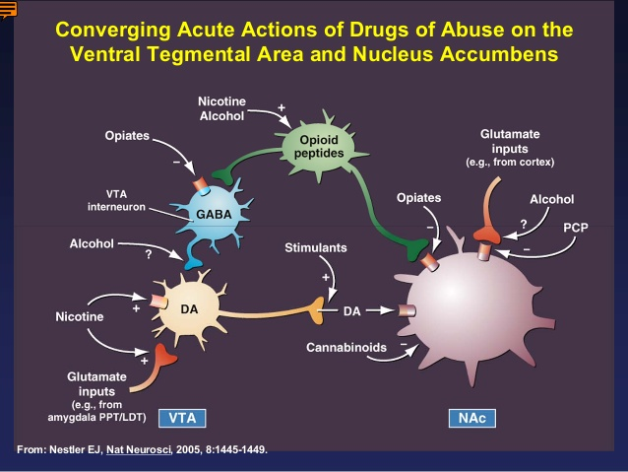

Slide 21
What do opioid feel like?
Decrease pain and emotional detachment from pain (supposed to)
“like being cradled to sleep by God, wrapped up in a warm luxurious blanket that shields you from all your worldly fears, angers, and pains”
“makes you feel like your problems have gone away, but when you come down they're still there waiting for you”
“weird, out of it, helped the pain, glad to not need it”

Slide 22
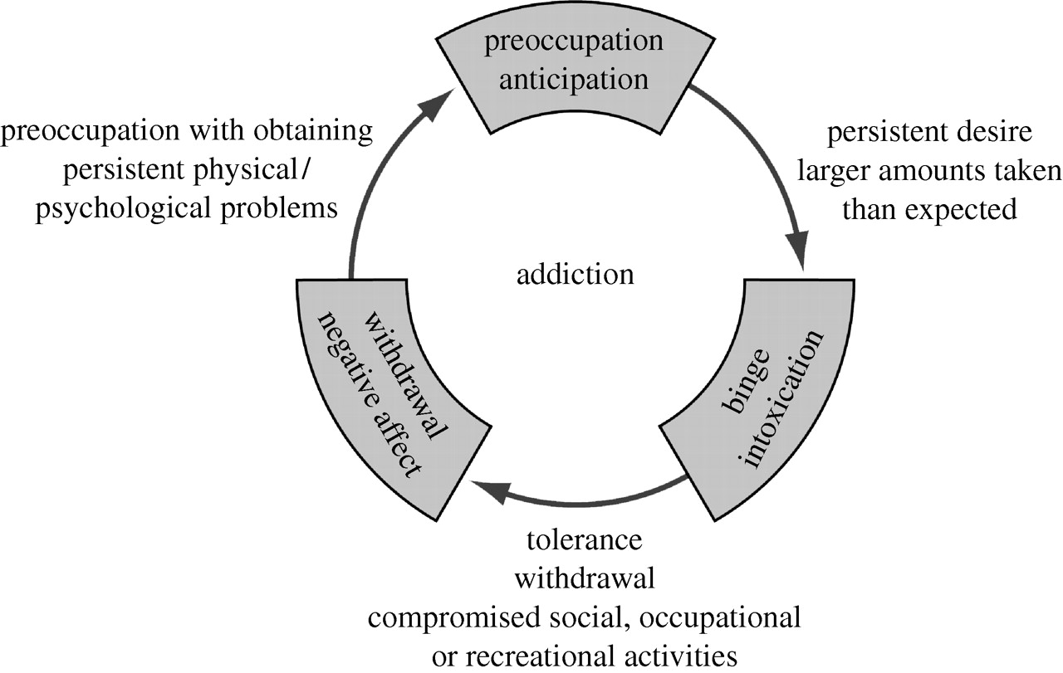
Disease Model - present
Addiction represents a dysregulation of incentive salience, reward (deficit), stress (surfeit) and executive function systems.

Slide 23
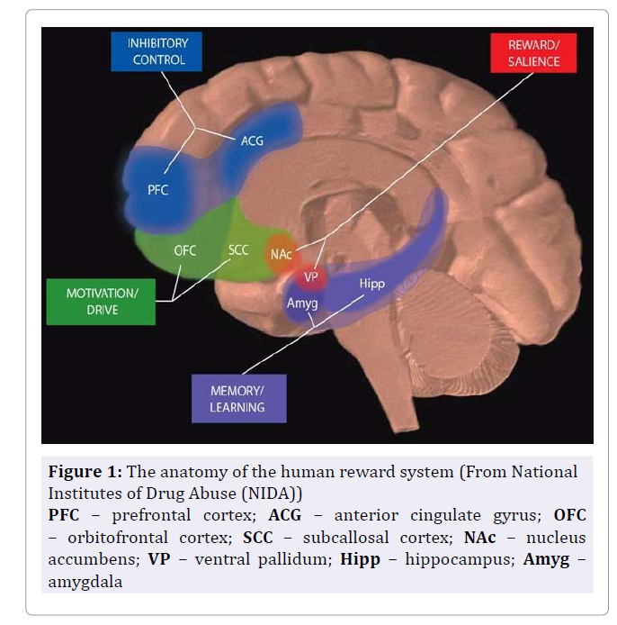
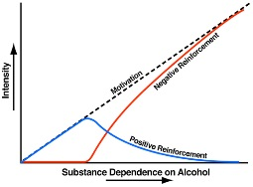
Neuro-adaptation - Summary
Notes:
Koob et al
“Liking” is not as important for addiction as “wanting”
Dopamine linked to “wanting” which calls for action
Induces learning that’s incredibly fast, effective, and incredibly hard to “unlearn”
“Resistance” weakens
Continued use does 2 things in parallel:
1: Reward center fights the “high”, leading to feeling poorer and poorer between using.
Need to use more and more (Tolerance). [+reinforcement]
Over time: using to not feel sick. [relief cravings] (Withdrawals)
2: Stress system gets activated [-reinforcement]
End result: Control is lost

Slide 24
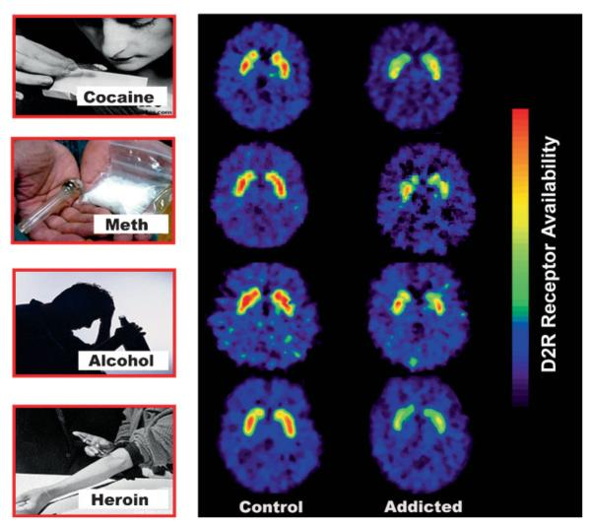
Brain changes:
Notes:
Brain images of DA D2 receptors (D2R) at the level of the striatum in control subjects and substance drug abusers. Images were obtained with [¹¹C]raclopride. Modified with permission from Volkow et al.

Slide 25
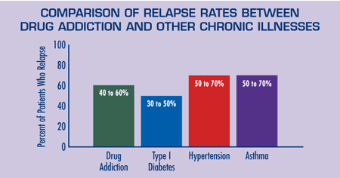
Relapse/ recovery:
Relapse can be drug, cue or stress induced
Relapse rate to heroin is about 70-90%
Even with 15 years abstinence 25% relapse
50% of iv heroin users dead after 20 years.

Slide 26
Relapse:
Drug induced
Cue induced – external and internal
Stress induced

Slide 27
Assessment:
Screening
Various instruments for alcohol or drugs
Assessment
Addiction history + labs + physical
Treatment planning
Bio-psycho-social model

Slide 28
Screening resources
https://www.icsi.org/_asset/ct0zf4/Brief-Screen--FINAL.pdf
  NIAAA-1 and NIDA-1. Followed by AUDIT C or DAST
  It has 82% sensitivity, 79% specificity
screening tool compilation
drug screen in general medical setting
NIDA quick screen alcohol and drugs
Rethinking drinking
Opioid Risk Tool
Screener and Opioid assessment for Patients with Pain-Revised

Slide 29

Assessment of Substance use:
Therapeutic assessment can help foster insight and motivation to change
Open-ended questions, non-judgmental
Drug use
  Ask the same question twice
  Be concrete and specific: “how many drinks does it take to get drunk?”
  Ask if they understand the question
  Ask “how do you use ……?”
  Elicit pattern of use: increase, decrease over time, attempts to d/c
  Context, consequences, attitude.
Integrate drug use history with life event history
  Builds understanding of triggers, level of insight, help seeking and accepting, other risk and supportive factors

Slide 30
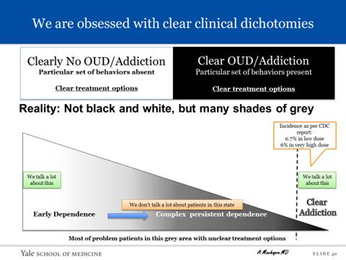

Slide 31

Treatment

Slide 32
Treatment principles
Medication assisted Treatment/ Recovery
Psycho-social-spiritual Modalities
Agonist therapy
  Methadone
Partial agonist therapy
  Buprenorphine
Antagonist therapy
  Naltrexone
Heavily cognitive/ behaviorally based (1:1, group, family)
Behavioral analysis
Skill building
Community support

Slide 33
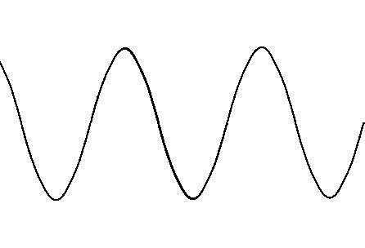
Isn’t this just substituting one drug for another?
“Highs”
Withdrawals

Slide 34
How do those meds help treat addiction?
Functional state

Slide 35
Medication assisted recovery:
Reduces:
  Relapses rates
  Overdose deaths
  Hepatitis C, HIV infection and transmission
  Drug related crime
  Improves:
  Brain health
  Treatment retention
  Work retention
  Physical health
  Mental health
  Pregnancy outcomes
Notes:
MAT Effectiveness
In 2013, an estimated 1.8 million people had an opioid use disorder related to prescription pain relievers, and about 517,000 had an opioid use disorder related to heroin use. MAT has proved to be clinically effective and to significantly reduce the need for inpatient detoxification services for these individuals. MAT provides a more comprehensive, individually tailored program of medication and behavioral therapy. MAT also includes support services that address the needs of most patients.
The ultimate goal of MAT is full recovery, including the ability to live a self-directed life. This treatment approach has been shown to:
Improve patient survival
Increase retention in treatment
Decrease illicit opiate use and other criminal activity among people with substance use disorders
Increase patients’ ability to gain and maintain employment
Improve birth outcomes among women who have substance use disorders and are pregnant
Research also shows that these medications and therapies can contribute to lowering a person’s risk of contracting HIV or hepatitis C by reducing the potential for relapse. Learn more about substance misuse and how it relates to HIV, AIDS, and Viral Hepatitis. Learn more about common comorbidities that occur with substance use disorders.
Unfortunately, MAT is greatly underused. For instance, according to SAMHSA’s Treatment Episode Data Set (TEDS) 2002-2010, the proportion of heroin admissions with treatment plans that included receiving medication-assisted opioid therapy fell from 35% in 2002 to 28% in 2010. The slow adoption of these evidence-based treatment options for alcohol and opioid dependence is partly due to misconceptions about substituting one drug for another. Discrimination against MAT patients is also a factor, despite state and federal laws clearly prohibiting it. Other factors include lack of training for physicians and negative opinions toward MAT in communities and among health care professionals.
Research also shows that these medications and therapies can contribute to lowering a person’s risk of contracting HIV or hepatitis C by reducing the potential for relapse.

Slide 36
FDA approved medications:
Currently 3:
  Methadone
  Buprenorphine/ naloxone
  Naltrexone intramuscular and oral
  Both methadone and buprenorphine are strong opioids
  Same warning for both as other opioids:
    Risk of dying when taking with alcohol, benzodiazepines
Notes:
https://www.healthquality.va.gov/guidelines/MH/sud/VADoDSUDCPGPocketcardScreeningandTreatmentRevised081017.pdf

Slide 37
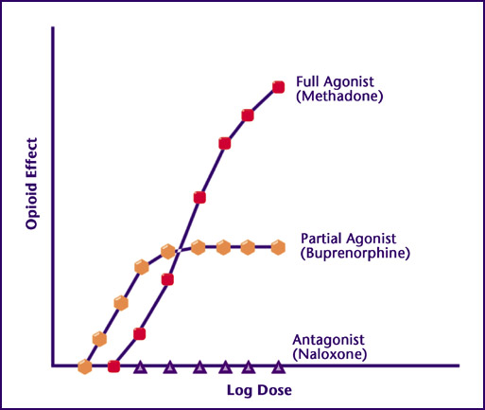
Different actions on the mu receptor

Slide 38
Methadone
Legal regulations are different if prescribed for pain vs for addiction
Dosing (strength and timing) is different for pain vs addiction treatment
Indicated for opioid “detox”, maintenance and chronic pain
Dose to treat withdrawals is different from dose that treats cravings
Opioid Treatment Programs require counseling. Preference given to pregnant patients for admission.
High stigma
Overall higher retention rate than buprenorphine
Notes:
http://atforum.com/documents/Drug_Interactions.pdf
https://www.ncbi.nlm.nih.gov/pmc/articles/PMC3334287/
https://www.asam.org/docs/default-source/public-policy-statements/safe_methadone_induction_and_stabilization__report-1.pdf?sfvrsn=971666c2_2
http://atforum.com/documents/DosingandSafetyWP.pdf

Slide 39
Methadone
Long, variable, unpredictable half-life
  Analgesia 6-8 hours
  Serum t½ 20-100 hours
Induction period is a high risk period for addiction and pain treatment
Risk for arrhythmia, QTc prolongation dose dependently (EKG), correct low K, Mg, Ca.
Multiple drug-drug interactions, CYP 3A4 main pathway (always check interactions!!), induces own metabolism
Stronger respiratory depressant effect
But less likely to induce tolerance and hyperalgesia (NMDA antagonism)
Lower dose with renal impairment (50% urinary excretion). Cave: liver impairment
Can be given im: ½ to 2/3 of po dose

Slide 40
Buprenorphine and Combination Products
Legal regulation different from methadone but still
  Strictly controlled by government
Partial receptor activation makes it safer : less risk for stopping breathing – unless alcohol or tranquilizers or CNS sedating meds added!
“Ceiling” effect: Does not treat patients with high tolerance well
Precipitated withdrawal possible

Slide 41
Buprenorphine and Combination Products
Different formulations for pain vs addiction. Bup/ nal products can be used off label for pain but then needs multiple dosings per day
Usually effective between 4/1mg to 24/6mg sl daily for addiction
OK to rx in Hep C patients.
Seems to be more prone to induce mild serotonin syndrome
Most prominent side effects: Constipation, headache, vomiting
  Less stigma

Slide 42
New legal regulation 2016:
Extends buprenorphine prescribing to
  Nurse Practitioners
  Physician Assistants
24 hrs training to obtain waiver, offered by ASAM, PCSSNow.org
1st year: 30 pts, 2nd year: 100 pts
Support:
  Mentoring via PCSSNow.org, ASAM, AAAP, SAMHSA buprenorphine clinical discussion web-board

Slide 43
Naltrexone
Blocks the mu opioid receptor – hence no addiction potential
Can precipitate withdrawal-
  7 day between last short acting opioid and naltrexone
Caution with liver impairment
Intramuscular preferred over oral (once a month)
  Deep injection, need enough muscle
Black box warning removed
Up to 5 x LFT elevation ok
Side effects: eosinophilic pneumonia, injection site reaction, nausea, headache, initial anxiety.

Slide 44
Naltrexone
Biggest concern:
Increased risk of death from overdose
Requires several months of commitment and engagement in intensive treatment
  Best started in rehab
  80% abandon naltrexone

Slide 45
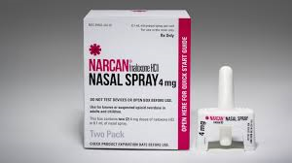
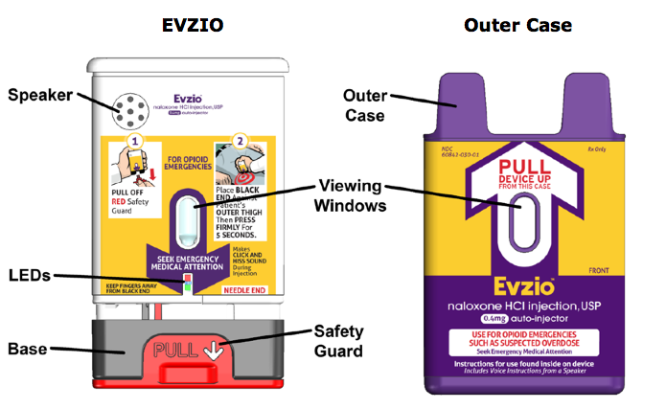
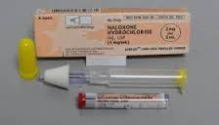
Harm Reduction
Anybody with opioid use disorder, long term opioid treatment, or a patient who is concerned about another person
Consider educating social network

Slide 46

Pearls:

Slide 47
ICU
Potential psychiatric presentations which can be substance induced
Assume withdrawals from more than 1 substance
Consider “hidden” infections:
  Listen for heart murmurs, think about empyema, osteomyelitis, discitis
With synthetic drugs, be aware of bleeding risk/ kidney failure due to rhabdo
Opioids can cause intoxication/ withdrawal delirium, depression, sleep disorder and withdrawal associated anxiety
Pts may want to sign out AMA while severely ill
Pain needs to be treated.

Slide 48
Emergency Department scenarios
Overdose:
  Keep strength of the opioid in mind
  Don’t rely on UDS (fentanyl in cocaine/ cannabis product)
  Linking, not referring to treatment (1:10 of naloxone rescues die)
  Might not be accidental
  Confidentiality?! Serious and imminent, incapacitated and unconscious
  Offering education, naloxone to pt, family, friends
  Start MAT: France recorded 79% OD death reduction over 4 ys in the 90s
Notes:
https://hipaahealthlaw.foxrothschild.com/2017/12/articles/privacy/new-hipaa-guidance-disclosure-phi-related-opioid-abuse-mental-health/
https://www.hhs.gov/sites/default/files/hipaa-opioid-crisis.pdf

Slide 49
Emergency Department scenarios
Pts w addiction experience more and more intense pain, MAT does not much for acute pain (think “basal insulin”)
72 hour emergency rule for dispensing methadone/ buprenorphine
  Dose can be verified even on weekends
For acute trauma:
Buprenorphine can be overridden by hydromorphine, fentanyl
Naltrexone can be overridden by fentanyl but good idea to stand ready to intubate!
Notes:
https://hipaahealthlaw.foxrothschild.com/2017/12/articles/privacy/new-hipaa-guidance-disclosure-phi-related-opioid-abuse-mental-health/
https://www.hhs.gov/sites/default/files/hipaa-opioid-crisis.pdf

Slide 50
Emergency Department scenarios
No IM or IV opioid injections for exacerbation of chronic non-cancer pain
  Have an established protocol, ie:
    No refills, small supply, less rewarding opioids)
People do not want to be addicted
Be mindful of the language you use – to patients, colleagues and how you document
Not every person who comes with pain complaint is drug seeking
Notes:
https://hipaahealthlaw.foxrothschild.com/2017/12/articles/privacy/new-hipaa-guidance-disclosure-phi-related-opioid-abuse-mental-health/
https://www.hhs.gov/sites/default/files/hipaa-opioid-crisis.pdf

Slide 51
Inpatient
Pain treatment (this needs another lecture): make use of consulting services: ie: anesthesiology/ addiction medicine/ psychiatry
Do not stop methadone or buprenorphine unless contraindicated with current presentation. Clouds diagnostic picture!
Stop naltrexone po: 1-3 days before surgery, im: 1m+ 1-2 ws.
If pts admitted for diagnoses other than opioid related, methadone and buprenorphine can be continued inpt for as long as it takes even without waiver!– however dose can’t be changed.
Starting buprenorphine inpt is legally tricky but possible. (VA example)
Notes:
https://psychnews.psychiatryonline.org/doi/full/10.1176/appi.pn.2018.2a21
Guidance Related to Opioid Crisis
A new fact sheet discusses HIPAA privacy regulations for professionals treating patients for opioid overdoses. It lays out a narrow set of circumstances under which providers may share information about an opioid overdose or opioid abuse disorder without the patient’s permission: (1) the patient must be incapacitated or unconscious; (2) the provider must determine it is in “the best interest” of the patient to disclose; and (3) the information must be “directly relevant” to the family’s or friend’s involvement in the patient’s care. Patients who regain their decision-making capacity hours after an overdose, for example, must then be offered the option to decide about any additional disclosures.
The difficulty with the privacy rule, Trivedi said, is that it must balance the need to share information during a true emergency while also trying to protect an individual’s privacy and civil liberties. Providers simply may not be able to meet all of the specified conditions. “The nature of an emergency is you are working with some or few of the facts. … You may not be able to ensure every one of these points is met because you have to start helping the person.”
The guidance explains that a provider can disclose a patient’s opioid use under certain circumstances, for example, if the patient poses a threat to his own health by continuing to use opioids upon discharge and the informed person might be able to help.
Both Trivedi and Pinals said that guidance is needed on how the HIPAA opioid guidance interplays with 42 Code of Federal Regulations (CFR) Part 2, which sets a higher bar for sharing information on patients being treated in any federally assisted alcohol or substance use program.
Among other provisions, Trivedi said that 42 CFR Part 2 requires that substance use treatment records be kept separate from the rest of a patient’s medical file. That separation can result in an individual’s obtaining a prescription for an opioid from another provider who has no way of knowing the individual is being treated for substance use.
A new OCR infographic spells out when a parent is not considered the minor child’s “personal representative” and is not automatically entitled to obtain protected health information from mental health professionals. ■

Slide 52
Inpatient
Consider substance involvement with psychiatric presentations
Visitor restrictions and/ or UDS if mental status changes after visitors leave
Detox is not treatment
Hospice and end of life is not the time to fight w pts but still cognizant to not let them kill themselves by quick dose escalation.
Notes:
https://psychnews.psychiatryonline.org/doi/full/10.1176/appi.pn.2018.2a21
Guidance Related to Opioid Crisis
A new fact sheet discusses HIPAA privacy regulations for professionals treating patients for opioid overdoses. It lays out a narrow set of circumstances under which providers may share information about an opioid overdose or opioid abuse disorder without the patient’s permission: (1) the patient must be incapacitated or unconscious; (2) the provider must determine it is in “the best interest” of the patient to disclose; and (3) the information must be “directly relevant” to the family’s or friend’s involvement in the patient’s care. Patients who regain their decision-making capacity hours after an overdose, for example, must then be offered the option to decide about any additional disclosures.
The difficulty with the privacy rule, Trivedi said, is that it must balance the need to share information during a true emergency while also trying to protect an individual’s privacy and civil liberties. Providers simply may not be able to meet all of the specified conditions. “The nature of an emergency is you are working with some or few of the facts. … You may not be able to ensure every one of these points is met because you have to start helping the person.”
The guidance explains that a provider can disclose a patient’s opioid use under certain circumstances, for example, if the patient poses a threat to his own health by continuing to use opioids upon discharge and the informed person might be able to help.
Both Trivedi and Pinals said that guidance is needed on how the HIPAA opioid guidance interplays with 42 Code of Federal Regulations (CFR) Part 2, which sets a higher bar for sharing information on patients being treated in any federally assisted alcohol or substance use program.
Among other provisions, Trivedi said that 42 CFR Part 2 requires that substance use treatment records be kept separate from the rest of a patient’s medical file. That separation can result in an individual’s obtaining a prescription for an opioid from another provider who has no way of knowing the individual is being treated for substance use.
A new OCR infographic spells out when a parent is not considered the minor child’s “personal representative” and is not automatically entitled to obtain protected health information from mental health professionals. ■

Slide 53
Ambulatory
Screening is important, asking directly can be very helpful
Patients will be honest if they understand you care for their health
PDMP for any pt!

Slide 54
Ambulatory
Don’t start benzos or z-drugs in patients with any history of addiction
Don’t combine benzos or z-drugs and opioids unless there is a very valid rationale
Don’t prescribe gabapentin as an “alternative” unless valid indication. Lyrica has higher abuse potential, think twice before prescribing to a person with any addiction history.
Please know basics about drug testing, including false positive, false negatives and that some benzos and zolpidem does not necessarily show up

Slide 55
Ambulatory
Warning signs: patterns: 1 lost rx vs 2-3, 1 stolen rx vs 2-3; running out early, pain or anxiety that never get better, refusal to engage in alternative but evidence based treatment (PT), “nothing” helps the pain
Know a pt’s social system: children with ADHD, sig others having surgery/ on long term opioids,
Don’t be fooled by age
Universal precautions

Slide 56

Closing words:
People do not want to be addicted
Medication assisted treatment best in combination with psycho-social therapies
Be mindful of the language you use – to patients, colleagues and how you document
Not every person who comes with pain complaint is drug seeking
It takes a village!

