Slide 1
Pain, Pain, Go Away
Lara India, MD
Great Lakes Palliative Care Conference
May 6, 2022

Slide 2
Disclosures
None

Slide 3
Objectives
Defend the practice of using a polypharmaceutical approach to pain management in the palliative care and hospice patient population.
Apply emerging literature on pharmacological non-opioid pain management strategies to this population.
Create pharmacological pain management plans for various patient presentations as outlined in case-based discussions.

Slide 4
interactive
And for the interactive portion:
Join: vevox.app ID: 144-581-730

Slide 5
In Defense of Polypharmacy
Polypharmacy
Polymyalgia
Polycythemia

Slide 6
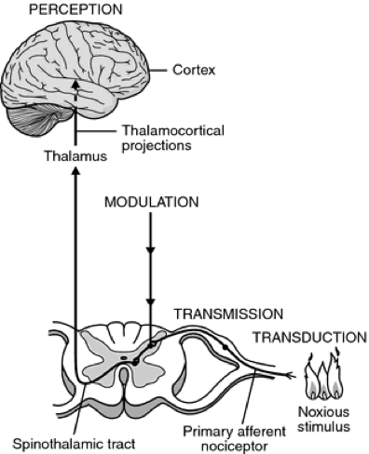
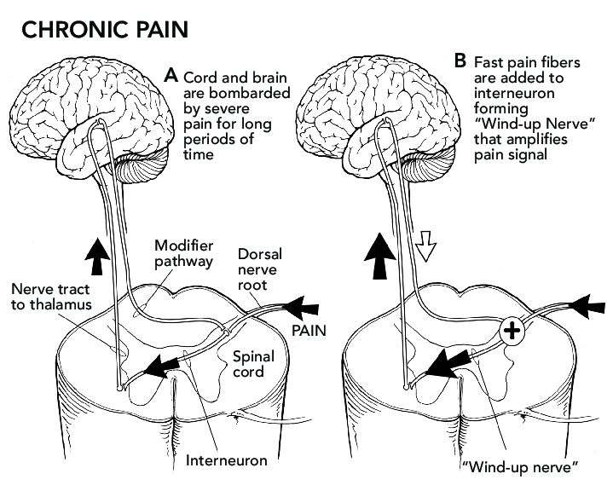
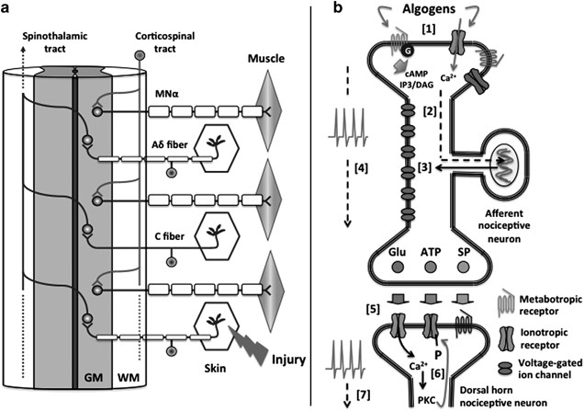
Pain
Nociception
Psychosocial Factors
Endogenous Pain Modification
Pathophysiology
Pain
Somatic
Visceral
Neuropathic
Nociceptive

Slide 7
Topicals | Anti-Depressants | Anti-Epileptics | Muscle Relaxants | IV Therapies
Lidocaine | TCAs | Gabapentin | Cyclobenzaprine | Acetaminophen
NSAIDs | SNRIs | Pregabalin | Baclofen | Ketamine
Capsaicin |  | Carbamazepine | Methocarbamol

Slide 8
Case #1
55-year-old male
Previous lumbar fusion
Postsurgical persistent pain
Lumbar radiculopathy
Met. pancreatic cancer
Abdominal pain

Slide 9
Of the following categories, which type of non-opioid analgesic would you start first for this patient?
POLL OPEN
Med List
1
Topical
0%
2
Anti-Depressant
0%
3
Anti-Epileptic
0%
4
Muscle Relaxant
0%
5
IV Therapy
0%
Join: vevox.app ID: 144-581-730
Vote Trigger

Slide 10
If your first selection was ineffective, which type of non-opioid analgesic would you start next for this patient?
POLL OPEN
Med List
1.
Topical
0%
2.
Anti-Depressant
0%
3.
Anti-Epileptic
0%
4.
Muscle Relaxant
0%
5.
IV Therapy
0%
Join: vevox.app ID: 144-581-730
Vote Trigger

Slide 11
Case #2
82-year-old male
Type 1 diabetic
Peripheral neuropathy
Previous CVA
Left-sided spasticity
No dysphagia
CKD IV-V
Declines dialysis

Slide 12
Of the following categories, which type of non-opioid analgesic would you start first for this patient?
POLL OPEN
Med List
1
Topical
0%
2
Anti-Depressant
0%
3
Anti-Epileptic
0%
4
Muscle Relaxant
0%
5
IV Therapy
0%
Join: vevox.app ID: 144-581-730
Vote Trigger

Slide 13
If your first selection was ineffective, which type of non-opioid analgesic would you start next for this patient?
POLL OPEN
Med List
1.
Topical
0%
2.
Anti-Depressant
0%
3.
Anti-Epileptic
0%
4.
Muscle Relaxant
0%
5.
IV Therapy
0%
Join: vevox.app ID: 144-581-730
Vote Trigger

Slide 14
Wrap-up
Notes:
We’ll start our section on topical analgesics with some basic information that applies to all topical agents, not just the ones that we’ll be discussing in depth today.

Slide 15
Take Home Points
“Old” medications interact with “new” receptors
Why traditional anti-depressants or anti-epileptics also treat pain
“New” receptors have multiple subtypes with varying distribution
Why a medication treats a specific neuropathic pain condition better
Distribution is affected by cell remodeling
Why a patient responds better to different medication in the same category
Most pharmacological non-opioids treat neuropathic pain
Why polypharmaceutical approach is needed for nociceptive/neuropathic pain relief

Slide 16
References
Aronson JK. In defence of polypharmacy. Br J Clin Pharmacol. 2004 Feb;57(2):119-20. doi: 10.1111/j.1365-2125.2004.02067.x. PMID: 14748809; PMCID: PMC1884429.
Pineda-Farias JB, Loeza-Alcocer E, Nagarajan V, Gold MS, Sekula RF Jr. Mechanisms Underlying the Selective Therapeutic Efficacy of Carbamazepine for Attenuation of Trigeminal Nerve Injury Pain. J Neurosci. 2021 Oct 27;41(43):8991-9007. doi: 10.1523/JNEUROSCI.0547-21.2021. Epub 2021 Aug 26. PMID: 34446571; PMCID: PMC8549540.
McNeil MJ, Kamal AH, Kutner JS, Ritchie CS, Abernethy AP. The Burden of Polypharmacy in Patients Near the End of Life. J Pain Symptom Manage. 2016 Feb;51(2):178-83.e2. doi: 10.1016/j.jpainsymman.2015.09.003. Epub 2015 Sep 30. PMID: 26432571; PMCID: PMC4733587.
Ohashi N, Kohno T. Analgesic Effect of Acetaminophen: A Review of Known and Novel Mechanisms of Action. Front Pharmacol. 2020 Nov 30;11:580289. doi: 10.3389/fphar.2020.580289. PMID: 33328986; PMCID: PMC7734311.
Petrenko AB, Yamakura T, Baba H, Shimoji K. The role of N-methyl-D-aspartate (NMDA) receptors in pain: a review. Anesth Analg. 2003 Oct;97(4):1108-1116. doi: 10.1213/01.ANE.0000081061.12235.55. PMID: 14500166.
Niesters M, Martini C, Dahan A. Ketamine for chronic pain: risks and benefits. Br J Clin Pharmacol. 2014 Feb;77(2):357-67. doi: 10.1111/bcp.12094. PMID: 23432384; PMCID: PMC4014022.
Wang GK, Russell C, Wang SY. State-dependent block of voltage-gated Na+ channels by amitriptyline via the local anesthetic receptor and its implication for neuropathic pain. Pain. 2004 Jul;110(1-2):166-74. doi: 10.1016/j.pain.2004.03.018. PMID: 15275764.
Wiffen PJ, Derry S, Moore RA, McQuay HJ. Carbamazepine for acute and chronic pain in adults. Cochrane Database Syst Rev. 2011 Jan 19;(1):CD005451. doi: 10.1002/14651858.CD005451.pub2. Update in: Cochrane Database Syst Rev. 2014;4:CD005451. PMID: 21249671; PMCID: PMC4160789.
Ya-Chin Yang, Chen-Syuan Huang, Chung-Chin Kuo; Lidocaine, Carbamazepine, and Imipramine Have Partially Overlapping Binding Sites and Additive Inhibitory Effect on Neuronal Na+Channels. Anesthesiology 2010; 113:160–174 doi: https://doi.org/10.1097/ALN.0b013e3181dc1dd6
Davison SN. Clinical Pharmacology Considerations in Pain Management in Patients with Advanced Kidney Failure. Clin J Am Soc Nephrol. 2019 Jun 7;14(6):917-931. doi: 10.2215/CJN.05180418. Epub 2019 Mar 4. PMID: 30833302; PMCID: PMC6556722.
Zhang Y, Otto P, Qin L, Eiber N, Hashemolhosseini S, Kröger S, Brinkmeier H. Methocarbamol blocks muscular Nav 1.4 channels and decreases isometric force of mouse muscles. Muscle Nerve. 2021 Jan;63(1):141-150. doi: 10.1002/mus.27087. Epub 2020 Oct 27. PMID: 33043468.
Voute M, Morel V, Pickering G. Topical Lidocaine for Chronic Pain Treatment. Drug Des Devel Ther. 2021 Sep 29;15:4091-4103. doi: 10.2147/DDDT.S328228. PMID: 34616143; PMCID: PMC8487862.
Derry S, Wiffen PJ, Kalso EA, Bell RF, Aldington D, Phillips T, Gaskell H, Moore RA. Topical analgesics for acute and chronic pain in adults - an overview of Cochrane Reviews. Cochrane Database Syst Rev. 2017 May 12;5(5):CD008609. doi: 10.1002/14651858.CD008609.pub2. PMID: 28497473; PMCID: PMC6481750.
Horishita T, Yanagihara N, Ueno S, Okura D, Horishita R, Minami T, Ogata Y, Sudo Y, Uezono Y, Sata T, Kawasaki T. Antidepressants inhibit Na_{v}1.3, Na_{v}1.7, and Na_{v}1.8 neuronal voltage-gated sodium channels more potently than Na_{v}1.2 and Na_{v}1.6 channels expressed in Xenopus oocytes. Naunyn Schmiedebergs Arch Pharmacol. 2017 Dec;390(12):1255-1270. doi: 10.1007/s00210-017-1424-x. Epub 2017 Sep 14. PMID: 28905186
Sho-Ya Wang, Joanna Calderon, Ging Kuo Wang; Block of Neuronal Na+Channels by Antidepressant Duloxetine in a State-dependent Manner. Anesthesiology 2010; 113:655–665 doi: https://doi.org/10.1097/ALN.0b013e3181e89a93.
Goodman CW, Brett AS. A Clinical Overview of Off-label Use of Gabapentinoid Drugs. JAMA Intern Med. 2019;179(5):695–701. doi:10.1001/jamainternmed.2019.0086
Jibril F, Sharaby S, Mohamed A, Wilby KJ. Intravenous versus Oral Acetaminophen for Pain: Systematic Review of Current Evidence to Support Clinical Decision-Making. Can J Hosp Pharm. 2015 May-Jun;68(3):238-47. doi: 10.4212/cjhp.v68i3.1458. PMID: 26157186; PMCID: PMC4485512.
Cohen SP, Bhatia A, Buvanendran A, Schwenk ES, Wasan AD, Hurley RW, Viscusi ER, Narouze S, Davis FN, Ritchie EC, Lubenow TR, Hooten WM. Consensus Guidelines on the Use of Intravenous Ketamine Infusions for Chronic Pain From the American Society of Regional Anesthesia and Pain Medicine, the American Academy of Pain Medicine, and the American Society of Anesthesiologists. Reg Anesth Pain Med. 2018 Jul;43(5):521-546. doi: 10.1097/AAP.0000000000000808. PMID: 29870458; PMCID: PMC6023575.

Slide 17
Topical Analgesics
Notes:
We’ll start our section on topical analgesics with some basic information that applies to all topical agents, not just the ones that we’ll be discussing in depth today.

Slide 18
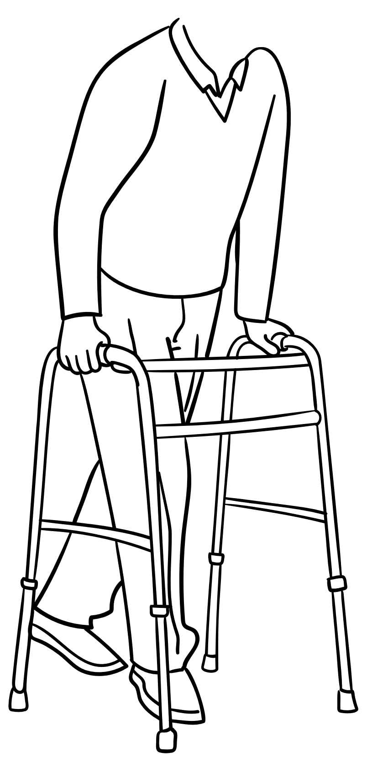
Indications
Musculoskeletal injury
Osteoarthritis
Neuropathic pain
Notes:
Topical analgesics carry a variety of indications, many of which as specific to the medication in question. In general, however, topical analgesics may be used for acute pain, such a sprain or strain, or chronic pain, such as osteoarthritis or neuropathic pain.

Slide 19
Topical vs. Transdermal
Notes:
There’s an important distinction between a topical medication and a transdermal medication. A topical medication is applied externally, absorbed through the skin, and acts locally. Its efficacy is not dependent on systemic absorption. Transdermal medications, however, do depend on systemic absorption. While they are applied to and absorbed through the skin, they are taken up into the bloodstream and produce systemic effects. This difference has significant implications for a medication’s side effect profile, making topical medications generally safe with limited systemic side effects.

Slide 20
Topical Lidocaine

Slide 21
Pre-synaptic Neuron
Calcium
Neurotransmitters
Voltage-gated Calcium Channel
Sodium
Voltage-gated Sodium Channel
Post-synaptic Neuron
Notes:
Lidocaine is an amino amide anesthetic. Its mechanism of action is through blockade of the voltage-gated sodium channels on the postsynaptic neuronal cell membrane. Under typical conditions, an action potential in the presynaptic neuron causes the voltage-gated calcium channel to open, thereby permitting calcium to enter the cell. The influx of calcium leads to neurotransmitter release into the extracellular space. The action potential then continues to propagate to the postsynaptic neuron, when the voltage-gated sodium channels open and permit an influx of sodium into the cell. This is the process by which action potentials, such as those carrying pain signals, are conducted.

Slide 22
Pre-synaptic Neuron
Calcium
Neurotransmitters
Voltage-gated Calcium Channel
Lidocaine
Sodium
Voltage-gated Sodium Channel
Post-synaptic Neuron
Notes:
However, when lidocaine binds within the voltage-gated sodium channel, propagation of the action potential is interrupted, and so, the pain signal is no longer transmitted.

Slide 23
Formulations and Uses
Cream
Gel
Patch
Postherpetic neuralgia
Diabetic peripheral neuropathy
Chronic low back pain
Osteoarthritis
Postsurgical persistent pain
Carpal tunnel syndrome

Slide 24
Topical NSAIDs

Slide 25
Extracellular
Arachidonic Acid
Intracellular
COX-1
COX-2
Prostaglandins
Prostacyclin
Thromboxane A₂
Prostaglandin D₂
Prostaglandin E₂
Prostaglandin F_{2α}

Slide 26
NSAIDs
Extracellular
Arachidonic Acid
Intracellular
COX-1
COX-2
Prostaglandins
Prostacyclin
Thromboxane A₂
Prostaglandin D₂
Prostaglandin E₂
Prostaglandin F_{2α}

Slide 27
Formulations and Uses
Gel
Emulsion
Spray
Patch
Diclofenac
Ibuprofen
Ketoprofen
Osteoarthritis
Musculoskeletal injury

Slide 28
Topical Capsaicin
Notes:
Next, we will discuss topical capsaicin. Capsaicin is a naturally occurring TRPV-1 agonist. It has a long history of use in folk medicine and its first documented use in western culture goes back to the 1850s, when it was recommended to use alcoholic hot pepper extract on burning or itching extremities.

Slide 29
Pre-synaptic Neuron
Neurotransmitters
Voltage-gated Calcium Channel
Endogenous TRPV1 agonist
Heat
Acid
Sodium
Calcium
TRPV1 Channel
Post-synaptic Neuron
Notes:
Select sensory nerves (primarily C and A-delta fibers) express the TRPV1 channel, which allows both sodium and calcium to enter the cell and thereby leads to depolarization.

Slide 30
Pre-synaptic Neuron
Neurotransmitters
Voltage-gated Calcium Channel
Capsaicin
Sodium
Calcium
TRPV1 Channel
Post-synaptic Neuron

Slide 31
Formulations and Uses
Cream
Patch
Postherpetic neuralgia
Diabetic peripheral neuropathy
Postsurgical persistent pain

Slide 32
When to Reach for a Topical Analgesic
Med List
Neuropathic pain
Osteoarthritis
Systemic risks > benefits
Return to Case 1
Return to Case 2

Slide 33
Anti-Depressants

Slide 34
Indications
Neuropathic pain

Slide 35
TCAs

Slide 36
Pre-synaptic Neuron
Calcium
Serotonin
Voltage-gated Calcium Channel
Serotonin
Reuptake Channel
Serotonin Receptor
Post-synaptic Neuron

Slide 37
Pre-synaptic Neuron
Calcium
Norepinephrine
Serotonin
Voltage-gated Calcium Channel
Norepinephrine
Serotonin
Reuptake Channel
Norepinephrine
Serotonin Receptor
Post-synaptic Neuron

Slide 38
Pre-synaptic Neuron
Calcium
Norepinephrine or Serotonin
Voltage-gated Calcium Channel
Norepinephrine or
Serotonin
Reuptake Channel
TCA
Norepinephrine or Serotonin Receptor
Post-synaptic Neuron

Slide 39
But how does it modulate pain?

Slide 40
Pre-synaptic Neuron
Calcium
Neurotransmitters
Voltage-gated Calcium Channel
Sodium
Voltage-gated Sodium Channel
Post-synaptic Neuron

Slide 41
Pre-synaptic Neuron
Calcium
Neurotransmitters
Voltage-gated Calcium Channel
TCA
Sodium
Voltage-gated Sodium Channel
Post-synaptic Neuron

Slide 42
Formulations and Uses
Amitriptyline
Nortriptyline
Desipramine
Imipramine
Various neuropathic pain conditions
Fibromyalgia
Chronic low back pain
Irritable bowel syndrome

Slide 43
SNRIs

Slide 44
Pre-synaptic Neuron
Calcium
Norepinephrine or Serotonin
Voltage-gated Calcium Channel
Norepinephrine or
Serotonin
Reuptake Channel
SNRI
Norepinephrine or Serotonin Receptor
Post-synaptic Neuron

Slide 45
But how does it modulate pain?

Slide 46
Pre-synaptic Neuron
Calcium
Neurotransmitters
Voltage-gated Calcium Channel
SNRI
Sodium
Voltage-gated Sodium Channel
Post-synaptic Neuron

Slide 47
Formulations and Uses
Duloxetine
Venlafaxine
Desvenlafaxine
Diabetic peripheral neuropathy
Postherpetic neuralgia
Chronic low back pain

Slide 48
When to Reach for an Anti-Depressant
Med List
Neuropathic pain
Concomitant depression/anxiety
Longer prognosis
Younger/more tolerant of anticholinergic side effects
Return to Case 1
Return to Case 2

Slide 49
Anti-Epileptics

Slide 50
Indications
Neuropathic pain

Slide 51
Gabapentin

Slide 52
Pre-synaptic Neuron
Calcium
Neurotransmitters
α2δ1 Subunit
Voltage-gated Calcium Channel
Post-synaptic Neuron

Slide 53
Gabapentin
Pre-synaptic Neuron
Calcium
Neurotransmitters
α2δ1 Subunit
Voltage-gated Calcium Channel
Post-synaptic Neuron

Slide 54
Formulations and Uses
Capsule
Tablet
Oral solution
Postherpetic neuralgia
Diabetic peripheral neuropathy
Chronic low back pain
Phantom limb pain
Fibromyalgia

Slide 55
Pregabalin

Slide 56
Pregabalin
Pre-synaptic Neuron
Calcium
Neurotransmitters
α2δ1 Subunit
Voltage-gated Calcium Channel
Post-synaptic Neuron

Slide 57
Formulations and Uses
Capsule
Oral solution
Postherpetic neuralgia
Diabetic peripheral neuropathy
Fibromyalgia
Pain from spinal cord injury

Slide 58
Carbamazepine

Slide 59
Pre-synaptic Neuron
Calcium
Neurotransmitters
Voltage-gated Calcium Channel
Sodium
Voltage-gated Sodium Channel
Post-synaptic Neuron

Slide 60
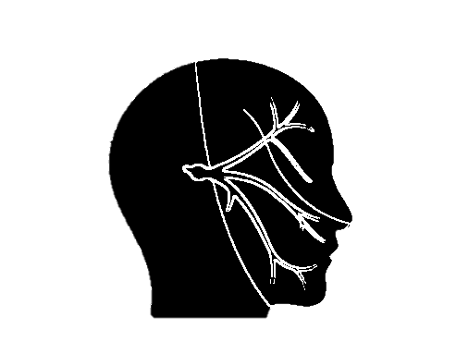
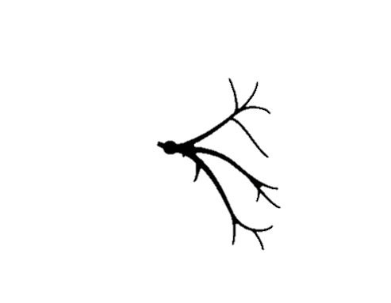
Pre-synaptic Neuron
Calcium
Neurotransmitters
Voltage-gated Calcium Channel
Carbamazepine
Sodium
Voltage-gated Sodium Channel
Post-synaptic Neuron

Slide 61
Formulations and Uses
Sustained-release capsule
Sustained-release tablet
Chewable tablet
Oral suspension
Trigeminal neuralgia
Diabetic peripheral neuropathy
Postherpetic neuralgia

Slide 62
When to Reach for an Antiepileptic
Med List
Neuropathic pain
Dysphagia
Trigeminal distribution → carbamazepine
No studies comparing anti-depressants and anti-epileptics
Return to Case 1
Return to Case 2

Slide 63
Muscle Relaxants

Slide 64
Indications
Musculoskeletal injury
Muscle spasticity
Cerebral palsy
Spinal cord injury
Multiple sclerosis
Notes:
Topical analgesics carry a variety of indications, many of which as specific to the medication in question. In general, however, topical analgesics may be used for acute pain, such a sprain or strain, or chronic pain, such as osteoarthritis or neuropathic pain.

Slide 65
Cyclobenzaprine

Slide 66
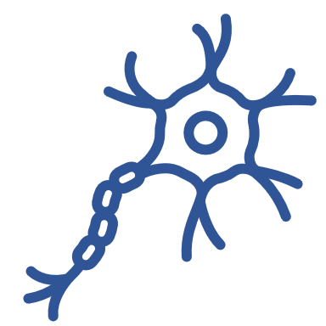
Pre-synaptic Motor Neuron
Neurotransmitters
Voltage-gated Calcium Channel
Sodium
Calcium
Post-synaptic Motor Neuron
Notes:
Select sensory nerves (primarily C and A-delta fibers) express the TRPV1 channel, which allows both sodium and calcium to enter the cell and thereby leads to depolarization.

Slide 67
Formulations and Uses
Immediate-release tablet
Sustained-release capsule
Musculoskeletal injury
TMJ disorders

Slide 68
Baclofen

Slide 69
Pre-synaptic Motor Neuron
Calcium
Excitatory Neurotransmitters
Voltage-gated Calcium Channel
GABA_{B} Receptor
Excitatory Neurotransmitter Receptor
Inhibitory Interneuron
Post-synaptic Motor Neuron

Slide 70
Pre-synaptic Motor Neuron
Calcium
Excitatory Neurotransmitters
Voltage-gated Calcium Channel
Baclofen
GABA_{B} Receptor
Excitatory Neurotransmitter Receptor
Inhibitory Interneuron
Post-synaptic Motor Neuron

Slide 71
Formulations and Uses
Tablet
Oral solution
Intrathecal solution
Muscle spasticity
Cerebral palsy
Spinal cord injury
Multiple sclerosis

Slide 72
Methocarbamol

Slide 73
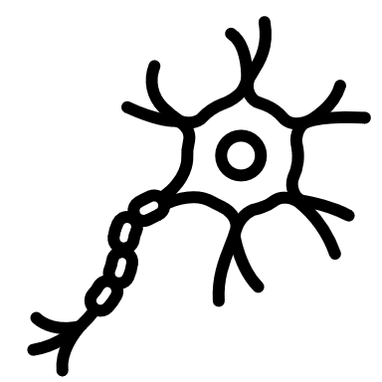
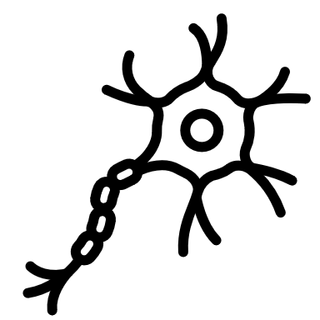
Pre-synaptic Motor Neuron
Neurotransmitters
Voltage-gated Calcium Channel
Sodium
Calcium
Post-synaptic Motor Neuron
Notes:
Select sensory nerves (primarily C and A-delta fibers) express the TRPV1 channel, which allows both sodium and calcium to enter the cell and thereby leads to depolarization.

Slide 74
Notes:
Select sensory nerves (primarily C and A-delta fibers) express the TRPV1 channel, which allows both sodium and calcium to enter the cell and thereby leads to depolarization.

Slide 75
Pre-synaptic Motor Neuron
Calcium
Neurotransmitters
Voltage-gated Calcium Channel
Sodium
Voltage-gated Sodium Channel
Post-synaptic Motor Neuron

Slide 76
Pre-synaptic Motor Neuron
Calcium
Neurotransmitters
Voltage-gated Calcium Channel
Methocarbamol
Sodium
Voltage-gated Sodium Channel
Post-synaptic Motor Neuron

Slide 77
Formulations and Uses
Tablet
IV
IM
Musculoskeletal injury

Slide 78
When to Reach for a Muscle Relaxant
Med List
Musculoskeletal pain/injury/spasticity
Acute > chronic
Return to Case 1
Return to Case 2

Slide 79
IV Therapies

Slide 80
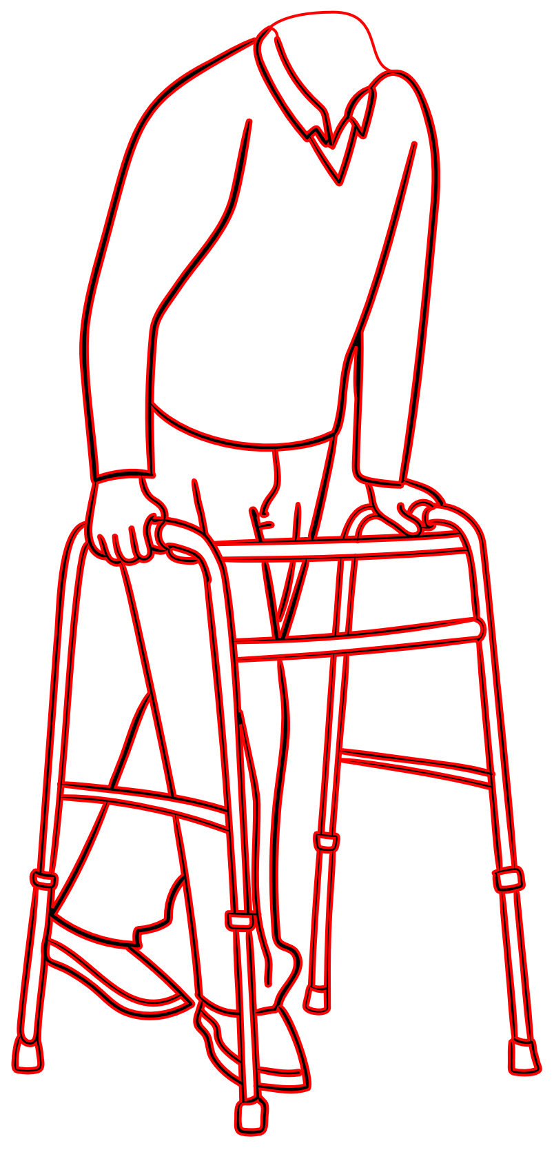
Indications
NPO
Uncontrolled with oral meds

Slide 81
Acetaminophen

Slide 82
Arachidonic Acid
Extracellular
COX-1
Intracellular
COX-2
Prostaglandins
Prostacyclin
Thromboxane A₂
Prostaglandin D₂
Prostaglandin E₂
Prostaglandin F_{2α}

Slide 83
Arachidonic Acid
Acetaminophen
Extracellular
COX-1
Intracellular
COX-2
Prostaglandins
Prostacyclin
Thromboxane A₂
Prostaglandin D₂
Prostaglandin E₂
Prostaglandin F_{2α}

Slide 85
Pre-synaptic Neuron
Neurotransmitters
Voltage-gated Calcium Channel
Endogenous TRPV1 agonist
Sodium
Calcium
TRPV1 Channel
Post-synaptic Neuron

Slide 86
Pre-synaptic Neuron
Neurotransmitters
Voltage-gated Calcium Channel
Acetaminophen Metabolite AM404
Sodium
Calcium
TRPV1 Channel
Post-synaptic Neuron
Notes:
Select sensory nerves (primarily C and A-delta fibers) express the TRPV1 channel, which allows both sodium and calcium to enter the cell and thereby leads to depolarization.

Slide 87
Formulations and Uses
Broad range
Musculoskeletal
Cancer-related
Postsurgical

Slide 88
Ketamine

Slide 89
Pre-synaptic Neuron
Calcium
Excitatory Neurotransmitters
Voltage-gated Calcium Channel
NMDA Receptor
Post-synaptic Neuron

Slide 90
Pre-synaptic Neuron
Calcium
Excitatory Neurotransmitters
Voltage-gated Calcium Channel
Ketamine
NMDA Receptor
Post-synaptic Neuron

Slide 91
Formulations and Uses
Acute
Nonoperative trauma
Sickle cell crisis
Chronic neuropathic pain
Pain from spinal cord injury
Complex regional pain syndrome

Slide 92
When to Reach for IV Therapies
Med List
Rapid analgesia
Alternative routes inappropriate
Central nervous system “reset”
Return to Case 1
Return to Case 2

Slide 93
Appendix

Slide 94
Topicals | Anti-Depressants | Anti-Epileptics | Muscle Relaxants | IV Therapies
Lidocaine | TCAs | Gabapentin | Cyclobenzaprine | Acetaminophen
NSAIDs | SNRIs | Pregabalin | Baclofen | Ketamine
Capsaicin |  | Carbamazepine | Methocarbamol

Slide 97
Pre-synaptic Neuron
Calcium
Serotonin
Voltage-gated Calcium Channel
Serotonin
Reuptake Channel
Serotonin Receptor
Post-synaptic Neuron

Slide 98
Pre-synaptic Neuron
Calcium
Norepinephrine
Serotonin
Voltage-gated Calcium Channel
Norepinephrine
Serotonin
Reuptake Channel
Norepinephrine
Serotonin Receptor
Post-synaptic Neuron

Slide 99
Pre-synaptic Neuron
Calcium
Neurotransmitters
Voltage-gated Calcium Channel
Voltage-gated Sodium Channel
Post-synaptic Neuron

Slide 100
Pre-synaptic Neuron
Calcium
Neurotransmitters
α2δ1 Subunit
Voltage-gated Calcium Channel
Post-synaptic Neuron

