Slide 1
Pharmacogenomics of Personalized Medicine
Bradley Stockard, PharmD, PhD
Assistant Professor, MCW School of Pharmacy

Slide 2
Objectives
Outline the fundamentals of pharmacogenomics as a foundation for clinical implementation
Explore how pharmacogenomics connects to other aspects of clinical pharmacology
Discuss strategies and examples for developing a pharmacogenomics implementation program

Slide 3
Interpatient Variability of Drug Response
Many drugs are still used with a “one size fits most” dosing strategy
Change to therapy is reactive, based on therapeutic failure or toxicity
Disease | Drug Class | Percentage of Non-Responders
Asthma | B₂-adrenergic Agents | 40-75%
Hypertension | various | 40-60%
Hyperlipidemia | HMG CoA-Reductase Inhibitors | 35-75%
Depression | SSRIs, SNRIs | 20-40%
Arthritis | Anti-metabolite therapy | 30-60%

Slide 4
Public Health Impact of Adverse Drug Events (ADE)
ADE: any injury caused by a drug (at normal dosage and/or overdose) and any harm associated with the use of the drug
Medications are a leading cause of death in the US
In 2010, ADEs were responsible for 500k serious injuries and hospitalizations
Avoidable expenses occur due to therapeutic failure and toxicity
Trial and error therapy wastes time for both clinicians and patients
He YJ, McLeod HL. Ready when you are: easing into preemptive pharmacogenetics. Clin Pharmacol Ther. 2012 Oct;92(4):412-4.

Slide 5
Factors Contributing to Interpatient Variability
Age
Gender
Weight
Comorbidity
Concomitant drugs
Genetics
Pharmacogenomics
Personalized Medicine

Slide 6
Personalized Medicine: Drug Therapy
Precision medicine: a medical model that proposes the customization of healthcare with prevention and treatment strategies that take individual variability into account
Precision Medicine Initiative (PMI)
Began in 2015, NIH Based
Two main components
Near term focus on cancers
Long term aim to generate knowledge applicable to a wider range of diseases
“Studies of a large research cohort exposed to many kinds of therapies may provide early insights into pharmacogenomics – enabling the provision of the right drug at the right dose to the right patient.”

Slide 7
All of Us (2018)
Built from the framework of PMI
Outlined a plan to build a research cohort of one million or more Americans
Data collection, management, biobanking
“All of Us is part of a new era in which researchers, health care providers, technology experts, community partners, and the public work together to develop individualized health care.”
Multiple health care institutions across the US contributing to this cohort, including several in Wisconsin
Will eventually distribute pharmacogenomic data for enrolled patients, resulting in a significant influx of patients with potentially actionable PGx results

Slide 8
Fundamentals of Pharmacogenomics

Slide 9
What is Pharmacogenomics?
Pharmacogenomics: study of how genetic variation influences interpatient variability in drug response
Pharmacogenetics: single-gene
Pharmacogenomics: multiple genes or whole genome
These terms are often used interchangeably
Pertains to the influence of genetic variation on drug response by correlating variants (single nucleotide polymorphisms) with pharmacokinetics and pharmacodynamics

Slide 10
Genetic Terms and Nomenclature
Central Dogma of Molecular Biology
Flow of genetic information within a system that results in observable traits
DNA to RNA to Protein
Gene
A section of DNA that ultimately encodes for a trait
Allele
Multiple definitions, can get confusing!
One of two or more forms of a nucleotide
Variant forms of a gene
Alleles represent variability at the genetic level that contribute to variability in observable traits

Slide 11
Many Different “-types”
Haplotype
A group of alleles in an organism that are inherited together from a parent
May be one locus, several loci, or an entire chromosome
Diplotype
Set of two haplotypes found in an individual
Genotype
DNA sequence of an organism at a specific, defined location
Phenotype
Observable traits influenced by the genetic make-up of an individual
E.g. blue eyes, brown hair, O+ blood type

Slide 12
Single Nucleotide Polymorphisms (SNPs)
DNA is composed of a nucleotide sequence
A SNP is a change of a single base pair in the sequence
Change in nucleotide sequence can cause a variety of changes
Change in the amino acid sequence of proteins
Change in splice junctions
Change in promoter, enhancer activity
No change at all
SNPs make up ~90% of human genetic variation

Slide 13
PGx Nomenclature
SNP Nomenclature
Basic: Gene, Position, WT Allele > Variant Allele
Example: CYP2C19 681 G>A
Reference SNP (rs) Number
The rs naming system is used by the NCBI for the SNP database (dbSNP)
Each SNP has an assigned rs number
Example: CYP2C19 681 G>A = rs4244285
Allele Nomenclature
Basic: Gene, Position, Allele
Example: CYP2C19 681 G
“Star” Nomenclature: Gene * Allele Number
Allele number represents a haplotype, can be one or multiple SNPs
Example: CYP2C19*1, CYP2C19*17

Slide 14
Pharmacogenomics as a Component of Clinical Pharmacology

Slide 15
How Does PGx Impact Pharmacology?
Pharmacokinetics
Absorption, Distribution, Metabolism, Excretion, Toxicity
Pharmacodynamics
Variability in receptor activity
Plays a large role in drug development
Evidence for clinical use is limited, not currently included in guidelines
Immunology
Variability in immune response to medication
Allergic reactions, drug hypersensitivities

Slide 16
Drug Metabolism: Cytochrome P450
Superfamily of enzymes
Function as monooxygenases
Responsible for approximately 75% of total drug metabolism
Major players in PGx
CYP2D6: opioids, antidepressants, beta blockers
CYP2C9: warfarin
CYP2C19: clopidogrel
CYP3A5: tacrolimus
CYP2B6: efavirenz
Nomenclature: CYP2D6*4A
Superfamily: CYP
Family: 2
Subfamily: D
Individual member: 6
Allele: 4
Suballele: A
Wester, MR, et al. The structure of human cytochrome P450 2C9 complexed with flurbiprofen at 2.0-A resolution. J Biol Chem. 2004 Aug 20;279(34):35630-7.

Slide 17
Functional Status: Alleles Using Activity Scores
Early Example of PGx Report: CYP2D6
Functional status | Activity value | Alleles
Increased function | >1 | *1 x N, *2 x N, *35 x N, *45 x N
Normal or increased function | 1 or >1 | *9 x N, *10 x N, *17 x N, *29 x N, *41 x N
Normal function | 1 | *1, *2, *27, *33, *34, *35, *39, *45, *46, *48, *53
Decreased function | 0.5 | *9, *10, *14B, *17, *29, *41, *49, *50, *54, *55, *59, *72
No function | 0 | *3, *3 x N, *4, *4 x N, *5, *6, *6 x N, *7, *8, *11, *12, *13, *14A, *15, *18, *19, *20, *21, *31, *36, *36 x N, *38, *40, *42, *44, *47, *51, *56, *57, *62, *68, *69, *92, *100, *101
Unknown | N/A | *22, *23, *24, *25, *26, *28, *30, *32, *37, *43, *43 x N, *52, *58, *60, *61, *63, *64, *65, *70, *71, *73, *74, *75, *81, *82, *83, *84, *85, *86, *87, *88, *89, *90, *91, *93, *94, *95, *96, *97, *98, *102, *103, *104, *105
https://www.pharmacytoday.org/article/S1042-0991(18)30160-9/fulltext

Slide 18
CYP2D6 phenotype status based on activity score from an individual genotype
Activity score | Phenotype | Prevalence | Genotype | Examples of diplotypes
>2.0 | Ultrarapid metabolizer | 1%–2% | Carrying more than two copies of functional alleles | *1/*1 x N, *1/*2 x N
1.0– 2.0 | Normal (extensive) metabolizer | 77%–92% | Carrying two alleles encoding full or reduced function or one full function allele together with either one nonfunctional or one reduced function allele | *1/*1, *1/*2, *2/*2, *1/*41, *1/*4, *2/*5, *10/*10
0.5 | Intermediate metabolizer | 2%–11% | Carrying one reduced and one nonfunctional allele | *4/10, *5/*41
0 | Poor metabolizer | 5%–10% | Carrying no functional alleles
https://www.pharmacytoday.org/article/S1042-0991(18)30160-9/fulltext

Slide 19
PK: Drug Absorption and Distribution
Drug Transporters
Responsible for movement of drug compounds across cellular membranes
Play a key role in how effectively drugs are absorbed and distributed throughout the body
SNPs can introduce variability in drug binding efficiency and overall activity
Examples of Gene-Drug pairs for Transporters
SLCO1B1: statins
ABCG2: statins
CFTR: ivacaftor

Slide 20
Immunology PGx
Human leukocyte antigens (HLAs) are cell surface proteins that play a critical role in the regulation of the immune system
Genetic variability in HLA genes can cause changes in HLA protein structure, leading to severe hypersensitivities to certain drugs
Steven’s Johnson Syndrome
Severe cutaneous adverse reactions
Organ injury

Slide 21
Hypersensitivity Gene-Drug Pairs
Gene | Drug | Effect
HLA-B*1502 | Carbamazepine, oxcarbazepine, phenytoin, lamotrigine | Steven’s Johnson Syndrome
HLA-B*5801 | Allopurinol | Steven’s Johnson Syndrome
HLA-B*5701 | Abacavir | Abacavir hypersensitivity reaction
HLA-B*5701 | Flucloxacillin | Drug-induced liver injury

Slide 22
Differences in Allele Frequencies by Race
Enzyme | Function | Variant Frequency by Race
CYP2D6 | Catalyzes metabolism of multiple drugs, notably analgesics, tamoxifen, antidepressants, ADHD drugs | Black: 0-5% Caucasian: 5-14% Asian: 0-1%
CYP2C19 | Catalyzes metabolism of multiple drugs, including clopidogrel, proton pump inhibitors, and some antidepressants | Black: 5% Caucasian: 2-14% Asian: 19%
UGT1A1 | Catalyzes phase II metabolism of certain anticancer drugs | Black: 19% Caucasian: 8% Asian: 2%
HLA-B*5701 | Can cause hypersensitivity reaction, Steven’s Johnson Syndrome in response to certain medications | Black: 1% Caucasian: 6-7% Asian: 20%
IL28b | CC alleles predict drug efficacy of antiviral medications used to treat chronic hepatitis C infections | Black: 20-50% Caucasian: 8-13% Asian: 0-1%

Slide 23
Clinical Implementation of Pharmacogenomics

Slide 24
Frequency of Prescribing PGx Drugs and Finding PGx Variants
Stoddard A, et al. 2019
EMR based study showed that in a study population of 55,654 patients, 80% of patients had one PGx related drug prescribed
Dunnenberger HM, et al. 2015
When 12 pharmacogenes with at least one known actionable inherited variant are considered, over 97% of the US population has at least one high-risk diplotype
Ji Y, et al. 2016
99% of subjects had an actionable variant in at least one of five genes evaluated at Mayo Clinic

Slide 25
FDA Black Box Warnings
FDA has evaluated over 200 medications that have a particular gene-drug interaction
Certain interactions are significant enough to justify boxed warnings on the drug label, recommending or requiring PGx testing before using the drug
Example: Ziagen (abacavir)
HLA-B*5701 variant associated with hypersensitivity reaction
FDA Label Warning: Do not take ZIAGEN if you have a certain type of gene variation called the HLA-B*5701 allele. Your healthcare provider will test you for this before prescribing treatment with ZIAGEN

Slide 26
CPIC Guidelines
Clinical Pharmacogenetics Implementation Consortium
International group of individual volunteers dedicated to facilitating use of pharmacogenetic tests for patient care
Goal of CPIC is to overcome barriers to PGx implementation due to difficulties in translating genetic lab test results into clinical decision support
Generate freely available, peer-reviewed, evidence-based, updateable, and detailed gene/drug clinical practice guidelines
CPIC Guidelines are the standard for PGx clinical decision making
cpicpgx.org, pharmgkb.org

Slide 27
Goals of Clinical Pharmacogenomics
Individualize Treatments
Improve Treatment Outcomes
Reduce Adverse Events
Reduce Healthcare Costs
Increase access to critical genetic information
Develop PGx expertise

Slide 28
PGx as Team Science
How best to move PGx forward as a medical practice?
Potential Team Members
Pharmacists
Physicians
Genetic Counselors
Physician Assistants
Nurses
Each team member can play a unique role and bring their own skills and perspectives to the implementation process

Slide 29
GenomeEd
NIH supported genomics education resource
Formerly Genetics/Genomics Competency Center (G2C2)
Genome.gov/GenomeEd
Online repository of genomics educational materials
Offers Discipline Specific Competencies for PGx
Pharmacists
Physicians
Genetic Counselors
Physician Assistants
Nurses

Slide 30
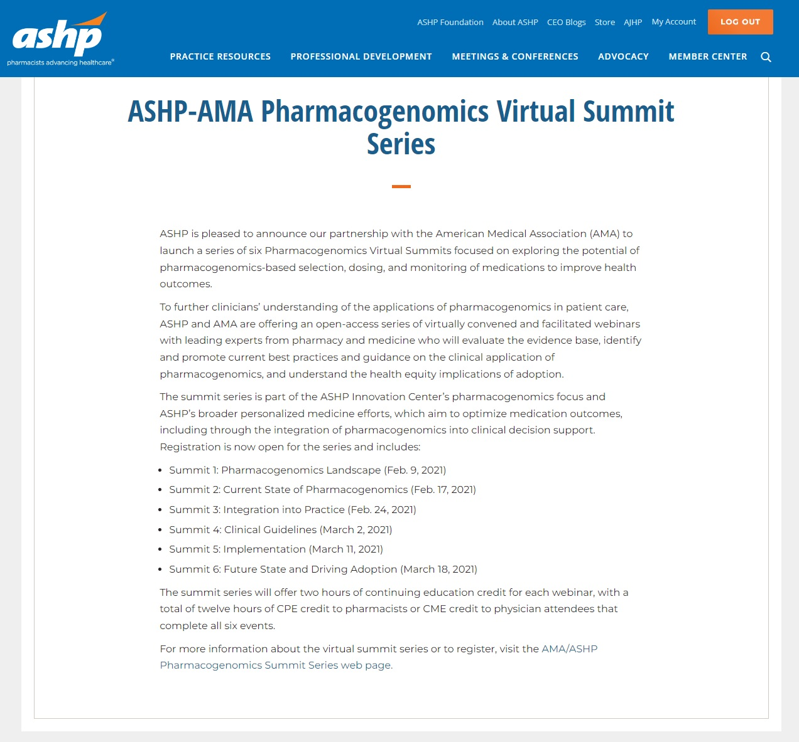
Continuing Education: PGx Summit Series

Slide 31
Reactive vs Preemptive PGx Workflow
Largest difference in workflow comes from the timing of PGx testing
Reactive Workflow
Genotype test recommended by pharmacist to patient care provider
Usually due to medication failure or side effects
Easier to implement, but requires ADE to occur and react
Preemptive Workflow
Genotype test flagged by EHR as patient already has genotyping or prescriber initiates based on professional judgement
Can also be initiated by protocol, requiring patient opt-out
Difficult to implement, requires more resources, but also helps prevent ADEs

Slide 32
PGx Panels
Commercially available panels
Advantages: generating genetic data, and often translating to phenotype, is handled by the private company
Disadvantages: not able to customize panel to patient/practitioner needs,
Designing panels for in-house testing
Advantages: full control of panel design; ease of communication and sample/data transfer
Disadvantages: full laboratory faculty and staff needed to perform testing; reimbursement
When determining panel design or company to use:
Consider your patient population, what specialties will you be working with?
What are the clinically actionable genes associated with treatments in this area of specialty? How often are these treatments prescribed?

Slide 33
Summary
Precision medicine is a significant research initiative with the NIH, and pharmacogenomics is an important component
Pharmacogenomics relates to many areas of clinical pharmacology, and its significance is evident with growing guidelines and labeling requirements
PGx Implementation is most successful as a team-based effort with involvement from a wide variety of healthcare professionals
There are many options to consider when designing a clinical pharmacogenomics program, with differences in workflow and testing panels that can impact your service

