Slide 1
Bioethics in Precision Medicine
JEREMY R. GARRETT, PH.D.
Children’s Mercy Bioethics Center
University of Missouri-Kansas City

Slide 2
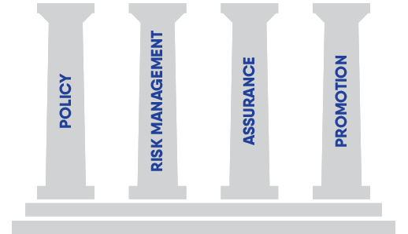
Principles of Bioethics

Slide 3
GENETIC EXCEPTIONALISM
The view that genetic information is “exceptional” in nature and, hence, requires new ethical, social, and legal constructs to regulate and guide how people access and use this information.
In other words, this view calls into question the adequacy of traditional bioethical principles and frameworks for this domain.

Slide 4
GENETIC EXCEPTIONALISM
Compared to other medical information, genetic information may seem:
Highly relevant to individual identity
Deeply intertwined with those to whom one is biologically related
More comprehensive or all-encompassing
More predictive and impactful to one’s future life story

Slide 5
TWO “EXCEPTIONAL” ETHICAL CONSTRUCTS
Principle of
Non-Directiveness
Right to an
Open Future

Slide 6
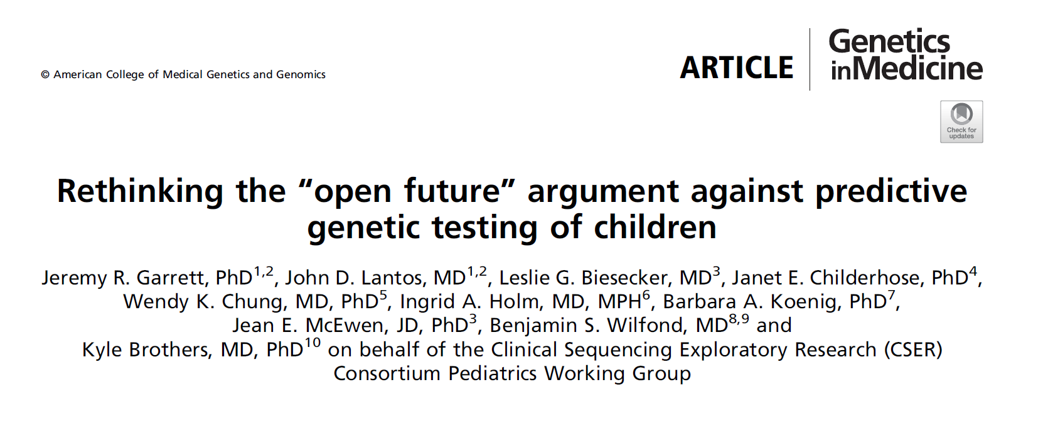

Slide 7
Kinsley
Kinsley is a 2-day old infant in the newborn nursery at a large academic medical center. Local investigators are conducting a study examining the potential utility of genome sequencing in newborns, with both a Neonatal Intensive Care Unit (NICU) arm and a “well baby” arm. Kinsley qualifies for the “well baby” arm, and her parents are approached for participation in the study.
The study coordinator explains that they will only receive results for pediatric conditions. If a finding indicating risk for an adult-onset condition is identified, it will not be returned. They give permission for Kinsley to participate.

Slide 8
Kinsley
Six weeks later, the analysts examining Kinsley’s genome discover that she carries a pathogenic variant in the BRCA2 gene, indicating risk for hereditary breast-ovarian cancer syndrome. They report this to the study principal investigator.
They are aware that the study protocol states that results related to adult-onset conditions will not be disclosed to parents, but they feel a strong moral obligation for the study to disclose this information to the parents.

Slide 9
Central Ethical Question
When and under what conditions should disclosing predictive genetic information about children—i.e., information related to adult-onset conditions, risk factors, and/or carrier status—be considered obligatory, prohibited, or merely permissible?

Slide 10
COMPETING CONCEPTUAL FRAMEWORKS
RIGHTS-BASED
INTERESTS-BASED
Singular focus on:
Child
Future
Autonomy
Broader focus on:
Child + Family
Future + Present
Multiple Interests

Slide 11
EARLY CONCEPTUAL FRAMEWORK
The Child’s Right to an Open Future

Slide 12
THREE TYPES OF RIGHTS
Rights held only by autonomous adults
E.g. Right to Vote
Rights held by both adults & children
E.g. Right to Bodily Integrity
Rights held primarily by children
E.g. Dependency Rights & Rights-in-Trust

Slide 13
THE RIGHT TO AN OPEN FUTURE
"When sophisticated autonomy rights are attributed to children who are clearly not yet capable of exercising them, their names refer to rights that are to be saved for the child until he is an adult, but which can be violated “in advance,”…before the child is even in a position to exercise them…”
Joel Feinberg

Slide 14
THE RIGHT TO AN OPEN FUTURE
“…The violating conduct guarantees now that when the child is an autonomous adult, certain key options will already be closed to him. His right while he is still a child is to have these future options kept open until he is a fully formed, self-determining adult capable of deciding among them.”
Joel Feinberg

Slide 15
INTELLECTUAL
CONTEXT OF FEINBERG’S ARGUMENT
Retrospective Analysis of 1972 SCOTUS Case
Wisconsin v. Yoder, which ruled in favor of exempting Amish from compulsory school attendance law

Slide 16
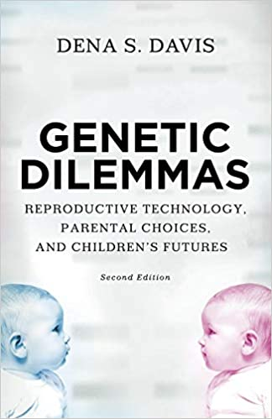
EXTENSION OF ROF TO PREDICTIVE GENETIC TESTING OF CHILDREN
“[Predictive genetic testing] is a decision each individual can make only for herself. Thus respect for the child’s right to an open future supports the growing consensus in the United States against allowing parents to choose such testing for their children.”

Slide 17
Strong Professional Consensus Against Testing For or Disclosing Predictive Genetic Information
American Society of Human Genetics & American College of Medical Genetics (1995-2015)
U.K. Clinical Genetics Society (1995-2010)
American Academy of Pediatrics (2001-2013)
Canadian Paediatric Society (2003-Present)
European Society for Human Genetics (2009-Present)
National Society of Genetic Counselors (2012-Present)

Slide 18
The Presupposition of Genetic Exceptionalism
“the unique potential of
pre-symptomatic genetic testing to predict a child’s future” entails such testing “should be approached with great caution”
ASHG/ACMG (1995-2015)

Slide 19
U.K. CLINICAL GENETICS SOCIETY
1995-2010
“Respect for autonomy” entails that “formal genetic testing should generally wait until the ‘children’ request such tests for themselves,
as autonomous adults.”

Slide 20
AMERICAN ACADEMY OF PEDIATRICS
2001-2013
Predictive genetic testing “inappropriately eliminates the possibility of future autonomous choice by the person”;
thus, “pediatricians should
decline requests from parents or guardians…until the child has
the capacity to make the choice.”

Slide 21
NATIONAL SOCIETY OF GENETIC COUNSELORS
2012-Present
“Predictive testing should optimally be deferred until the individual has the capacity
to weigh the associated risks, benefits, and limitations of this information,
taking his/her circumstances, preferences,
and beliefs into account to preserve his/her autonomy and right to an open future.”

Slide 22
Any decision made for children regarding PGT will affect their future.
Each opens up some options, while closing others (sometimes permanently).
In particular, disclosing information about future risk rules out
the child and/or family
not knowing that information.

Slide 23
However, delaying testing/disclosure until adulthood also is a decision made for the child in childhood.
Moreover, this decision also may close off important opportunities.
In particular, many test results:
alleviate anxiety & uncertainty
inform planning for future health condition
help child/family prioritize & maximize what matters most when quality or length of life will be limited

Slide 24
Either way, fiduciaries must make a decision for the child in childhood and cannot avoid opening some options while closing others.
As such, it is inappropriate to privilege some decisions about PGT and fervently discourage others by appeal to a “right” to an open future.

Slide 25
EMERGING CONCEPTUAL FRAMEWORK
The Open Future as
One Among Many Important Interests
to Weigh and Balance

Slide 26
An open future is best understood not as a separate principle of pediatric bioethics
but instead as one component of its traditional focus on interests, which involves balancing benefits and harms to children and families.

Slide 28
We can (and often should) protect future interests of children, including deferring important but non-urgent decisions until they have greater capacity to participate.
An interest framework does this while also accounting for the many other (future & present) interests of the child and other stakeholders.

Slide 29
It bypasses the question of whether disclosing information will foreclose some future option.
(Any decision will do that.)
Instead, it redirects focus to whether child’s full set of interests are better served by opening or closing certain futures.

Slide 30
In some cases, it will be reasonable to close off some future choices (even permanently) to promote other interests.
In other cases, it will be in a child’s best interest to produce/preserve openness.
Individual families working with chosen care providers are best positioned to identify & balance relevant interests
in specific cases.

Slide 31
Kinsley
The analysts examining Kinsley’s genome discover that she carries a pathogenic variant in the BRCA2 gene, indicating risk for hereditary breast-ovarian cancer syndrome.
The lab analysts and PI are aware that the study protocol states that results related to adult-onset conditions will not be disclosed to parents, but they feel a strong moral obligation for the study to disclose this information to the parents.

Slide 32
Kinsley
The study team brings the lab’s concerns to the IRB. Together, they decide to change the protocol and allow the disclosure of findings for adult-onset conditions. Kinsley’s parents are reconsented on the new protocol and informed of her BRCA2 variant.
In follow-up testing, Kinsley’s mother, Tina, finds that she has the same BRCA2 variant.

Slide 33
Kinsley
Tina undergoes breast MRI and mammography, and a small tumor is discovered. She undergoes bilateral mastectomy, and the mass is found to be an early-stage malignancy.
She is convinced that Kinsley’s sequencing results saved her life.

Slide 34
Kinsley
An interest-based framework can consider…
Potential benefits to Kinsley’s mother and (indirectly) to Kinsley from her mother avoiding morbidity & mortality
Possibility of deferred decision being “lost” later, weighing Kinsley’s interest in deciding later with her interest in not missing an opportunity to receive important genetic information that otherwise may be unavailable.

Slide 35
Life
Health and health care
Basic needs
Protection from neglect and abuse
Emotional development
Play and pleasure
Education and cognitive development
Expression and communication
Interaction
Parental relationship
Identity
Sense of self
Autonomy
Interests to Evaluate when Making Decisions for Children
(From Malek 2009)

Slide 36
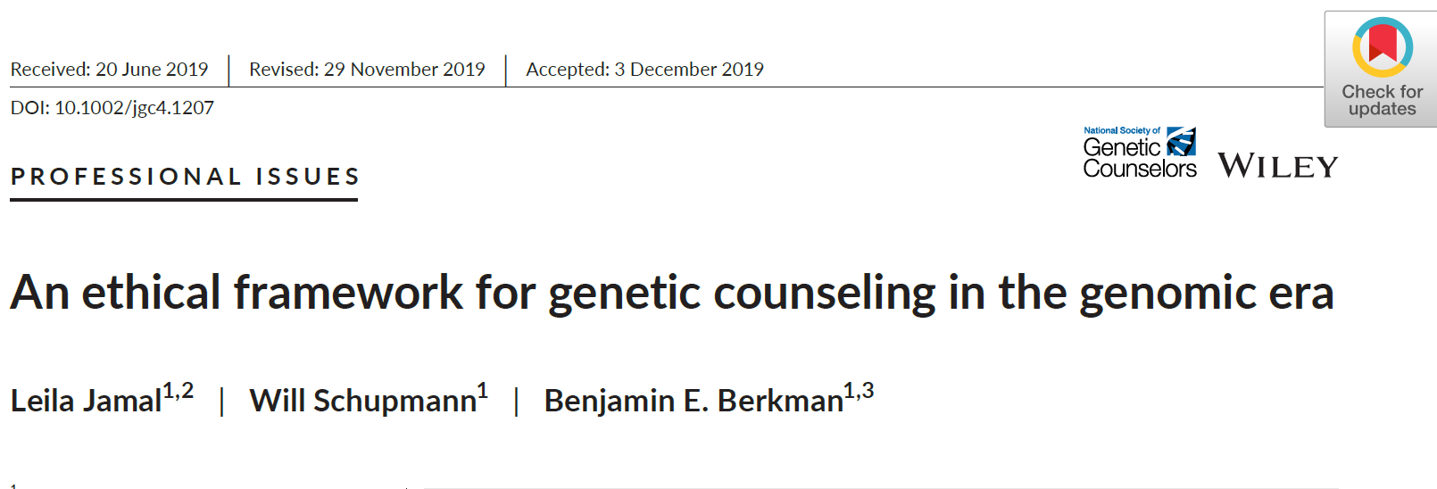

Slide 37
Mei & Albert
Mei is a 33-year-old woman whose 38-year-old sister was recently diagnosed with breast cancer. In addition, Mei’s paternal grandmother had breast cancer in her 30’s and a paternal cousin was diagnosed with breast cancer at 35.
Mei has recently become engaged and has come with her fiancé, Albert, to discuss genetic testing based on this family history.

Slide 38
Mei & Albert
Over the course of counseling, Albert has indicated that he would be reluctant to have children with Mei if she were diagnosed with a cancer-causing mutation and so has pushed her to undergo testing.
Mei plans to have children regardless of the outcome of testing and thus is ambivalent about pursuing testing even though she understands it could be important for protecting her future health.

Slide 39
Central Ethical Question
When and under what conditions should directive guidance based on genetic information—i.e., guidance directing a patient/family/client toward a particular decision or course of action—be considered obligatory, prohibited, or merely permissible?

Slide 40
COMPETING CONCEPTUAL FRAMEWORKS
NON-DIRECTIVENESS
ETHICAL RECOMMENDATION
Neutral
Universal
Client Autonomy
Clinical Judgment
Nuanced & Tailored
Beneficence &
Non-Maleficence

Slide 41
EARLY CONCEPTUAL FRAMEWORK
Principle of Non-Directiveness

Slide 42
HISTORICAL ORIGINS OF PND
The ethos of non-directiveness emerged as a counter-response to the use of genetic information to organize eugenics movements across the world in the early 20th century, culminating in the race hygiene programs of Nazi Germany.

Slide 43
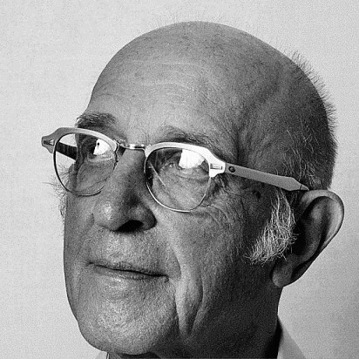
HISTORICAL ORIGINS OF PND
During that same Post-WWII period, the intellectual climate was ripe for PND to take root in the emerging field of genetic counseling.
The psychologist, Carl Rogers, introduced non-directiveness in his person-centered approach to therapy & counseling more generally.
Meanwhile, the geneticist, Sheldon Reed, coined the term “genetic counseling” & advocated for a non-directive client-centered approach.

Slide 44
OBJECTIONS TO PND
NEUTRALITY IS IMPOSSIBLE.
Genetic counselors are humans with
personal attitudes and values and can
never truly prevent these from informing
their counseling practice.
NON-DIRECTIVENESS IS INCONSISTENT WITH PROFESSIONAL MEDICAL PRACTICE.
Sharing all options (even those not medically
recommended) can overwhelm & confuse,
rather than empower, clients. And simply
providing options without recommendations
is deeply at odds with most medical care.

Slide 45
EMERGING CONCEPTUAL FRAMEWORK
The Ethical Recommendation Model

Slide 46
THE ETHICAL RECOMMENDATION MODEL
Jamal et al. state their core claim as follows:
“…owing to the expanded scope and complexity of genetic counseling work, the profession should favor a more explicitly normative framework that gives genetic counselors broader license to make recommendations while operating within a well-defined scope of practice.”
They argue for the need to:
Balance beneficence/non-maleficence with autonomy
Operate with a broader relational notion of autonomy
Consider the family as a unit of significance

Slide 47
RELATIONAL THEORY
Conceptualizes genetic counseling as:
a “form of time-limited, highly circumscribed psychotherapy”
with the goal of establishing a therapeutic relationship to meet the “emotional and informational needs” of patients/clients.

Slide 48
RELATIONAL
AUTONOMY
Shifts away from viewing persons as independent, purely rational actors. Instead:
Recognizes persons as “socially embedded”
“Captures the interplay between individual and familial interests”
“Develops a relational bond with a patient to produce meaningful guidance”
“Encourages attention to emotional needs of patients and their family members”

Slide 49
Six Considerations
for Ethical Recommendations
Pertaining to Content of Counseling
Goal of Counseling
Clinical Relevance of Genetic Information
Informational Burden of Test Options or Results
Pertaining to Relational Aspects of Counseling
Relational Considerations
Role-based Considerations
Familial Considerations

Slide 50
Genetic counseling serves a diverse array of goals from the mundane & technical (providing information about test options) to the controversial & emotionally fraught (decision-making about abortion or facilitating adaptation to grief and loss).
UPSHOT → More purview to provide recommendations when goal is to impart technical information or to facilitate a goal that is widely understood to be good (minimizing pain) and less purview when touching on strongly held or differing conceptions of what is good.
GOAL OF COUNSELING

Slide 51
Some genetic findings are more “actionable” than others depending on:
Severity & likelihood of clinical outcome
Effectiveness of interventions
Financial and family planning
Lifestyle decisions
UPSHOT → When genetic information would clearly benefit the patient’s health, GCs are duty-bound by beneficence to make recommendations.
CLINICAL UTILITY OF GENETIC INFORMATION

Slide 52
Genetic testing often provides complex information & uncertain results
Healthcare providers sometimes over-interpret genetic results and inappropriately use them to guide medical treatment
UPSHOT → Genetic counselors have unique expertise to interpret results and thus should recommend evidence-based action to patients and colleagues
INFORMATIONAL BURDEN OF TEST OPTIONS/RESULTS

Slide 53
Two aspects of a counseling relationship are particularly ethically salient:
Degree to which empathy has been established
Degree of shared cultural understanding
UPSHOT → More purview to recommend when relationship is closer and more therapeutic and more culturally synchronized. Conversely, special attention and humility are necessary when there are wide gaps in experience and identity between the counselor and the client.
RELATIONAL
CONSIDERATIONS

Slide 54
The institutional setting of counseling affects ethical responsibilities.
CLINICAL → Counselors have the “most explicit duties to maximize benefits and minimize harms” of testing & information
RESEARCH → Counselors are often limited, but can have duties to recommend (especially with rare diseases) and also to discuss limits of research and alternatives.
INDUSTRY → Counselors must recognize COIs and work to mitigate them by being transparent about conflict. This may include making direct recommendations to patient about which tests they pursue and where they get information.
ROLE-BASED
CONSIDERATIONS

Slide 55
Genetic information often has relevance for family members and can be shared w/ them for two reasons:
TO BENEFIT FAMILY MEMBERS
No consensus on whether genetic counselors should share medically useful information with family members for their separate benefit, but Jamal et al. argue disclosure should be default unless strong reasons for privacy.
TO BENEFIT THE PATIENT
In some cases, familial testing will benefit the initial patient by providing additional information that will improve the interpretation of genetic testing results.
In both cases, focusing solely on the individual undergoing testing excludes benefits and harms that accrue to the wider family circle and are important to consider in determining when to make recommendations.
FAMILIAL
CONSIDERATIONS

Slide 56
Applying the
Six Considerations
to Mei & Albert
Goal of Counseling
Clinical Relevance of Genetic Information
Informational Burden of Test Options or Results
Relational Considerations
Role-based Considerations
Familial Considerations

Slide 57
An Ethical Recommendation for Mei & Albert
Jamal & colleagues would likely conclude that the counselor should recommend (and not merely neutrally present) testing due to the clear potential for clinical benefit for Mei.
However, the counselor must also help Mei and Albert begin to discuss the impact a positive result would have on their future decisions to have children.
This would involve a detailed explanation of the likelihood of transmitting the mutation and the odds and severity of potential future illness for children who may inherit it.

Slide 58
QUESTIONS WELCOME!
jgarrett@cmh.edu
JEREMY R. GARRETT, PH.D.
Children’s Mercy Bioethics Center
University of Missouri-Kansas City

