Slide 1
Introduction to Clinical Informatics
Jake Luo, PhD
Associate Professor
Department of Health Informatics and Administration, UWM

Slide 2
About Me
About the instructor:
  Jake Luo, PhD, Associate Professor
  Department of Health Informatics and Administration
  Director of Center for Heath System Solutions
  LinkedIn: https://www.linkedin.com/in/jakeluo/
  Lab research deals with massive amount of data: patient records, clinical trials, social media, FDA drugs data, consumer comments; leveraging the data to find new knowledge to advance medicine and health care
Book: Biomedical Informatics: Computer Applications in Health Care and Biomedicine (Health Informatics)
Overall goal of this class?
  Introduce clinical informatics
  Cover major biomedical data types and common standards
  Discuss common functions of electronic health record (EHR) systems
  Describe clinical decision support systems

Slide 3
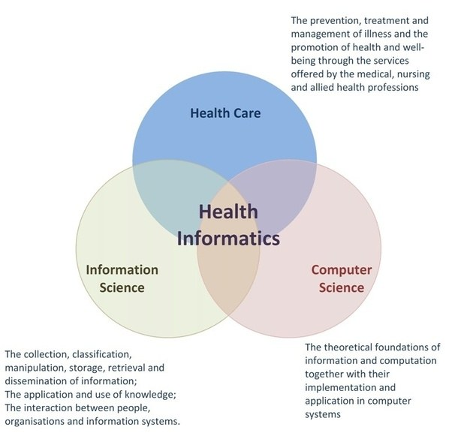
Health/Clinical
Informatics
Health Informatics is a cross-disciplinary field that lies in the intersection of information science, computer science, and health care

Slide 4
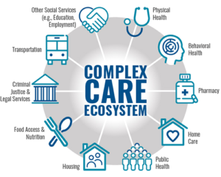
Why We Need Informatics?
Healthcare is very complex: complex business, multidisciplinary, diverse service population, happening on many levels on a person and in our society
Informatics provides systematic information strategies and solutions to support the healthcare system
Better information leads to better decisions
Better information system leads to better management and collaboration
Health services, health business management, governing and policy making all needs good information system

Slide 5
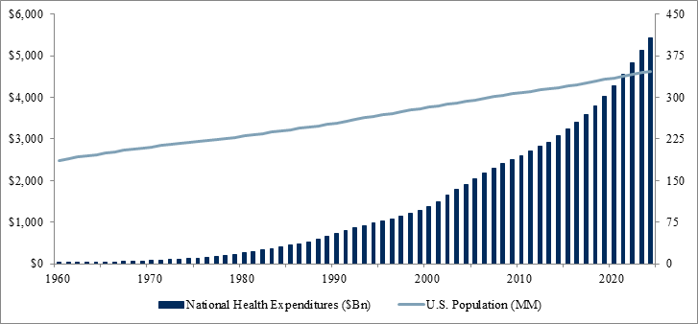
Significant Growth of Healthcare Cost
Growing population size
Aging
Shortage of labor
Healthcare Informatics is a key strategy to reduce health care cost and improve health outcome
-Improve efficiency
-Share information and knowledge
-Encourage patient participation
-Increase coordination between departments
-Improve health outcome

Slide 6

Who Involves in Health Informatics (stakeholders)
Health professionals
  Doctors (Primary / secondary care)
  Nurses
  Allied professions
Healthcare Administrators
Government and policy makers
Biomedical Researchers
Pharmaceutical Companies
IT professionals
Patients

Slide 7
Clinical Data

Slide 8
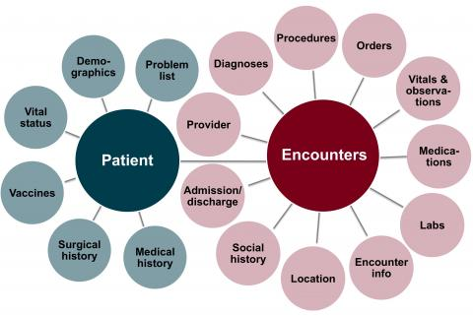
Clinical Data
Clinical data are central to health care, because they focus on patients. They are critical to the process of clinical decision making
All modern health care encounter activities involve gathering, analyzing, or using data.

Slide 9

Who collects data
Data collection team:
physician, nurse, administrator, staff, lab technician, radiologist, pharmacists, patients
Nowadays, a lot of the data are also generated by technologies,
such as vital sign sensors, wearable devices, voice-to-text summary machines

Slide 10

Health data usage scenarios
Aggregation use: public health, clinical research (P45)
Used as history of patient records (P46)
Support communication (Fig 2.5, 2.6)
Anticipate future problem (P48)
Prevention measure (P48)
Identify outliers (P49, Fig 2.7)
Clinical research (P50)
– Randomized Clinical Trials
- Retrospective Studies

Slide 11
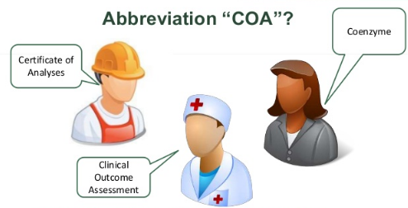
Structure of clinical data
Standardized controlled vocabulary (coding systems)
  A lack of formal definition of medical terms
  A lack of vocabulary standards
Clinical Ontology
  Clinical entities, such as disease names, lab test items, procedure names, drug names etc
  Relationships of clinical entities, such as drug -> treat - diseases

Slide 12
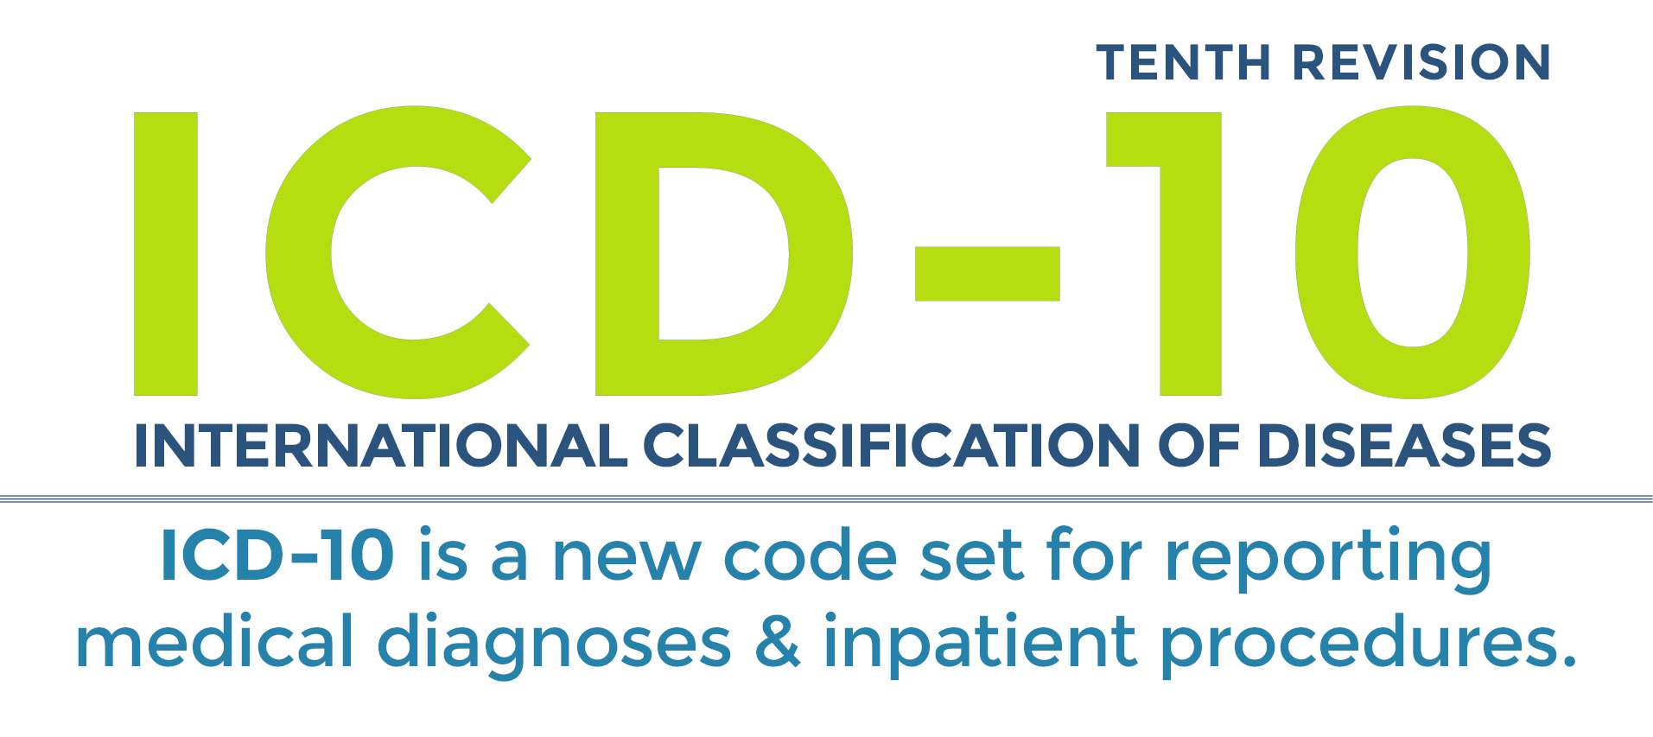

Diagnosis Coding System
ICD: international classification of diseases
SNOMED-CT: Systematized Nomenclature of Medicine – Clinical Terms

Slide 13
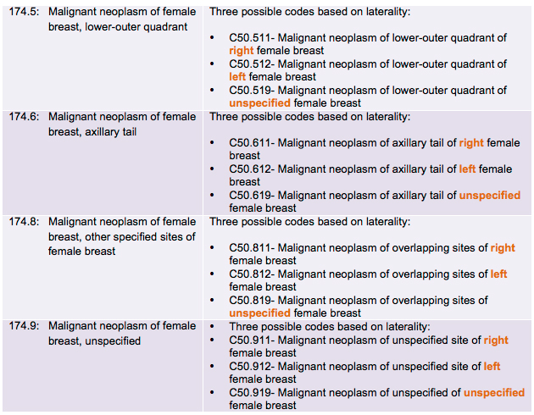
ICD code example
Commonly used in billing, insurance reimbursement, classifying patients, patient population research

Slide 14
CPT (Current Procedural Terms)
First published by American Medial Association in 1966
Commonly used in billing and reimbursement
CPT-4 is the most widely accepted in use for reporting physician procedures for insurance reimbursement
Link: https://www.ama-assn.org/practice-management/cpt-current-procedural-terminology

Slide 15
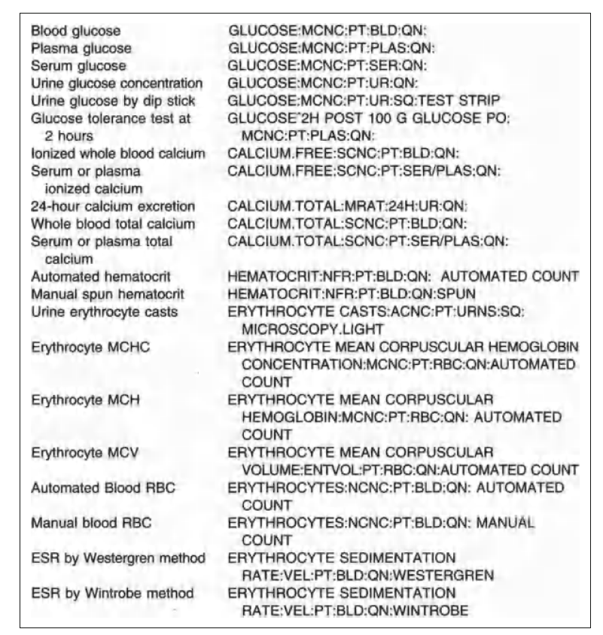
LOINC (logical observation identifiers names and codes)
For encoding lab test, lab test results, clinical observations
Link: https://loinc.org/international/

Slide 16
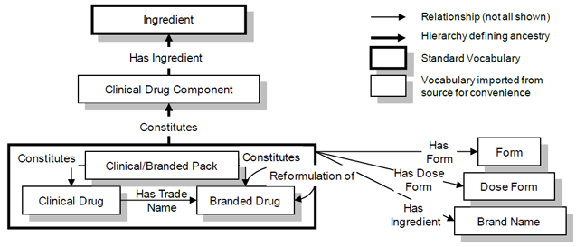
RxNORM
Collaboration result of NLM, FDA, and VA
Specialized in drug terms
Link: https://www.nlm.nih.gov/research/umls/rxnorm/

Slide 17
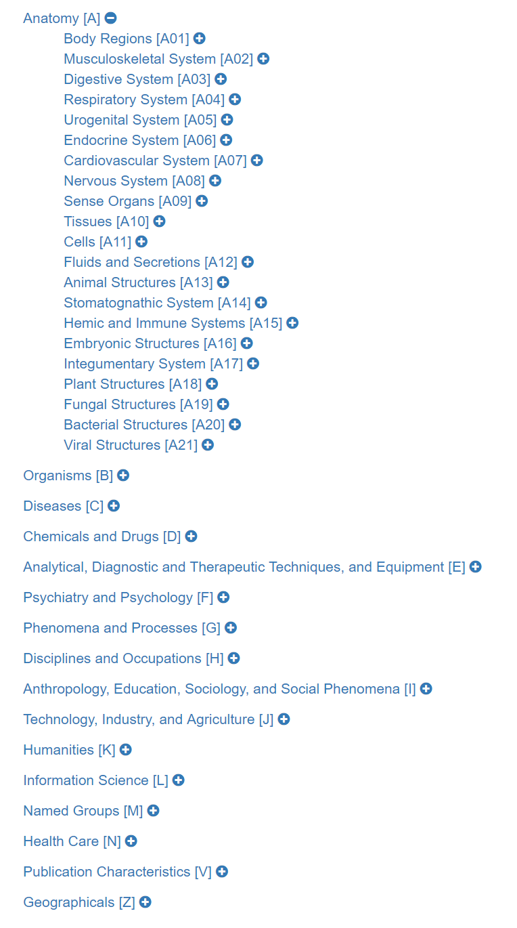
MeSH
Medical Subject Heading (MeSH) is developed and maintained by NLM
Primarily used to index and organize the topics of research publications
https://meshb.nlm.nih.gov/treeView
Demo: https://www.ncbi.nlm.nih.gov/pubmed/29109303

Slide 18
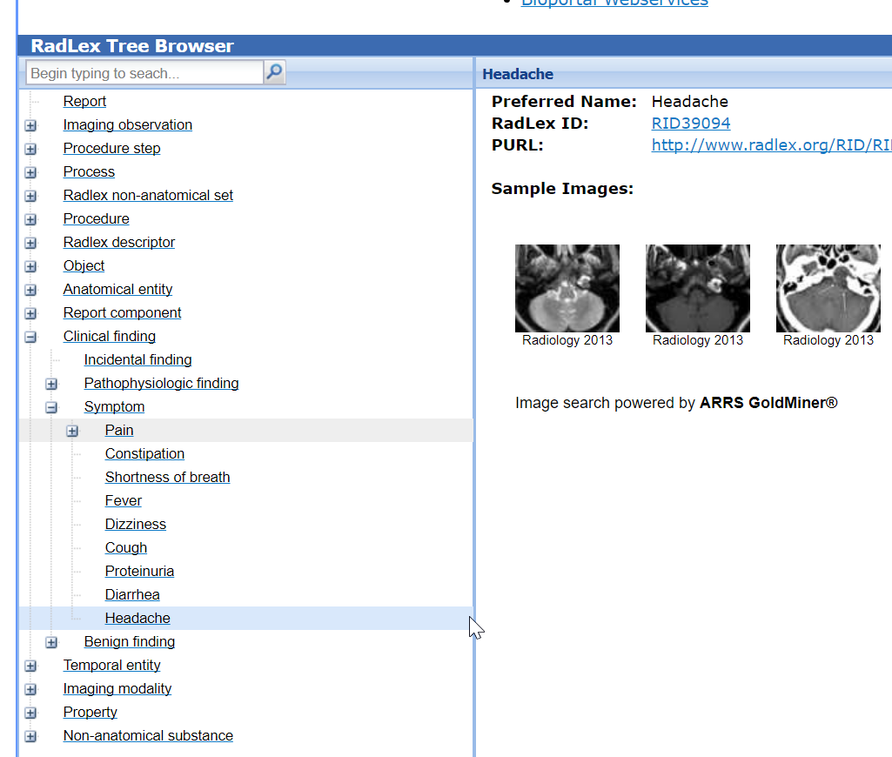
RadLex
Produced by Society of North America (RSNA)
Used in the radiology domain for indexing and information retrieval
Includes names of anatomic parts, radiology devices, exams, procedures etc.
Link: http://www.radlex.org/

Slide 19
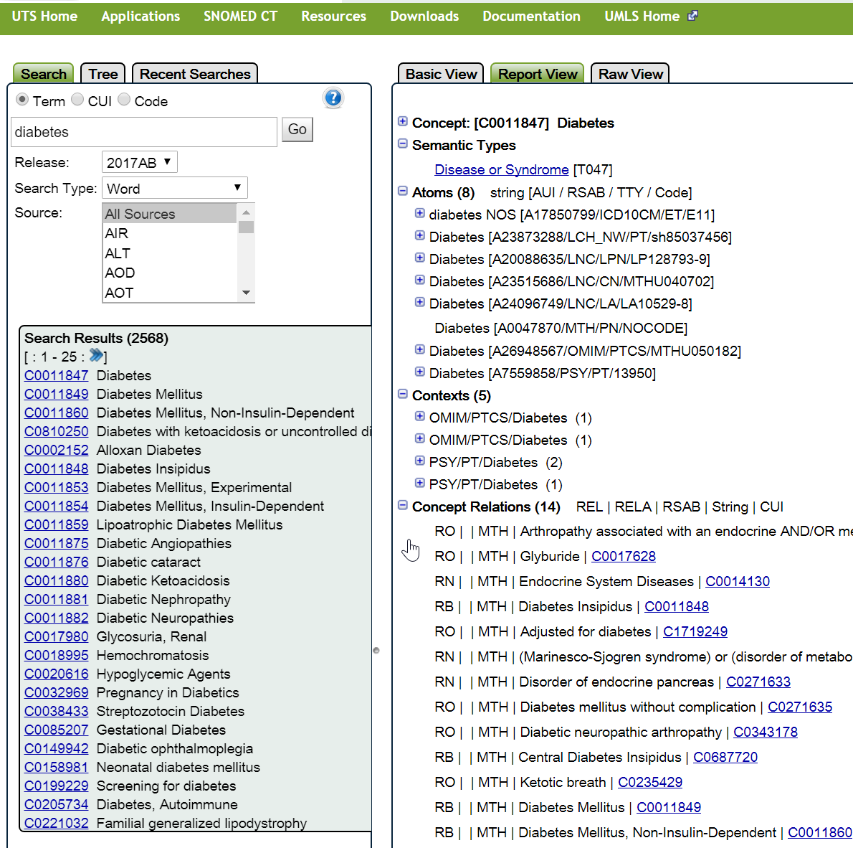
UMLS
Unified medical language system (UMLS)
Maintained by NLM and first published in 1989
Probably the largest controlled medical terminology
Metathesaurus 8.9 million terms from over 160 sources
Link: https://www.nlm.nih.gov/research/umls/

Slide 20
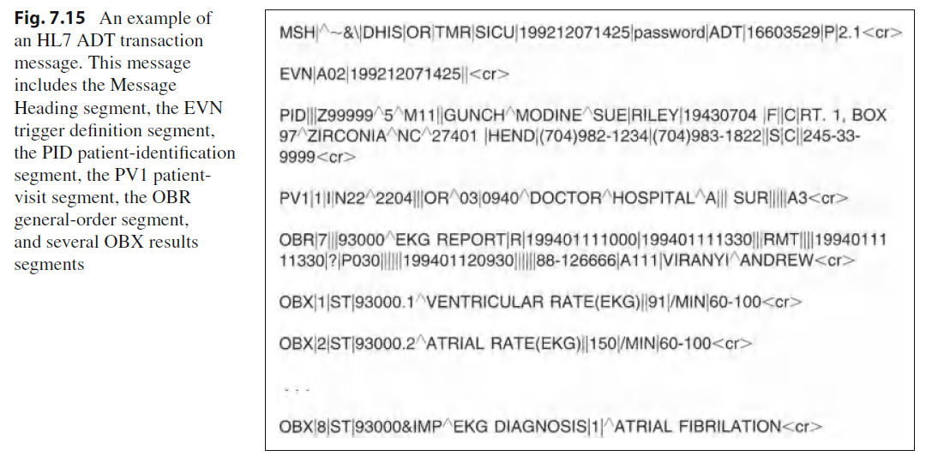
Data Interchange Standards: HL7
Version 1.0 was published in 1987.
HL7 is a messaging data interchange protocol
Link: http://www.hl7.org/

Slide 21
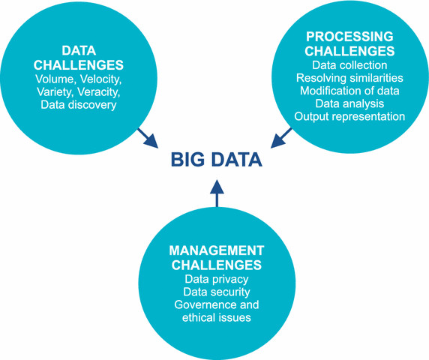
New Data Challenges
Omic data
Biomedical Data, translational data
Aggregated clinical research
Public health data
The “big data” problem

Slide 22
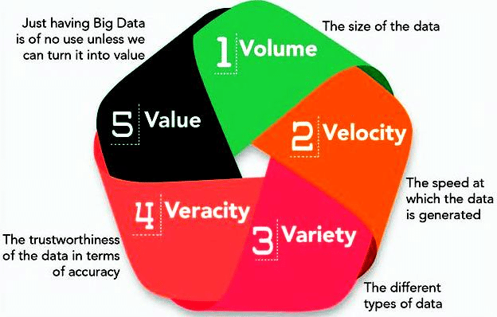
The rise of “big” clinical data
More and more clinical and biomedical data are collected in the past 20 years, such EHRs, genomic, large-scale survey, clinical trials
Very valuable for knowledge discover and advancing medical science
Can be used to create new application
How to process and leverage the data for research and application development becomes a hot topic
“Health Data Science”
Five “V”

Slide 23
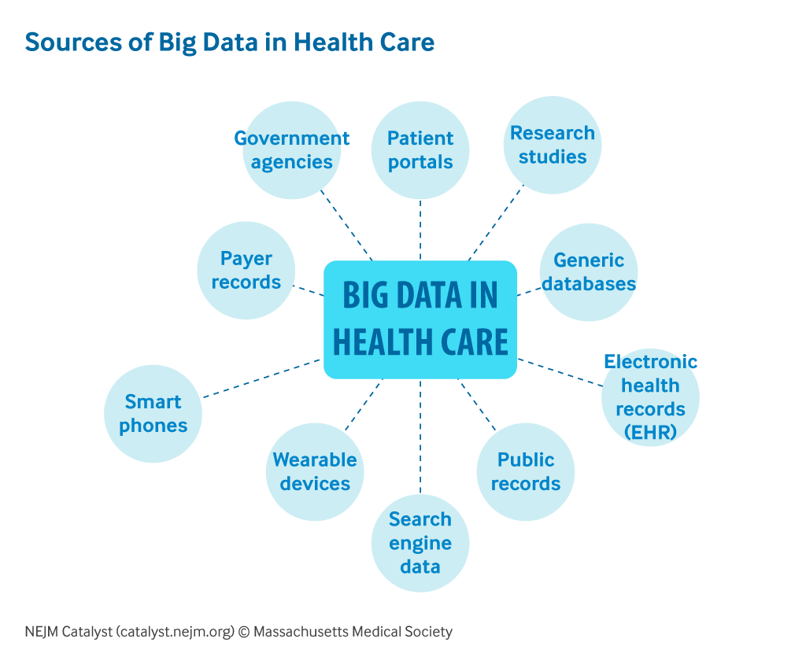
Big Data
NEJM Article:
Healthcare Big Data and the Promise of Value-Based Care

Slide 24
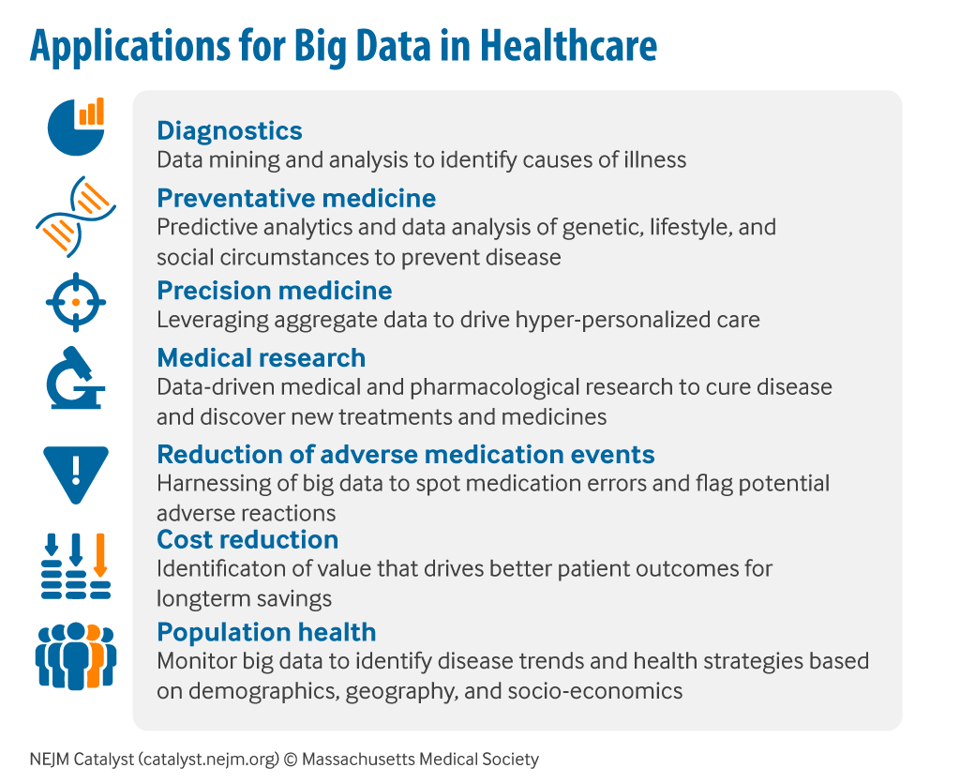
Applications of Big Data

Slide 25
Reading Materials
Clinical Informatics, clinical data, and common clinical data standards
  Recent advances of HCI in decision-making tasks for optimized clinical workflows and precision medicine.
  Healthcare Big Data and the Promise of Value-Based Care.

Slide 26
Electronic Health Record System (EHRs)

Slide 27
EHR: Electronic Patient Records
An electronic health record ( EHR ) is a repository of electronically maintained information about an individual’s health status and health care, stored such that it can serve the multiple legitimate uses and users of the record.
The term electronic health record system (also referred to as a computer-based patient record system) includes the active tools that are used to manage the information, but in common use, the term EHR can refer to the entire system.

Slide 28
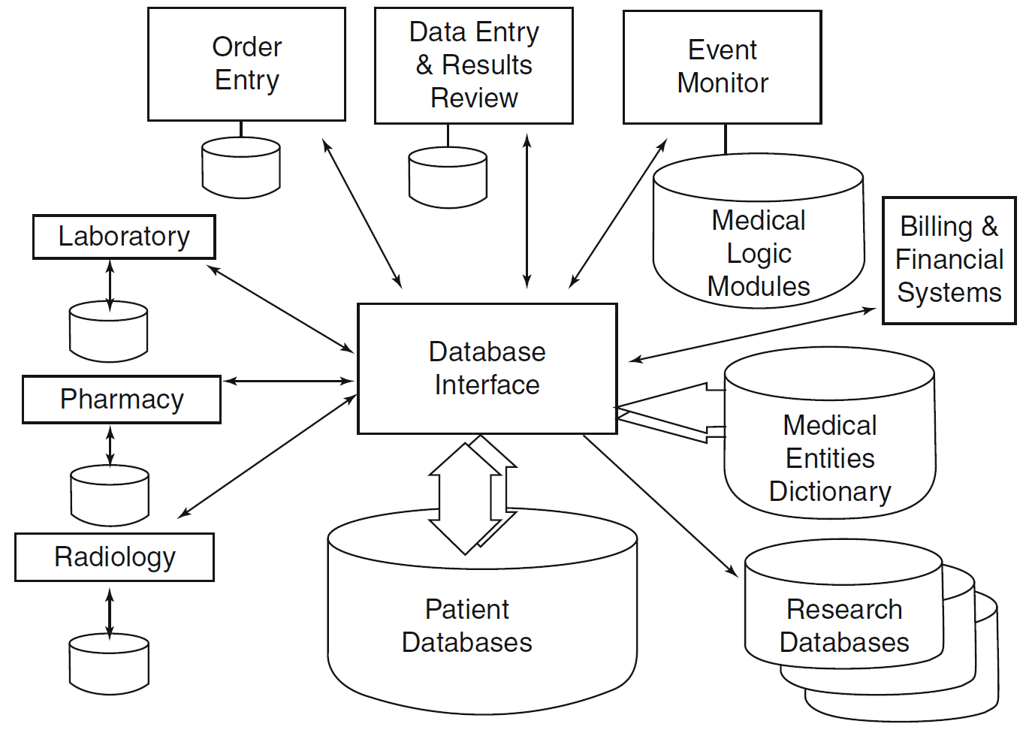
EHR: Data Perspective (P396)
Fig 12.1

Slide 29
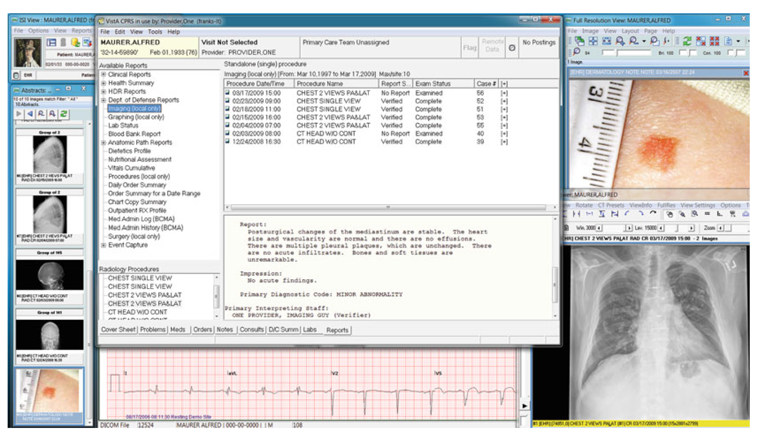
EHR Components – Integrated View
Fig 12.1

Slide 30
Order Entry
Order entry: clinicians make decisions and take actions
E.g. check vital sign three times a day, take one finasteride once a day, order blood test
Computer assist and document this process

Slide 31
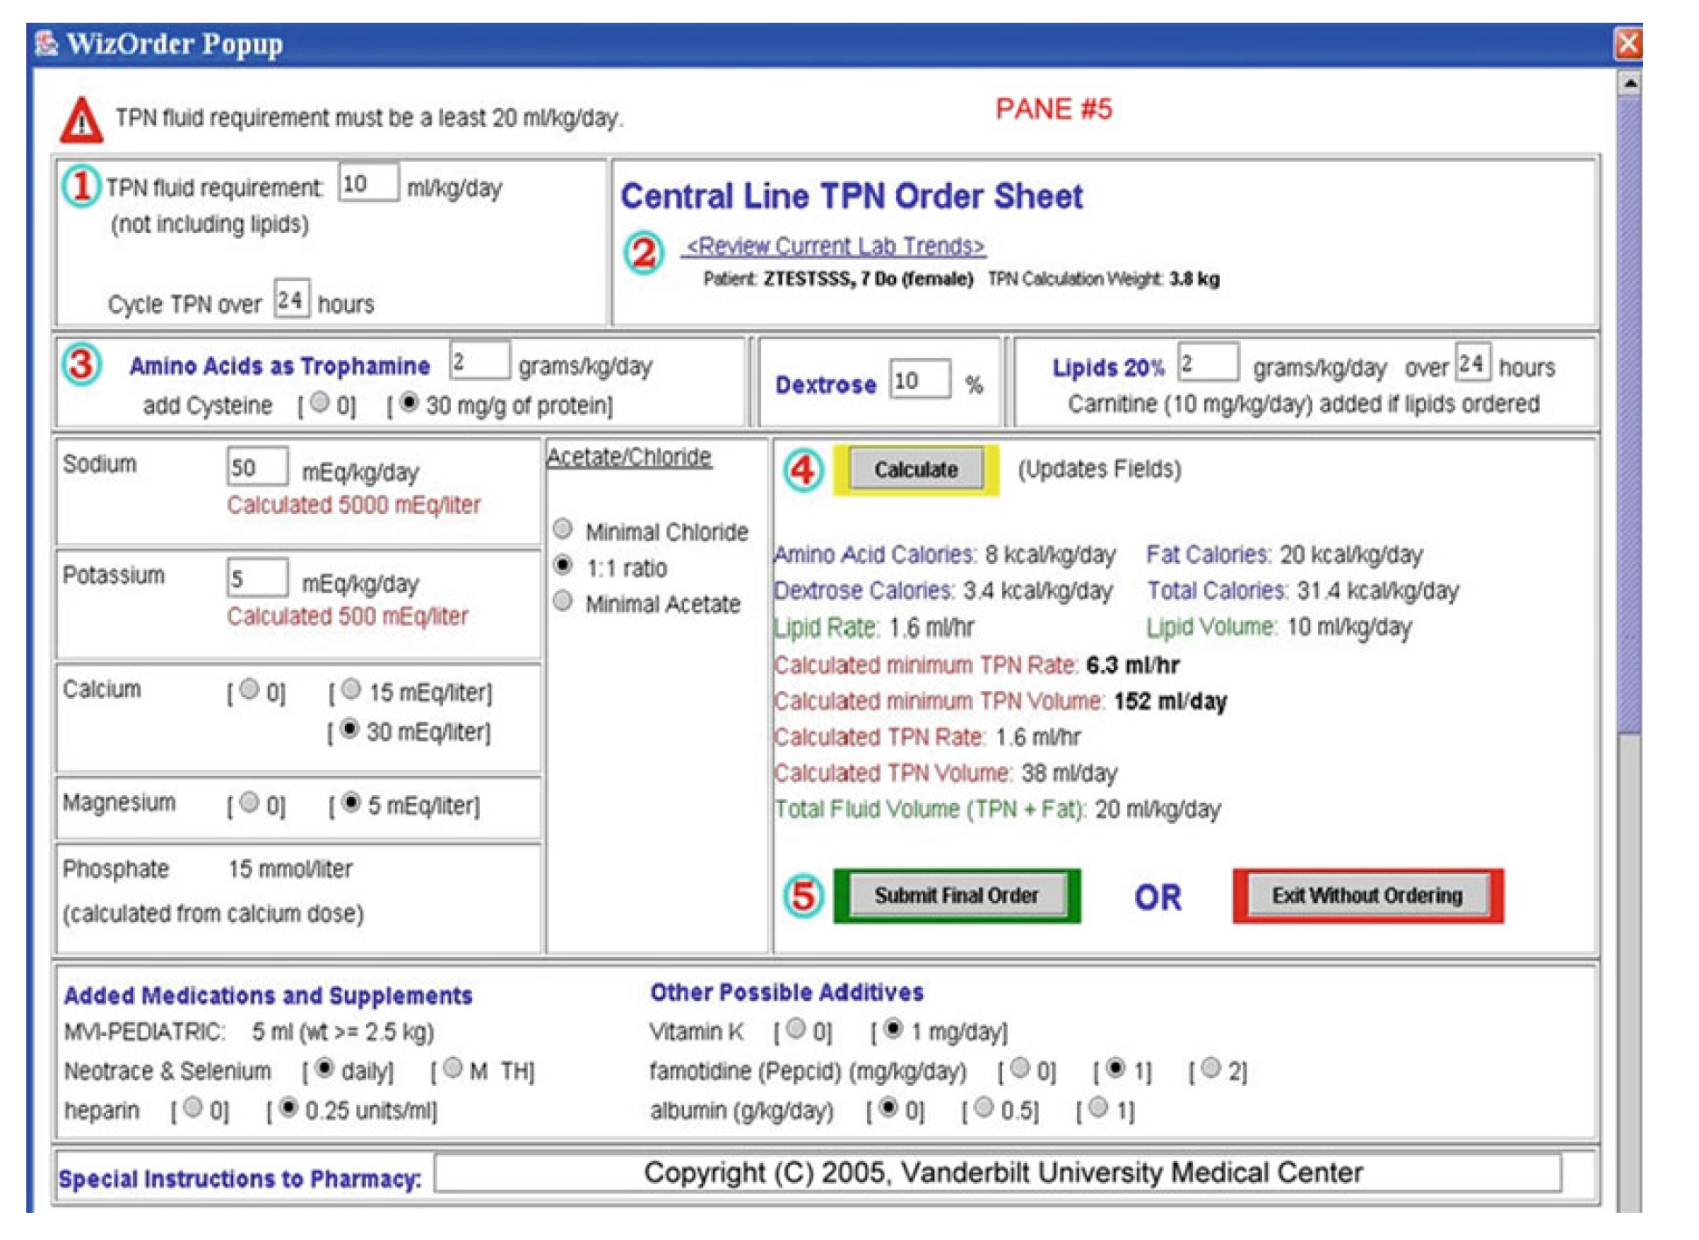
Order Entry
Example using an informatics tool
Fig 12.3
Vanderbilt Total Parenteral Nutrition (TPN)
Computerized Physician Order Entry (CPOE)

Slide 32
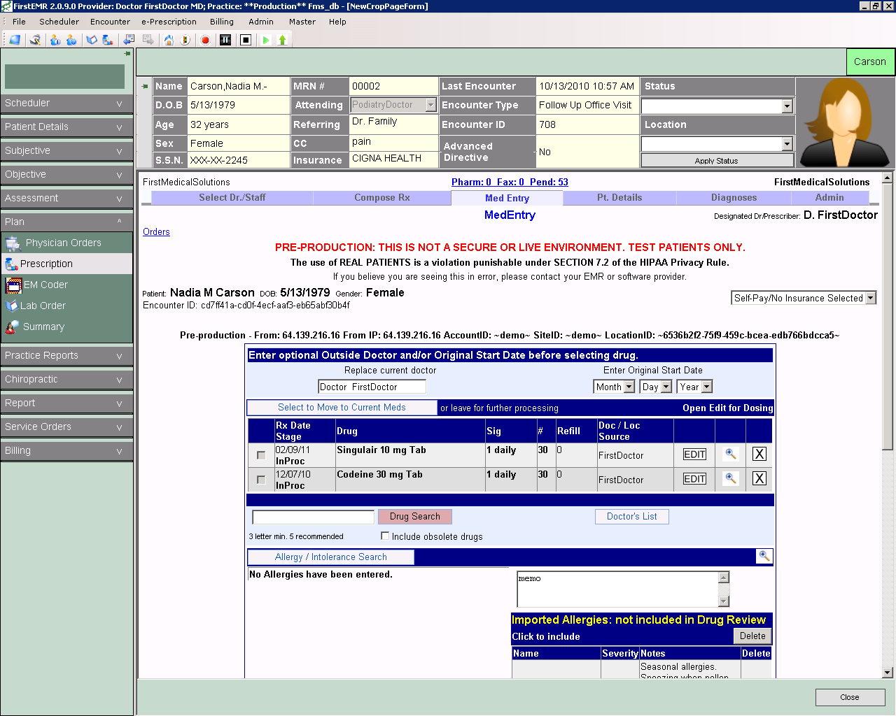
Oder Entry example 2
Drug intervention entry

Slide 33
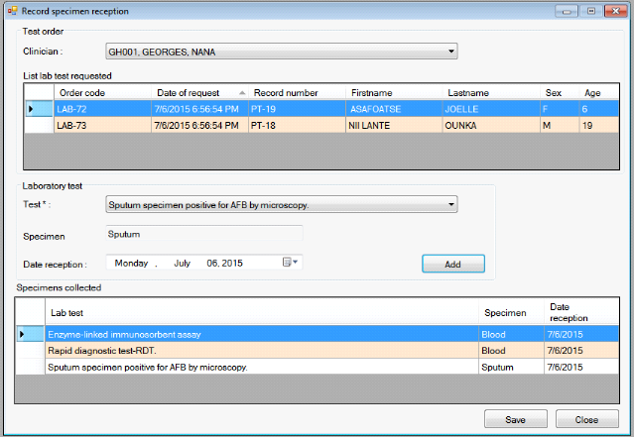
Oder Entry example 3
Lab test entry

Slide 34
Data Capture
Two common methods for data capture:
1. Using electronic interface to transfer from other systems, e.g. lab test results, drug orders
2. Manual input data, e.g. discharge summaries (narrative text input), ICD diagnosis (code input)

Slide 35
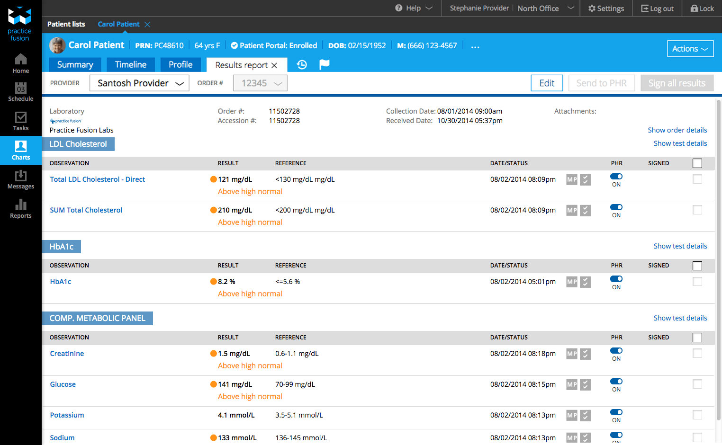
EHR lab report
Lab report data

Slide 36
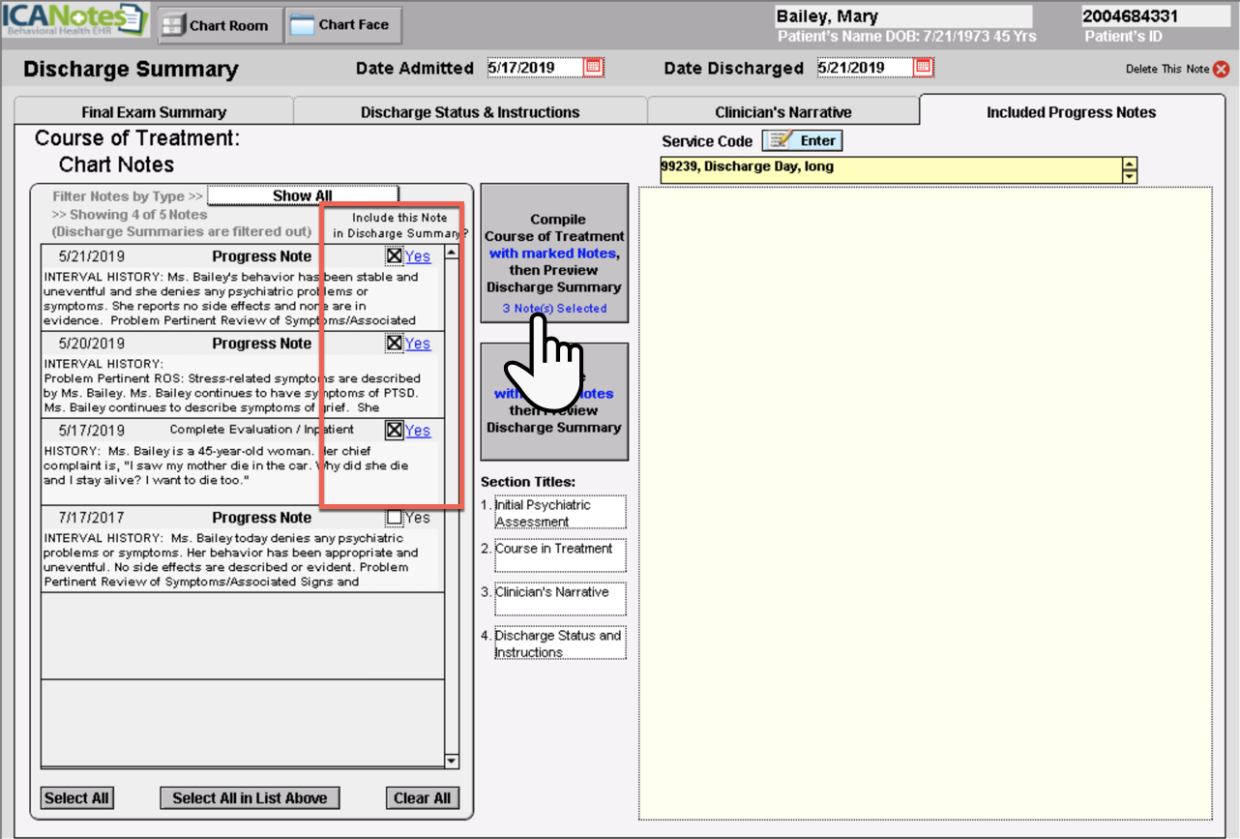
EHR discharge summary

Slide 37
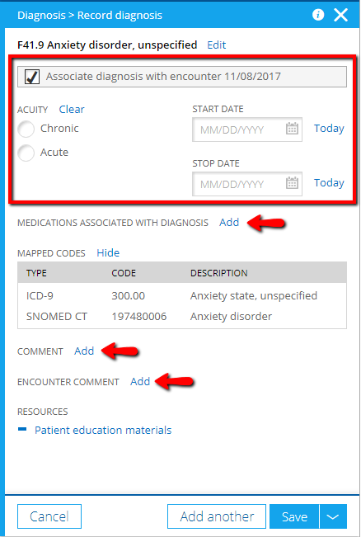
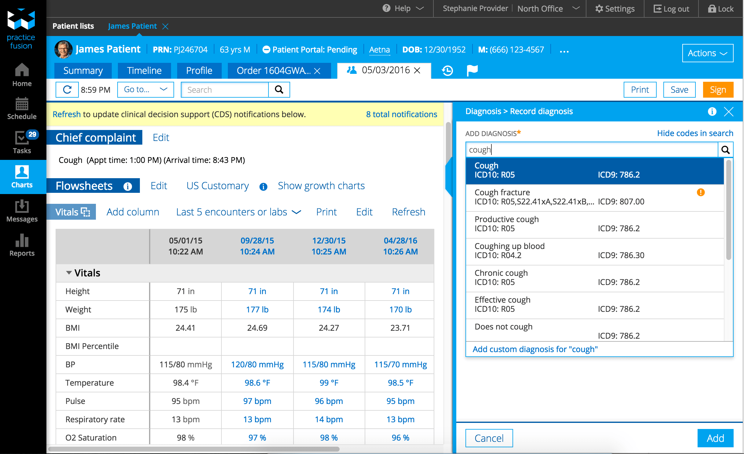
EHR ICD Code input
Diagnosis coding
Billing

Slide 38
Displaying Physician Entered Data
Charts: Problem list, medication, diagnosis
Images: x-ray, MRI
Forms: lab test results
Textual narratives: e.g., discharge summary

Slide 39
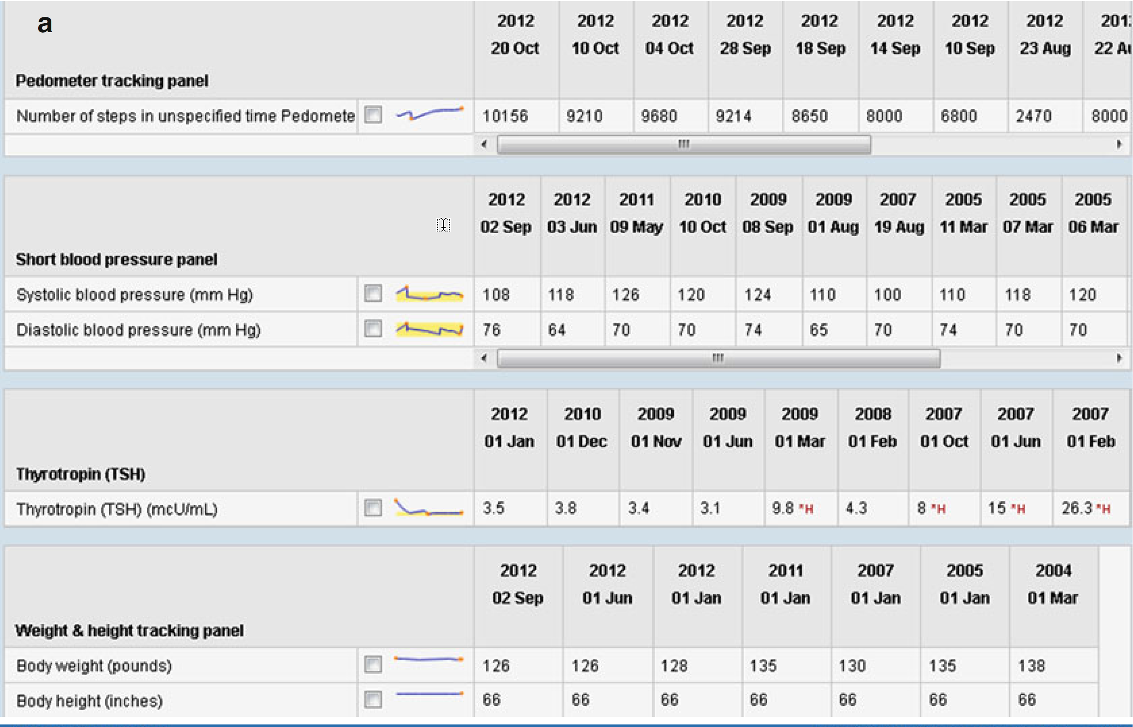
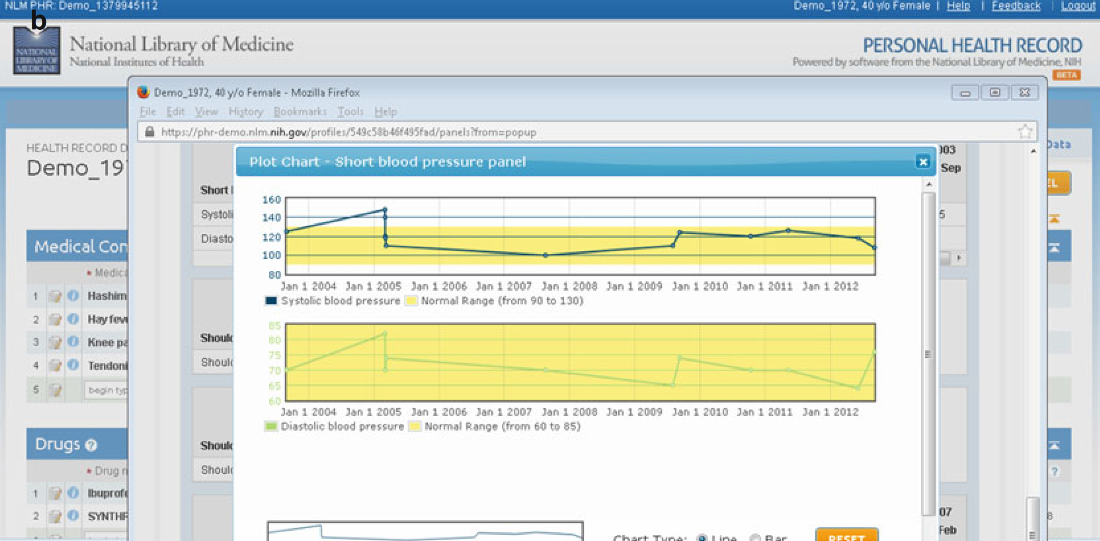
Data Display – Timeline (P412, Fig 12.12)

Slide 40
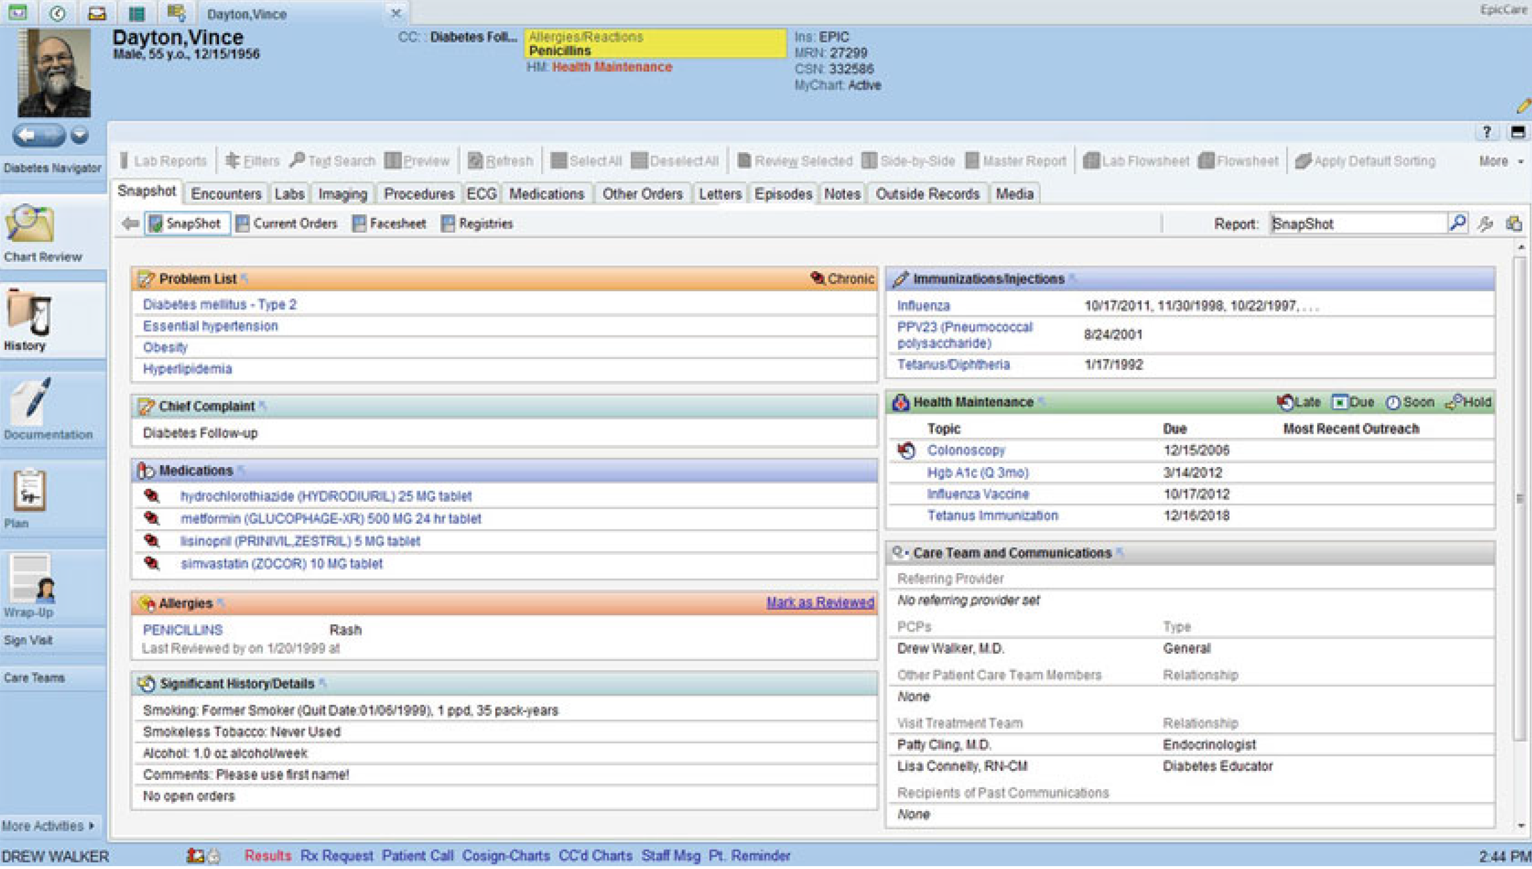
Data Display – Summaries and Snapshots (P412)
Fig 12.15 (P417)

Slide 41
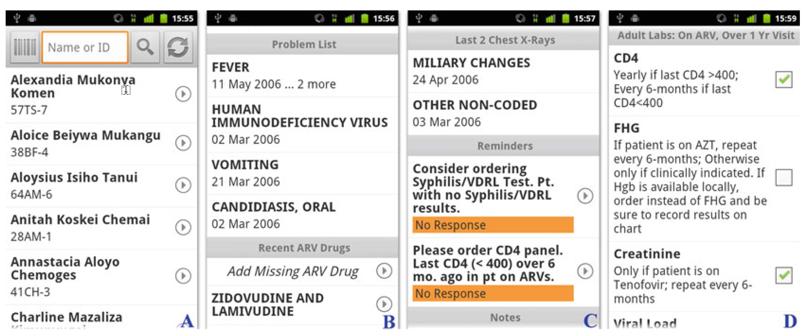
Tablet and Smart Phone Example
Fig 12.11
A) a list of patient
B, C) summaries
D) lab test results

Slide 42
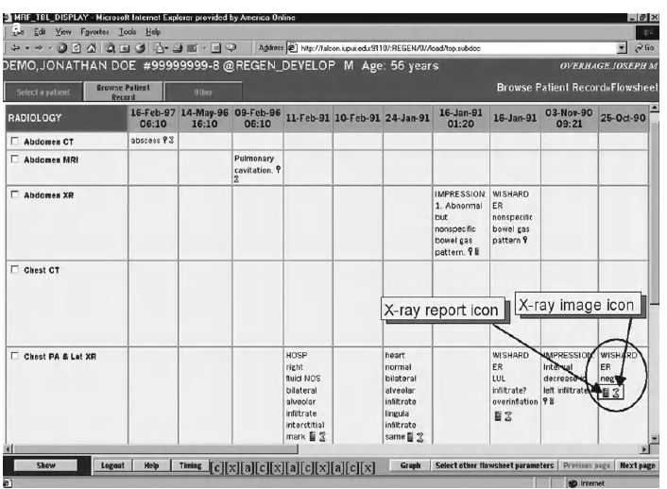
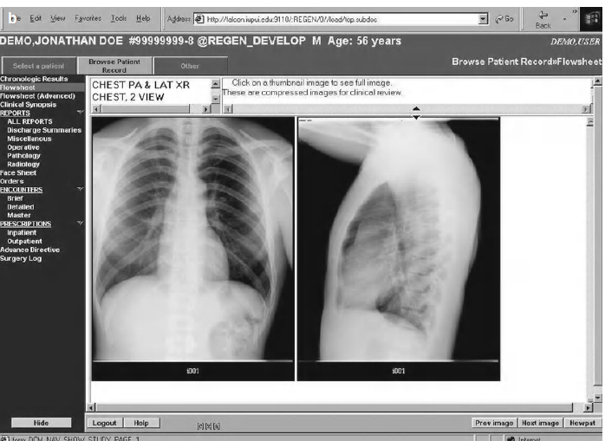
Example of imaging information (P413-414)

Slide 43
Query and Surveillance
Find data and use the searched data for analysis, such as outcome or patient patterns.
Use the results to support decision making, such as alert and notification based on query results

Slide 44
Health Service Support
Identify patients based on certain condition
For example:
  Due for periodic screening
  Generating patient calling list
  Identify patients that need to be notified about new development, such as recall of drug
  Find candidate patients for review

Slide 45
Clinical Research
Identify patient who meet eligibility criteria for clinical trials
Identify a population of patients and analyze their patterns

Slide 46
Quality Reporting
Use patient data for quality measures
For example:
  Treatment outcome
  Symptom reports
  Cost analysis
  Physician efficiency

Slide 47
Support Administration
Billing
Claim
Insurance
Time management
Resource allocation

Slide 48
Reading Materials
Roles of Electronic Health Records (EHRs) and Clinical Data
  Integrated precision medicine: the role of electronic health records in delivering personalized treatment.
  Digital Twins from Personalized Medicine to Precision Public Health

Slide 49
Clinical Decision Support System
Notes:
CDSS: adverse event alert system, order entry system

Slide 50
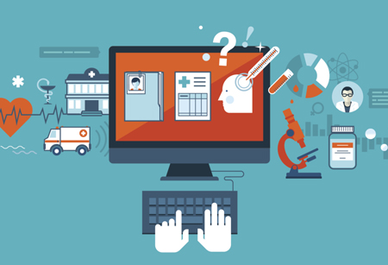
EHR: Clinical Decision Support Perspective
Clinical Decision Support (CDS): the process that provides clinicians, staff, patients, or other individual with knowledge and person-specific information, filtered or present at appropriate times, to enhance health and health care.
Clinical Decision Support Systems (CDSS)
  Informatics system offering situation-specific information and recommendation
  Provide knowledge or analysis to support decision makers
Notes:
CDSS: adverse event alert system, order entry system

Slide 51
Motivation of CDSS
Challenges of knowledge management and clinical practice
  Significant growth of data and knowledge
  Limited time for providers
  Error due to inadequate patient information
Meaningful use of electronic health records
  American Recovery and Reinvestment Act (ARRA) created widespread adoption of health information technologies (HIT)
  Achieving meaningful use of HIT: safety, quality, efficacy
Delivering personalized health services
  Personalized medicine: the need to tailor care to individual factors – personal factors (clinical and biological), family history, social and environmental factors
  Optimize well-being: not just treating diseases, but changing lifestyle and other behavior to achieve overall healthier condition
  Prospective health: risk assessment based on genomic, family history, social history, environmental history

Slide 52
“Five-rights” model of CDSS
Intervention contains complex triggers, reasoning logics, data processing, and actions, therefore it is essential to provide decision support correctly:
Provide right information
To right person
In the right format
Through the right channel
At right time
Can be viewed as general guidelines for designing CDSS
Right Information
Right Person
Right Format
Right Channel
Right Time

Slide 53
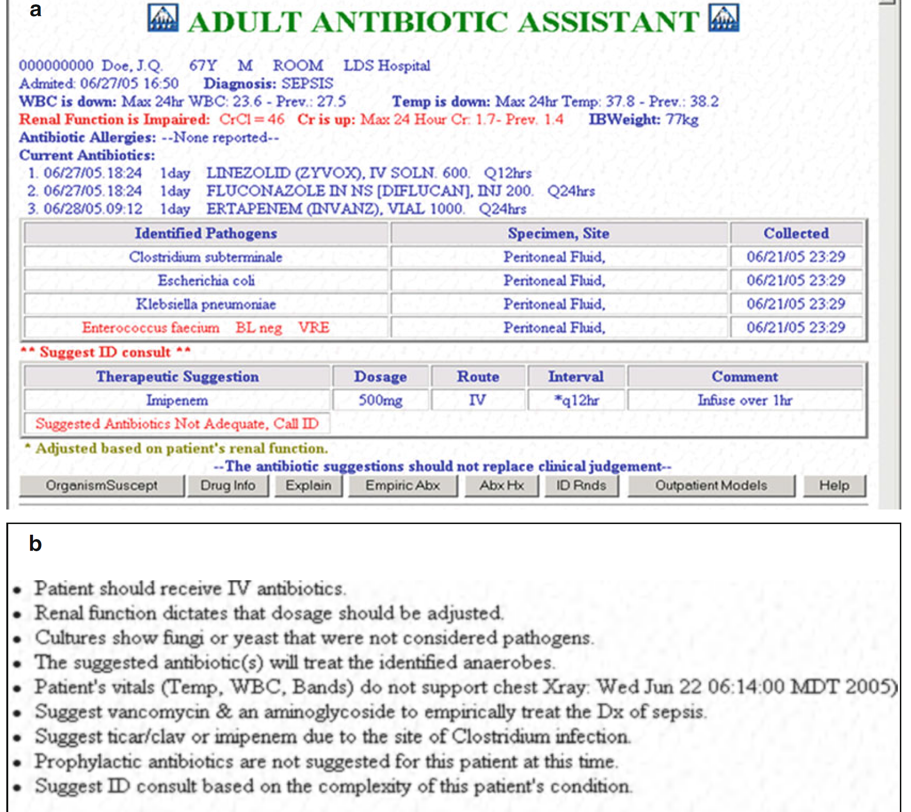
CDS Example
Fig 12.4
Antibiotic

Slide 54
CDS Common Implementation
Commonly provided as reminder or alerts
Preferable implemented in a way a physician can reject or accept with a click
Annotate the suggestion with rationales

Slide 55
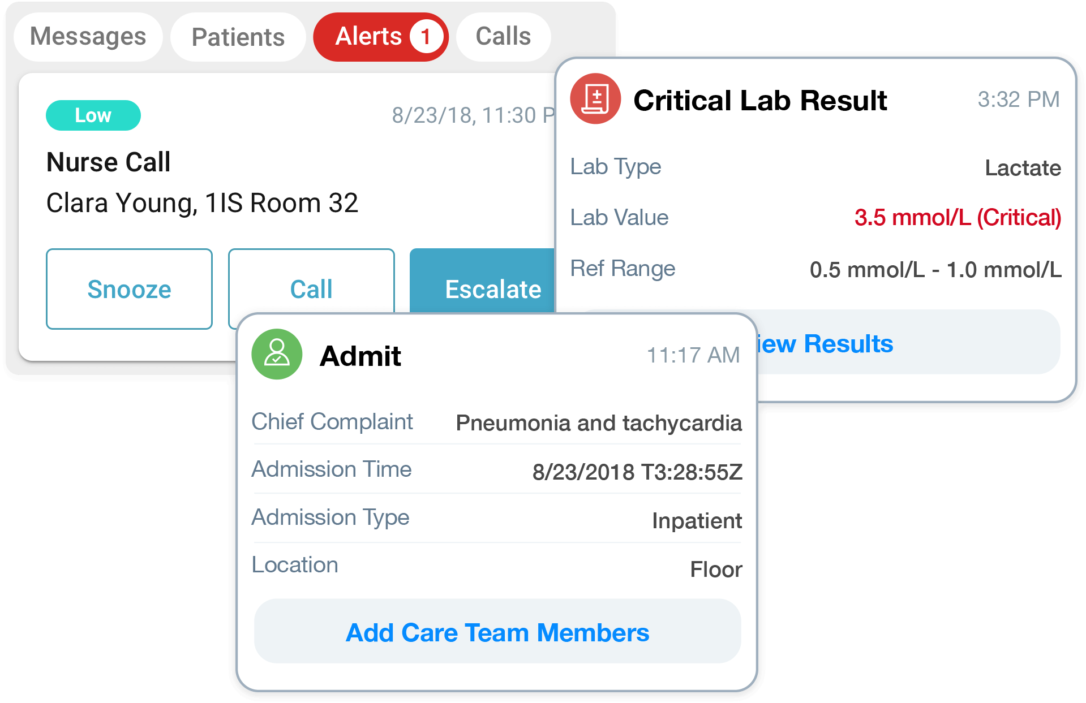
Alert example
Significant abnormality of lab test

Slide 56
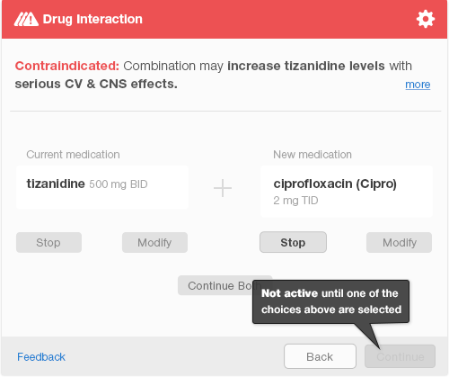
Alert example
Adverse drug-drug interaction

Slide 57
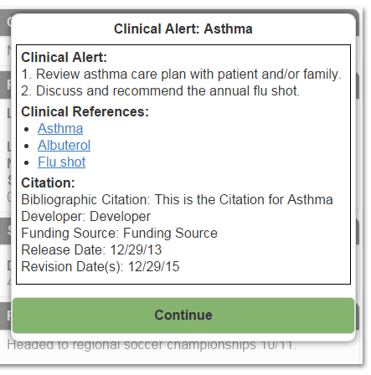
Alert example
Alert with reference knowledge

Slide 58
CDSS: Access to Knowledge
Provide knowledge resource references to physician when they are writing notes or orders for patients.
Common knowledge source:
  National Library of Medicine (NLM): research results, evidence
  Center for Disease Control and Prevention (CDC): travel, vaccines, out breaks
  Agency for Healthcare Research and Quality (AHRQ): health care quality comparison, service comparison

Slide 59
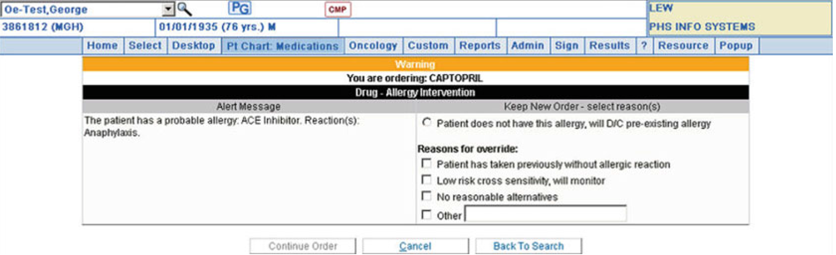
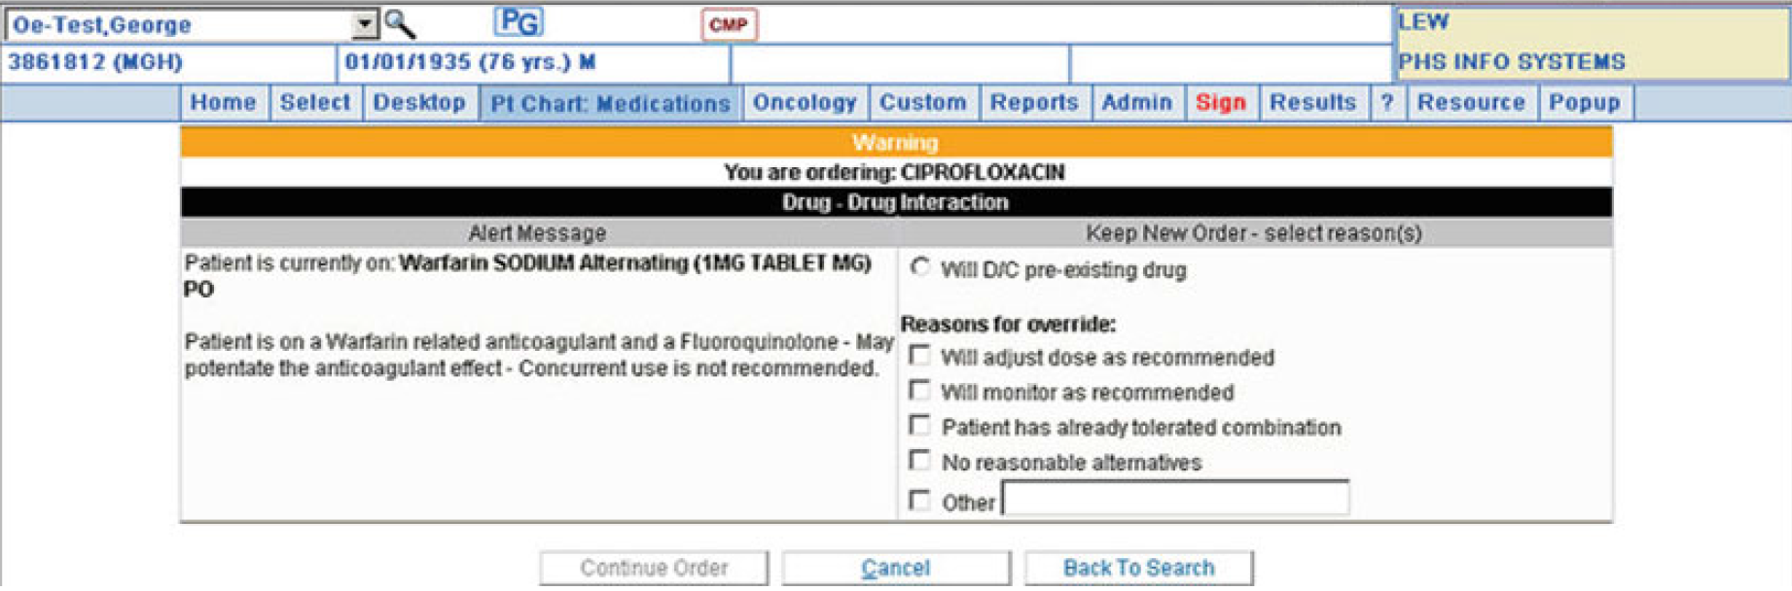
Knowledge Ref Example (P401)
Fig 12.6
Drug allergic and drug interaction

Slide 60
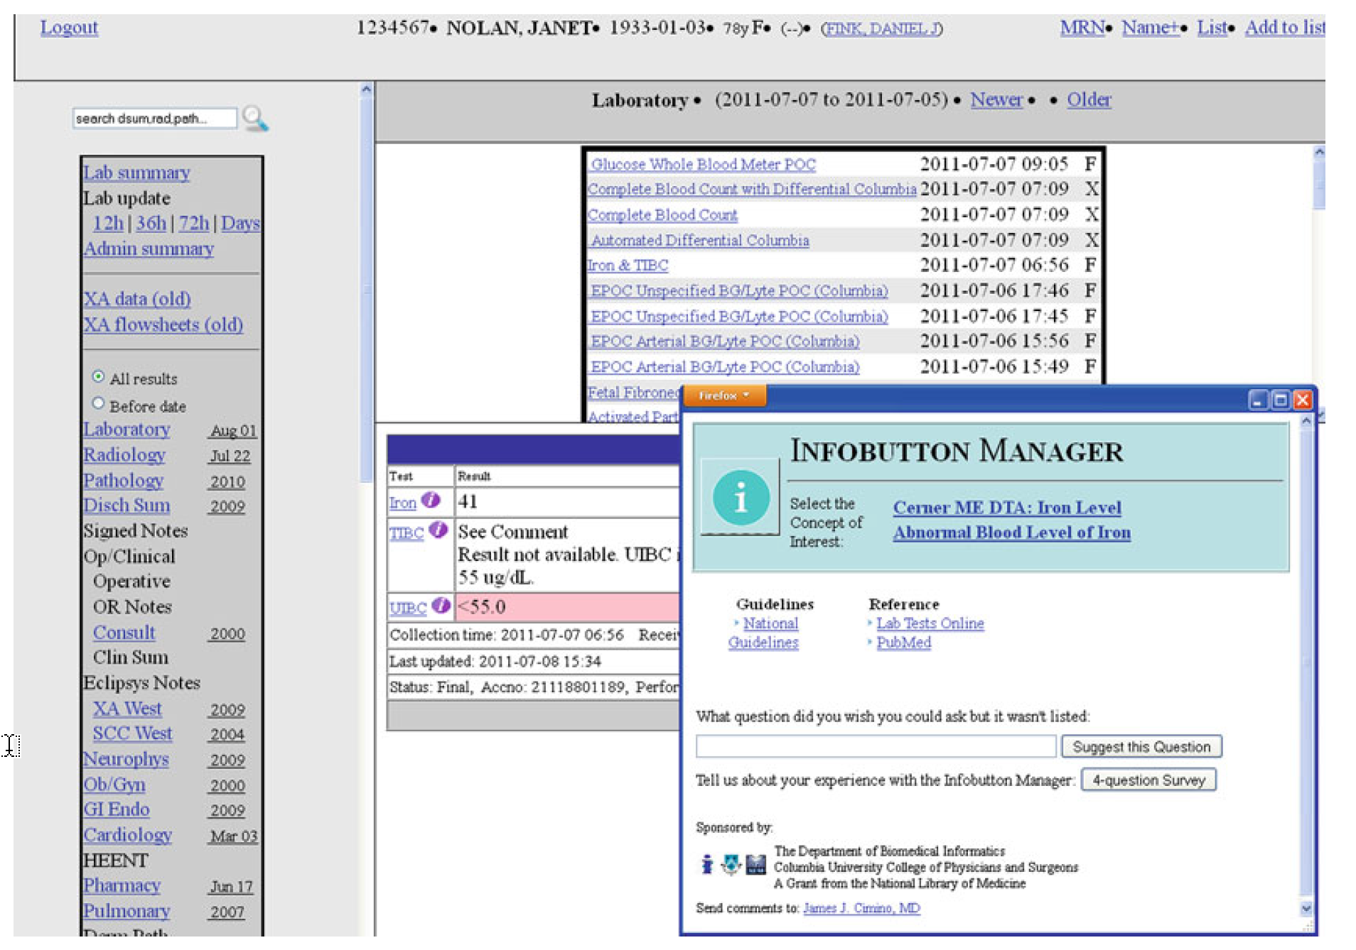
Knowledge Ref -
Inforbutton
Fig 12.8 (P402)

Slide 61
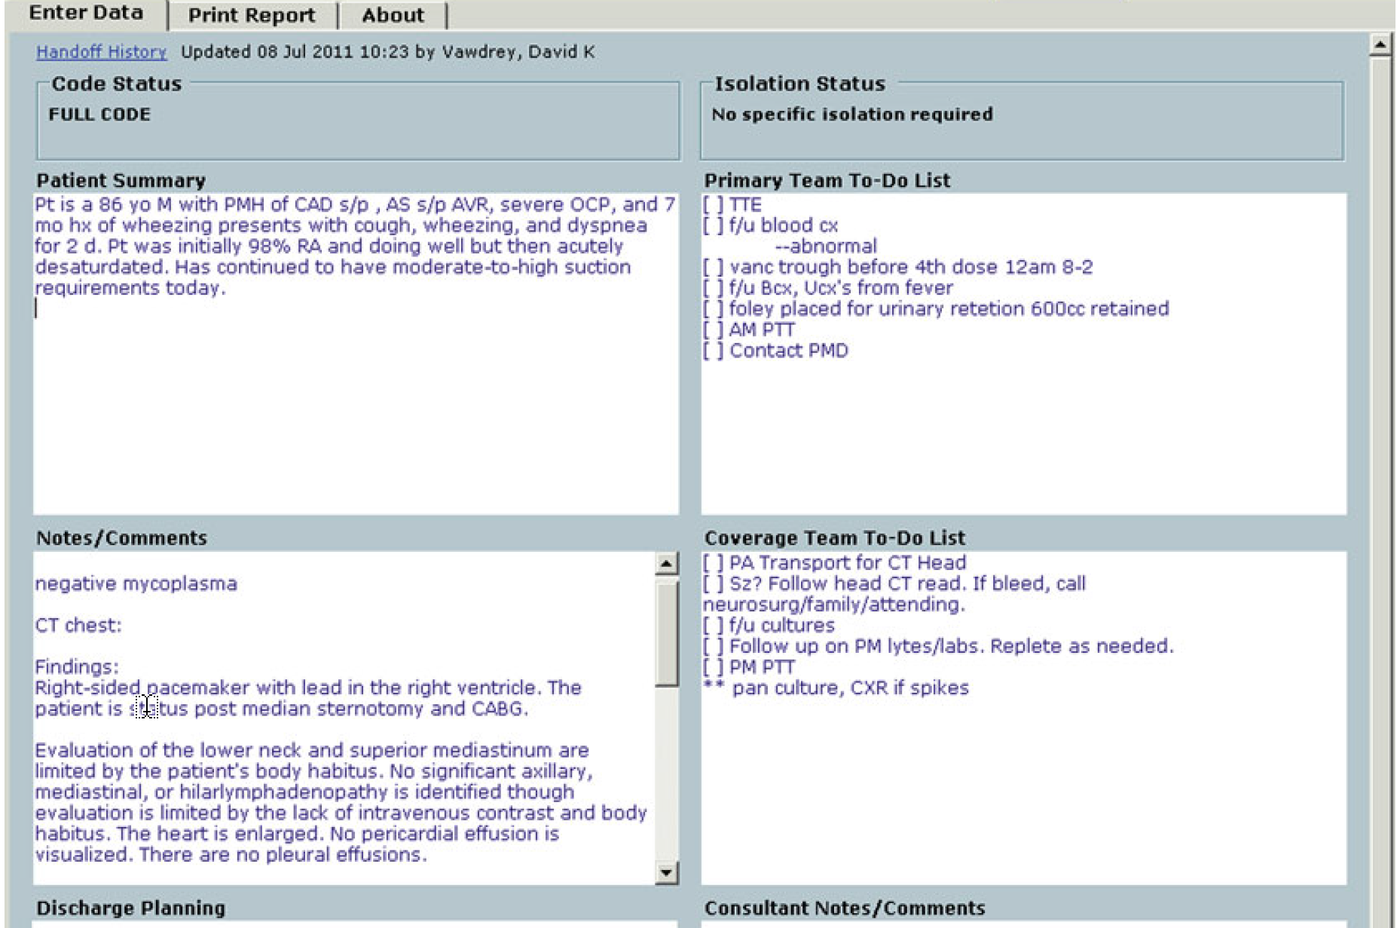
CDSS: Integrated Communication and Reporting
Support health care across departments or different organizations
Fig 12.9 (P404): patient handoff report: when the responsibility of care is transferred

Slide 62
Reading Materials
Clinical decision support systems (CDSS) implementation and its application in precision medicine
  Clinical informatics accelerates health system adaptation to the COVID-19 pandemic examples from Colorado.
  Clinical decision support systems for improving diagnostic accuracy and achieving precision medicine.

Slide 63
Thank you!
Jake Luo, PhD
jakeluo@uwm.edu

