Slide 1
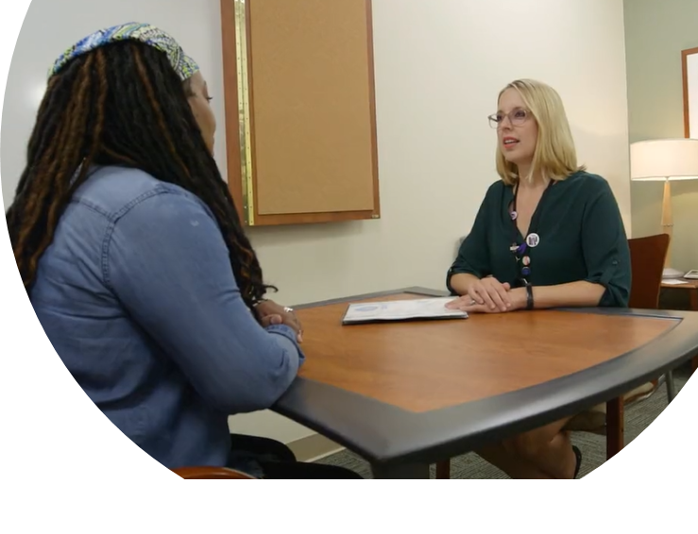
Pedigree Interpretation & Genetic Counseling
Precision Medicine Education
Jenny Geurts, MS, CGC
(she/her)
Institute for Health & Equity
jgeurts@mcw.edu
Notes:
Hello I'm Jenny Geurts genetic counselor, assistant professor in the Institute for Health and equity and director of the Master of Science and genetic counseling program
This session 's topic is pedigree interpretation and genetic counseling for precision medicine.

Slide 2
Learning Objectives
Construct a family pedigree
1
Distinguish factors that influence phenotype and inheritance pattern.
2
Summarize the elements of informed decision making in genetic counseling
3
Notes:
Here are the learning objectives for this lecture.

Slide 3
Outline & Readings
Construct a family pedigree
Standardized pedigree nomenclature update centered on sex and gender inclusivity: A practice resource of the National Society of Genetic Counselors. https://doi.org/10.1002/jgc4.1621
Pedigree nomenclature
Constructing pedigrees
Distinguish factors that influence phenotype and inheritance pattern.
Jorde LB, Carey, Bamshad. Medical Genetics. Chapter 4, section: Factors that affect expression of disease-causing genes
Inheritance of genetic traits
Interpreting Pedigrees
Summarize the elements of informed decision making in genetic counseling
Genetic Counseling and the Central Tenets of Practice doi: 10.1101/cshperspect.a038968
Communicating information
Psychotherapeutic counseling
Notes:
Outline for today
Roman numerals in corner of each slide correspond to this outline and the handout
Autosomal dominant inheritance-
Autosomal recessive inheritance-
X-linked inheritance-
Recurrence risk-
Transmission pattern-
Sex ratio-
U.01.03.01 Principles of pedigree analysis (inheritance patterns, occurrence & recurrence risk determination)
U.01.03.05 Genetic mechanisms (eg penetrance genetic heterogeneity)
U.01.03.04 Genetic testing and counseling

Slide 4
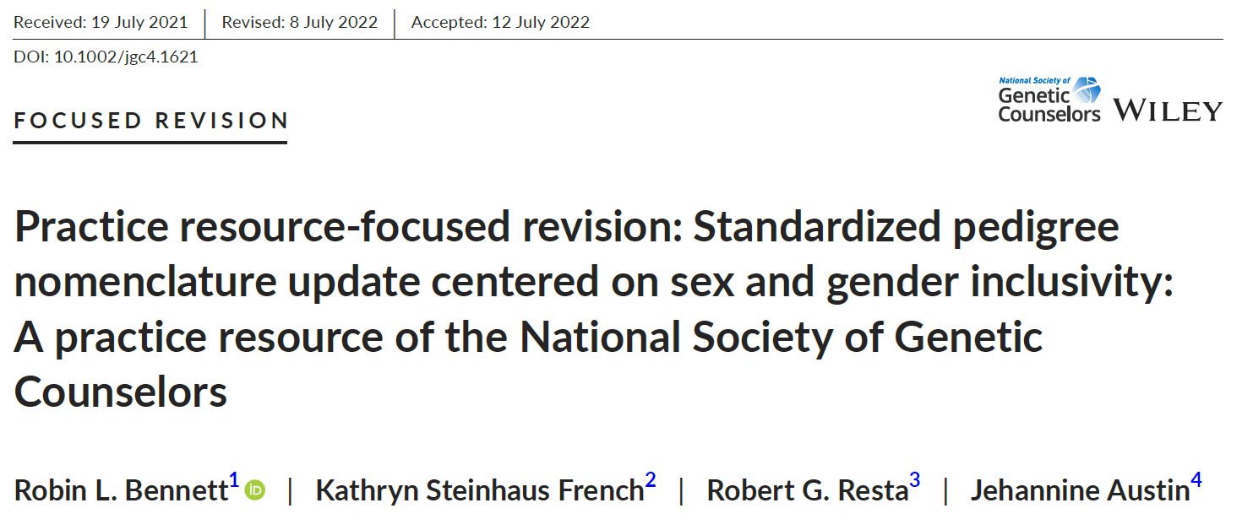
Pedigree Nomenclature
Notes:
After reading this and reviewing the figures, you should be very familiar with symbols for sex and gender, number and types of family members, ways to illustrate various reproductive considerations, and clinical status.

Slide 5
Pedigree Construction
Relationship line – horizontal line connecting spouses or partners
Sibship line – horizontal line connecting offspring in a row from a relationship
Line of descent – vertical line that connects the offspring from relationship line to the sibship line
Notes:
Again from this publication it should be clear how to use the symbols and lines to construct a pedigree.
Relationship line – horizontal line connecting spouses or partners
Sibship line – horizontal line connecting offspring in a row from a relationship
Line of descent – vertical line that connects the offspring from relationship line to the sibship line
Consanguinity – mating where individuals share a common ancestor, shown with a double relationship line
Proband- An affected family member coming to medical attention
Consultand- Individual seeking genetic counseling/testing
Coefficient of relationship-

Slide 6
Test Your Knowledge
Family History Narrative
Kaysha is 37 yrs old and recently diagnosed with colon cancer. She has a brother who is alive and well and was assigned female at birth.
Her mother and father are alive and well.
She has 2 maternal uncles, one of whom had colon cancer at age 42. The other is alive and well and has a daughter that is alive and well.
She has one maternal aunt who died and was diagnosed with endometrial cancer 53.
Her maternal grandfather died and was diagnosed with colon cancer at age 59.
Her maternal grandmother died from unknown causes at an unknown age.
Pause the recording
Draw a pedigree from the following family history narrative….

Slide 7
Answer
Family History Narrative
Pedigree
Kaysha is 37 yrs old and recently diagnosed with colon cancer. She has a brother who is alive and well and was assigned female at birth.
Her mother and father are alive and well.
She has 2 maternal uncles, one of whom had colon cancer at age 42. The other is alive and well and has a daughter that is alive and well.
She has one maternal aunt who died and was diagnosed with endometrial cancer 53.
Her maternal grandfather died and was diagnosed with colon cancer at age 59.
Her maternal grandmother died from unknown causes at an unknown age.
AFAB

Slide 8
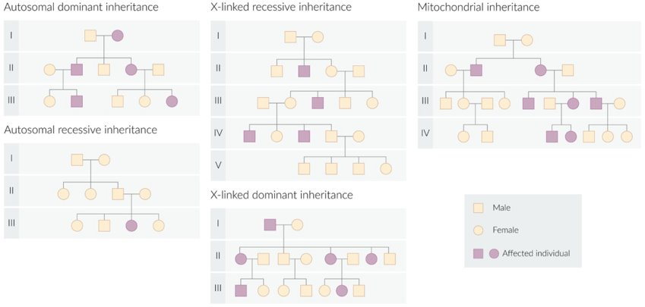
Interpreting Pedigrees
Notes:
From your previous training you should be familiar with basic inheritance patterns.
AD
Usual recurrence risk = 50%​
Transmission pattern = Vertical; phenotype seen in multiple generations​
Sex ratio = usually equal number of affected males & females​
Other = Father to son transmission is possible
AR
Usual recurrence risk = 25%​
Transmission pattern = Phenotype may be seen in multiple siblings, but typically not in earlier generations​
Sex ratio = usually equal number of affected males & females​
Other = Consanguinity is sometimes seen, especially in ultra rare conditions. Carrier parents typically have no phenotype.
XLR
100% incidence of affected sons from an unaffected female SUGGESTS x-linked recessive.
X-linked dominant
100% incidence of affected daughters from an affected father SUGGESTS x-linked.
Mito
Transmitted only through the maternal lineage, so all children from an affected female are expected to be affected to some degree

Slide 9
Genotype Doesn’t Always Predict Same Phenotype
Individuals can have the same genetic variants but different phenotypes
One may have the disease while the other does not
They may both have the same disease but exhibit different symptoms or severity
Individuals may have the same phenotype but different genetic causes
What?! …it’s complicated
Notes:
Studying inheritance patterns from the example pedigrees above seems pretty straightforward. However, in the real world, often the genotypes don’t absolutely predict the phenotypes in a pedigree

Slide 10
Penetrance
The probability that an individual with a ‘disease’ genotype will present with the disease phenotype
Complete penetrance: if an individual has the disease genotype they will always present with the disease
e.g. 100% of individuals with FGFR3 mutation will develop achondroplasia
Incomplete penetrance: if an individual has the disease genotype they may or may not present with the disease
e.g. ~50% of females with BRCA1 mutation will develop breast cancer
Complete penetrance
Incomplete penetrance
Notes:
We will now go through some factors that influence phenotype and inheritance pattern, starting with…

Slide 11
Expressivity
The extent or severity of the observed phenotype
The trait/disease is present
Variable expressivity: individuals with the same disease genotype and phenotype, but the severity is variable
e.g. Marfan syndrome has variable severity and age of onset
Expected phenotype
Variable expressivity
Notes:
In other cases, having a particular genotypes results in a range of expression of the trait…

Slide 12
Pleiotropy
Unrelated (or seemingly unrelated) phenotypes caused by a single gene variant
e.g. Marfan syndrome
Autosomal dominant - FBN1
Affects multiple systems
Eye – myopia, displaced lens
Skeleton – long slender limbs, hollow chest, scoliosis
Heart – mitral valve prolapse, aortic dilatation
Notes:
Pleiotropy – one gene variant can cause more than one outwardly unrelated phenotypes

Slide 13
Genetic Heterogeneity
The same phenotype or clinical disorder can be caused by different genetic mechanisms = genetic heterogeneity
Two types of heterogeneity
Allelic heterogeneity: different variants in the same gene result in the same observable disease or phenotype
Locus heterogeneity: variants in different genes cause the same observable disease or phenotype

Slide 14
Allelic Heterogeneity: Cystic Fibrosis
Cystic fibrosis – autosomal recessive disease >2000 different CFTR mutations
CFF Patient Registry, 2010
Notes:
Cystic Fibrosis is an AR disease caused by variants in CFTR. However, there are >2000 DIFFERENT variants that can cause CFTR. By far the most common variant is the delta F508 which deletes one phenylalanine at amino acid position 508

Slide 15
Locus Heterogeneity
Bardet Biedl syndrome (BBS)
Rare autosomal recessive disorder characterized by obesity, polydactyly, retinitis pigmentosa, cognitive impairment, hypogonadism
Caused by loss of function variants in any of at least 26 different genes
Also displays variable expressivity AND pleiotropy
https://link.springer.com/chapter/10.1007/978-1-4939-7784-0_2

Slide 16
Anticipation
From one generation to the next the age of onset is earlier, and the severity of disease is worse = anticipation
e.g. Fragile X syndrome, Huntington disease
Often in disease caused by trinucleotide repeat expansion (three nucleotides repeated in tandem – e.g. (CAGCAGCAG)_{n})
https://3billion.io/blog/diagnostic-approach-for-huntington-disease
Notes:
The final concept I want to mention where inheritance patterns in a family are not always straightforward involves anticipation.

Slide 17
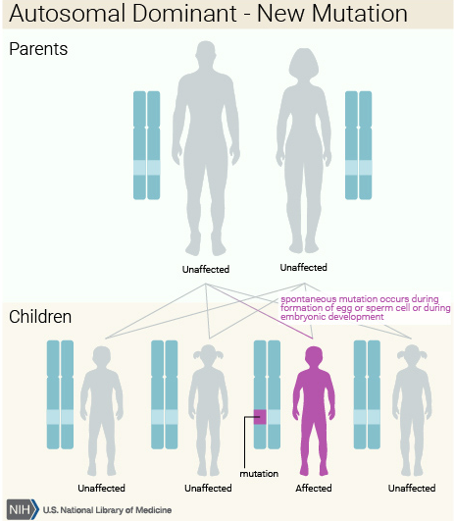
De novo Mutation
Definition: A genetic alteration present for the first time in one family member
Result of a mutation in a parent’s germ cell (egg or sperm), or a mutation in the fertilized egg itself during early embryogenesis
Also called de novo variant, new mutation, and new variant
For example, most achondroplasia caused by de novo mutations; only 1/8 are inherited from an affected parent
Notes:
If a child is born with a genetic disease that has not occurred previously in the family, it is possible that the disease is the product of a de novo (new) mutation. That is, the gene transmitted by one of the parents underwent a change in DNA sequence, resulting in a mutation from a normal to a disease-causing allele. The alleles at this locus in the parent’s other germ cells would still be normal.
De novo mutations are a common cause of the appearance of a genetic disease in a person with no previous family history of the disorder. The recurrence risk for the person’s siblings is very low (in the event of germline mosaicism), but the recurrence risk for the person’s offspring may be substantially increased.

Slide 18
Pedigree Interpretation Summary
Standardized nomenclature and pedigree construction helps to decipher complex family history.
Inheritance patterns and recurrence risk can be assessed through pedigree interpretation.
Many nuances affect disease phenotype and inheritance pattern.
Notes:
Peple and families are complex, and it isn’t always easy to interpret.
When we collect a pedigree, we then interpret it. You’ll be learning about inheritance patterns from Anne Kwitek in week 3.
She will define these concepts for you.
I just want to illustrate how the expression of a trait (the phenotype) can be influenced by many things.

Slide 19
Genetic Counseling
Notes:
Switch gear to talk about genetic counseling and genetic counselors such as myself

Slide 20
Masters Prepared – 2 years
Certified Genetic Counselor
Coursework
Practicums
Research Thesis
Board Exam
Notes:
Work in a variety of practice settings

Slide 21
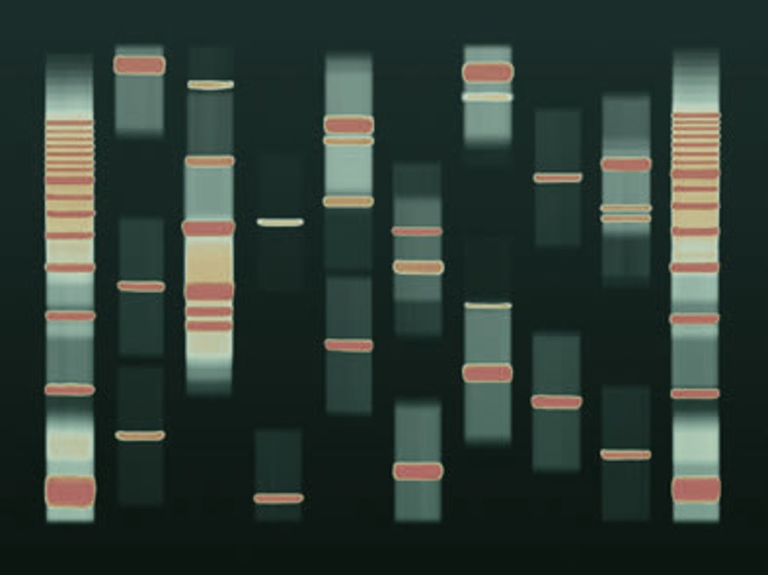
Genetic counseling is the process of helping people understand and adapt to the medical, psychological and familial implications of genetic contributions to disease. ​
Notes:
Basic definition

Slide 22
Genetic Counseling Tenents
Psychoeducational= Incorporation of a teaching and counseling model of practice
https://doi.org/10.1007/s10897-007-9113-4
Notes:
Client Centered Care & Reciprocal Engagement Model:
1.Information is key and must be accurate in reflecting cutting-edge genomic science. 2.The relationship is integral and should be psychotherapeutic. 3.Patient autonomy is important, but at times may be challenged in the interest of mitigating health risks. 4. Patients are resilient and capable, but some are vulnerable and need further interventions. 5. Patients’ affect reflects only one of a triad of psychological responses to genetic information—cognition, affect, and behavior—all of which are important patient/client experiences to be addressed in genetic counseling.

Slide 23
Evaluation Tools
Family History
3 generation pedigree
Health issues
Age of onset
Genetic Testing
Testing Strategy
Gene Panels
DNA banking
Notes:
Focused pedigree

Slide 24
Genetic Counseling Appointment
Establish mutual goals, address patient’s expectations
Review medical history
Family history: Take a detailed 3 generation pedigree
Risk assessment: Analyze medical and family history, assess inheritance patterns
Discuss genetic testing options
Balancing discussion about what makes most sense medically, financially
Consider DNA banking
Obtain informed consent, review expectations
Address insurance concerns, review genetic discrimination laws
What will happen, possible results (positive, negative, inconclusive), turnaround time
Psychological impact of test for patient and other family members
Genetic counselors are not physicians, they do not perform clinical exams and do not provide medical management.
Notes:
In a typical GC appointment, every patient is unique, so things are always different. But, in general we cover a lot of ground. With each patient we try to establish mutual goals for our time together, and set expectations for the appointment – really try to help them understand WHY they’re meeting with us. We review their medical history and spend time talking about their family history and when possible we try to get information about their generation, their children and parents, and grandparents or other extended family members. We are able to use that information to really make an informative, personalized risk assessment for each patient we see. After that, we are able to use that information to talk to patients about what their testing options might be. So, really, we’re trying to balance what makes the most sense for the patient (medically and financially), and give them the opportunity and information to make a decision about testing that’s ultimately going to be best for them, based on where they are in their own process. We also talk to them about consent information: risks, benefits, and limitations of genetic testing. We try to help patients navigate any psychosocial impact of genetic testing for themselves and their family members.
Lastly it is important to point out that we are not physicians or NPs or Pas, we do not perform clinical exams and do not provide medical management.

Slide 25
Genetic Testing
Benefits​
Provides risk information for individuals and families​
Provides information useful for medical management​
May offer options of PREVENTION, EARLY detection or more effective TREATMENT​
May actually relieve anxiety/end uncertainty​
Risks​
Emotional (increased fear/anxiety)​
Strain family relationships
Insurance Discrimination​
State and Federal Laws​
Limitations​
Genetic testing is not able to detect all causes of hereditary disease​
Continued risk for sporadic diseases​
Some management strategies not proven effective

Slide 26
Reasons to not pursue testing
Diagnosis is made on clinical exam
History is not suggestive of a hereditary condition
Ineffective detection/prevention options for at risk individuals
‘I don’t want to know’ (knowledge=burden)
Not a good time
Other family members?

Slide 27
Reasons to pursue testing
Proactive Health: Effective early detection and risk reduction options
Screening based on family history alone is burdensome, invasive or expensive
‘I want to know’ (knowledge=power)
This can impact my immediate treatment
Children are approaching ‘that age’
Other family members?

Slide 28
Federal law that prevents health insurance companies and employers from using genetic information for discrimination purposes
Genetic information
Family history information
Whether or not someone has had genetic counseling
Genetic test results
Does NOT apply to life insurance, long term care, or disability insurance
Does NOT apply to members of the military enrolled in Tricare, veterans receiving care at the VA, Indian Health Service, federal employees enrolled in the Federal Employee Health Benefits plan, small employers (<15 employees)
www.GinaHelp.org
Notes:
http://ginahelp.org

Slide 29
Informed Decision Making
Sarah Moharem-Elgamal et al. J Am Coll Cardiol Case Rep 2020; 2:392-395.
Notes:
The GC role is to guide patients through this process of risk assessment and informed decision making.
What would you and your family need to consider if making a decision about genetic testing. Think about that for a minute, what would you need to know, what would be your priorities, who would help you decide?
Pedigree analysis, risk assessment, of understanding general risks for cancer, how the family history impacts them, Puts things into context and helps them understand how a hereditary predisposition to cancer could affect them.
This along with the education about inheritance, and screening and surveillance is how the patient can come to the decision to know if genetic testing is right for them.

Slide 30
Test Your Knowledge
How will this impact Kaysha & her family?
Pedigree
AFAB
Notes:
So going back to Kaysha, you may have recognized based on your previous knowledge and experience that her history is consistent with a condition called Lynch syndrome, which is a hereditary colon cancer syndrome that also predisposes to endometrial cancer, ovarian cancer and various other cancers. Pause the recording now and consider….
Pause here and think about how this genetic diagnosis of a hereditary cancer syndrome might impact Kaysha?

Slide 31
Genetic Counseling Summary
Genetic counselors are advanced practice members of the health care team who :
-practice a psychoeducational model of client-centered care
-collect & interpret pedigrees
-provide risk assessment
-identify available genetic testing & appropriate testing strategy
-provide informed consent to facilitate informed decision making
-order & interpret genetic test results
-explore the psychological impact for the patient & family
-they do not perform clinical exams and do not provide medical management.

