Slide 1
Precision Medicine
Medical Genomics
Donald Basel, MBBCh FACMG

Slide 2
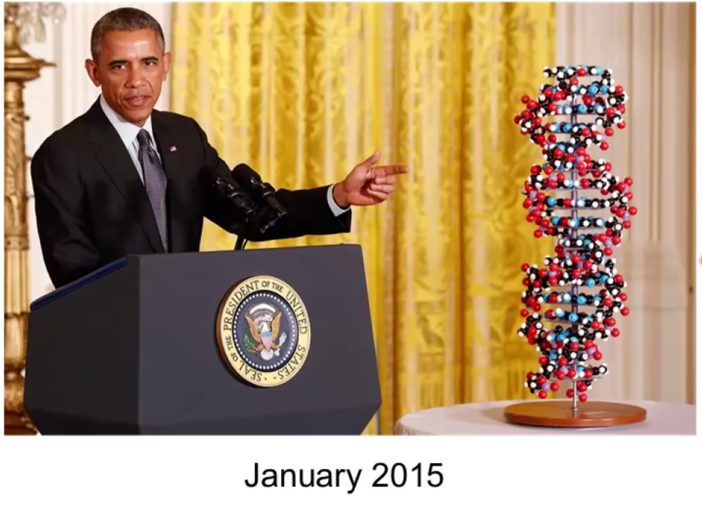
Obama announced “Precision Medicine” Initiative

Slide 3
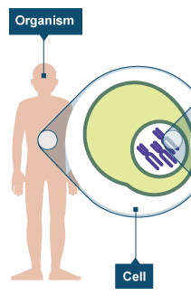
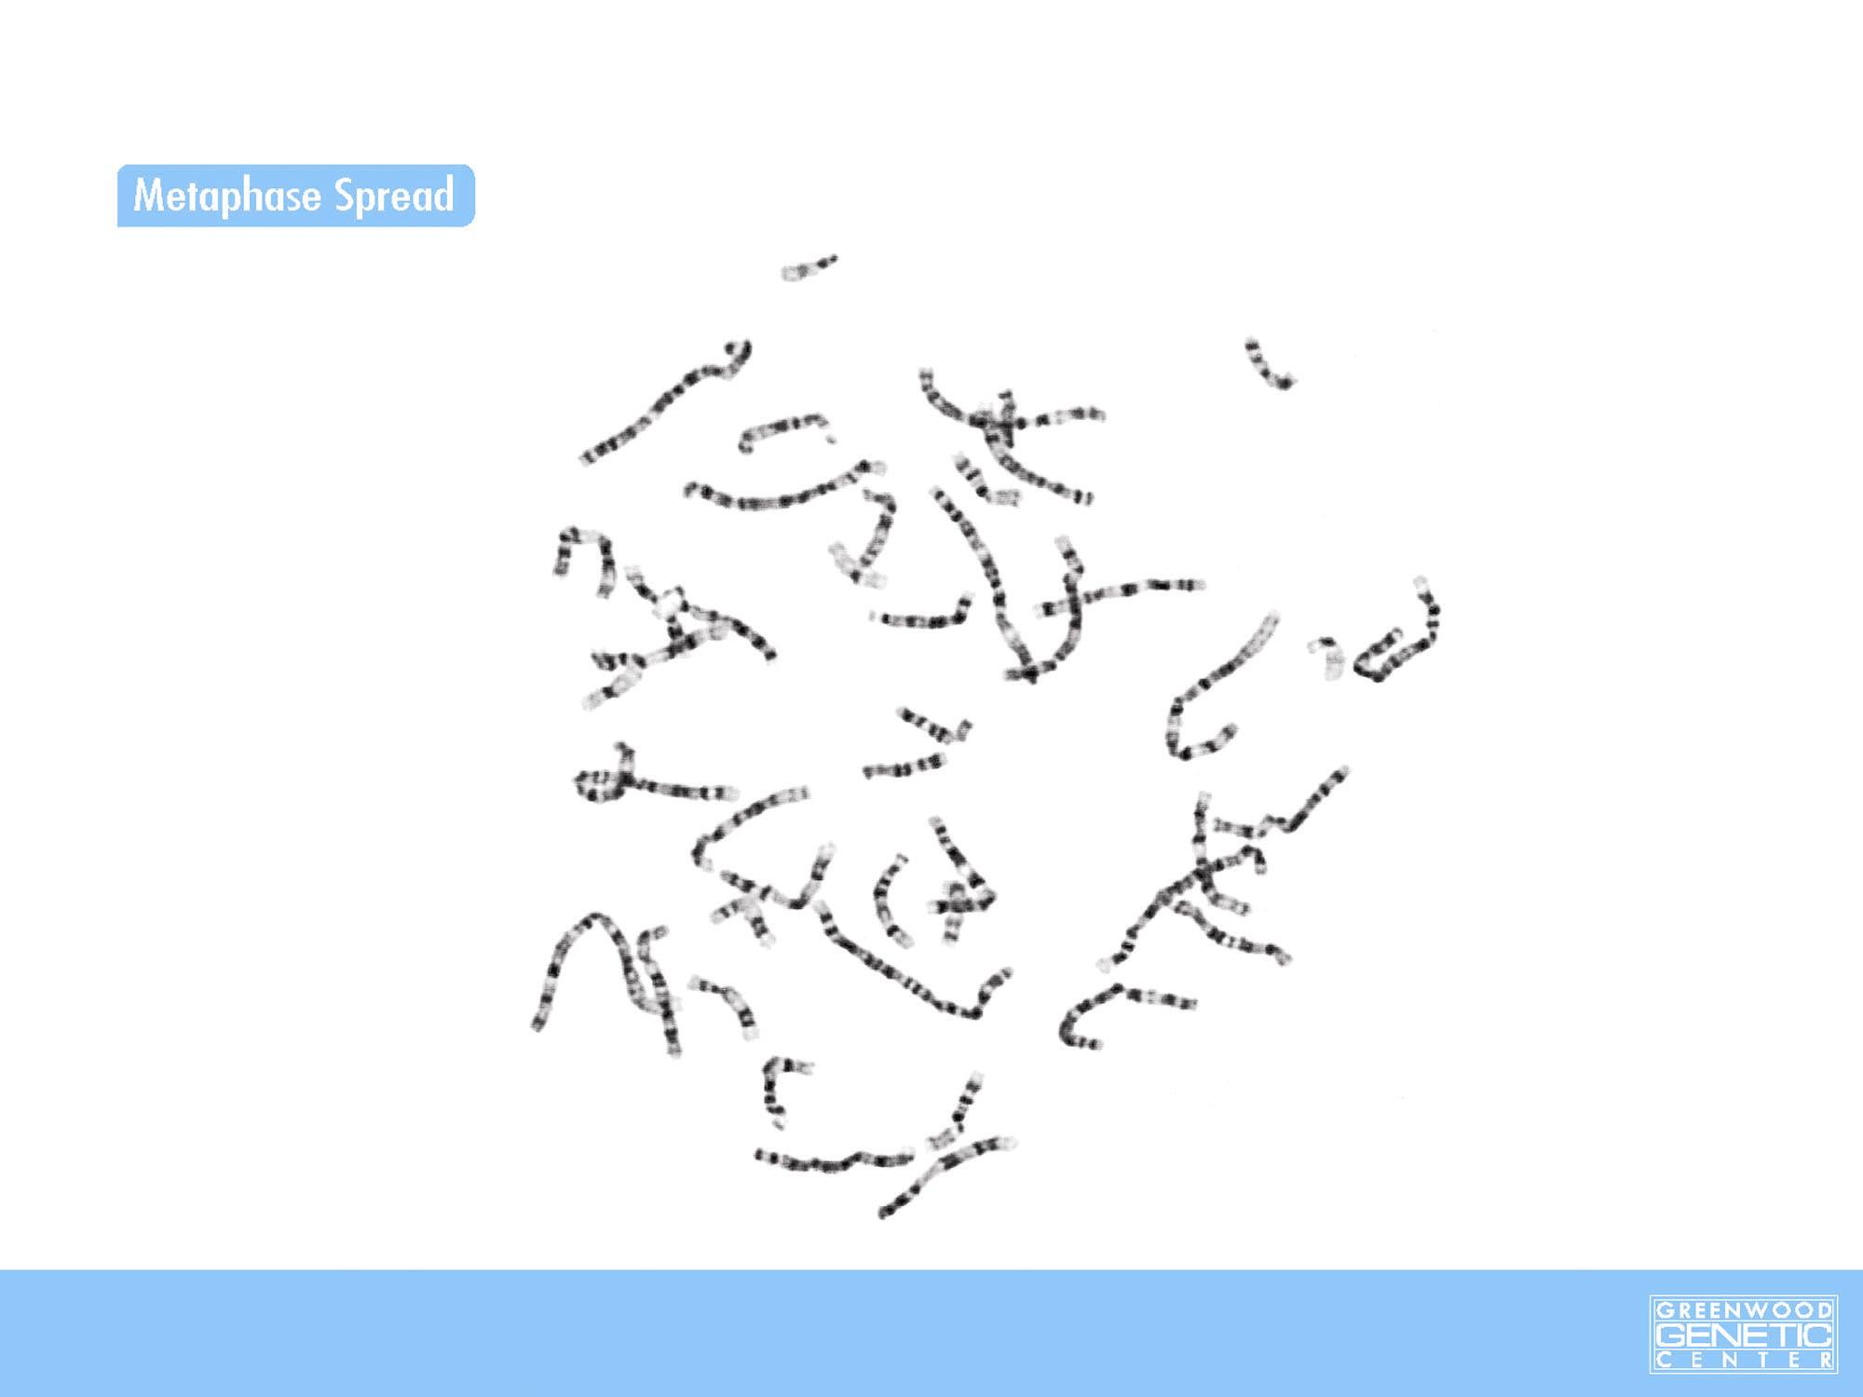
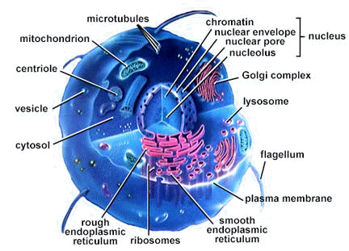
HUMAN
Genomic Literacy
The Nucleus contains Chromosomes
Chromosomes
40 trillion cells

Slide 4
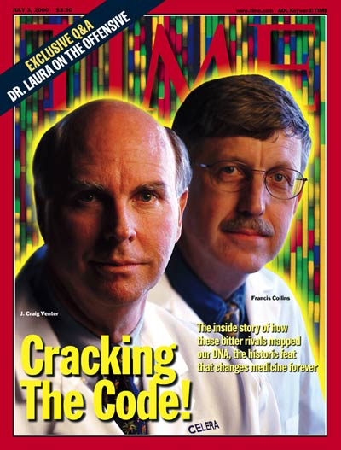
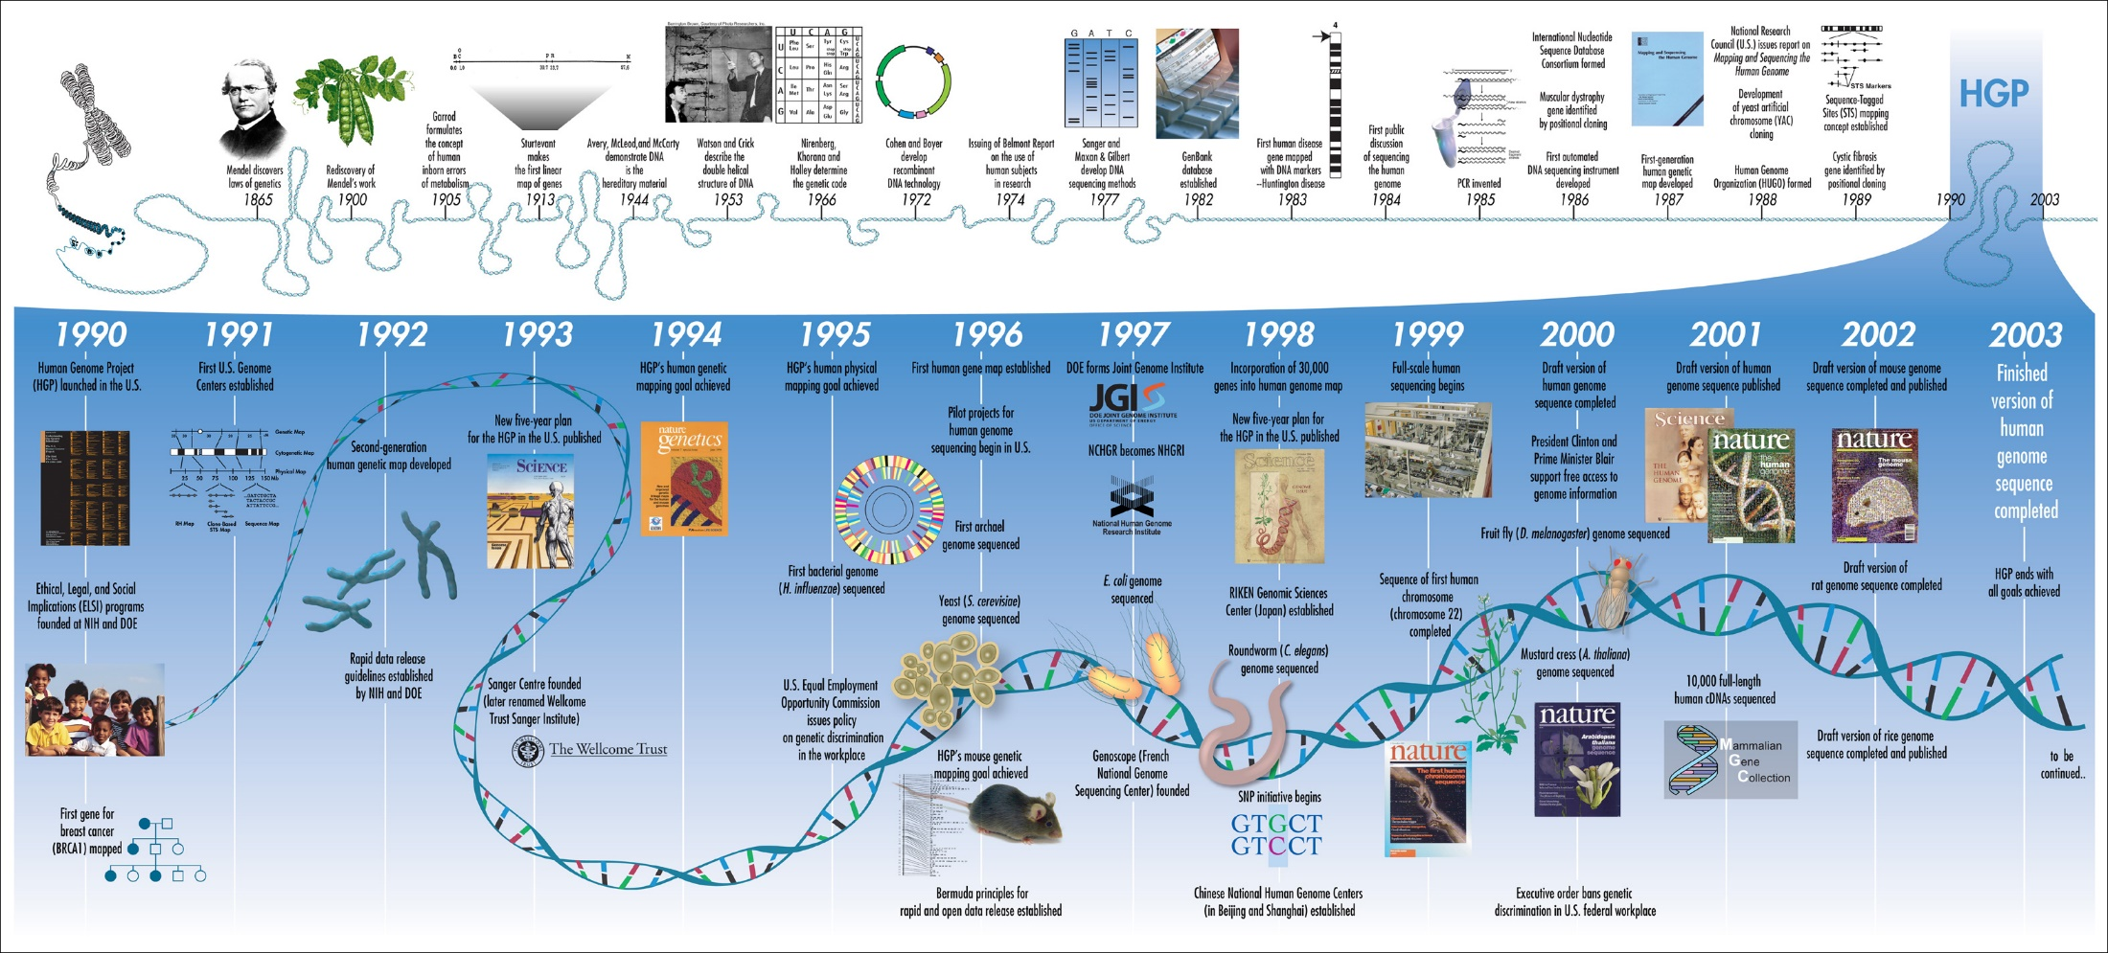
“genomics”
1856 Gregory Mendel = inherited traits & segregation
1859 Darwin “Origin of Species”
1953 Watson & Crick : DNA double helix
1977 Chemical sequencing
Sanger , Maxam and Gilbert
1985 PCR invented
2001 First Draft of Human Genome Published

Slide 5
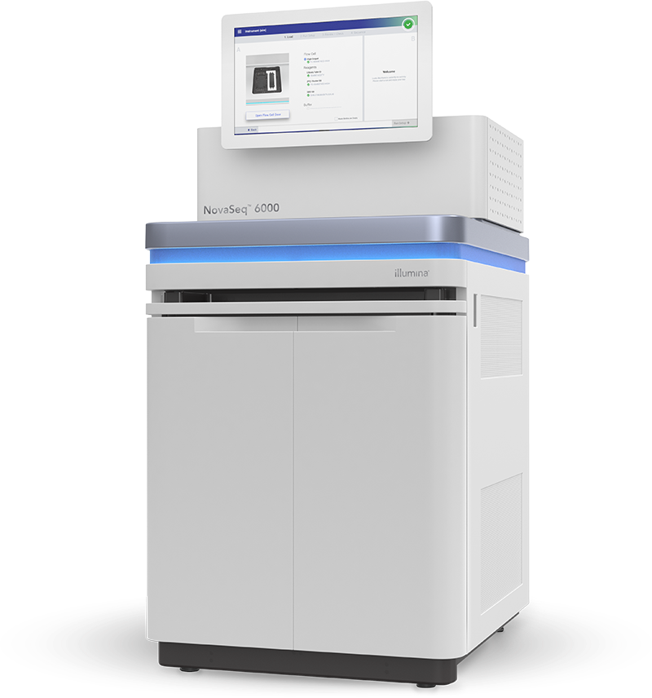
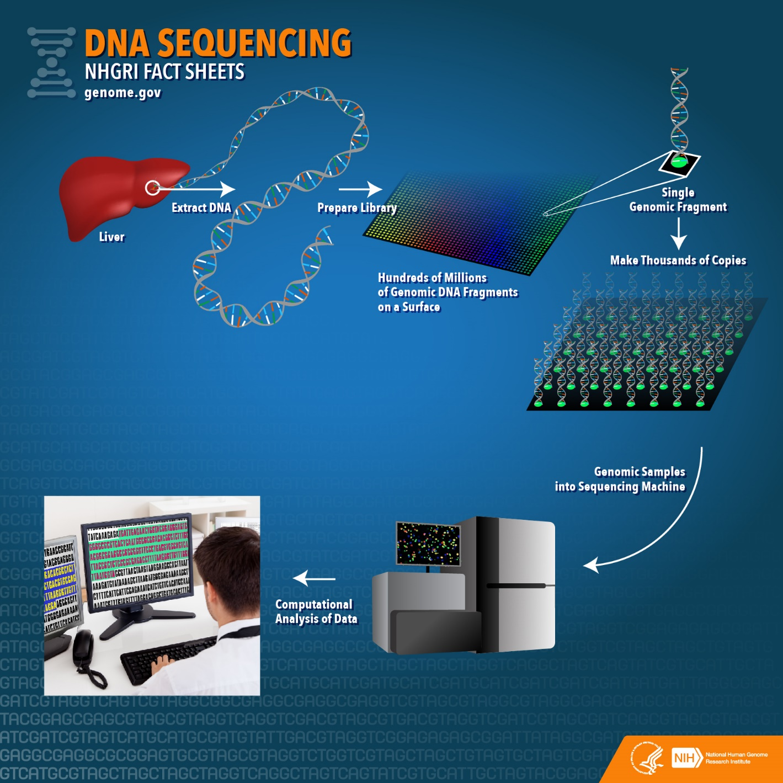

Slide 6
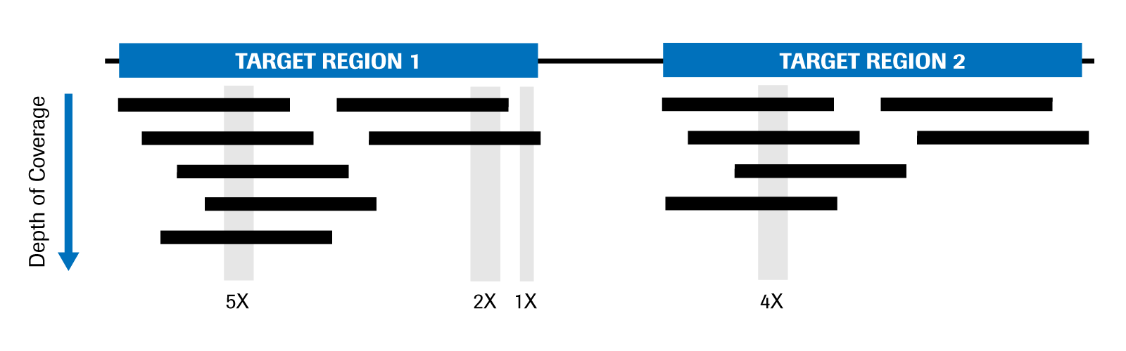

Slide 7
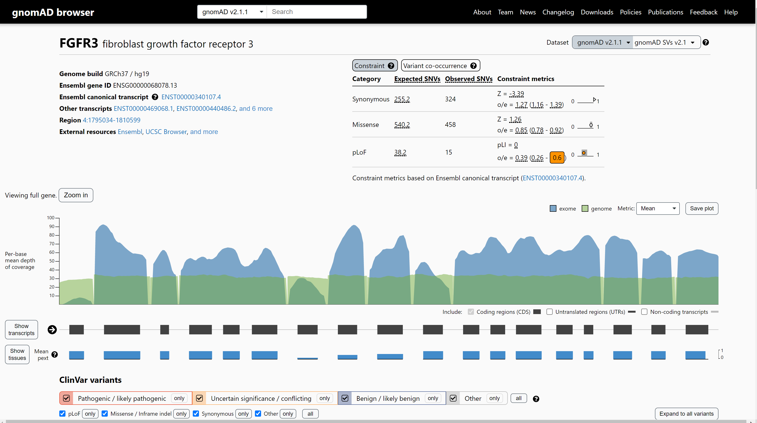
https://www.genome.gov/about-genomics/fact-sheets/Sequencing-Human-Genome-cost

Slide 8
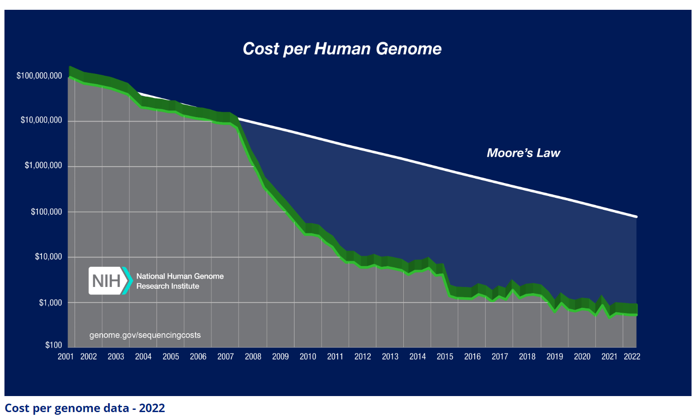
https://www.genome.gov/about-genomics/fact-sheets/Sequencing-Human-Genome-cost

Slide 9
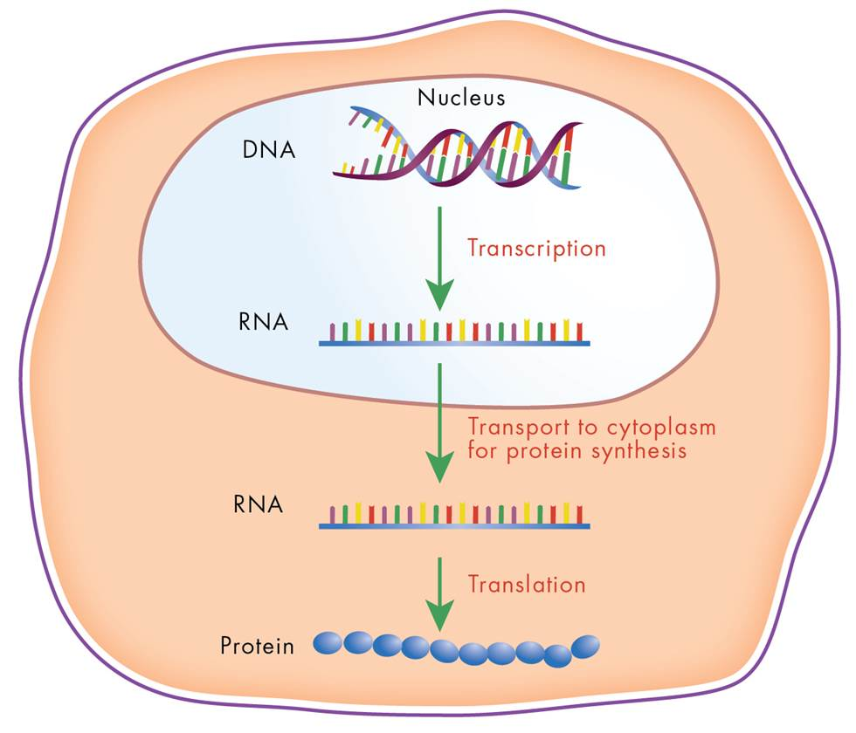
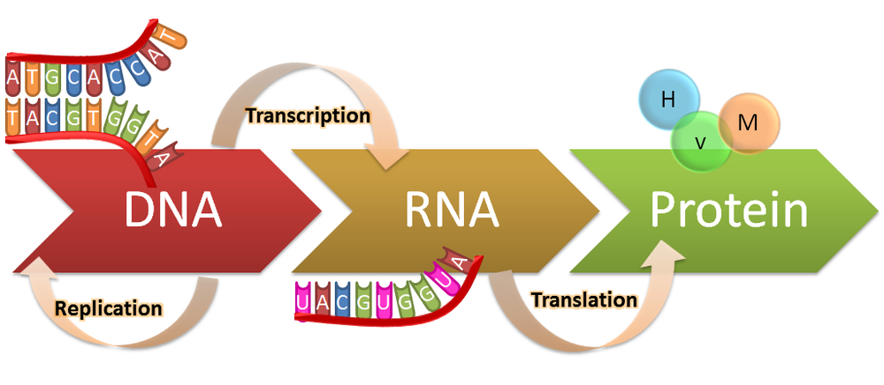
What’s in the code
3 Billion base pairs
~20,000 genes - passed down from parents to children
3 Million genomic variants
20-40,000 variants in or close to exons
DNA is your blueprint
99.9 percent identical
0.1 percent is what makes you unique

Slide 10
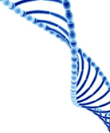
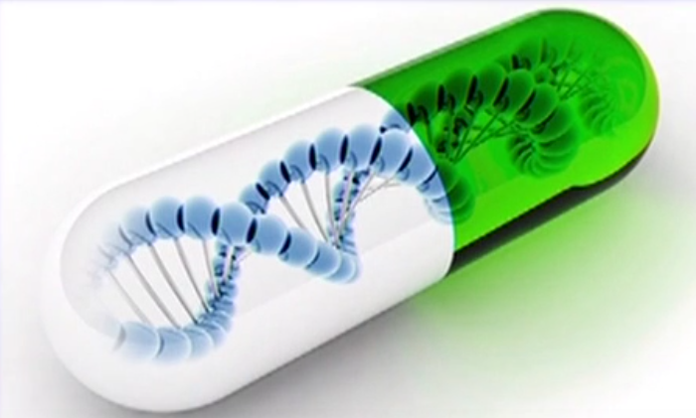
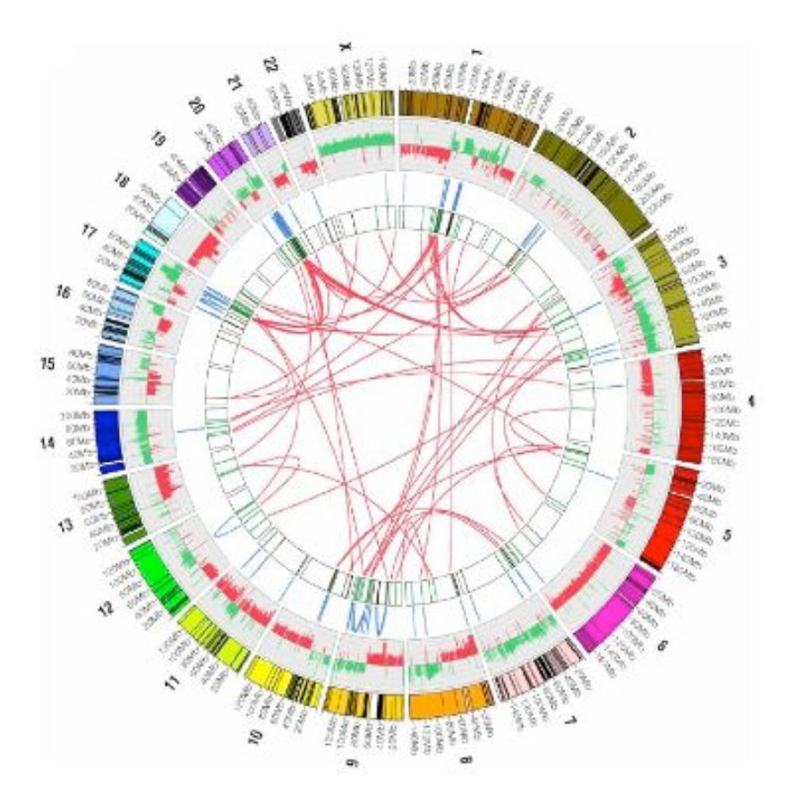
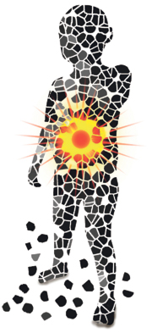
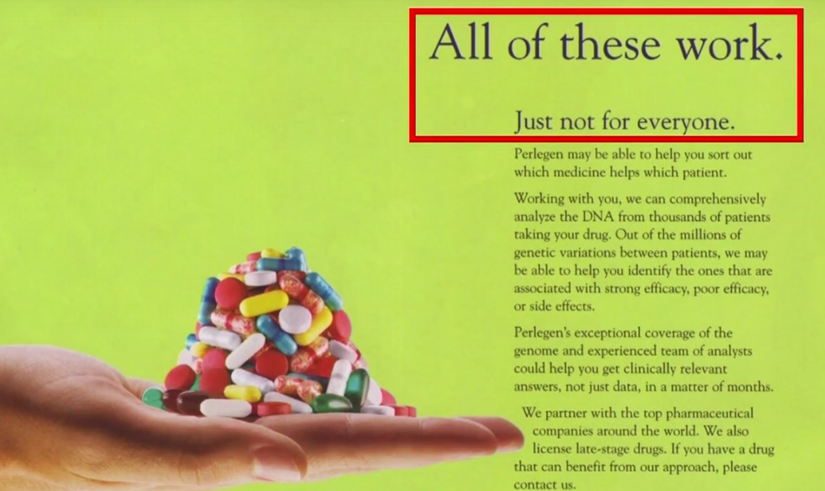
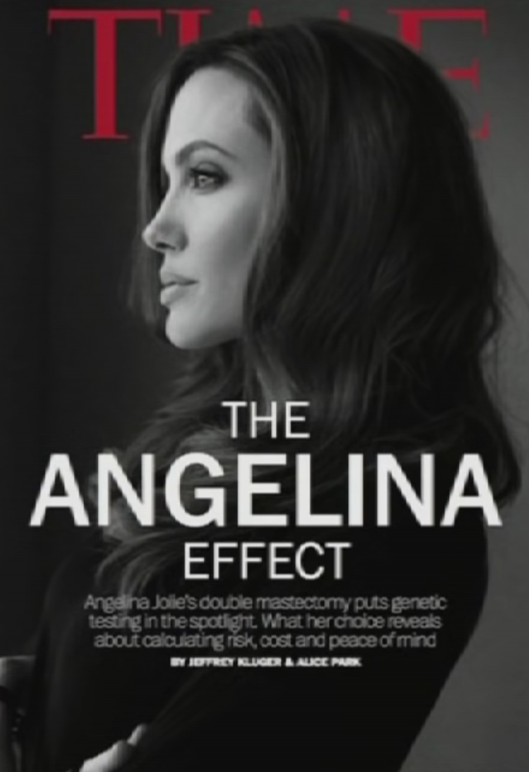
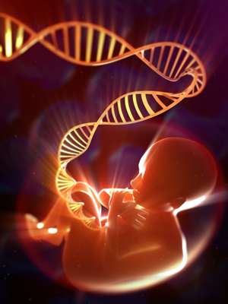
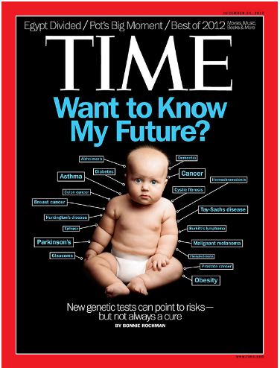
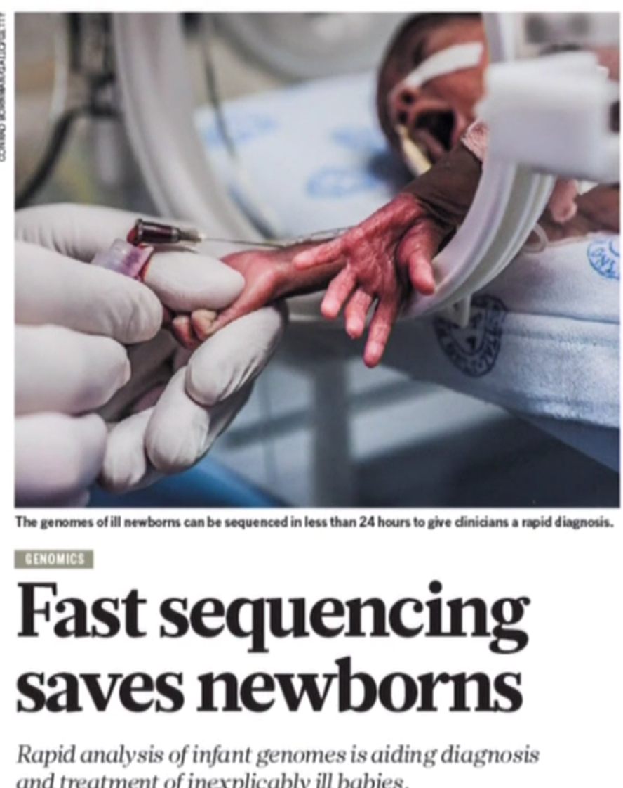
Areas of focus in Medical Genomics
Genomic Literacy
Pharmacogenetics
Cancer Genetics
“One in Billion”
ultra-rare diseases
Prenatal Medicine
Treating undiagnosed diseases

Slide 11
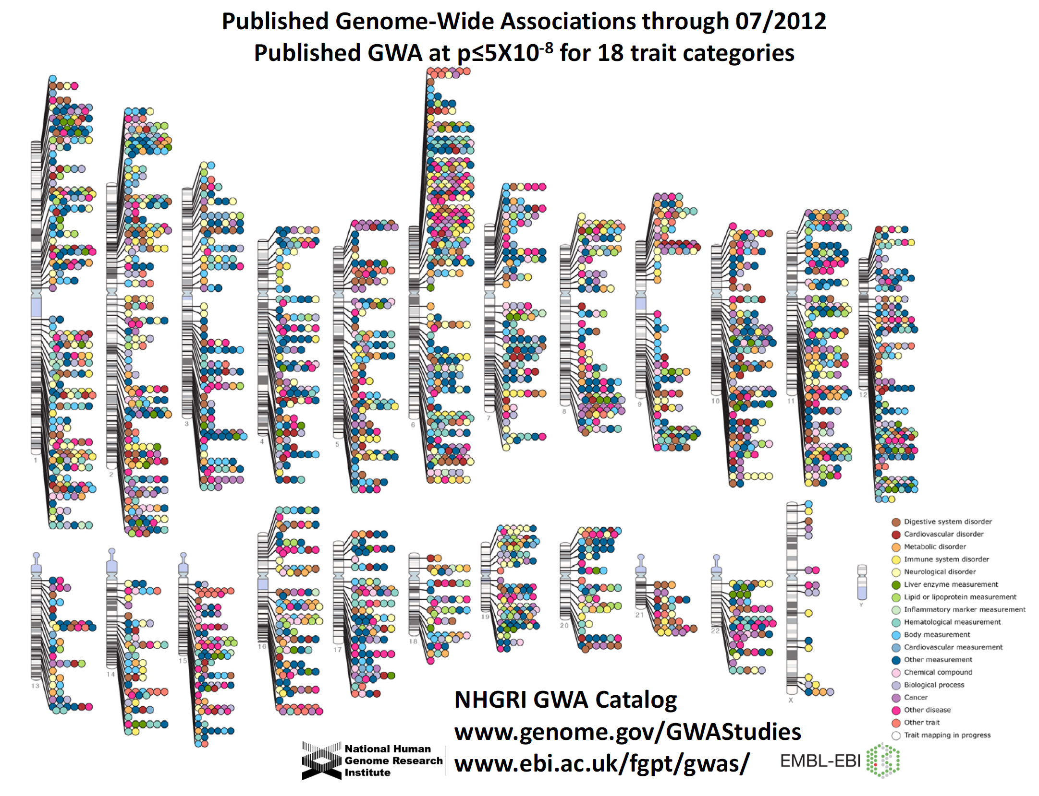
Genomic Literacy

Slide 12
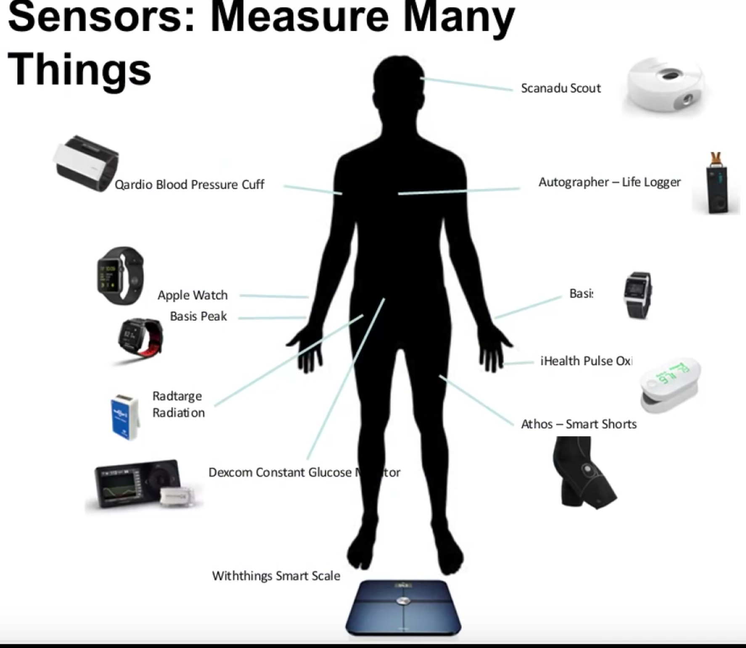
Generation of Personalized “Big Data”
Genome
Epigenome
Transcriptome
Proteome
Metabolome
Inflammasome
Microbiome
Genomic Literacy

Slide 13
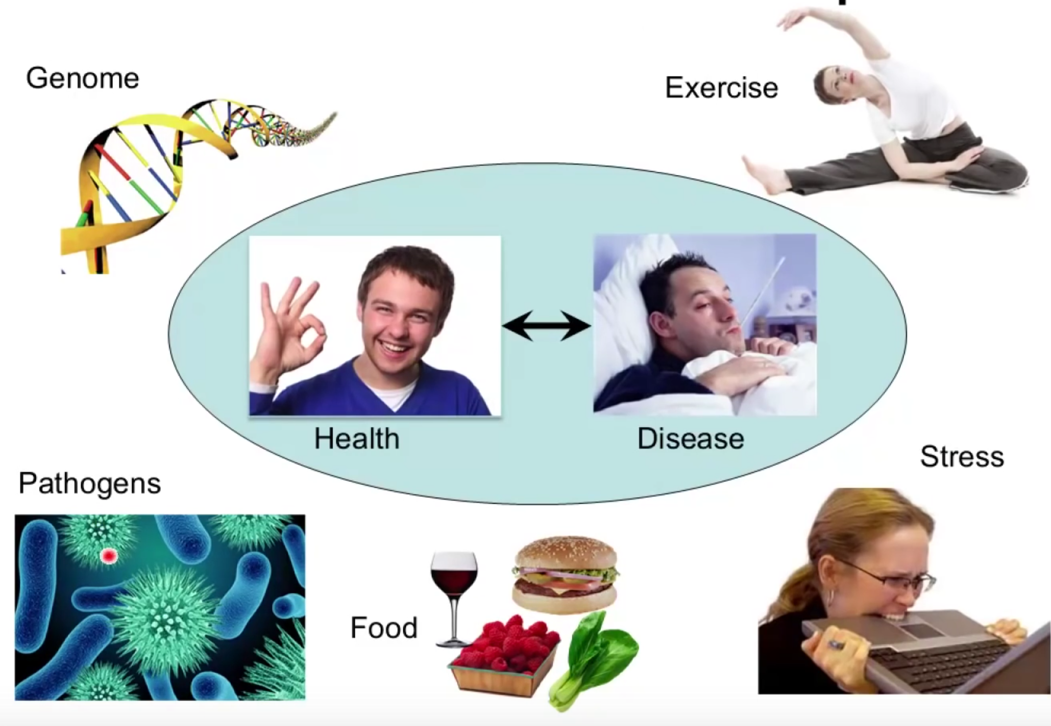
Health is the product of complex interacting “omics”
Genomic Literacy

Slide 14
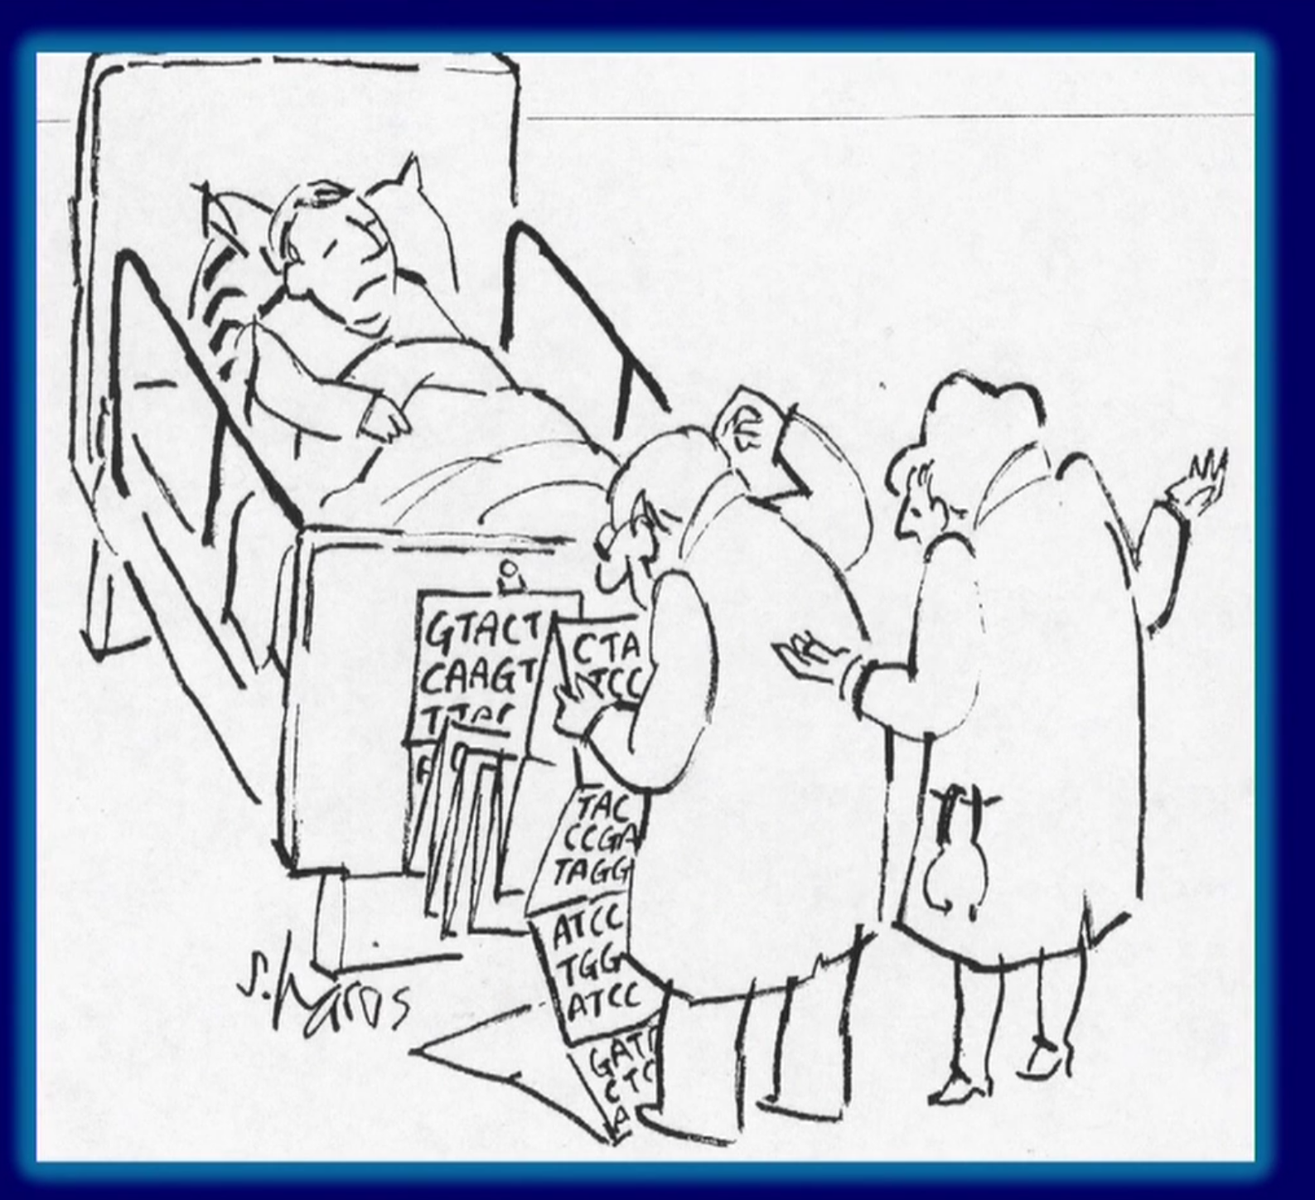
What to do in Practice
Genomic Literacy

Slide 15
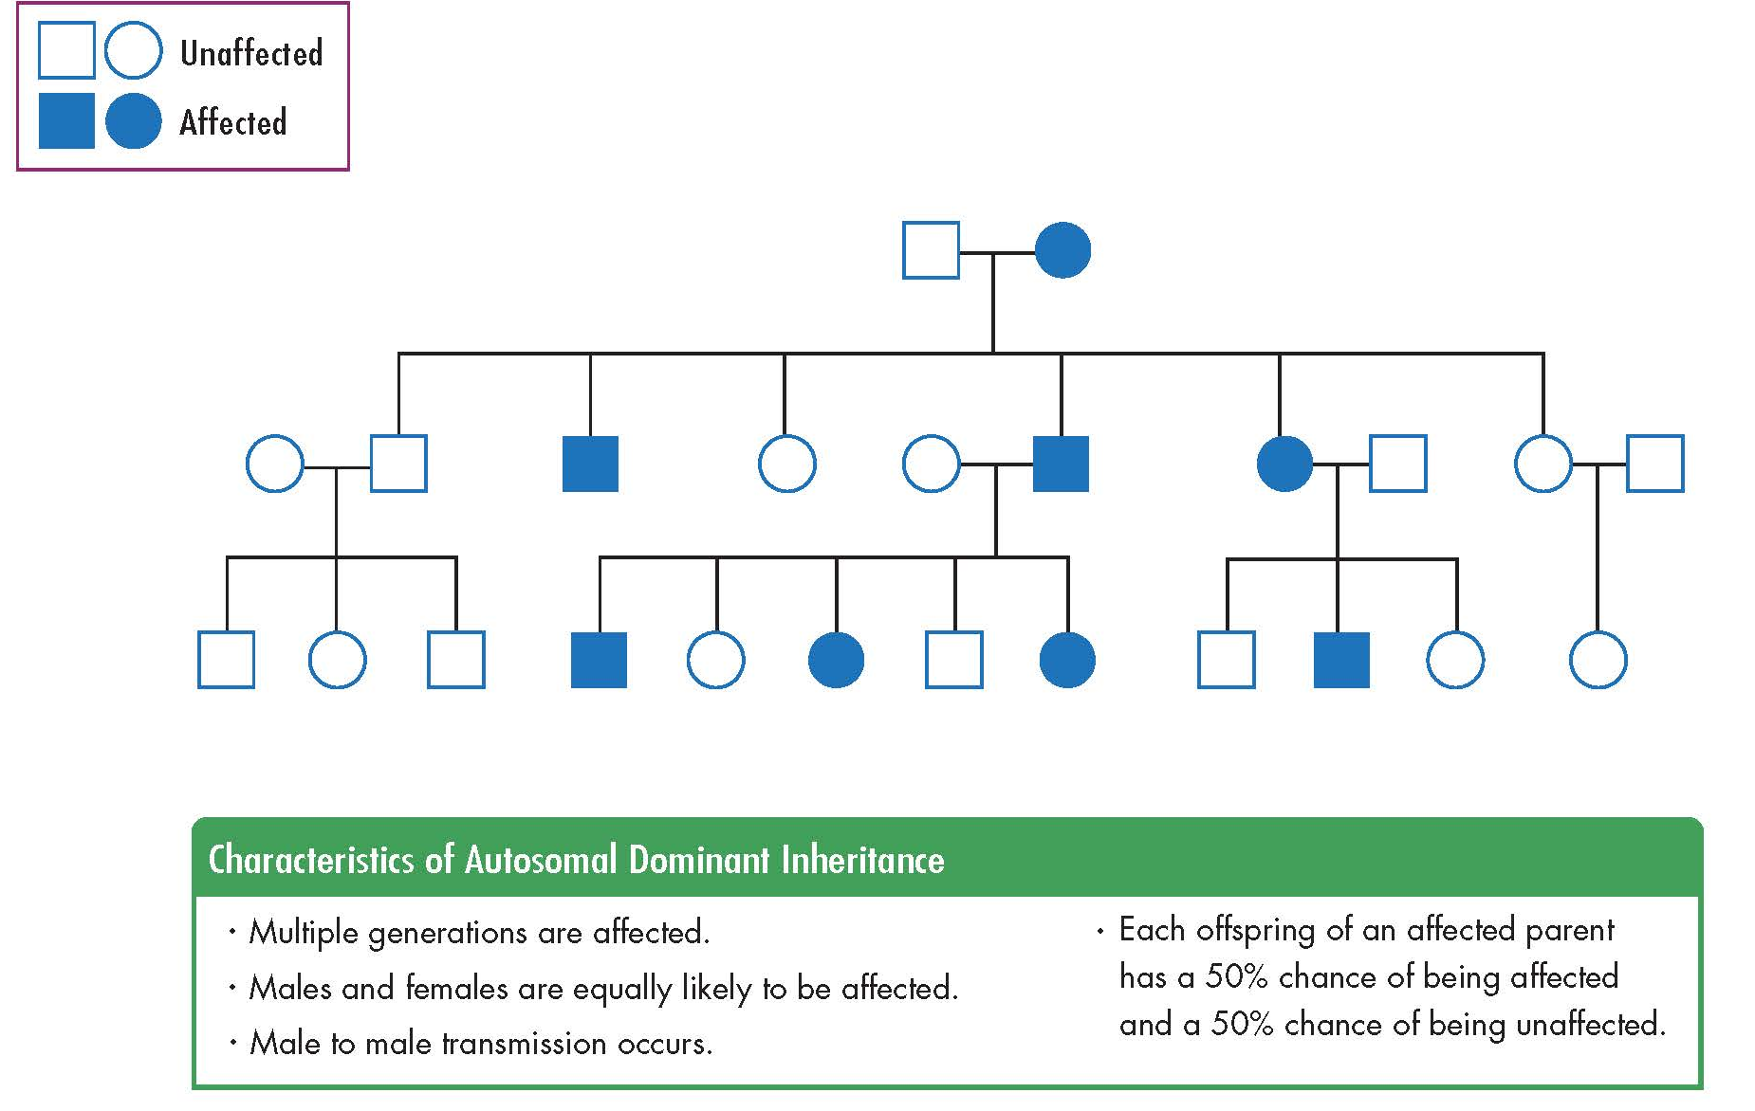
Autosomal Dominant Inheritance
Genomic Literacy

Slide 16
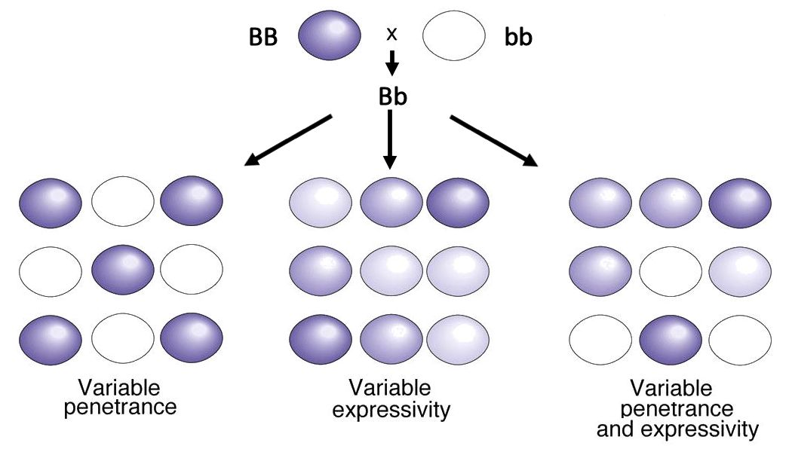
Penetrance and Expressivity
Genomic Literacy

Slide 17
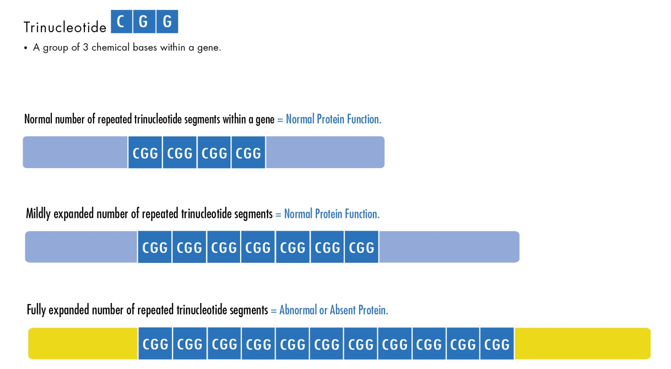
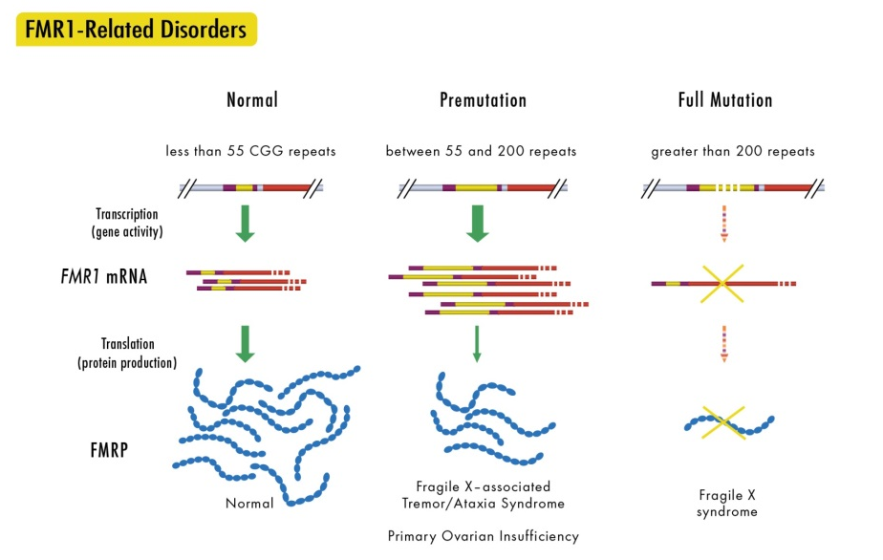
Anticipation
Genomic Literacy

Slide 18
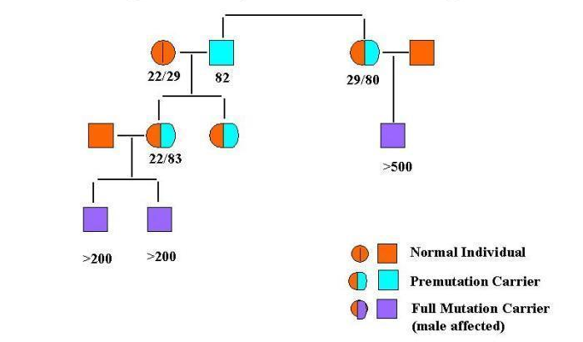
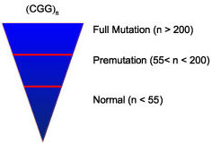
POF
FXAS
Genomic Literacy
POF
POF
FX
FX
FX

Slide 19
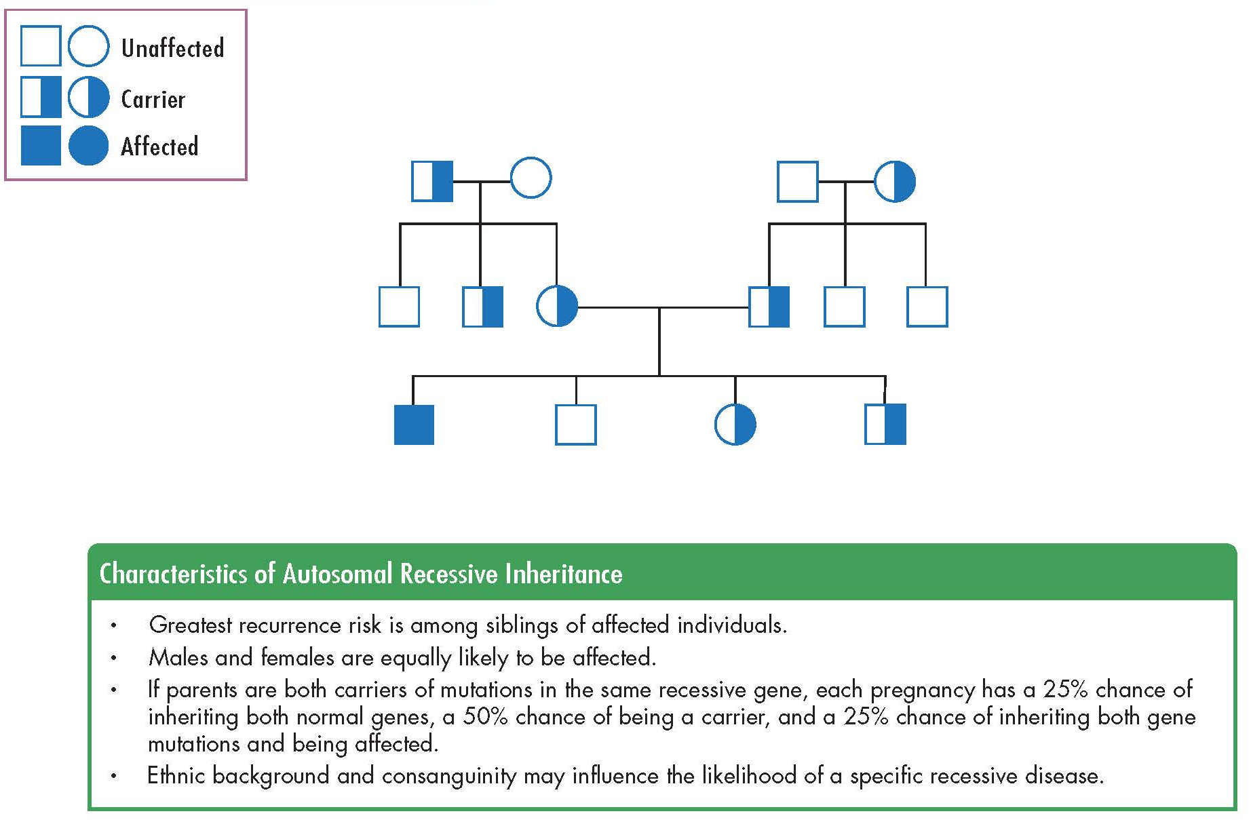
Autosomal Recessive Inheritance
Genomic Literacy

Slide 20
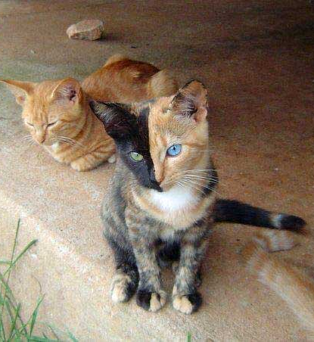
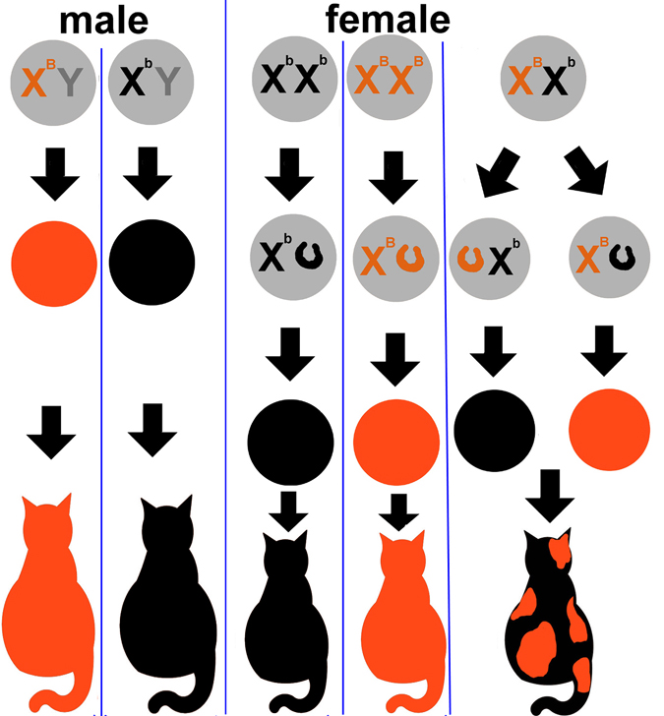
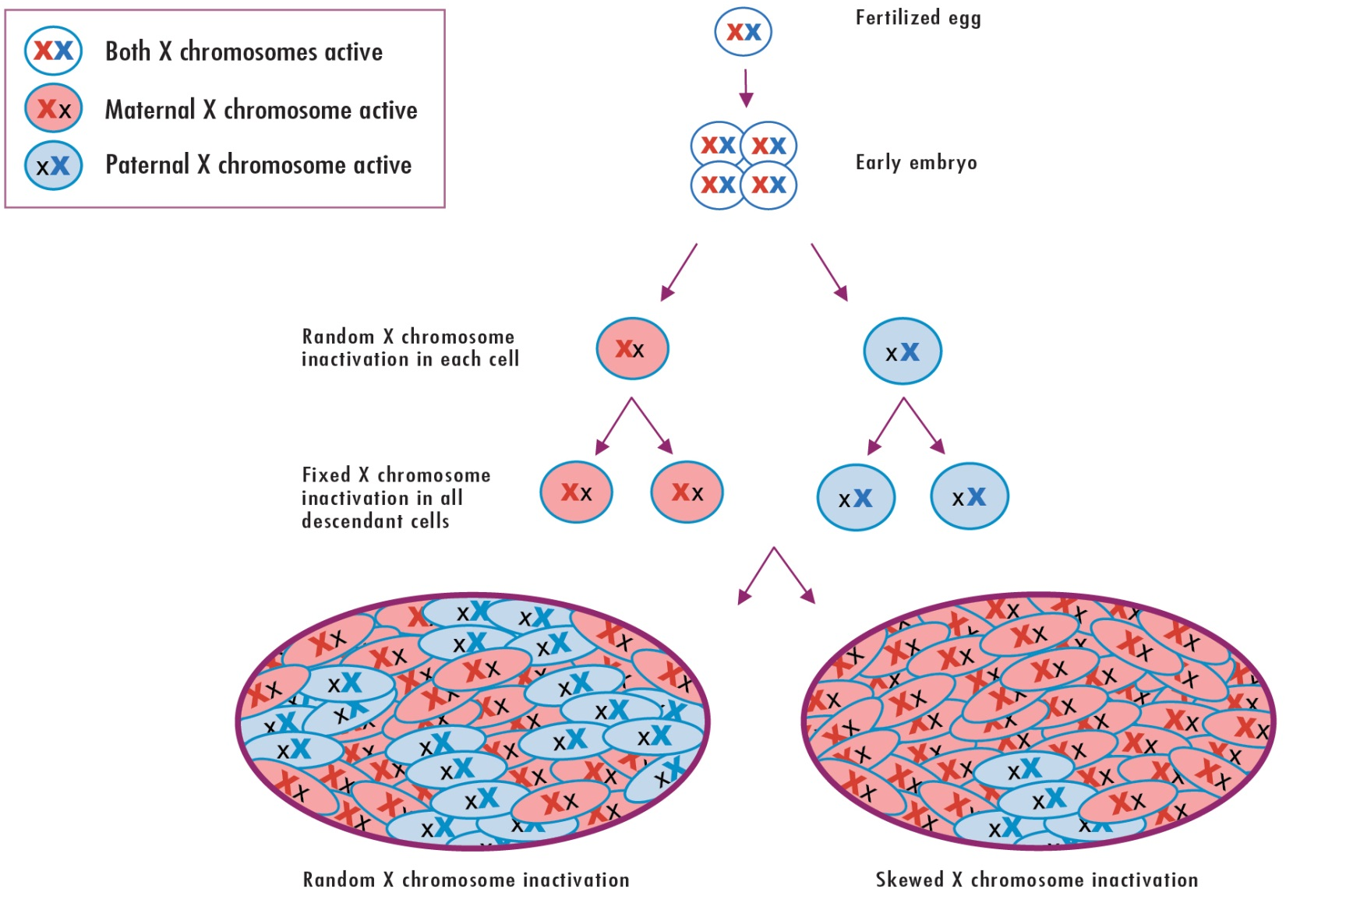
Lyonization = X inactiviation
Genomic Literacy

Slide 21
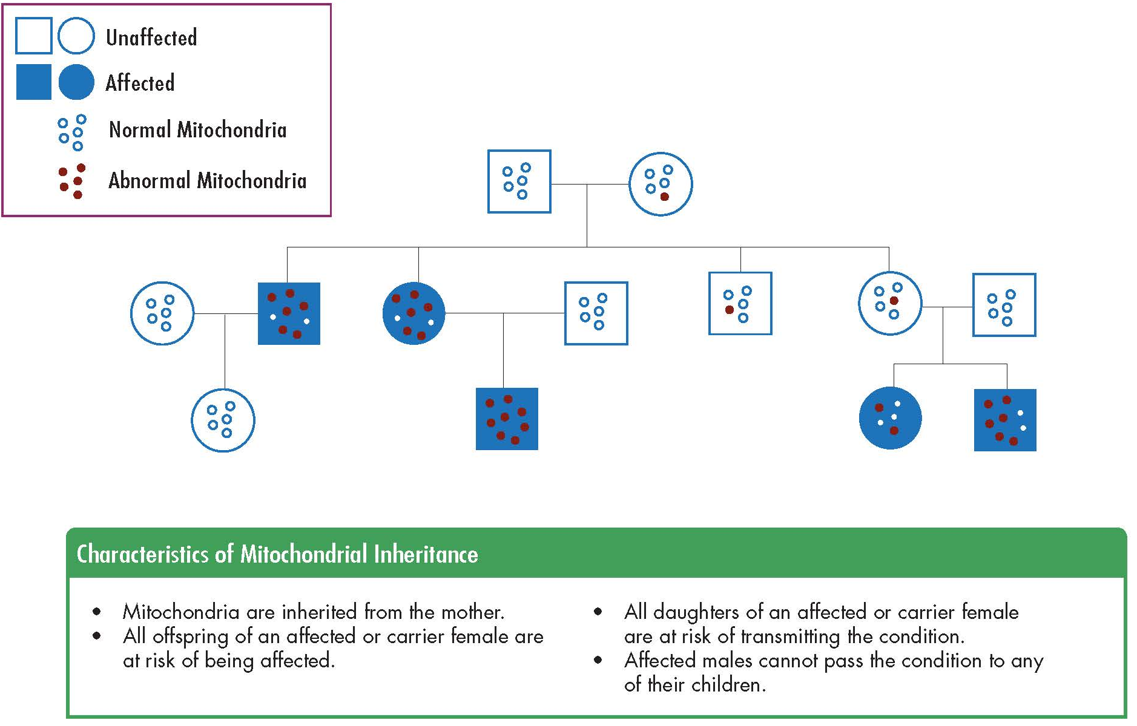
Mitochondrial Inheritance
Genomic Literacy

Slide 22
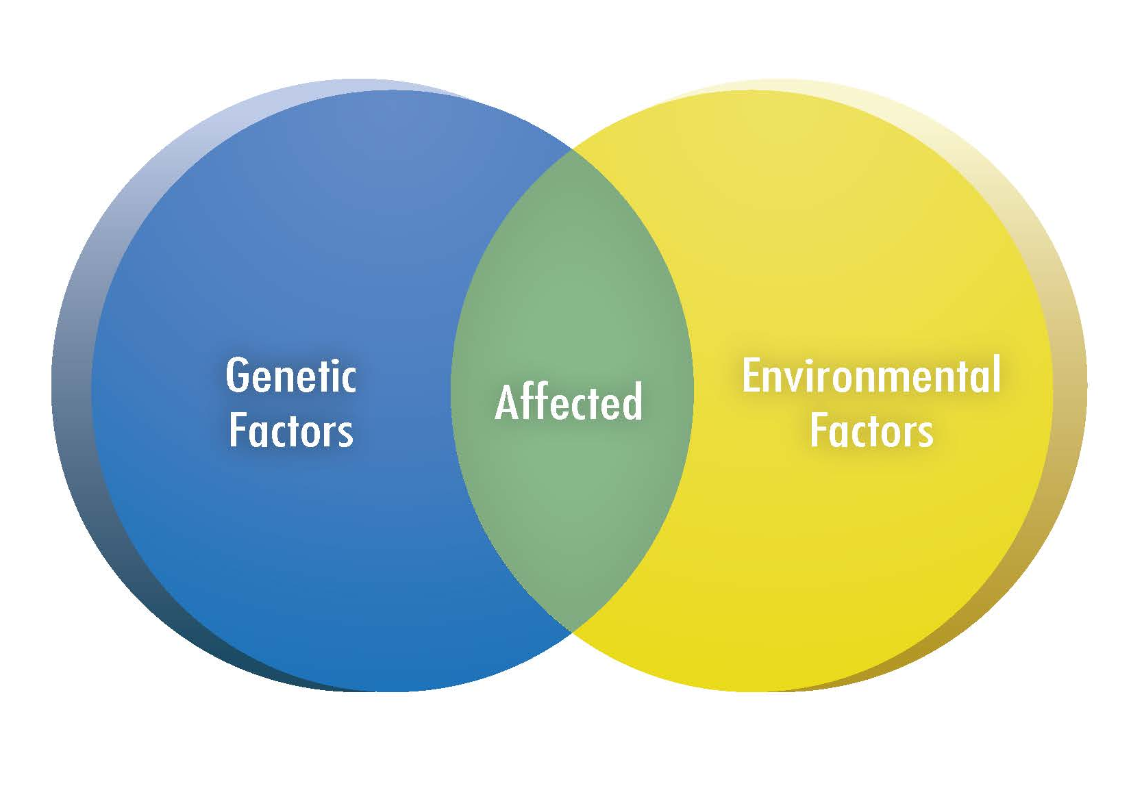
Multifactorial Inheritance
Genomic Literacy
Notes:
How multiple genetic variants interact with each other as well as how the environmental exposure effect expression plays into the inheritance of diseases like diabetes, autoimmunity, and coronary artery disease.

Slide 23
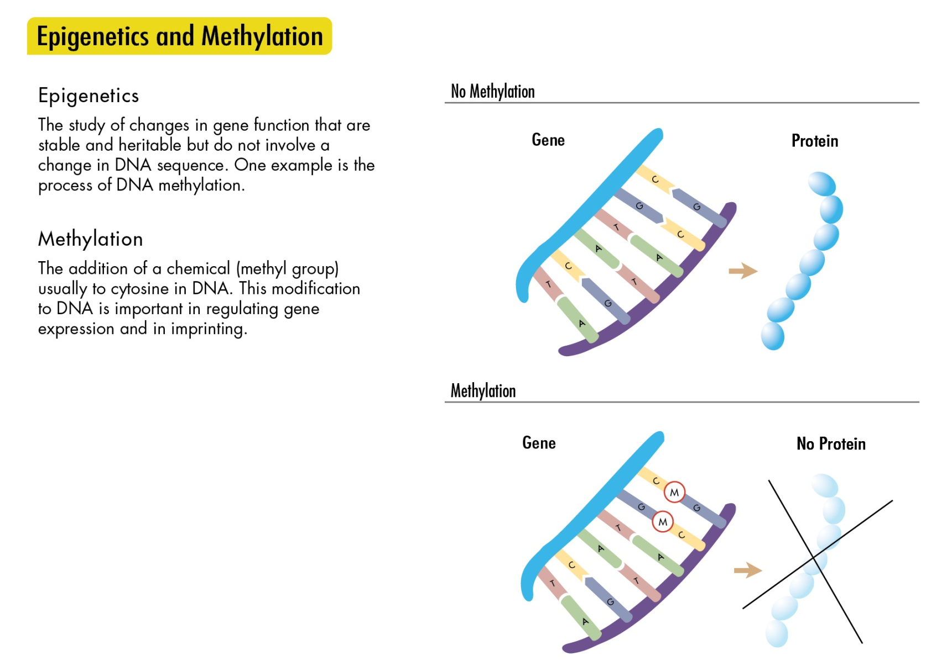
Epigenetic Imprinting
Genomic Literacy

Slide 24
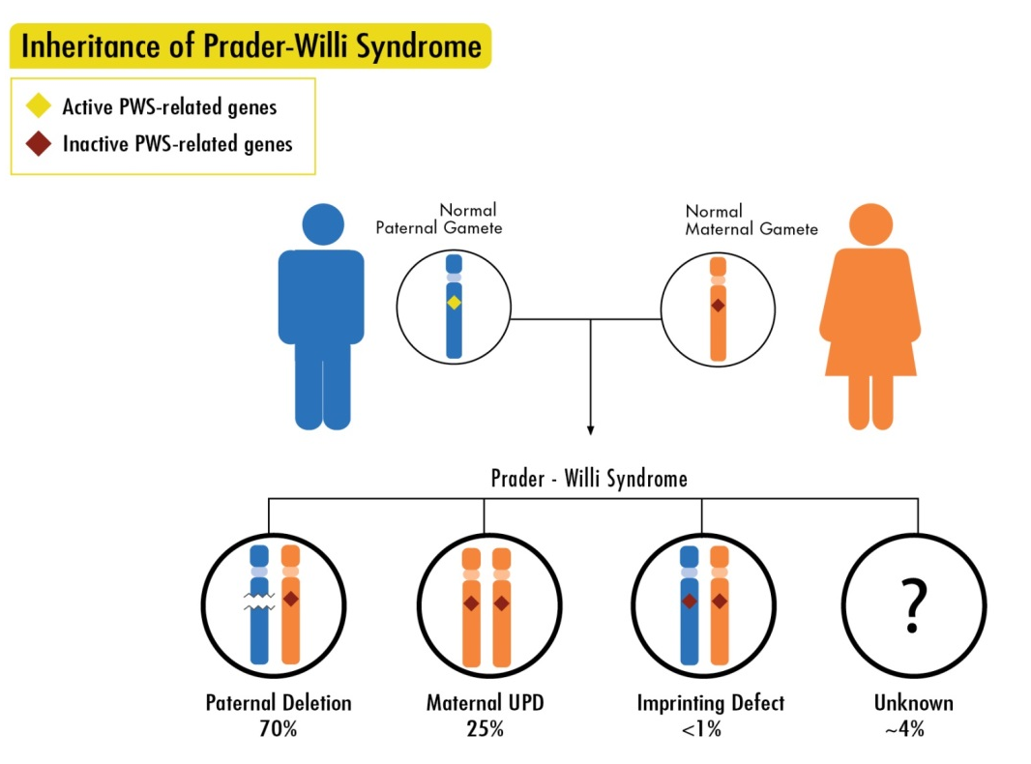
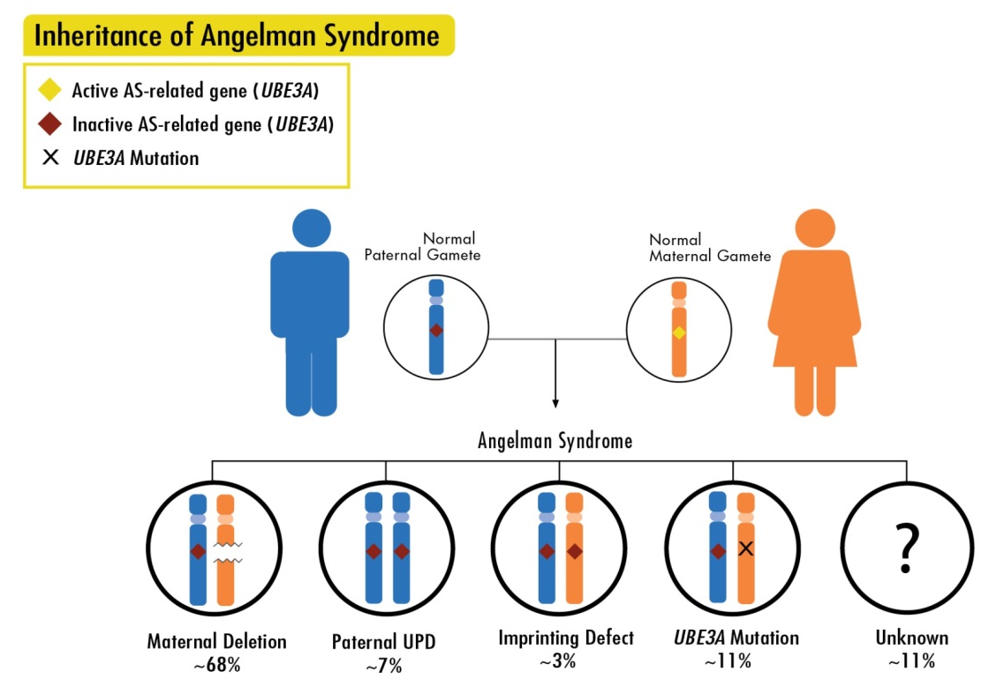
Epigenetic Imprinting
Genomic Literacy

Slide 25
Imprinting Disorders
Location | Disorder | Mechanism
15q11.2q13 | Prader Willi Syndrome 1 in 10,000-30,000 | Paternal Allele Loss
 | Angelman Syndrome 1 in 12,000-24,000 | Maternal Allele Loss UBE3A Loss of Function
11p15.5 | Beckwith Wiedemann Syndrome 1 in 13,700 | Maternal Allele Loss IC1 or IC2
 | Russell Silver Syndrome 1 in 100,000 | Paternal Allele Loss IC1 hypomethylation
7 | Russell Silver Syndrome | Paternal Allele Loss
20q13.2q13.3 | Pseudohypoparathyroidism | Maternal GNAS Disruption
 | Pseudopseudohypoparathyroidism | Paternal GNAS Disruption
Genomic Literacy
Imprinted Chromosomes: 6,7,11,14,15,20

Slide 26
G-Banded Karyotype (Chromosome Analysis)
Genomic Literacy
Can detect deletions and duplications larger than 3-5 Megabases
(Several Hundred Genes)
Detects balanced translocations

Slide 27
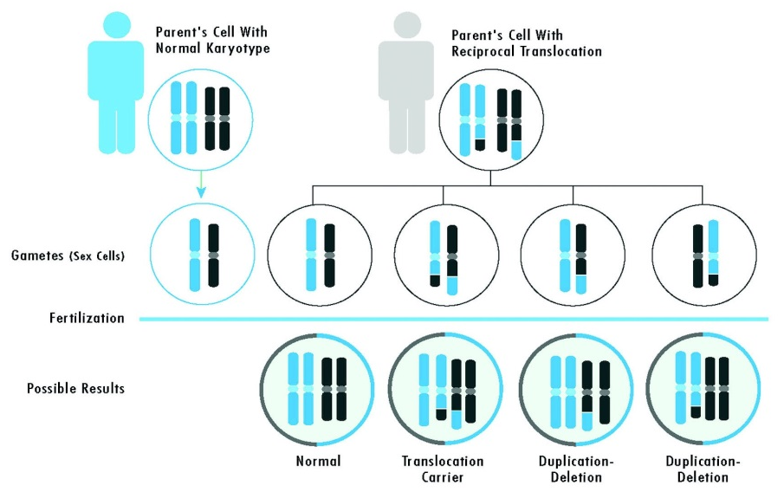
Chromosomal Translocations
History typically includes multiple miscarriages in the family
In an infant with a large chromosomal rearrangement, parental karyotypes are indicated
Translocations can have complex inheritance patterns and varying recurrence risk based on specific location- there are algorithms to determine these specific risks for genetic counseling
Genomic Literacy

Slide 28
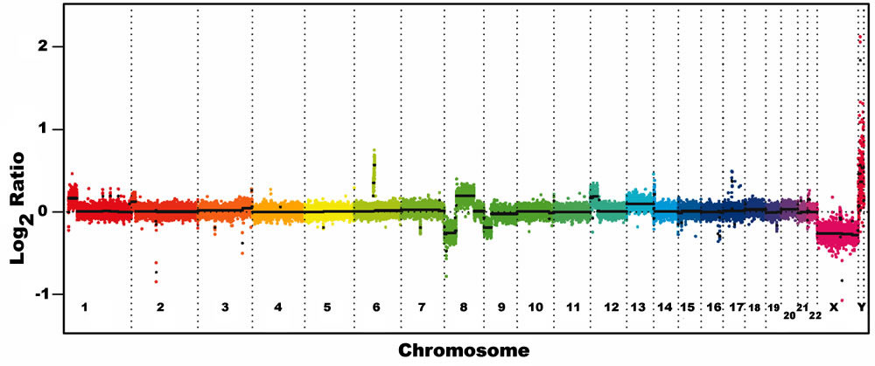
Comparative Genomic Hybridization Array (Microarray)
Reports deletions larger than 0.2 Megabases
Reports duplications larger than 0.5 Megabases
Reports increased homozygosity
Microarray is current standard of care evaluation of Autism Spectrum Disorder, Developmental Delay, and Major Congenital Malformations
Genomic Literacy

Slide 29
Recurrent CNVs (copy number variants)
Deletion | Location | Duplication
TAR Syndrome | 1q21 | Variable
ID/Microcephaly | 1q21.1 | ID/Autism
3q29 Del Syndrome | 3q29 | Variable
Sotos Syndrome | 5q35 | Short Stature, Microcephaly
Williams Syndrome | 7q11.23 | Autism
8p23.1 Del Syndrome | 8p23.1 | Variable
Prader Will/Angelman | 15q11.2q13 | Autism
ID/Epilepsy | 15q13.2q13.3 | Psychiatric Disorders
Autism/ID/Schizophrenia | 16p13.11 | Variable
Autism | 16p11.2 | Autism
HNPP | 17p12 | CMT1A
Smith Magenis Syndrome | 17p11.2 | Potocki Lupski Syndrome
Renal cysts, DM, Autism | 17q12 | Epilepsy
17q21 Del Syndrome | 17q21.31 | Behavioral Problems
22q11.2 Del Syndrome | 22q11.2 | Variable
Genomic Literacy

Slide 30
Chromosomal Deletions
Chromosomal Deletions detectable on Karyotype are always clinically significant due to the size (>5-10 MB)
Smaller deletions, clinically detectable on microarray (>0.2 MB), may have clinical significance or may have unknown significance.
Deletions can predispose to autosomal recessive conditions depending on what genes are involved and whether there is a disruption of the gene on the other chromosome
Genomic Literacy

Slide 31
How do we approach thinking about etiology
Genomic Literacy

Slide 32
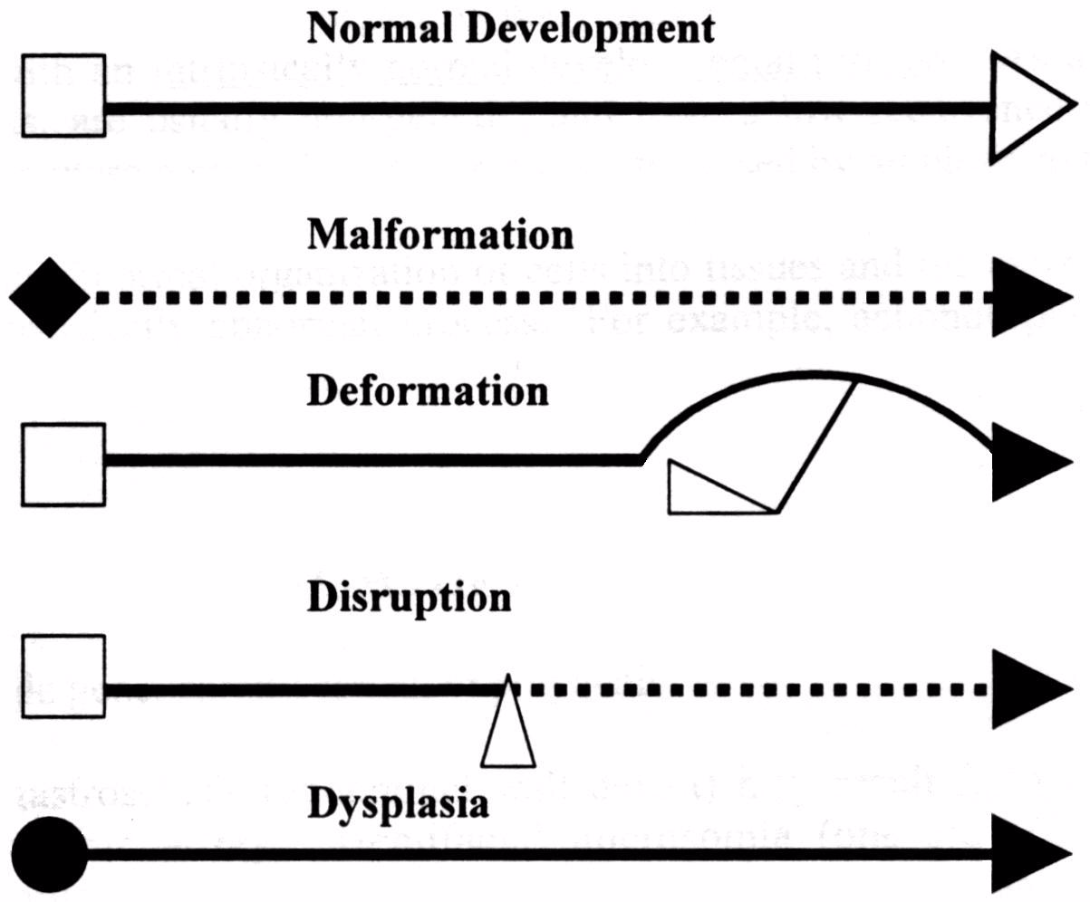
Genomic Literacy

Slide 33
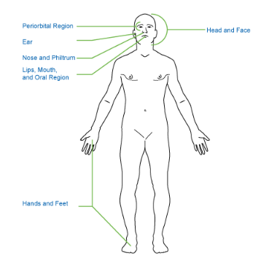
HPO
Elements
of
Morphology
Human Phenotype Ontology
Notes:
Basic breakdown of regions – don’t forget the skin
33

Slide 34
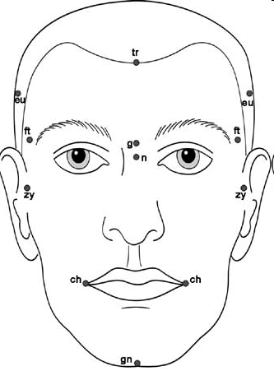
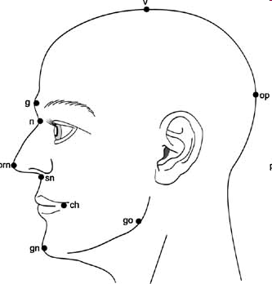
Notes:
34

Slide 35
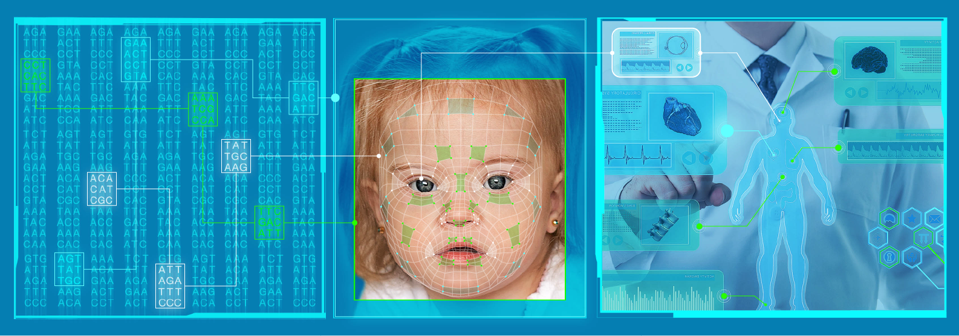
Next Generation Phenotyping

Slide 36
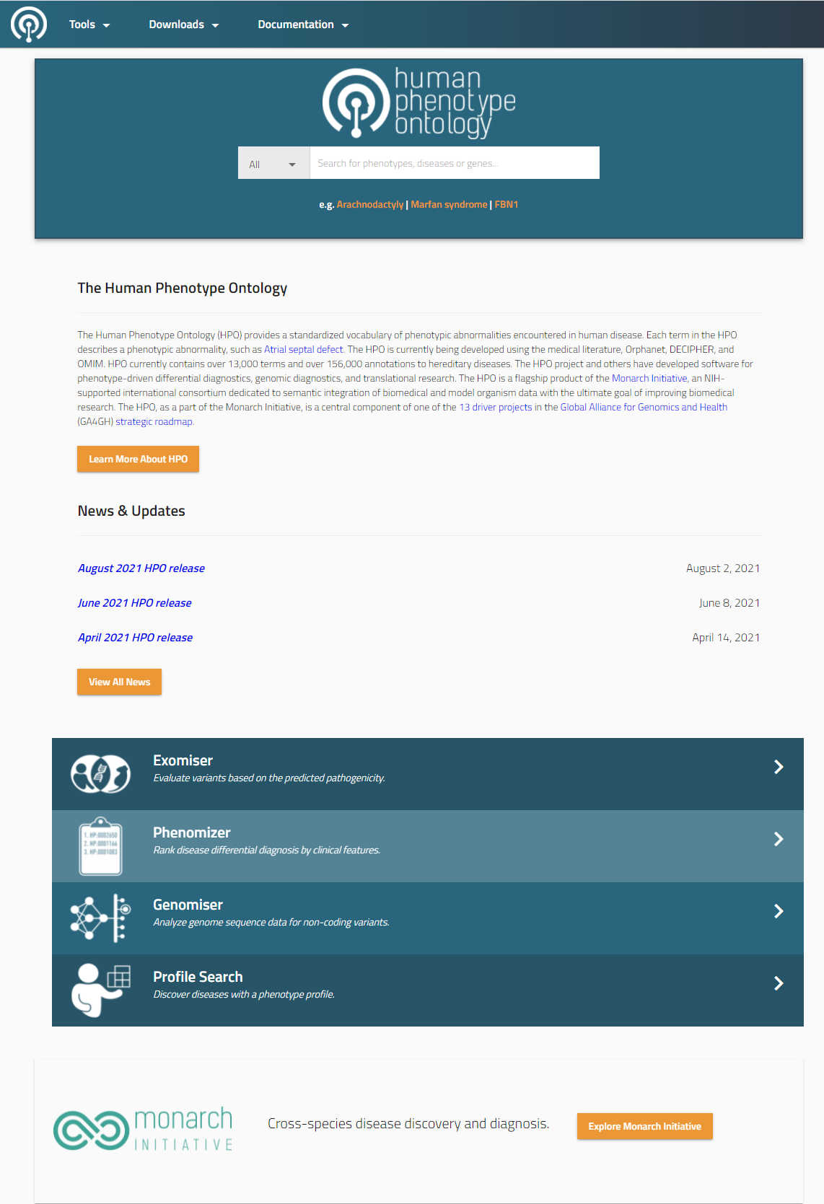
Genomic Literacy

Slide 37
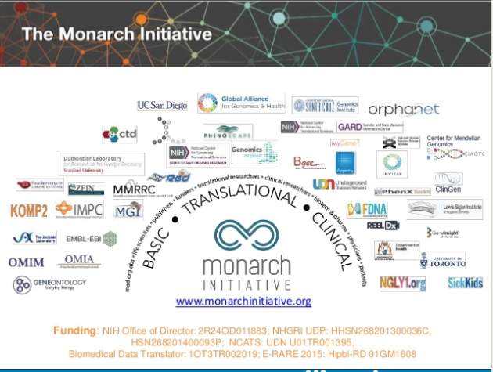

Slide 38


Slide 39

Genomic Literacy

Slide 40





TOOLS

Slide 41


www.omim.org

Slide 42


Slide 43


Slide 44


Slide 45


Slide 46


Slide 47


Slide 48


Slide 49


Slide 50


Slide 51


Slide 52

Genomic Literacy
http://emedgene.com/

Slide 53



