Slide 1

Precision Medicine CME and CEU Introduction and Overview
John Meurer, MD, MBA
Director of the MCW Precision Medicine Education Program
Professor of Pediatrics and Community Health
Director of the MCW Institute for Health & Equity
jmeurer@mcw.edu
No financial disclosures or conflicts of interest

Slide 2
Purpose
Precision medicine is an innovative approach to tailoring disease diagnosis, treatment and prevention that accounts for differences in individual patient’s genomics and molecular factors, lifestyles, and environments
This recurrent semiannual series of an AMA 15-credit continuing medical education (CME), maintenance of certification (MOC2), and continuing education unit (CEU) course provides physicians, nurse practitioners, physician assistants, pharmacists, genetic counselors, and other health care professionals with knowledge, experiences and skills to transform their clinical practices to include precision medicine

Slide 3
Competencies and Quality Dimensions
ACGME & ABMS Competencies
IOM Quality Dimensions
Medical knowledge
Patient care and procedural skills
Practice-based learning and improvement
Systems-based practice
Communication/interpersonal skills
Professionalism
Safety
Equity
Efficiency
Timeliness
Effectiveness
Patient Centeredness
Cost of Care

Slide 4
Program Learning Objectives
Explain Precision Medicine (PM) concepts and draw connections among PM ideas
Understand published PM research and use this information in clinical practice
Formulate PM ideas for cultural transformation of health care with more precision

Slide 5
Topics and Faculty Educators
Precision medicine course overview: John Meurer, MD
Medical genetics: Donald Basel, MD
Laboratory genomics: Honey Reddi, PhD
Epigenomics: Gwen Lomberk, PhD
Biomedical informatics: Michael Zimmerman, PhD
Clinical informatics: Jake Luo, PhD
Pharmacogenomics: Bradley Stockard, PharmD, PhD
Genetic counseling, Jennifer Geurts, MS, CGC
Cancer precision medicine: Ben George, MD
Bioethics in precision medicine: Jeremy Garrett, PhD

Slide 6
Learning Activities
1.5 hours per topic x 10 sessions = 15 hours CME/CEU credits
3 learning objectives for each session
Read 2 or 3 published articles per topic: 60 minutes
Listen to voice-over slide presentations: 30 minutes
Examinations: 7 multiple choice questions per topic

Slide 7
Grading Rubric
Exams assess knowledge gained from readings and presentations
Faculty provide questions, correct answers, and brief explanation note
Participants should achieve 6 of 7 (> 85%) questions correctly
You may repeat the exams once for a passing score

Slide 8
Course Evaluation
For each of the 10 sessions (5-point scale of strongly agree to strongly disagree)
Faculty was clear and organized
Faculty pointed out major concepts
Readings supported the objectives
For the course
Overall effectiveness (outstanding, excellent, very good, good, fair, poor)
Comments on strengths and opportunities to improve

Slide 9
CME, MOC2, and CEU Certificates
Participants must pay $35 for CME or CEU certificate and $15 for MOC2 certificate within 90 days of completing the course
MOC2 available from Boards in:
Anesthesiology
General Internal Medicine
Ophthalmology
Otorhinolaryngology
Pathology
Pediatrics
Surgery
(Sorry not Family Medicine)
CEU credits for Genetic Counseling

Slide 10
Session 1 Objectives
Define precision medicine
Analyze precision medicine systems and strategies to gather and use data and to improve health outcomes
Evaluate precision medicine business models

Slide 11
Definitions
Precision medicine
Model for health care delivery that relies on data, analytics, and info
Tailoring clinical prevention, diagnosis, and treatment to individual variation in genes, environment and lifestyle (National Research Council 2011)
Personalized medicine: approach to patients that considers their genetics and their knowledge, beliefs, attitudes, preferences, and sociocultural context

Slide 12
Precision Health Examples CDC Office of Genomics and Precision Public Health 2022
Prediction and prevention
Family history of breast cancer
Personal smartphone with atrial fibrillation alert
Social media to track influenza
Genome sequencing to track Salmonella outbreak
Newborn screening for severe combined immunodeficiency
Medical options for BRCA mutations, Lynch syndrome (colon cancer), and hypercholesterolemia
Treatment and management
Biomarker testing showing triple negative breast cancer
Pharmacogenomics to test for gene CYP2D6 to guide dose of pimozide for Tourette syndrome
Continuous glucose monitoring to improve insulin dosing for diabetes
Smartphone reminders for healthy lifestyle

Slide 13
Key Components of Precision Medicine
Genomics and molecular profiling: e.g., DNA sequencing to identify specific variations in DNA that may contribute to disease susceptibility, drug response, and health
Biomarkers: e.g., genetic mutations and protein levels to identify specific traits
Data integration and analysis of genetic info, clinical records, and environmental exposures; use AI to identify patterns and correlations
Therapies targeted at underlying disease mechanisms, minimizing side effects, and increasing treatment effectiveness
Patient-centered approach: account for individual preferences, values and lifestyles, empower to share in decision making
Preventive and predictive medicine: intervene before disease become symptomatic

Slide 14
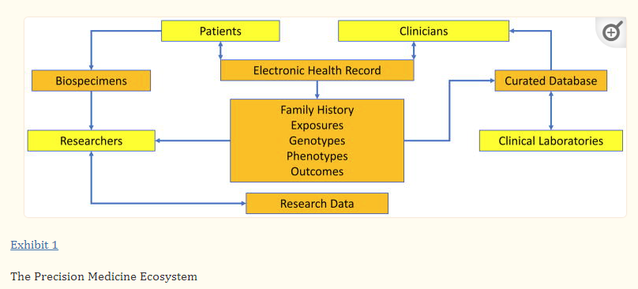
Aronson, Rehm. Nature 2015

Slide 15
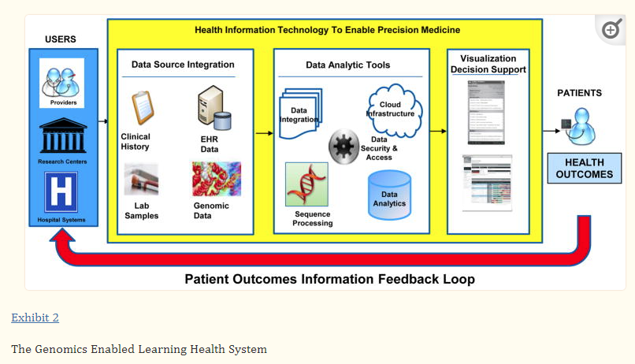
IOM 2015

Slide 16
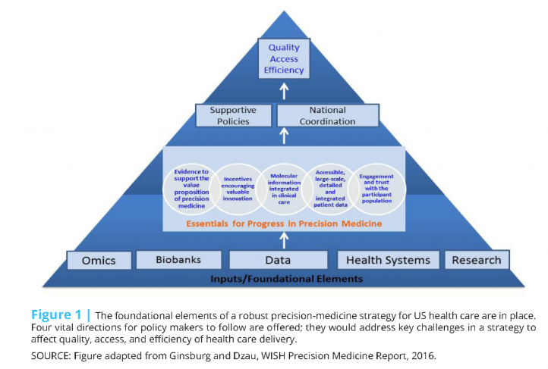

Slide 17
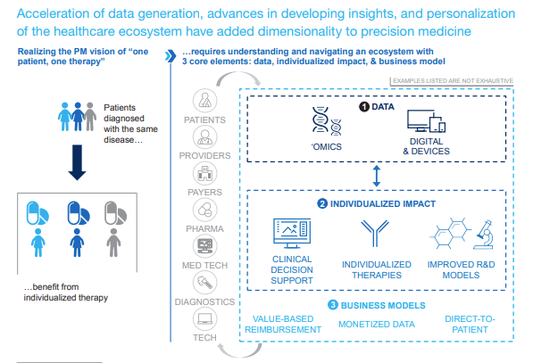
McKinsey & Co, Precision Medicine

