Slide 1


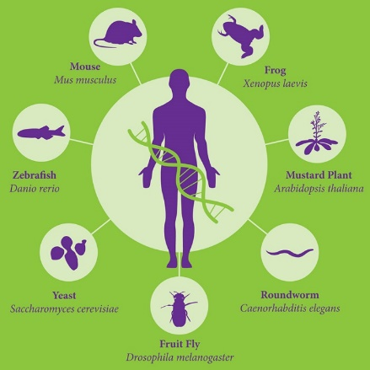
Biomedical Informatics & Genomics in Health Care
Dr. Michael T. Zimmermann, PhD
Director, Bioinformatics Research & Development Lab,
Co-Director, Structural Bioinformatics and Proteogenomics Unit, Linda T. and John A. Mellowes Center for Genomic Sciences and Precision Medicine
Assistant Professor of Bioinformatics, Clinical and Translational Sciences Institute, and Dept Biochemistry

Slide 2
Learning objectives:
Define types of biomedical informatics approaches in health care
Describe the clinical utility of major types of genomic assay technologies
Readings:
DNA sequencing at 40: past, present and future <link>
Epigenetics and Metabolism in Health and Disease <link>
ACGS Best Practice Guidelines for Variant Classification in Rare Disease

Slide 3
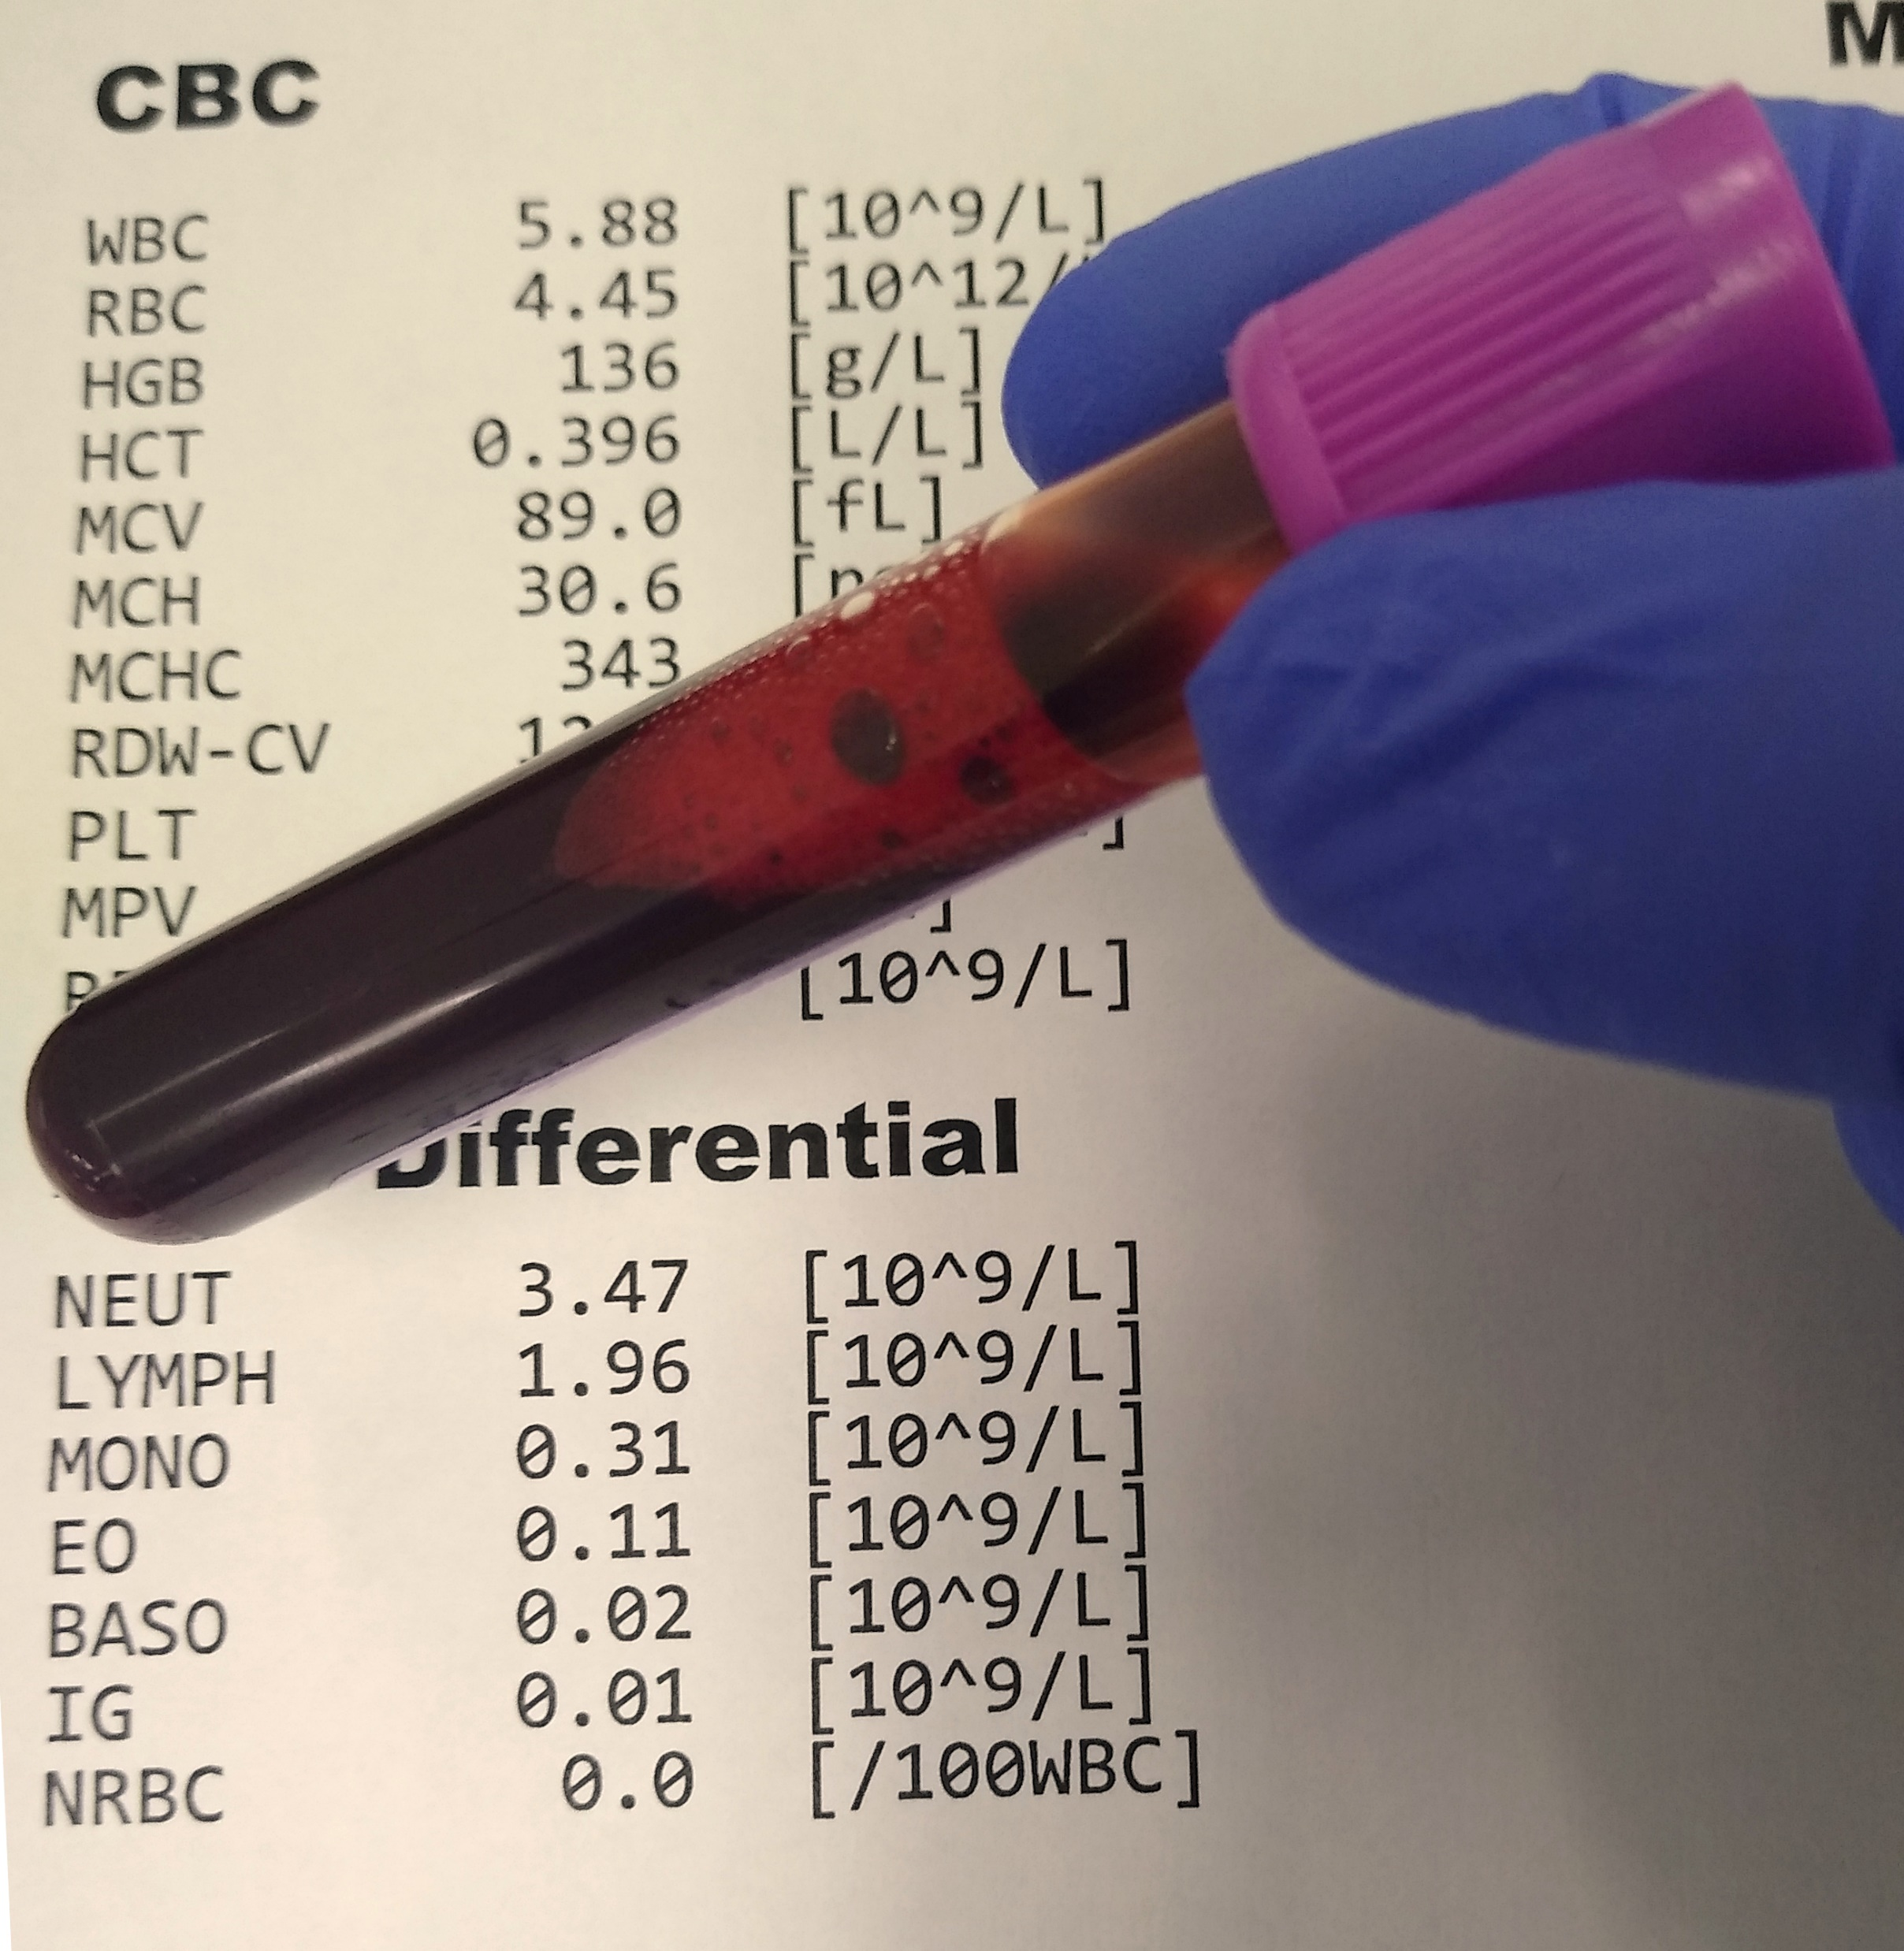
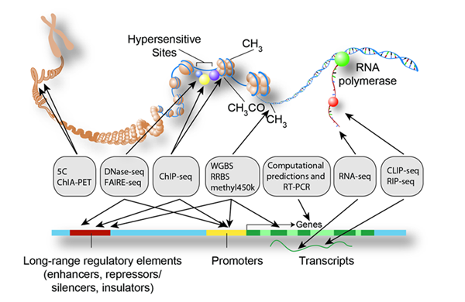
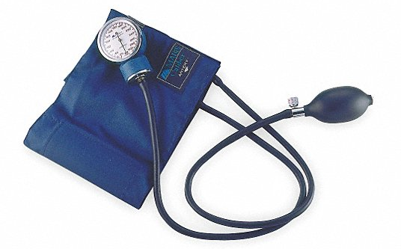
Why Data Science in Healthcare?
Data Size and Complexity → Specialty
Notes:
HR = 1 data point
CBC = 12 data points
Genome is thousands to millions

Slide 4












The Many Informatics in Health Care
Gynecology
Obstetrics
Pediatrics
Psychology
Dermatology
Ear Nose & Throat
Ophthalmology
Anesthesiology
…
(Data Science)
Biostatistics
Bioinformatics
Medical Informatics
Clinical Informatics
Chemical Informatics
Machine Learning / AI
Databasing
…

Slide 5

Translation
Notes:
Translation is key. It’s important to be able to translate across specialties.

Slide 6
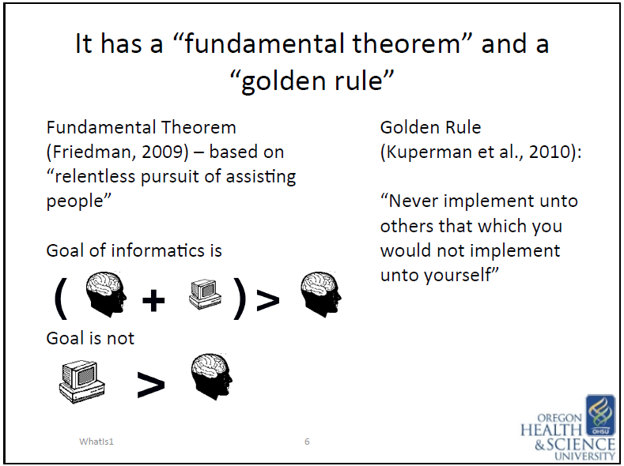
What is “Medical Informatics?”
“[…] resources, devices, and formalized methods for optimizing the storage, retrieval, and management of biomedical information for problem solving and decision making.”
~ Edward Shortliffe, M.D. Ph.D.
Knowledge Management
Clinical Information Management
Communication
Clinical Decision Support
✗
✓
William Hersh, MD

Slide 7
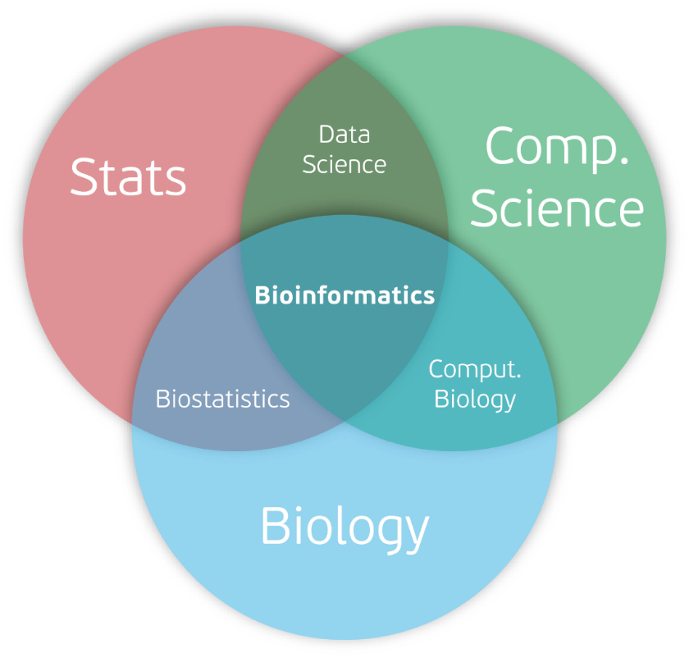
What is “Bioinformatics?”

Slide 8

How do we meet our patient’s unmet needs?
Research
New Measurements
New Tools for Making Better Decisions
Better Interpretations

Slide 9
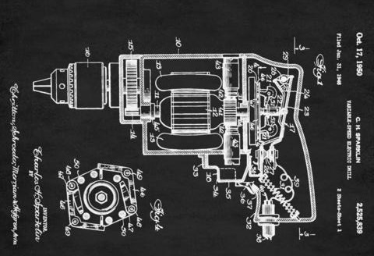
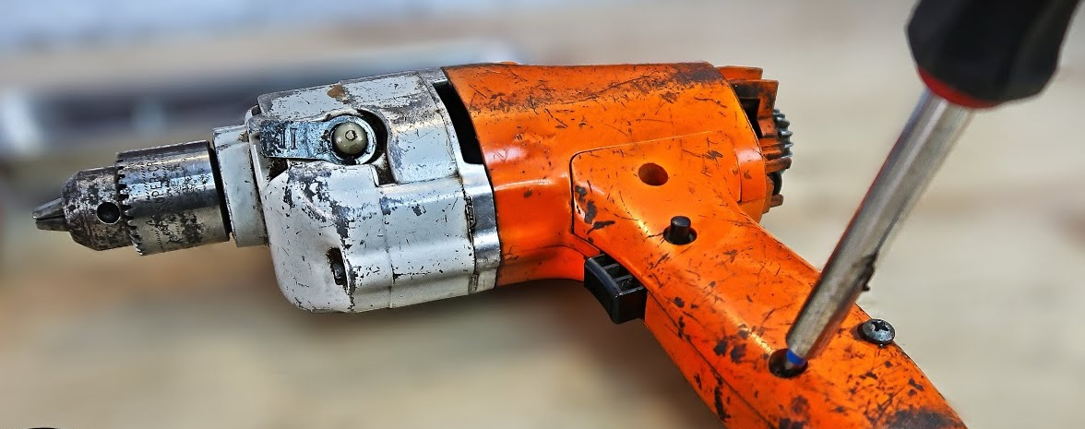
Blueprints Versus Tools
Genome = Blueprint
Altered 3D Protein
Notes:
But, we do not know what jobs many of our genes perform…

Slide 10


Blueprints Versus Tools
Notes:
But, we do not know what jobs many of our genes perform…

Slide 11
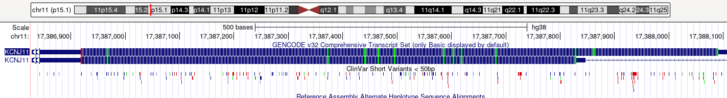
Blueprints Versus Tools
Notes:
From flatland to 3D
Optimistic that continued dev – out wish
Person with diabetes from flatland to 3D
Now the person can be seen

Slide 12

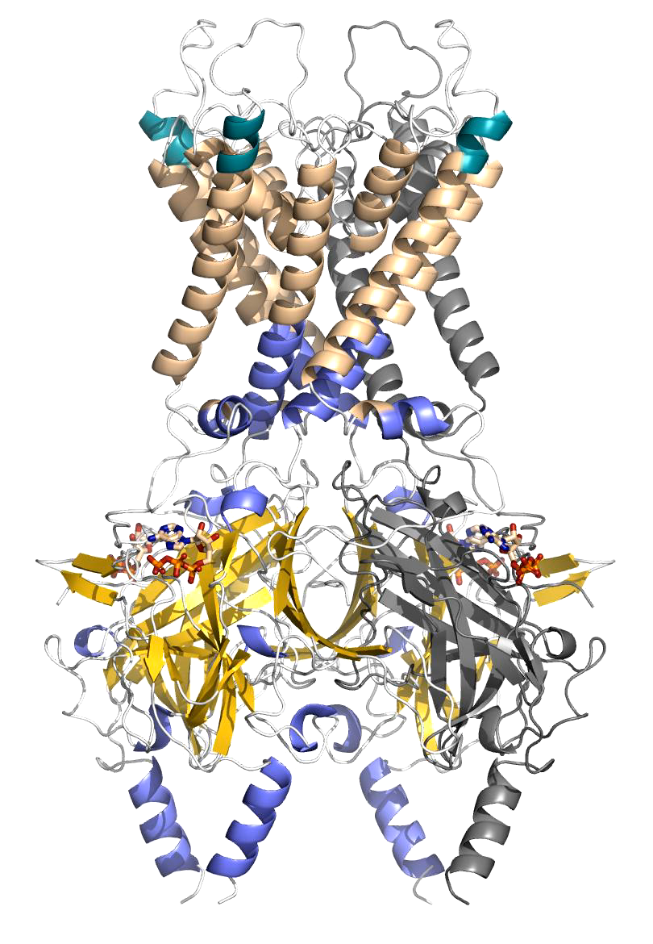
Blueprints Versus Tools
Notes:
From flatland to 3D
Optimistic that continued dev – out wish
Person with diabetes from flatland to 3D
Now the person can be seen

Slide 13
How do we meet our patient’s unmet needs?
Research
New Measurements
New Tools for Making Better Decisions
Better Interpretations

Slide 14
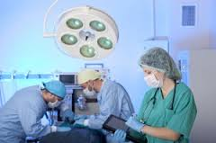

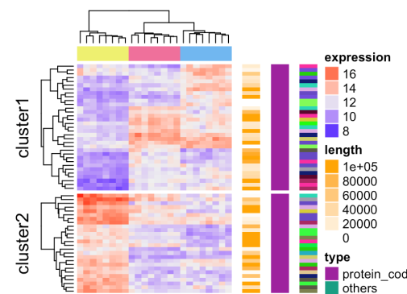
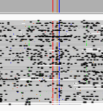
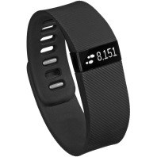
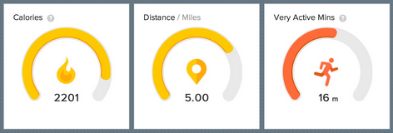
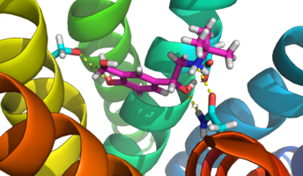
Types of Informatics
Clinical Informatics
Medical Informatics
Bioinformatics
Biomedical & Health Informatics
Cheminformatics

Slide 15
What Does Bioinformatic Data Look Like?

Slide 16
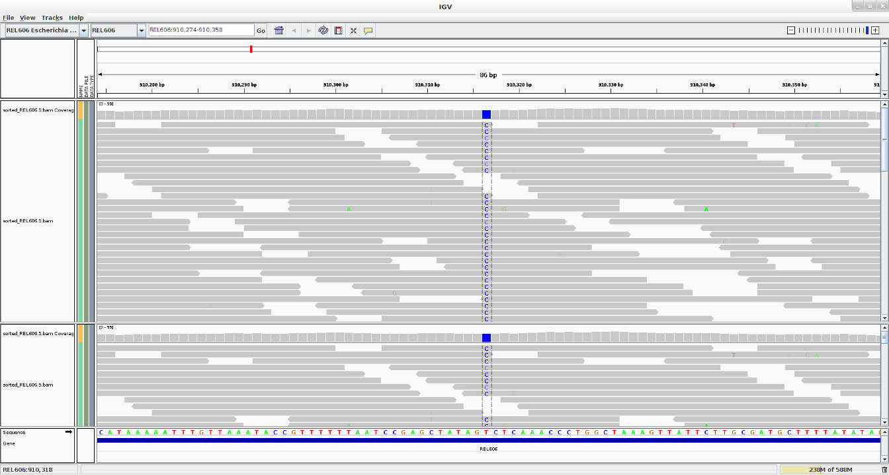
What Does Bioinformatic Data Look Like?

Slide 17
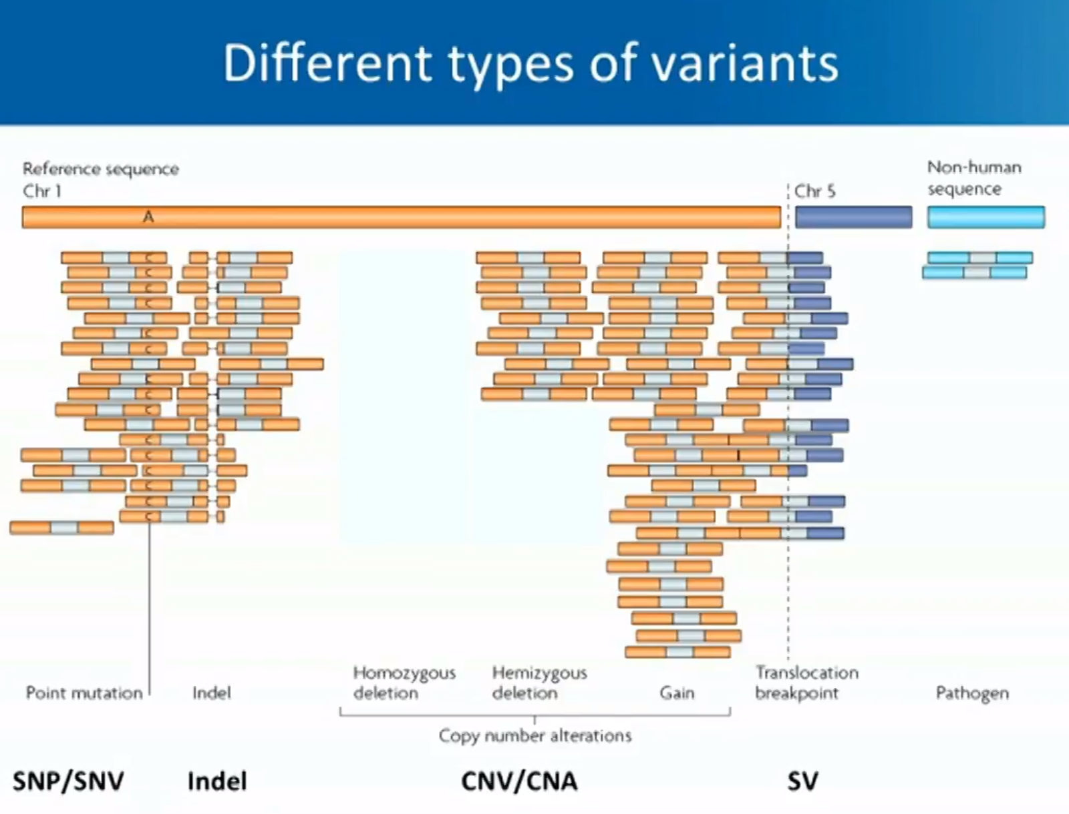
Broad Primer
Notes:
A limitation in DNA sequencing the short reads. Whole Genome does not mean complete coverage of that individuals genome.

Slide 18
Broad Primer

Slide 19
Broad Primer

Slide 20
Is DNA-Seq Solved?

Slide 21
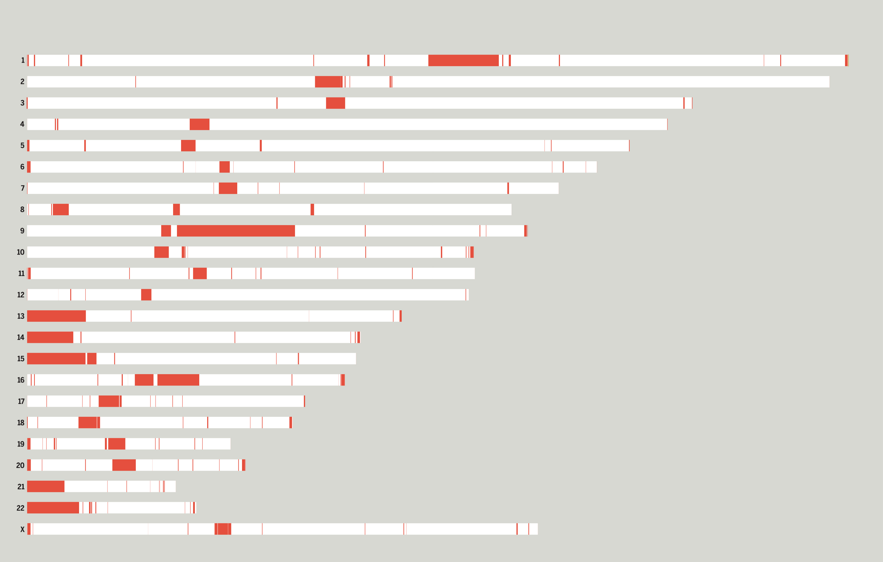

Slide 22
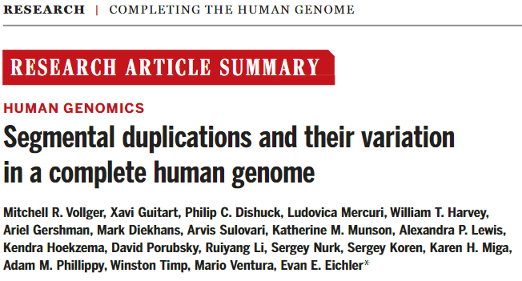
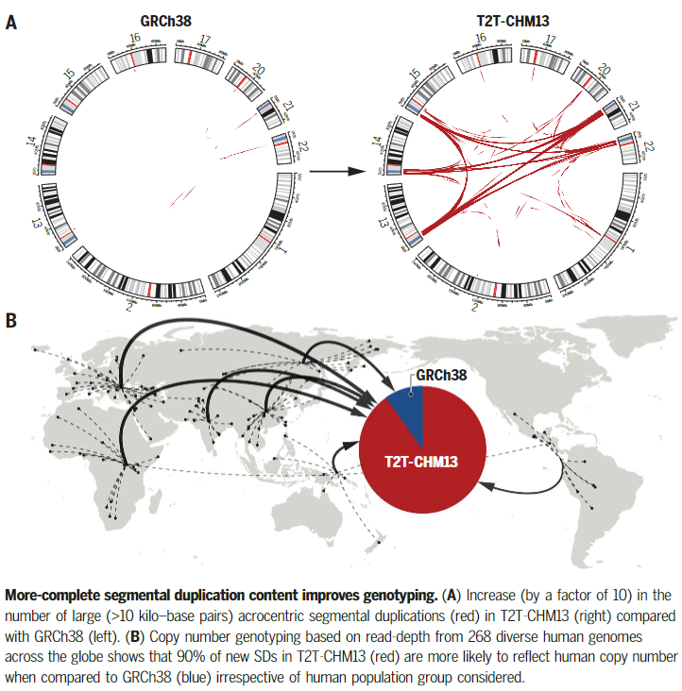

Slide 23
What about other ‘Omics?

Slide 24
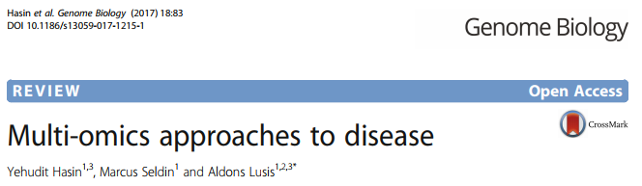
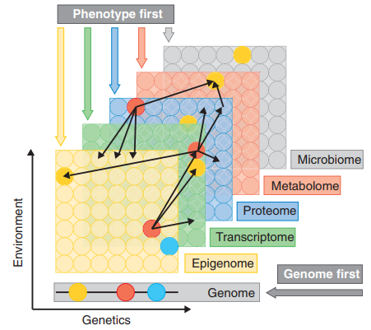

Slide 25
Each Type of Data Has a Specialty

Slide 26
Types of Informatics
Clinical Informatics
Medical Informatics
Bioinformatics
Biomedical & Health Informatics
Cheminformatics

Slide 27
The Informatics are:
Skills for data + knowledge processing and management
Biologic and/or medical data
Technology and algorithms that augment what people can do
Large volume or high-throughput measurements
Diverse records or entities

Slide 28
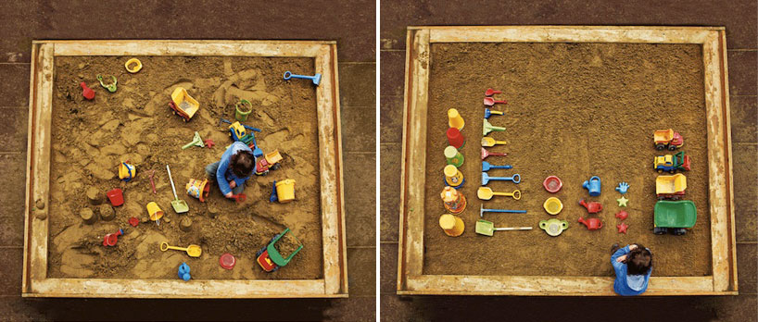
Better Tools to Meet Patient’s Unmet Needs
Integrative
Reductionist
Ursus Wehrli

Slide 29
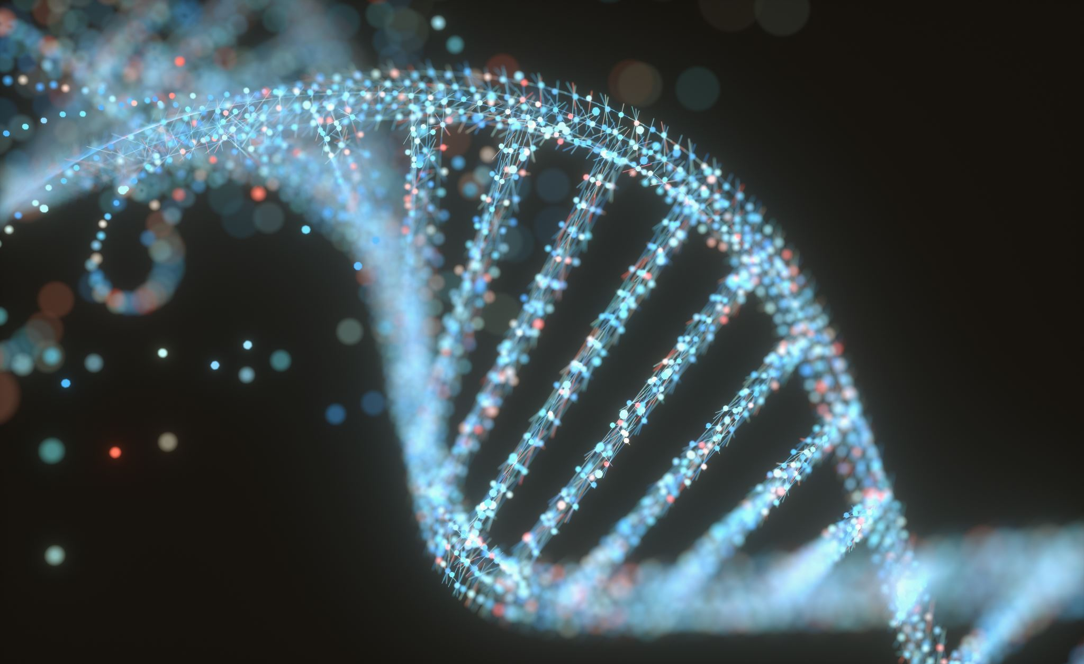
DNA sequencing at 40: past, present and future

Slide 30
DNA sequencing at 40: past, present and future
The most established analyte for high-throughput sequencing
Chemistry + Engineering + {Computers, Algorithms}
“Next-Gen” is now 3rd, 4th, or 5th gen (depending on the review)
Applicable in a wide range of settings
  Non-invasive prenatal testing
  Meta-genomics
  Real-time sensors
Populations and Diversity

Slide 31


Epigenetics and Metabolism in Health and Disease

Slide 32
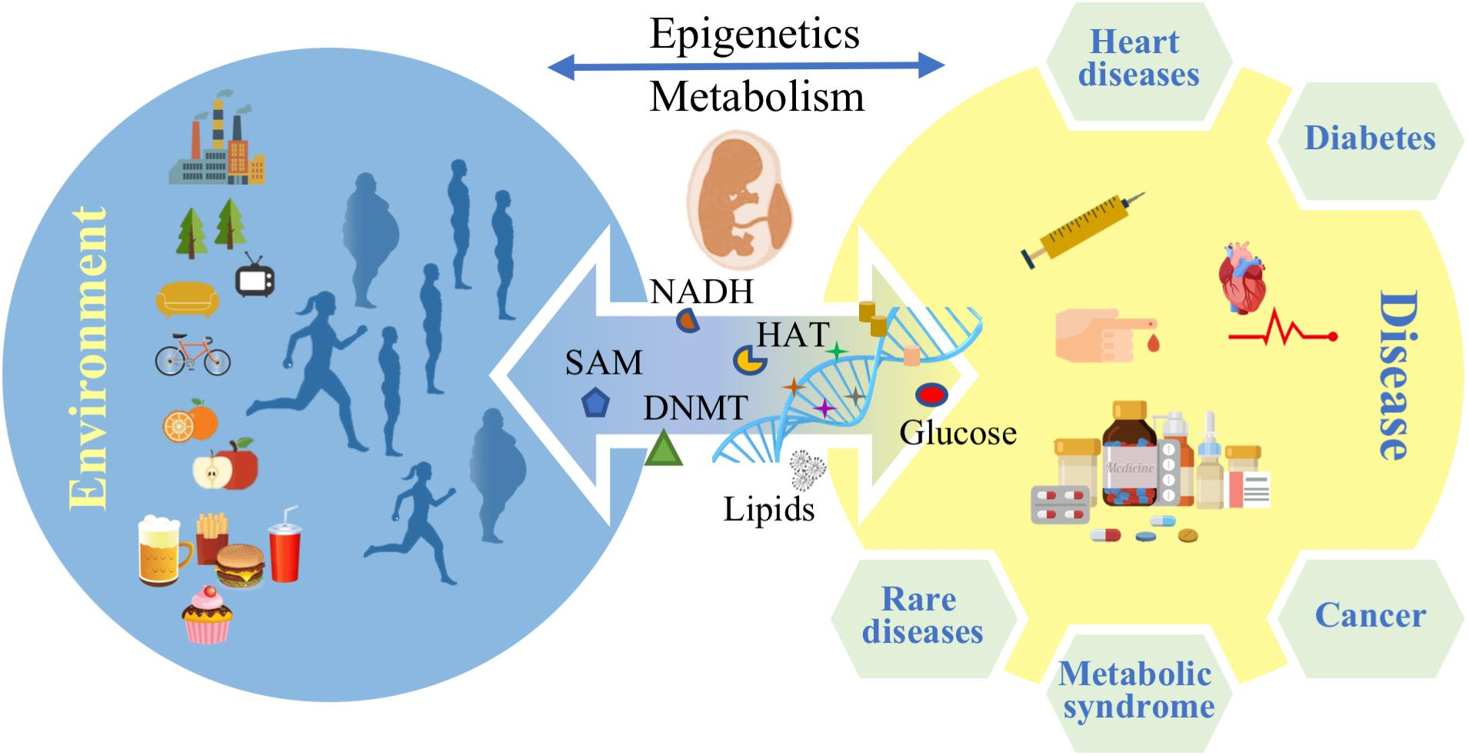
Epigenetics and Metabolism in Health and Disease
“In the next 10 years, one billion people are estimated to suffer from disabling consequences of metabolic disorders, making them the number one noncommunicable disease on a global scale by 2030”
Rare Diseases are Common
Each tumor can be unique
Q: Reactive or Proactive?
Q: Newborn screening?

Slide 33

Genetics in the Medical Practice
Pharmacogenomics
Toxicogenomics
Inborn errors of metabolism
Immuno-deficiencies
Clotting deficiencies
Cancer Risk
Cardiovascular Risk
…

Slide 34

RECAP: Biomedical Informatics + Bioinformatics
Specializations within Data Science
Each has complexities
Each unlocks information about the patient
Current + Future Clinical Utility
Notes:
Hit the power bottom line, learning objectives, and the themes that will be in the questions

Slide 35

What will you do when a patient:
Hands you a flash drive with their genome on it?
Shares their 23&Me report to you through their Patient Portal?
Tells you they are a rapid metabolizer of what you prescribed?
Asks you about their exposure history and immune health?

Slide 36

How might genomic assays be used in your clinical practice?

