Slide 1
Multimodal Pain Management
APP Grand rounds
May 13th, 2026
William Peppard, pharmd, bcps, fccm
Pain stewardship coordinator, pharmacy
Research and scholarship coordinator, pharmacy
Assistant professor, surgery - division of trauma & acute care surgery

Slide 2

Conflict of Interest
No actual or potential conflicts of interest to disclose
Standards for Integrity and Independence in Accredited Continuing Education. https://accme.org/accreditation-rules/standards-for-integrity-independence-accredited-ce, Accessed January 6, 2022.

Slide 3
Previous Years Grand Rounds Objectives
2023 – Focus on guidelines
  2022 CDC Clinical Practice Guideline for Prescribing Opioids for Pain
  Review pain-related resources available at F&MCW
2024 – Focus on recognizing and reducing risk
  Recognize/avoid high-risk opioid prescribing
  Implement risk mitigation strategies
Notes:
Add conflicts if necessary

Slide 4
This Years Objectives - A More Granular Approach
Review treatment strategies to treat acute pain in the setting of opioid use disorder (OUD)
Leverage clinical decision support (CDS) to promote evidence-based and safe prescribing for the management of pain
Identify practices to maintain good pain control and safety during transitions of care
Review new medication(s) to treat pain and identify patients that are potentially good candidates to receive this therapy
Notes:
Add conflicts if necessary

Slide 5
Abbreviations
CDS: Clinical Decision Support
OUD: Opioid Use Disorder
OPA: Our Practice Advisory (formerly BPA, Best Practice Advisory)
PGx: Pharmacogenomics

Slide 6
Updated Guidelines
2016 – Inaugural Version
CDC Guideline for Prescribing Opioids for Chronic Pain – United States, 2016
Recommendations for treatment of chronic pain
Provided recommendations on opioid dosages, durations, and discontinuation
2022 – Updates to 2016 Version
CDC Clinical Practice Guideline for Prescribing Opioids for Pain – United States, 2022
Significant clarity related to inclusion and exclusion
More broadly covers subacute and acute pain
Criticism
Failure to implement patient-centric care
One-size-fits-all
Rapid tapering led to patient harm
Dowell D, Haegerich TM, Chou R. CDC guideline for prescribing opioids for chronic pain – United States, 2016. MMWR Recomm Rep. 2016; 65: 1-49.
Dowell D, Ragan KR, Jones CM, Baldwin GT, Chou R. CDC clinical practice guideline for prescribing opioids for pain – United States, 2022. MMWR Recomm Rep. 2022; 71: 1-95.
Kroenke K, Alford DP, Argoff C. Challenges with implementing the CDC opioid guideline: a consensus panel report. Pain Med. 2019; 20(4): 724-735.
FDA. FDA identifies harm reported from sudden discontinuation of opioid pain medicines and requires label changes to guide prescribers on gradual, individualized tapering. Silver Spring, MD: US DHHS; 2019. https://www.fda.gov/drugs/drug-safety-and-availability/fda-identifies-harm-reported-sudden-discontinuation-opioid-pain-medicines-and-requires-label-changes

Slide 7
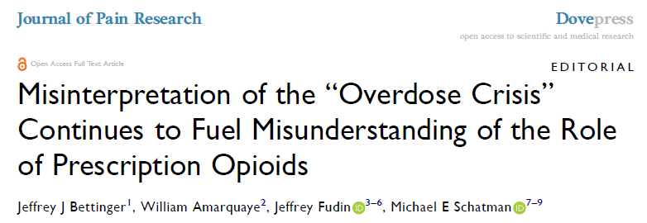
Keeping Things In Perspective…
Bettinger et al. Misinterpretation of the "Overdose Crisis" Continues to Fuel Misunderstanding of the Role of Prescription Opioids. J Pain Res. 2022;15:949-958.

Slide 8
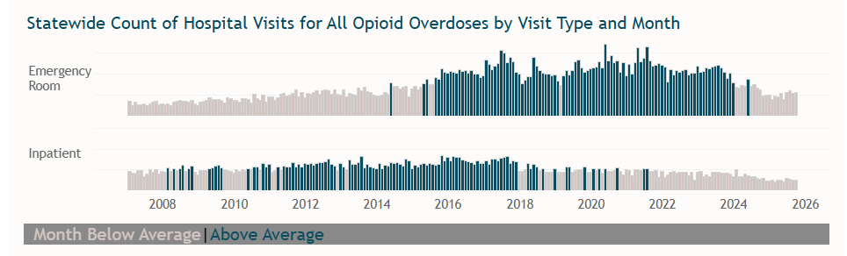
Dose of Reality: WI DHS Opioid Hospital Visit Dashboard
Prevention & Healthy Living. Does of Reality: Opioids. Wisconsin Department of Health Services. Updated Apri 15, 2026. Accessed May 13, 2026. Dose of Reality: Opioid Hospital Visit Dashboard | Wisconsin Department of Health Services.

Slide 9
Review treatment strategies to treat acute pain in the setting of opioid use disorder (OUD)

Slide 10
Patient Case #1
HPI: BB is a 31-year-old patient with OUD (PTA buprenorphine-naloxone 8-2 mg BID) and no other PMH presents to the trauma service following an unwitnessed single vehicle MVC at highway speed, found several hours later, prolonged extrication.
Injuries: open tib-fib fracture, frostbite on toes, 7 rib fractures, grade 4 splenic lac
Day #0: Emergent orthopedic surgery, splenectomy, admit ICU for observation post-op. Patient is emerging from anesthesia and beginning to complain of pain.
What treatment options are you considering?

Slide 11
Receptor Review
Receptor | Physiologic Effect | Association
Mu (μ) | Analgesia, euphoria, respiratory depression, sedation, suppression of HPA axis, promotes dopamine and acetylcholine release | Dependence
Kappa (κ) | Dysphoria, decreased GI motility, appetite suppression, depression, psychotic symptoms, orthostatic hypotension, diuresis | Not associated with respiratory depression
Delta (δ) | Hormonal changes, appetite suppression, promotes dopamine release | Dependence, counteract respiratory depression and constipation
Activity at Receptor | Physiologic Effect | Medication Example
Full Agonist | Produces maximum biological response and positive intrinsic activity | Conventional Opioids (morphine, hydromorphone, fentanyl, etc.)
Partial Agonist | Produces a partial biological response & positive intrinsic activity, but lower than a full agonist. Competitively inhibit a full agonist from binding | Buprenorphine
Antagonist | Produces an inhibitory effect. No intrinsic activity, biologic response from blocking an agonist from binding | Naloxone, naltrexone
*For completeness, buprenorphine is also an agonist for orphan-like receptor (ORL-1), receptor for orphanin FQ/nociceptin (NOP), but is out of scope of this presentation.
Arbuck D, Gharibo C, Labhsetwar S, et al. Management of Opioid Tolerability and Related Adverse Effects. The Journal of Medicine. 2010; 3(1): 1-10. Published May/June 2010.
Davis MP, Pasternak G and Behm B. Treating Chronic Pain: An Overview of Clinical Studies Centered on the Buprenorphine Option. Drugs. 2018; 78(12): 1211-1228. doi: 10.1007/s40265-018-0953-z.
Notes:
Mu partial antagonist contributes to ceiling effect. Binding of the mu opioid receptor creates a cascade of signaling that ultimately promotes analgesia. I will explain a little more in depth on the next slide.
Kappa inverse agonism (also referred to as antagonist) – thought to be why there is less sedation, less dysphoria, a reduction in depression and suicidal ideation.
Delta activity is not fully understood on its importance for contributing to buprenorphine pharmacology
NOP are neuropeptides that are involved in a broad range of central functions including pain, learning, memory, anxiety, and feeding and are thought to be an important component of pain signaling.

Slide 12
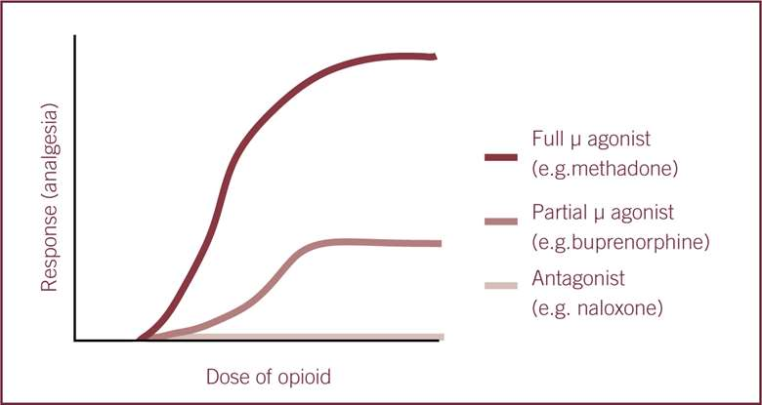
Rationale for Partial Agonist – Safety due to “Ceiling Effect”
Nutt D, Lingford-Hughes. Addiction: the clinical interface. Brit J Pharmacol. 2009;154(2):397-405. https://doi.org/10.1038/bjp.2008.101
Yamaoka TT. Analgesia in veterinary patients – opioids part one. The Veterinary Nurse, Accessed 01.03.23. https://www.theveterinarynurse.com/review/article/analgesia-in-veterinary-patients-opioids-part-one
Notes:
At a certain point, a higher dose of buprenorphine would not lead to significantly more activity at the opioid receptor.
That is to say that the agonist effects of buprenorphine increase linearly as dose increases but only to a certain point, at which it plateaus and no longer continue to increase as dose increases. This is true for both analgesic effects, but also seems to be true for less desirable effects such as respiratory depression.

Slide 13
Buprenorphine History
~80% of BUP used at F&MCW is for OUD
Davis MP, Pasternak G and Behm B. Treating Chronic Pain: An Overview of Clinical Studies Centered on the Buprenorphine Option. Drugs. 2018; 78(12): 1211-1228.
Gudin J and Fudin J. A Narrative Pharmacological Review of Buprenorphine: A Unique Opioid for the Treatment of Chronic Pain. Pain and Therapy. 2020; 9: 41-54.
Notes:
Chronic pain medication therapy has typically involved full opioid agonists such as morphine, oxycodone, fentanyl, hydrocodone and hydromorphone
Use of these opioids has resulted in millions of people misusing and abusing such medications
Buprenorphine was invented in 1966 by synthesizing thebaine (paramorphine)
Since then, numerous formulations have been created for treatment of opioid use disorder (OUD) and chronic pain due to its effect of abuse deterrence

Slide 14
Buprenorphine Formulations & Indications
OUD = higher doses
Pain = lower doses
Drug Formulation | Strength(s) | Dosing | Indication
BUP SL tablet (SUBUTEX ®) | 2 mg, 8 mg | Once daily* | OUD
BUP extended release injection (SUBLOCADE®; BRIXADI®) | 100 mg/0.5 mL, 300 mg/1.5 mL; 64 mg, 96 mg, 128 mg | Once monthly SQ | OUD
BUP/naloxone SL tablet or film (SUBOXONE®) | Tab: 2/0.5 mg, 8/2 mg; Film: 2/0.5 mg, 4/1 mg, 8/2 mg, 12/3 mg | Once daily* | OUD
BUP/naloxone SL tablet (ZUBSOLV®) | 0.7/0.18 mg, 1.4/0.36 mg, 2.9/0.71 mg, 5.7/1.4 mg, 8.6/2.1 mg, 11.4/2.9 mg | Once daily* | OUD
BUP/naloxone buccal film (BUNAVAIL®) | 0.1/0.3 mg, 4.2/0.7 mg, 6.3/1 mg | Once daily* | OUD
BUP implant (PROBUPHINE®) | 74.2 mg per implantable rod (1 dose = 4 rods) | Every six months | OUD
BUP buccal film (BELBUCA®) | 75 mcg, 150 mcg, 300 mcg, 450 mcg, 600 mcg, 750 mcg, 900 mcg | Twice daily | Chronic pain
BUP transdermal patch (BUTRANS®) | 5 mcg, 7.5 mcg, 10 mcg, 15 mcg, 20 mcg (dose is mcg/hr) | Once weekly | Chronic pain
BUP immediate release injection (BUPRENEX®) | 0.3 mg/1 mL | IV or IM every 6 hours as needed | Acute pain
*Alternative off-label regimens may also be available

Slide 15


Managing the Intersection of Pain & OUD – Walking a Tightrope
Risk of undertreated acute pain
  Inpatient illicit drug use
  Delayed recovery
  OUD recurrence
  Leaving AMA
Risk of undertreated OUD
  Opioid withdrawal
  OUD recurrence
OUD
Pain
Herscher M. Med Clin North Am. 2020;104(4):695-708.

Slide 16
OUD Myths
MOUD provides adequate around-the-clock analgesia
Use of opioids for analgesia will result in addiction recurrence
Full agonist opioids used in addition to BUP will not be effective in providing analgesia
Reporting pain equates to manipulation to obtain opioids, drug seeking, manifestation of worsening addiction
Naloxone in Suboxone® blunts effects of opioids for analgesia
Alford DP. Ann Intern Med. 2006;144(2):127-134.
Haber LA et al. J Hosp Med. 2019;14:633-5.
Herscher M et al. Med Clin North Am. 2020; 104(4):695-708.
Lembke A et al. Pain med. 2019; 20(3):425-8.

Slide 17
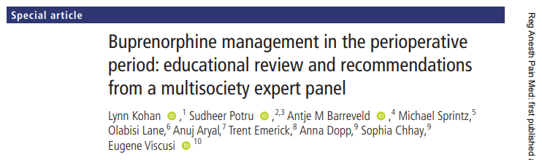
Development of Multidisciplinary Recommendations
American Society of Regional Anesthesia and Pain Medicine
American Society of Anesthesiologists
American Academy of Pain Medicine
American Society of Addiction Medicine
American Society of Health System Pharmacists

Slide 18

Mu Receptor Binding Affinity of Common Opioids
This is (in part)
why pain management
In BUP patients
is complicated!
Ranked from HIGH to LOW Affinity
Gudin J, Fudin A narrative pharmacological review of buprenorphine: a unique opioid for the treatment of chronic pain. Pain and Therapy. 2020; 9: 41-55.
Springer. A Narrative Pharmacological Review of Buprenorphine: A Unique Opioid for the Treatment of Chronic Pain | SpringerLink Accessed November 11, 2021
.
Notes:
Binding affinity is measured by determining the equilibrium dissociation constant (K_{i})
Lower K_{i} = higher binding affinity
Since not all mu-opioid receptors are bound, when necessary full mu-agonist receptors are necessary, a highly-lipopholic and low K_{i} medication has the best potential to compete for unoccupied receptors.
Caption from reference: Buprenorphine exhibits a higher binding affinity at the µ-opioid receptor than full μ-opioid receptor agonists. A low K_{i} value corresponds to greater binding affinity but does not necessarily translate to greater receptor activity [18]

Slide 19
Receptor Binding Occupancy at Various Buprenorphine Doses
Several studies have evaluated this relationship, results are somewhat consistent
Efficacy of pure opioid agonists seems reduced as BUP dose increases, but remains reliable up to 16 mg per day
BUP doses ≥ 24 mg per day seems to limit the efficacy of supplemental pure opioid agonists
Buprenorphine Dose | Available Mu Receptors
1 mg | 71-85 %
2 mg | 53-72 %
4 mg | 36-55 %
8 mg | 20-35%
12 mg | 13-24%
16 mg | 9-20%
24 mg | 4-15 %
32 mg | 2-12 %
Greenwald MK,, et al. Effects of bUP maint dose on mu-opioid receptor availability, plasma conc, & antagonist blockade in heroin-dependent volunteers. Neuropsychopharmacology 2003;28:2000–9.
Greenwald MK, Comer SD, Fiellin DA. BUP maintenance and mu-opioid receptor availability in the treatment of opioid use disorder: implications for clinical use and policy. Drug Alcohol Depend 2014;144:1–11.
Zubieta J, Greenwald MK, Lombardi U, et al. BUP-induced changes in muopioid receptor availability in male heroin-dependent volunteers: a preliminary study. Neuropsychopharmacology 2000;23:326–34.
Quaye AN-A, Zhang Y. Perioperative management of buprenorphine: solving the conundrum. Pain Med 2019;20:1395–408.
Comer SD, Walker EA, Collins ED. Buprenorphine/naloxone reduces the reinforcing and subjective effects of heroin in heroin-dependent volunteers. Psychopharmacology 2005;181:664–75.
Greenwald MK, Schuh KJ, Hopper JA, et al. Effects of buprenorphine sublingual tablet maintenance on opioid drug-seeking behavior by humans. Psychopharmacology 2002;160:344–52.

Slide 20
General Treatment Considerations
Non-pharmacologic
  Heat/cold, positioning
  Relaxation strategies, mindfulness & breathing (apps such as “Calm” or “Breathe”)
  Distracting behaviors (read, music, social interaction, virtual reality, etc.)
  Peer recovery support
  Physical therapy
Non-opioid Pharmacologic
  Regional anesthesia, local infiltration
  Intra- and post-op ketamine and/or lidocaine infusions
  Topical agents (lidocaine patch, IcyHot, Ben Gay, etc.)
  NSAIDs, APAP, muscle relaxants, gabapentinoids, TCAs, SNRIs, etc.

Slide 21
Acute Pain Management Patients Receiving BUP for Chronic Pain
Low-dose BUP (for chronic pain) will present minimal barriers for the management of acute pain
  Optimize non-pharmacologic and non-opioid therapy first
  Continue current BUP regimen
  Add supplemental pure opioid agonist as needed
    May expect slightly higher than usual doses will be required to achieve usual efficacy
  Alternative approach to temporarily increase the buprenorphine dose
  Plan to taper back to baseline regimen once acute pain resolves

Slide 22
Pre-op Pain Management Planning for Patients Receiving BUP for OUD
BUP should not be routinely discontinued as adequate analgesia can be achieved
  Grade B, moderate level of certainty
Discontinuing buprenorphine can increase the risk of OUD recurrence or harm
  Grade B, moderate level of evidence
Avoid tapering BUP perioperatively
  Grade B, moderate level of certainty

Slide 23
Discontinue vs. Continue Chronic BUP During Acute Pain Management
Discontinue BUP (historical approach) | Continue BUP (preferred approach)
Potential improved opioid analgesia | Dose supplemental opioid independency of BUP
Must include MMEs from BUP into opioid strategy BUP 16 mg ~ 480 MMEs??? No, not really! Analgesia not achieved until baseline MMEs met Potential concern for withdrawal | Evidence supports adequate analgesia may be obtained with BUP + supplemental opioids Supported by recommendations from multidisciplinary panel
Transitions of care may be more complicated | Reduces risk of discontinuity of care and risk or re-induction therapy
Increased risk of OUD recurrence, including death | Decrease risk of OUD relapse and accidental overdose
Haber LA. J Hosp Med. 2019;14:633-5. Herscher M. Med Clin North Am. 2020;104(4):695-708

Slide 24
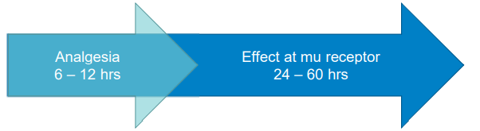
Post-operative Pain Management for Patients Receiving BUP for OUD
Multimodal analgesia should be used whenever possible (adjunctive medications, regional anesthesia, etc.)
  Grade B, moderate level of certainty
Consider administration of full mu agonists (with high affinity for mu receptor → hydromorphone, fentanyl)
  Grade B, moderate level of certainty
Alternatively, increase &/or divide doses of BUP
  Grade C, low level of certainty
Provide close monitoring for uncontrolled post-operative pain if multimodal analgesia proves inadequate
  Ungraded recommendation

Slide 25
Discharge Planning
If a full mu agonist is initiated, or if BUP is increased during the peri-operative period, a post-discharge plan to taper off the full mu agonist or return to the pre-operative maintenance dose of BUP is recommended
  Grade A, moderate level of certainty
Engage in ongoing collaboration with the patient’s outpatient BUP prescriber
  Grade A, moderate level of certainty

Slide 26
Leverage clinical decision support (CDS) to promote evidence-based and safe prescribing for the management of pain

Slide 27
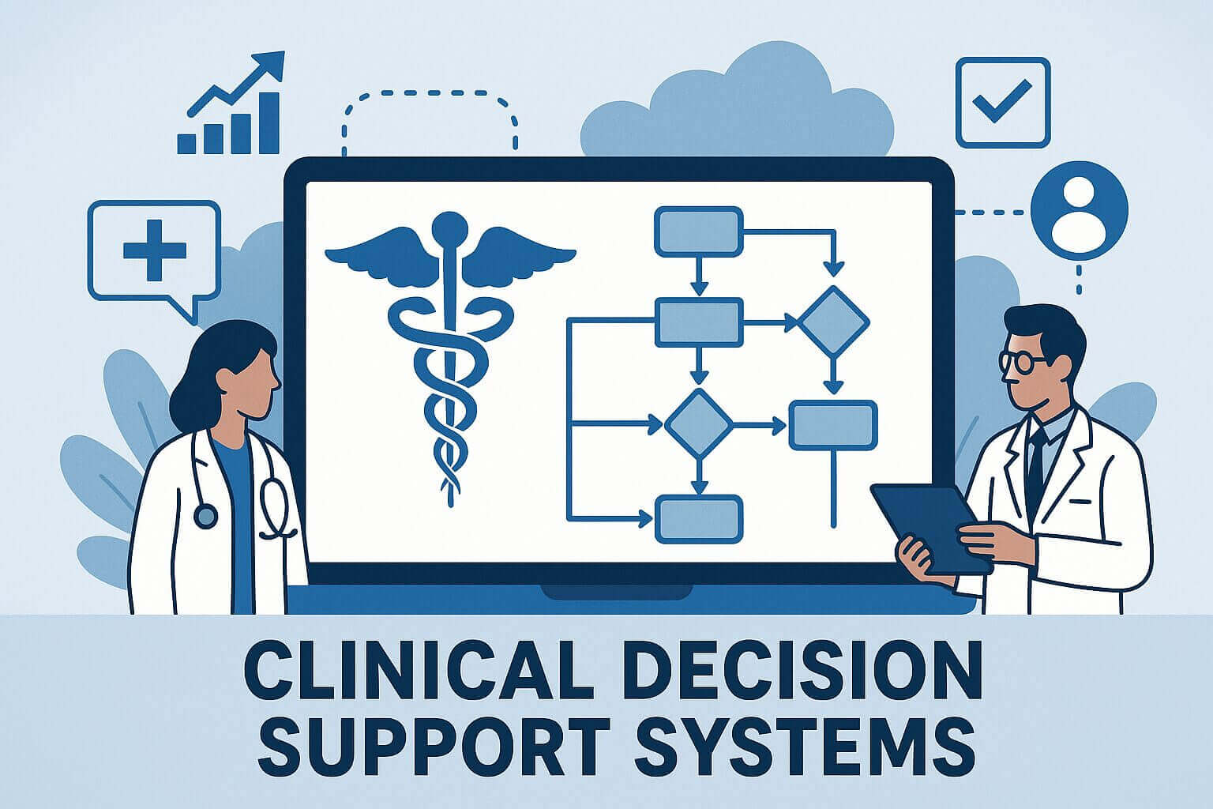
Clinical Decision Support (CDS)
CDS provides clinicians, staff, patients or other individuals with knowledge and person-specific information, intelligently filtered or presented at appropriate times, to enhance health and health care.
CDS encompasses a variety of tools to enhance decision-making in the clinical workflow which include:
  Computerized alerts and reminders to care providers and patients; clinical guidelines; condition-specific order sets; focused patient data reports and summaries; documentation templates; diagnostic support, and contextually relevant reference information, among other tools.
AHRQ, 2024. ASTP, 2024. Tcheng JE, Nat Aced Med 2017.
Notes:
Clinical Decision Support. Agency for Healthcare Research and Quality. Updated November 2024. Accessed May 2, 2025. https://www.ahrq.gov/cpi/about/otherwebsites/clinical-decision-support/index.html

Slide 28
The Five Rights of CDS
 | Criteria | Our Alert
1 | The right information
2 | To the right people
3 | Through the right channels
4 | In the right intervention formats
5 | At the right points in workflow
Why the alert fired
Prescribers
Via interruptive EHR alert
Pop-ups that allow action within the alert
At time order entry or order signing
Use thoughtful inclusion/exclusion criteria to optimize both sensitivity and specificity,
thus, minimizing alert fatigue to yield the greatest impact.
Centers for Medicare & Medicaid Services. Clinical Decision Support: More Than Just “Alerts” Tipsheet. September 2014. Accessed May 4, 2026.

Slide 29
Goal of CDS
Make it easy to do the right thing,
while making it difficult to do the wrong thing!

Slide 30
Identify Patients at High Risk of ORAE
TJC and CMS require hospitals to prioritize safe opioid prescribing and identify patients at high risk for ORAE
Currently, the naloxone administration rate at F&MCW is ~0.68% for patient exposed to any opioid
  For those exposed to morphine, the rate is 0.94%
    Related to active metabolite (Morphine-6-glucornide) accumulation due to renal dysfunctions, more pronounced in elderly patients

Slide 31
Morphine OPA Inclusion & Exclusion Criteria
Inclusion Criteria
Morphine is ordered
Aged ≥18 years and admitted to a F&MCW hospital
Renal dysfunction within 30 days (eGFR of ≤60 mL/min/1.73m²)
Exclusion Criteria
Morphine order: GEN IP End of Life Order-Supplement order-set Intra-articular route of administration Chest pain as indication
Presence of any order from a hospice/palliative order-set

Slide 32
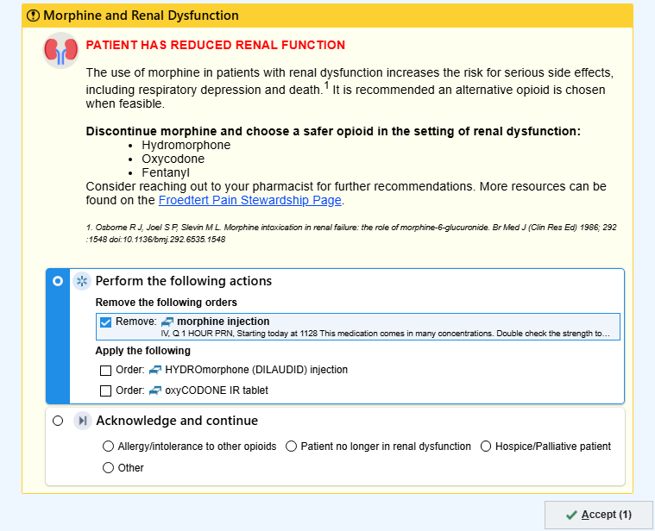
OPA in Action

Slide 33
OPA in Action
Rationale
Encouragement to choose a safer opioid, discuss with a pharmacist, and provides easy access to Froedtert-specific resources

Slide 34
OPA in Action
Able to order alternatives within the OPA
Acknowledgement reasons for continuing with morphine (if choosing to do so)

Slide 35
Primary Outcome – Action Taken Percentage
Notes:
Suggest Bold and maybe make larger the headers above each pie graph so they stick out a bit more. Make same titles above graphs as the 2 slides that follow
Can you include the “n” on the slides? I see the numbers ie 49, 32% maybe the total N for each somewhere for a quick reference? (Maybe this is just me) – Trish
- Added n to the chart titles. Will keep titles as is, since there is no ATP for the pre-implementation cohort (would be 0% since OPA was not implemented)

Slide 36
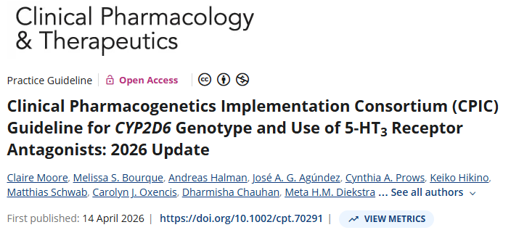
New Pharmacogenomics (PGx) Guidelines

Slide 37
Coming Soon - PGx OPA Focused on CYP2D6
Intermediate (AS=0.25-0.75) or Poor Metabolizer (RX PGX OPIOIDS CYP2D6 IM (AS=0.25-0.75)/PM PROVIDER)
PROBLEM: This patient’s CYP2D6 genotype is associated with decreased production of active forms of certain opioid analgesics. This patient may receive LITTLE TO NO PAIN RELIEF with CYP2D6-metabolized opioids such as codeine, hydrocodone, and tramadol.
RECOMMENDATIONS:
Consider a non-opioid analgesic.
  OR
If an opioid analgesic is indicated, consider an alternative opioid that is not affected by CYP2D6 metabolism such as hydromorphone or oxycodone
See CPIC clinical guidelines for more information or consult a clinical pharmacist.
CPIC Guideline for CYP2D6 and Opioids

Slide 38
Coming Soon - PGx OPA Focused on CYP2D6
Ultrarapid Metabolizer (RX PGX OPIOIDS CYP2D6 UM PROVIDER)
PROBLEM: This patient’s CYP2D6 genotype is associated with excess production of active forms of certain opioid analgesics. This patient is at risk for ADVERSE EVENTS such as RESPIRATORY DEPRESSION OR DEATH with CYP2D6-metabolized opioids such as codeine, hydrocodone, tramadol.
RECOMMENDATIONS:
Consider a non-opioid analgesic.
OR
If an opioid analgesic is indicated, consider an alternative opioid that is not affected by CYP2D6 metabolism such as hydromorphone or oxycodone
See CPIC clinical guidelines for more information or consult a clinical pharmacist.
CPIC Guideline for CYP2D6 and Opioids

Slide 39
Identify practices to maintain good pain control and safety during transitions of care

Slide 40
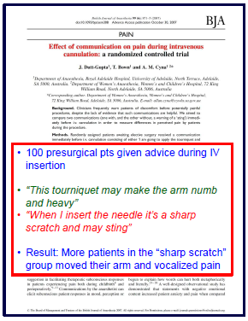
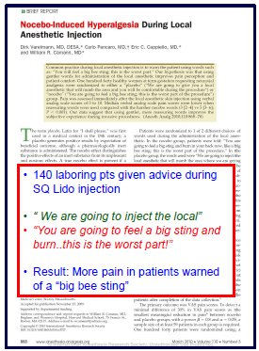
Word Choice Matters
Should you tell them
“it’s gonna hurt…”
or
“it’s not gonna hurt”…?
Br J Anaesth 2007; 99: 871–5. Anesth Analg 2010;110:868-70.
Notes:
I know you are all great with setting realistic expectations, and nurses do a great job with this at the bedside when they establish the patients tolerable pain score, and this is important, but what I want to emphasize is that evidence suggest how the messaging is delivered affects outcomes.

Slide 41
Non-pharmacologic Options
Comfort Therapy
Companionship
Physical and Occupational Therapy
Exercise
Heat/cold application
Lotions/massage therapy
Meditation
Music, art, or drama therapy
Pastoral counseling
Positioning
Aquatherapy
Tone and strengthening
Desensitization
Psychosocial Therapy/ Counseling
Individual counseling
Family counseling
Group counseling
Neurostimulation
Transcutaneous electric nerve stimulation (TENS)
Acupuncture

Slide 42
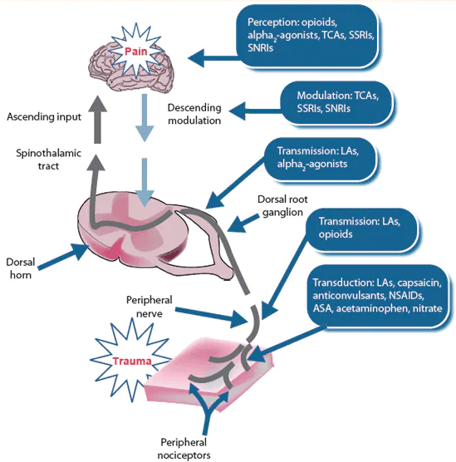
Multomodal Pharmacologic Options
Different drug classes work at different sites in the body
We often use more than one drug class to treat pain because the effects are additive and sometimes synergistic
Opioid-sparing effect
  Acetaminophen
  NSAID
  Topical agents
  Opioids… maybe NOT tramadol
  Anticonvulsants, antidepressants (chronic)
  Regional anesthesia/analgesia (inpt)
  Ketamine / lidocaine IV infusion (inpt)

Slide 43
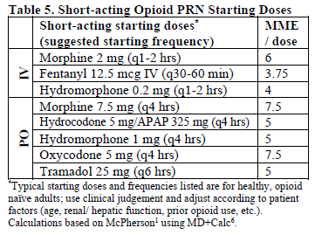
Pain Stewardship “Green Pocket Card”
Link to pocket card

Slide 44
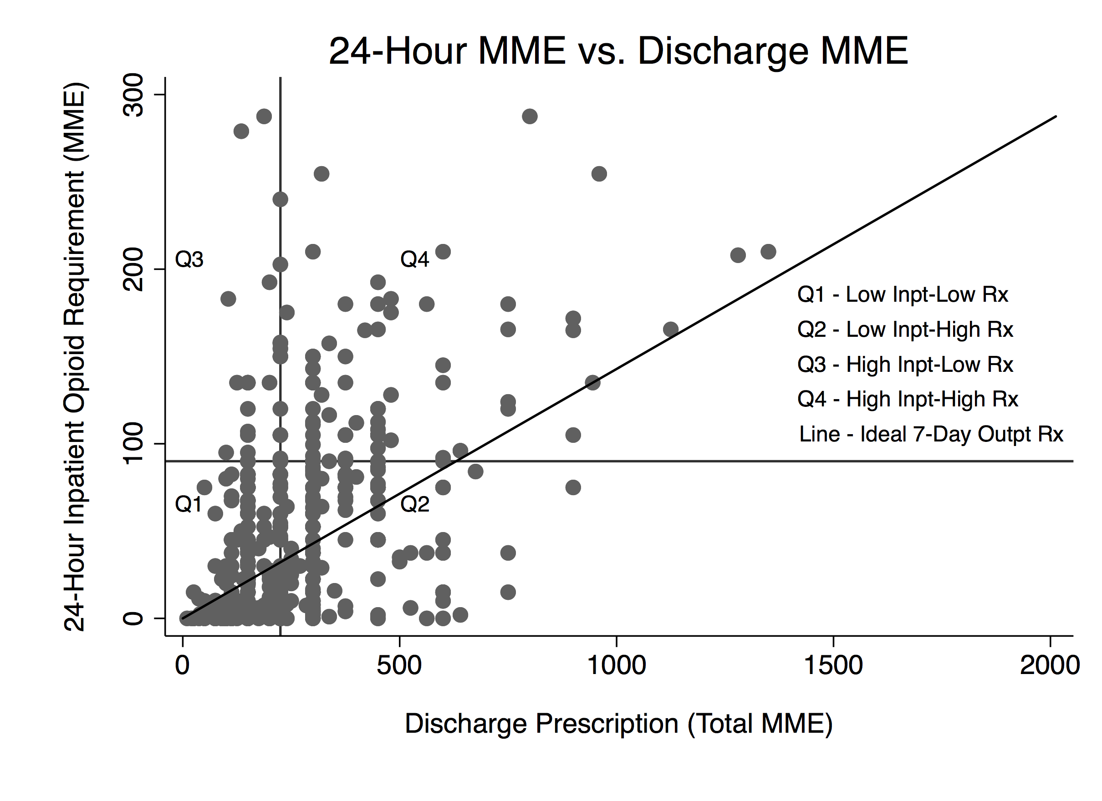
Inpatient MME and Discharge MME Don’t Often Correlate
Notes:
10.06 Correlation Between Inpatient Opioid Use and Discharge Prescriptions: Patient-Centered Prescribing - Academic Surgical Congress
Correlation Between Inpatient Opioid Use and Discharge Prescriptions: Patient-Centered Prescribing
Posted on January 31, 2019
J. Bleicher¹, S. M. Stokes¹, B. C. Nguyen¹, L. C. Huang^{1,2}, B. S. Brooke¹, R. E. Glasgow¹ ¹University Of Utah,General Surgery,Salt Lake City, UT, USA ²Huntsman Cancer Institute At The University Of Utah,General Surgery,Salt Lake City, UT, USA
Introduction: As knowledge of the opioid epidemic grows, many have begun to generate guidelines to optimize opioid prescribing. Adherence to blanket guidelines, as opposed to a patient-centered approach to opioid prescribing, may lead to significant problems with over- and under-prescribing of opioids for patients. Patients’ in-hospital narcotic requirements can serve as a valuable way to determine the optimal amount of opioids for discharge. As the first step to developing a patient-centered approach to opioid prescribing, we compared inpatient opioid use during the 24 and 48 hours prior to discharge with the amount of opioids prescribed at discharge.
Methods: We conducted a retrospective observational study at a single academic tertiary center. All patients with CPT codes for Roux-en-Y gastric bypass, distal pancreatectomy, pancreaticoduodenectomy, colectomy, and abdominal wall reconstruction between July 1, 2016 and June 30, 2018 were included. Patients with chronic pain requiring preoperative methadone and fentanyl patches were excluded from the study. The total 24 and 48 hour pre-discharge opioids used, and the discharge prescription, were convered to morphine milligram equivalents (MME). This was converted to daily MME prescribed by dividing the total discharge prescription by 7 days – based on the Centers for Medicare and Medicaid Services recommendations. Spearman’s rank coefficients were used to measure the correlation between inpatient opioid use and discharge prescriptions. We examined the association between 24 and 48 hour inpatient opioid use with the total discharge prescription MME using hierarchical multiple linear regression models (with clustering by procedure and provider) to examine the association between total discharge MME with 24 and 48 hour pre-discharge opioid use.
Results: Of 631 patients who met the inclusion criteria, 53.1% (335/631) received a prescription for daily MME that exceeded their 24 hour opioid requirement. 130 patients (25.1%) required no pain medications within 24 hours of discharge and 66 patients (12.7%) required no pain medications within 48 hours of discharge who still received a discharge prescription. The 24 hour inpatient (r = 0.33) and 48-hour inpatient (r = 0.35) pain requirement showed low correlation with the discharge MME. Increasing length of stay was associated with a higher total MME prescribed at discharge (+10.1 MME/additional hospital day, p < 0.001).
Conclusion: Opioid prescriptions at discharge do not consistently correlate with actual patient opioid requirements. This leads to significant problems with over- and under-prescribing. Systematic and prescriber educational interventions are needed to create a practice of patient-centered opioid prescribing.

Slide 45
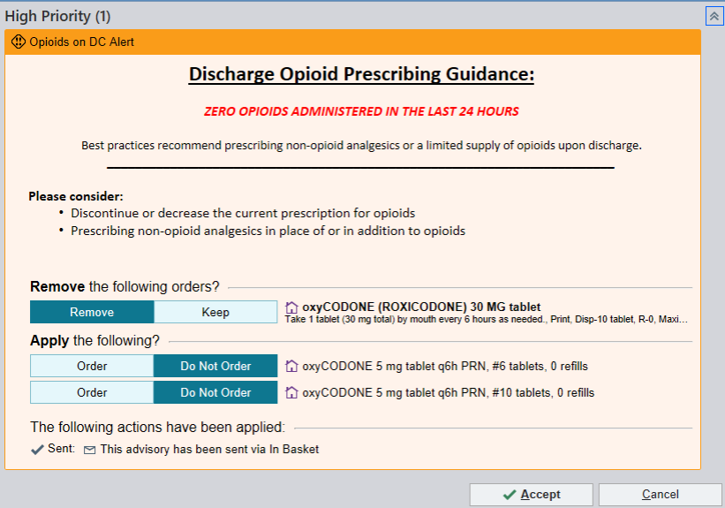
The OPA: Alert Criteria and Content
Criteria
Oxycodone discharge prescription
Post-surgical patient
No opioids on prior to admission medication list
No opioids administered during inpatient admission in the preceding 24 hours
Options
  Discontinue (default)
  Decrease quantity
  Continue as entered
© 2025 Epic Systems Corporation.

Slide 46
OPA Opioid Prescribing Results
 | Pre (n = 1,251) | Post (n = 1,542) | P-value
Rate of Opioid Prescription | 100% | 90% | < 0.001
Quantity, mean (SD) | 15.7 (11.6) | 13.3 (10.9) | < 0.001
Day Supply, mean (SD) | 3.04 (2.02) | 2.56 (2.02) | < 0.001
Total MME, mean (SD) | 120.6 (90.4) | 104.0 (95.4) | < 0.001
7 Day Post-Discharge Opioid Rate, percent (n) | 4.2% | 4.4% | 0.852
MME: Morphine Milligram Equivalents
Total MME: MEDD multiplied by day supply
Permission granted by Froedtert & the Medical College of Wisconsin to use data

Slide 47
OPA Opioid Prescribing Results
 | Declined (n = 635) | Accepted (n = 145) | P-value
Quantity, mean (SD) | 15.2 (11.0) | 7.2 (10.2) | < 0.001
Day Supply, mean (SD) | 2.95 (2.02) | 1.33 (1.50) | < 0.001
Total MME, mean (SD) | 116.0 (88.3) | 56.8 (87.6) | < 0.001
7 Day Post-Discharge Opioid Rate, percent (n) | 3.6% (23) | 5.5% (8) | 0.343
MME: Morphine Milligram Equivalents
Total MME: MEDD multiplied by day supply
Permission granted by Froedtert & the Medical College of Wisconsin to use data

Slide 48
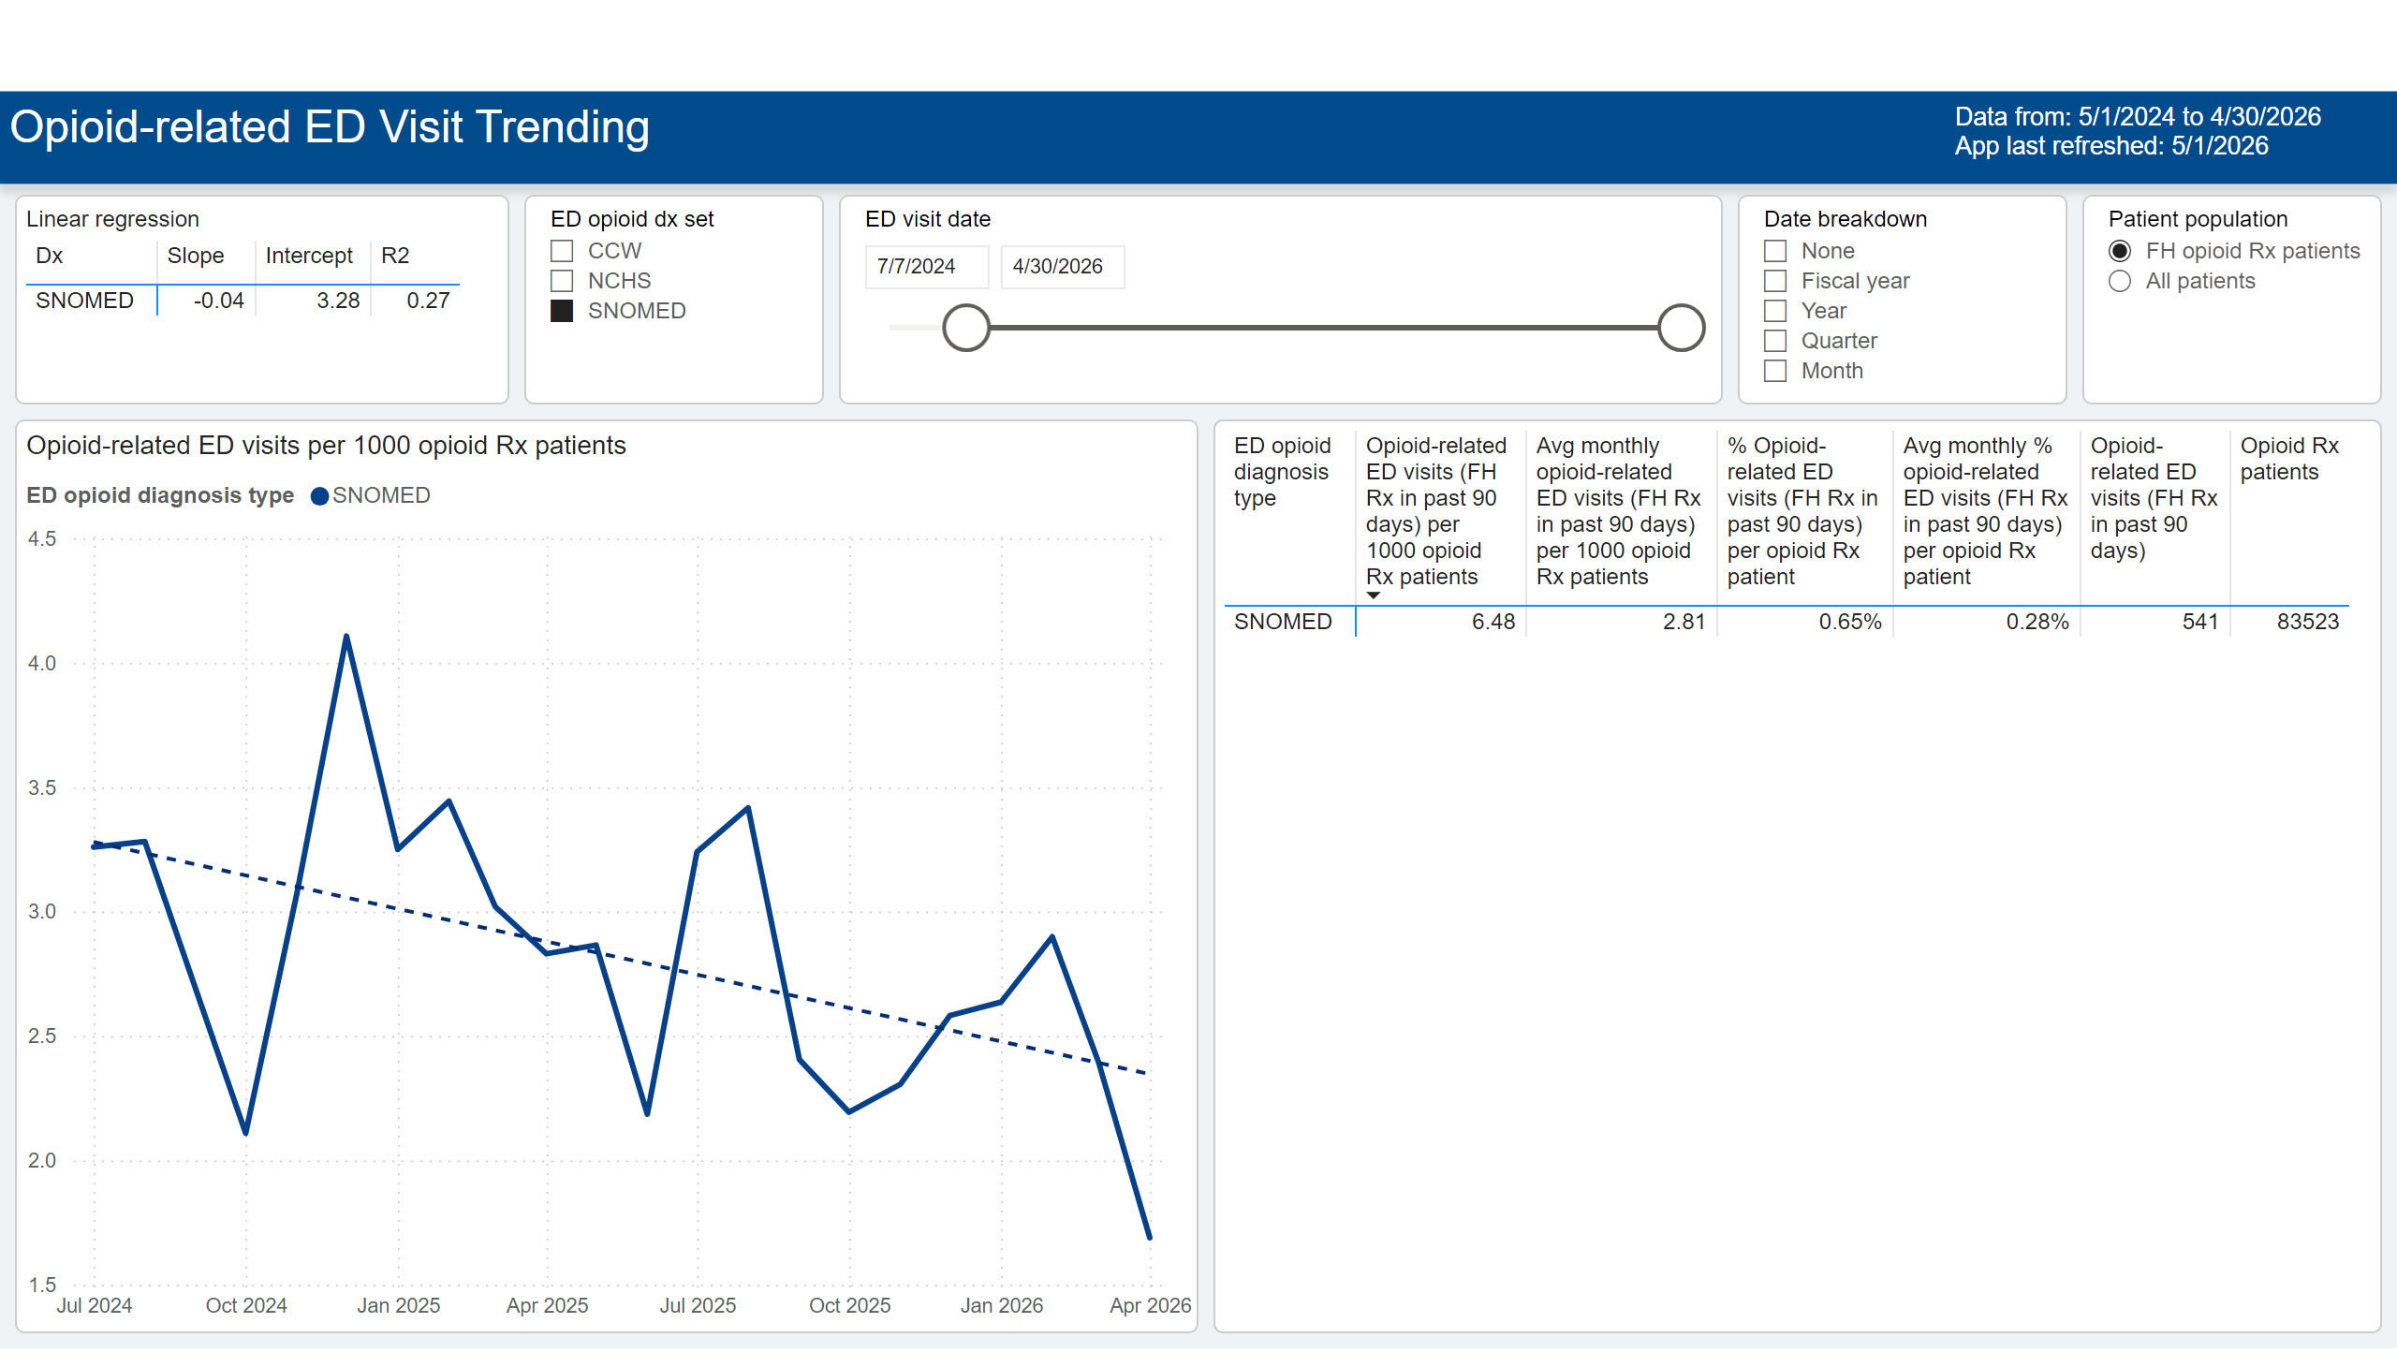
OREDV Trending
Notes:
slicer
No alt text provided
Linear regression
No alt text provided
slicer
No alt text provided
slicer
No alt text provided
pivotTable
No alt text provided
Opioid-related ED visits per 1000 opioid Rx patients
No alt text provided
textbox
No alt text provided
slicer
No alt text provided
pivotTable
No alt text provided
textbox
No alt text provided

Slide 49
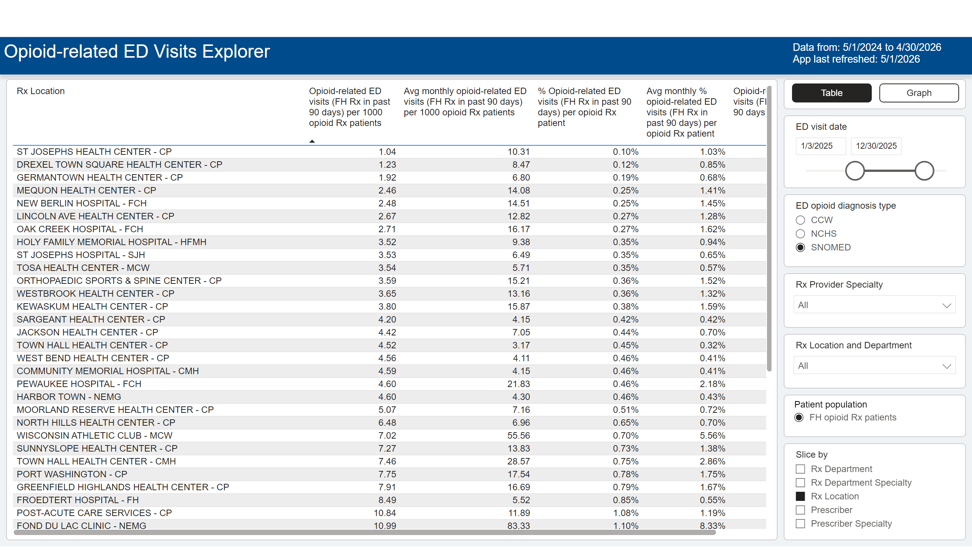
OREDV Explorer
Notes:
textbox
No alt text provided
lineChart
No alt text provided
slicer
No alt text provided
slicer
No alt text provided
bookmarkNavigator
No alt text provided
slicer
No alt text provided
slicer
No alt text provided
tableEx
No alt text provided
slicer
No alt text provided
slicer
No alt text provided
textbox
No alt text provided

Slide 50
Review new medication(s) to treat pain and identify patients that are potentially good candidates to receive this therapy

Slide 51
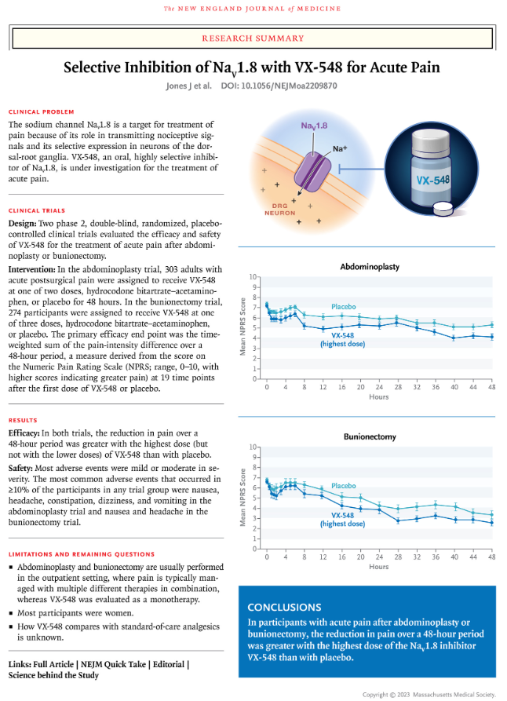
Recently Approved - Suzetrigine
The Na_{V}1.8 voltage-gated sodium channel, expressed in peripheral nociceptive neurons, plays a role in transmitting nociceptive signals.
The effect of VX-548 (suzetrigine), an oral, highly selective inhibitor of Na_{V}1.8, on control of acute pain is being studied
Preliminary findings are encouraging
Jones J et al. Selective Inhibition of Nav1.8 with VX-548 for Acute Pain. N Eng J Med 2023;389:393-405.
Waxman SG. Targeting a Peripheral Sodium Channel to Treat Pain. N Eng J Med 2023;389:466-469.

Slide 52
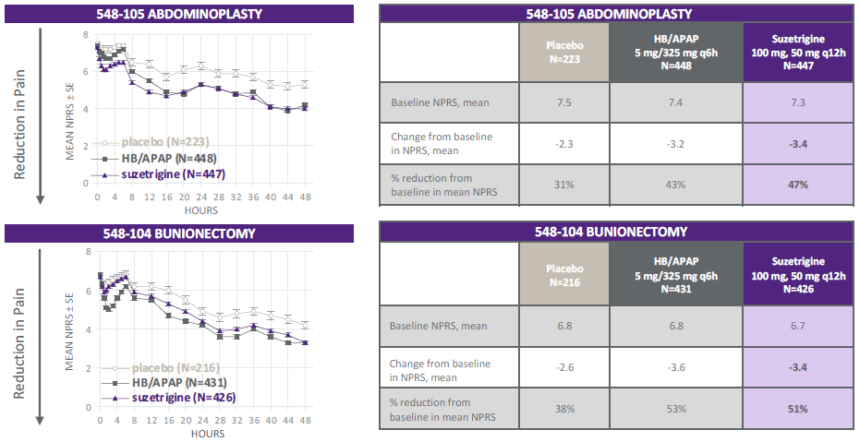
Suzetrigine
Jones J et al. Selective Inhibition of Nav1.8 with VX-548 for Acute Pain. N Eng J Med 2023;389:393-405.
Waxman SG. Targeting a Peripheral Sodium Channel to Treat Pain. N Eng J Med 2023;389:466-469.

Slide 53
Suzetrigine (Journavx™)
Safety profile based on pooled data from double-blind, placebo- and active-controlled trials (n=874) and one single-arm, open-label study (n=25)
Adverse Reactions Reported in ≥1% of Suzetrigine-Treated Patients
Adverse Reactions | Placebo (N = 438) n (%) | Suzetrigine (N = 874) n (%) | HB/APAP (N = 879) n (%)
Pruritus | 7 (1.6) | 18 (2.1) | 30 (3.4)
Muscle spasms | 2 (0.5) | 11 (1.3) | 6 (0.7)
Increased blood creatine phosphokinase | 2 (0.5) | 10 (1.1) | 7 (0.8)

Slide 54
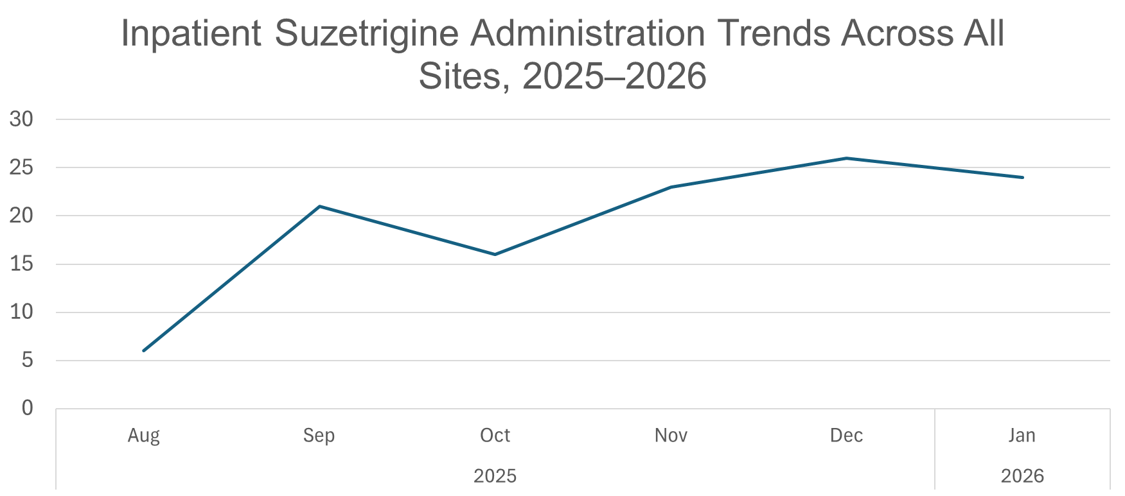
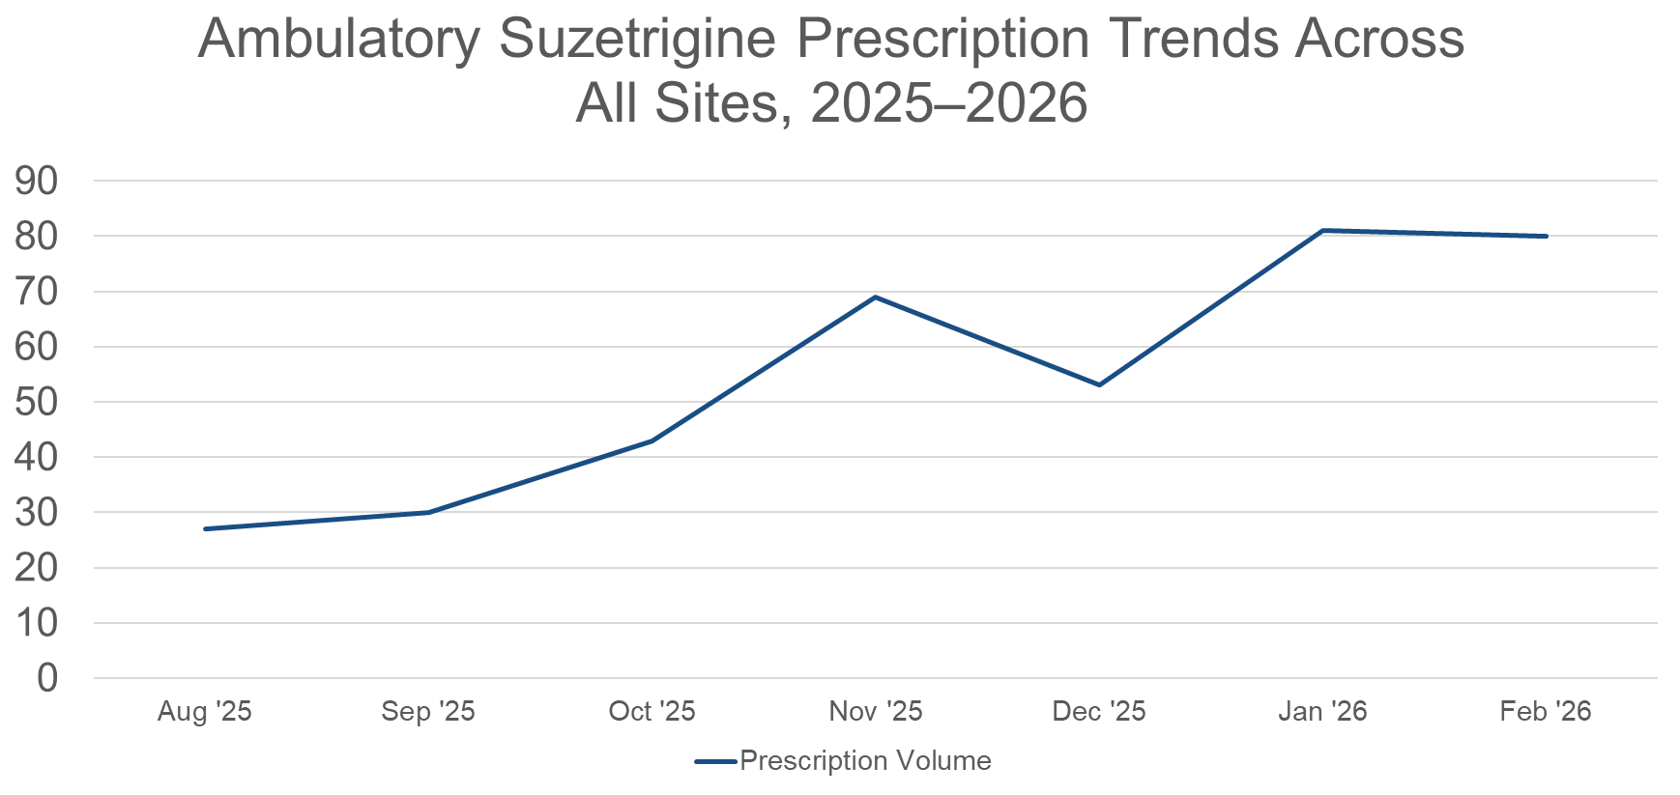
Suzetrigine Use at F&MCW
Inpatient Use
Ambulatory Use

Slide 55
Suzetrigine Prescription by Specialty

Slide 56
TKA Evaluation: CONSORT Diagram
Historic Control
Suzetrigine
107 patients
identified
53 patients
identified
4 patients:
Suzetrigine prescribed
51 patients excluded:
Already matched suzetrigine sample size
5 patients excluded:
Cancelled or rescheduled operation
52 patients
included
52 patients
included
Notes:
Multimodal therapy on discharge therapy was assessed and collected; all equal except for decrease in gabapentinoid utilization 2/2 gabapentin project:
APAP: 51 (98.1%) vs. 50 (96.2%)
NSAID: 15 (28.8%) vs. 17 (32.7%)
Musc. Relaxant: 8 (15.4%) vs. 7 (13.5%)
Gabapentinoid: 6 (11.5%) vs. 2 (3.8%)
Topical: 7 (13.5%) vs. 7 (13.5%)
SNRI: 3 (5.8%) vs. 3 (5.8%)

Slide 57
Results: Pain/Opioids
Opioid Free at 6-week Follow-Up:
All Patients
Opioid Free at 6-week Follow-Up:
Opioid Naïve Patients Only
p = 0.013
p = 0.097
*This value does not factor in missing data points pending completion of 6-week follow-up appointment for 6 patients

Slide 58
Results: Pain/Opioids
p = 0.014
p = 0.002

Slide 59
Suzetrigine Postop Patient Outcomes (Knee Arthroplasty)
Conclusions
Suzetrigine prescribed for knee arthroplasty compared with an unmatched historic cohort led to statistically significant decreases in:
Total MME prescribed at discharge
Proportion of patients receiving an opioid at or before 2-week follow-up appointment
MEDD prescribed at or before 2-week follow-up appointment
Total MME prescribed at or before 2-week follow-up appointment
Unable to confirm suzetrigine impact on patient outcomes (eg, patients opioid-free, pain scores, range of motion) despite a change in prescribing practices
Data Limitations
Retrospective design
Selection and observer biases
  Small patient samples
  Only 2 surgeons
  Unmatched cohorts
Usage of automated reports – not all data points manually verified
Opioid free at 6 weeks data point relied on manual chart review
“Standard” discharge and refill opioid prescriptions still utilized
Notes:
Other data limitations – only looking at patients opioid naïve

Slide 60
Formulary Considerations:
How does your organization define value?
Value-based formulary decision making does not mean the lowest price, it is a multifactorial decision
Efficacy
Patient
Satisfaction
Quality
Safety
Staff
Satisfaction
Outcomes
Cost
Value =
Drug acquisition cost
(varies by environment)
Non-drug expenditures
(time, supplies, readmits, etc.)

Slide 61
Drug Pipeline: LEVI-04 (non-opioid)
Mechanism of action: First-in-class p75 neurotrophin receptor (p75NTR) fusion protein that inhibits neurotrophin-3 (NT-3), a protein involved in transmitting pain signals
Targets chronic musculoskeletal pain
Phase 2, randomized, double-blind, placebo-controlled trial (NCT05618782) enrolled 518 patients with moderate-to-severe knee OA
  Monthly IV infusion was well tolerated and showed significant improvements in pain and function through 17 weeks compared to placebo
Possible phase 3 trial - may explore SUBQ administration
Conaghan PG, Katz N, Bihlet AR, Guermazi A, Rom D, Perkins MC, Hughes B, Herholdt C, Bombelka I, Westbrook S. Efficacy and safety of LEVI-04 in patients with osteoarthritis of the knee: a randomised, double-blind, placebo-controlled, phase 2 trial. Lancet. 2026 Mar 28;407(10535):1237-1248. doi: 10.1016/S0140-6736(26)00131-5. PMID: 41905364.

Slide 62
Drug Pipeline: AP-325 (non-opioid)
Mechanism of Action: Activates GABA A signaling, which helps counteract excessive neuronal activation in neuropathic pain pathways
Targets chronic neuropathic pain
Phase 2a randomized, double-blinded, placebo-controlled trial took place at multiple study sites across Europe → results released in February 2025 are “encouraging”

Slide 63
Non-pain Medication Relevant to Pain Management
Olanzapine/samidorphan (Lybalv): schizophrenia and bipolar disorder
Olanzapine: dopamine D2 receptors antagonist
Samidorphan: opioid antagonist (similar to naloxone), helps mitigate weight gain associated with olanzapine use; Samidorphan is not commercially available by itself
Serious Side Effects / Warnings
Opioid withdrawal: Do not take olanzapine/samidorphan for at least 7 days after discontinuation of short-acting opioids / 14 days for long-acting opioids
Life-threatening opioid overdose: Do not start taking opioids for at least 5 days after discontinuation of olanzapine/samidorphan
Notes:
Olanzapine acts on dopamine D2 receptors in the mesolimbic pathway as an antagonist, blocking the potential action of dopamine on postsynaptic receptors. Olanzapine binds loosely to the receptor and dissociates readily, allowing normal dopamine neurotransmission.

Slide 64
Conclusions
Opioids, as part of a multimodal regimen, may be used to treat acute pain in patients with OUD
CDS can be leveraged to steer safe and effective prescribing
A patient-centric approach should be used at transitions of care
Some promising non-opioid pain medications have recently been approved or are in development

Slide 65
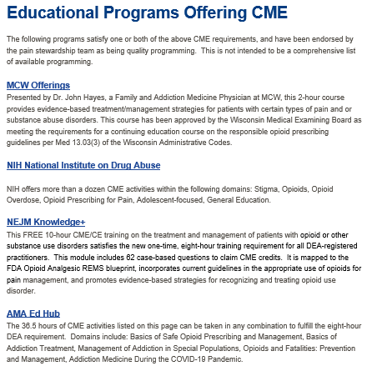
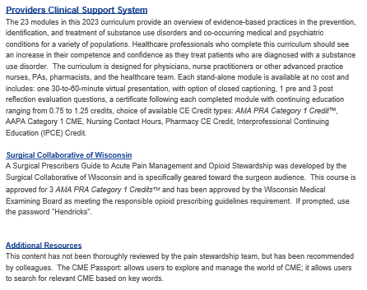
CME Resources
CME Resources - Froedtert Hospital - Froedtert Health

Slide 66
Multimodal Pain Management
APP Grand rounds
May 13th, 2026
William Peppard, pharmd, bcps, fccm
Pain stewardship coordinator, pharmacy
Research and scholarship coordinator, pharmacy
Assistant professor, surgery - division of trauma & acute care surgery

